Slide 1
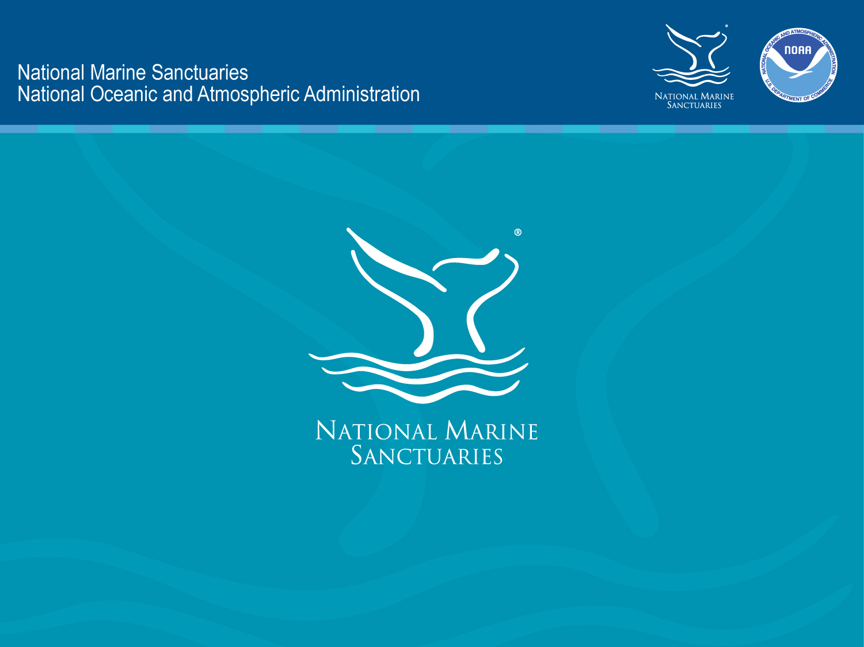

Slide 2

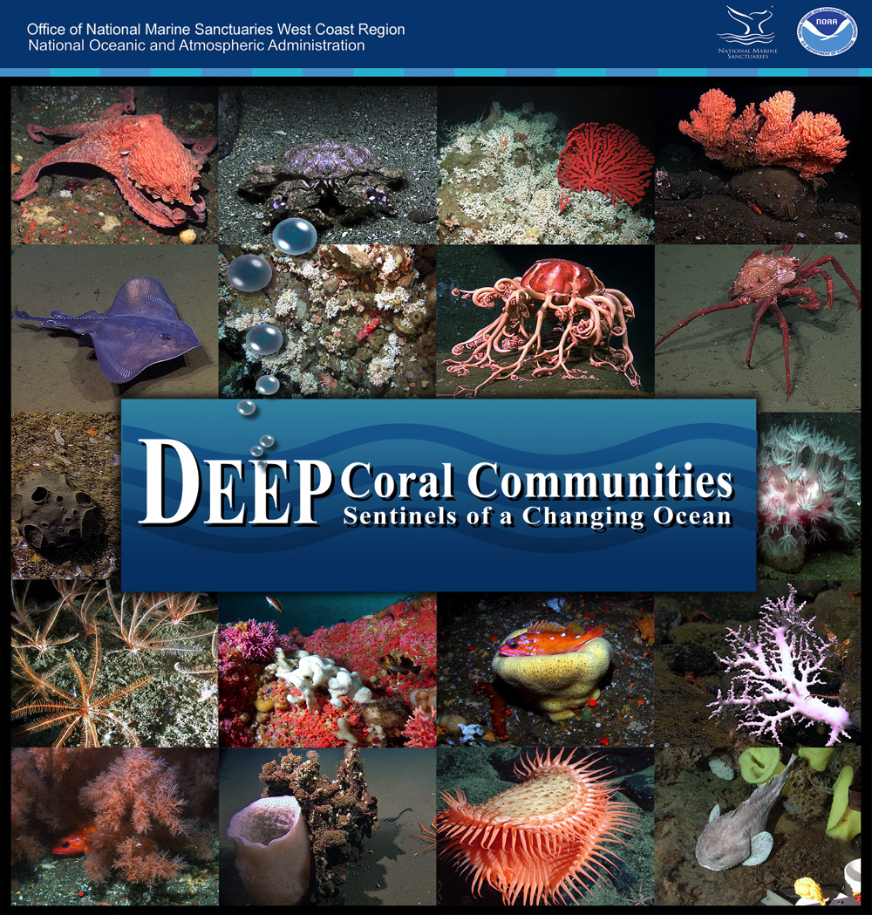
Notes:
We are going to take a look at the deep coral communities of the West Coast through the eyes of a deep sea researcher. These communities support vibrant biodiversity in a variety of habitats, but they face many threats. We are going to learn how our national marine sanctuaries work to protect these special places, what scientists are doing to research them and how we all can help keep them healthy.

Slide 3
Deep Sea Science in the Classroom
Background on deep sea coral communities found in West Coast Sanctuaries
Focus Concepts:
-Technology
-Habitat
Threats
-Biodiversity and Abundance
Overview of classroom resources
Notes:
We are going to take a look at the deep coral communities of the West Coast through the eyes of a deep sea researcher. These communities support vibrant biodiversity in a variety of habitats, but they face many threats. We are going to learn how our national marine sanctuaries work to protect these special places, what scientists are doing to research them and how we all can help keep them healthy.

Slide 4
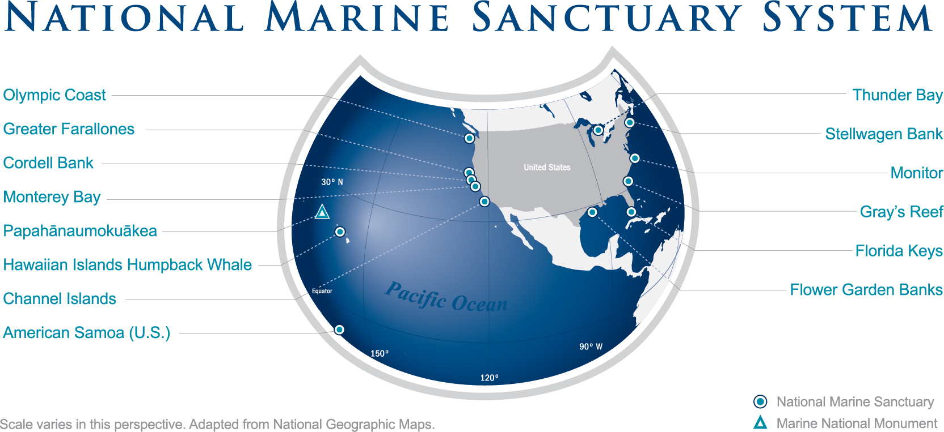
Notes:
Managed by the National Oceanic and Atmospheric Administration (NOAA), the Office of National Marine Sanctuaries is a network of 14 marine protected areas encompassing more than 170,000 square miles of marine and Great Lakes waters. This system preserves the extraordinary scenic beauty, biodiversity, historical connections and economic productivity of these underwater treasures. Our sanctuaries protect sandy beaches, rocky shores and open ocean, in addition to deep sea communities found on the seafloor.

Slide 5
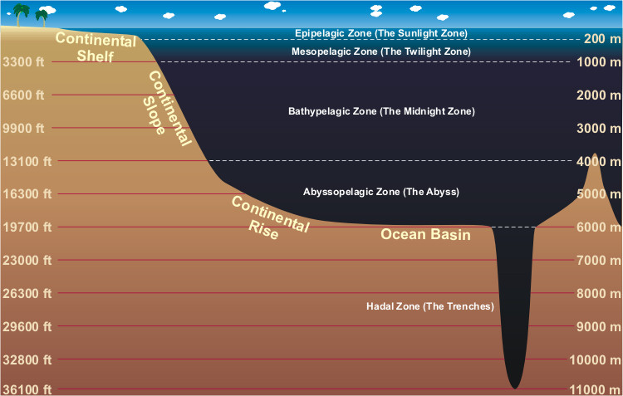
Notes:
These are the zones of the ocean. Sunlight only penetrates the first 200 meters of the ocean (Epipelagic Zone or the Sunlight Zone). Most of the coral communities (but not all) we are going to look at today fall within the Mesopelagic or Twilight Zone, or the area found between 200 meters and 1,000 meters; however, deep sea corals can be found at much deeper depths (up to 3,000 meters!). The organisms found within these communities are specially adapted to withstand the high pressure and low light of the deep sea environment.

Slide 6

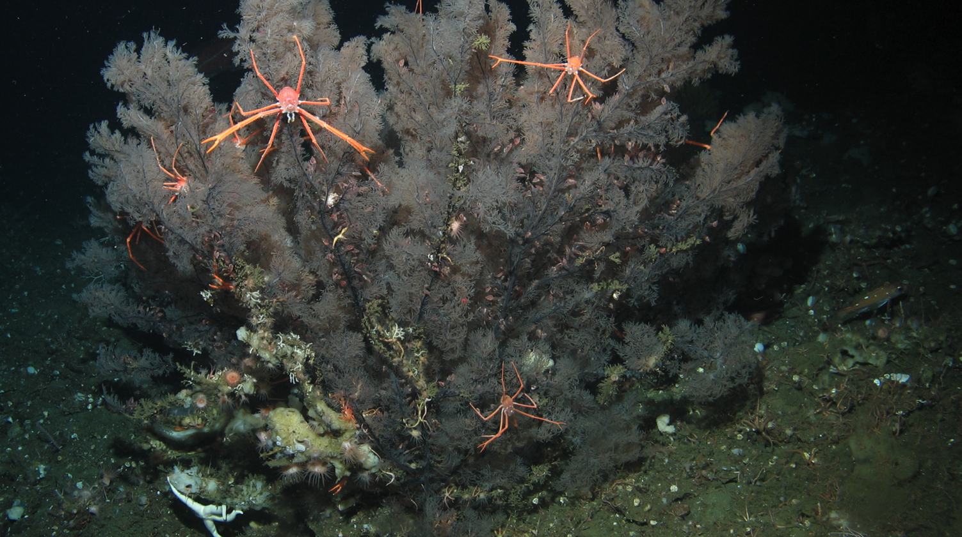
Deep-sea coral communities along the West Coast provide habitat for fish and invertebrates at depths from 50 meters to more than 3,000 meters (160 feet-10,000 feet).
Notes:
Black coral with several squat lobsters. Deep sea coral communities along the West Coast provide habitat for fish and invertebrates at depths from 50 meters to over 6,000 meters (160 feet-20,00 feet). Deep coral communities contain incredible biodiversity, which is why they are such important ocean habitats. Many species thrive in these habitats, including commercially and recreationally important fish and invertebrate species, such as rockfish, lingcod and crabs. Without these communities, our fisheries would suffer along with the entire ecosystem.

Slide 7
Focus Questions
How do we utilize technology to explore deep-sea habitats?
What are the different deep-sea habitats along the West Coast, and what species are found there?
Do species abundance and biodiversity vary with depth and habitat?
What threats face these habitats? How can we help protect them?
Notes:
1. To explore deep sea coral communities, researchers utilize Remotely Operated Vehicles (ROVs) that are designed to withstand deep sea pressures. ROVs are tethered to a vessel and operated from a boat via remote control. They are equipped with lights and a live feed camera so researchers on the vessel can observe and record the deep sea habitat.
2. We will explore various habitat types at different depths and measure species abundance and diversity found within deep sea coral communities. We will become familiar with the unique organisms that live in these communities and learn real scientific methods that researchers use to gauge the health of these habitats.
3. Depth and habitat type definitely influence these communities – and this lesson provides only a small snapshot!
4. Many threats face these habitats including fishing, marine debris and ocean acidification.

Slide 8
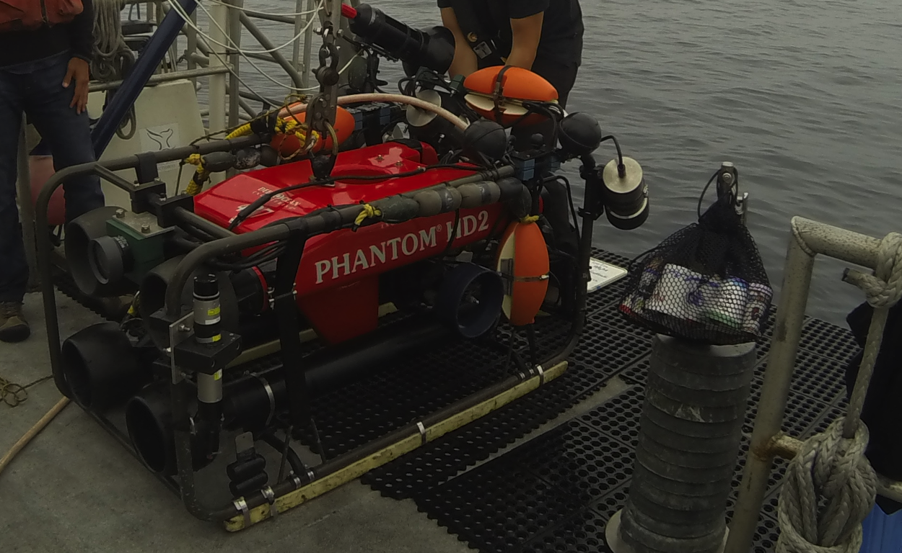
Remotely Operated Vehicles (ROVs) allow researchers to study the deep-sea environment.
Notes:
Due to the challenges of reaching the deep ocean, less than 5% of our ocean has been explored. Remotely Operated Vehicles (ROVs) have made it possible to explore farther and deeper than ever before. ROVs are designed to withstand the pressures of the deep sea and are equipped with video cameras. This allows scientists to view species diversity and abundance in deep sea communities while staying above water. There is often a tether that connects the ROV to a research vessel, and researchers view live footage from the camera mounted on an ROV. An ROV is also equipped with lights to illuminate the deep ocean environment. Video transects and still photos are recorded throughout each dive so that researchers can go through them in detail at a later time in order to identify deep sea species and characterize habitat.

Slide 9
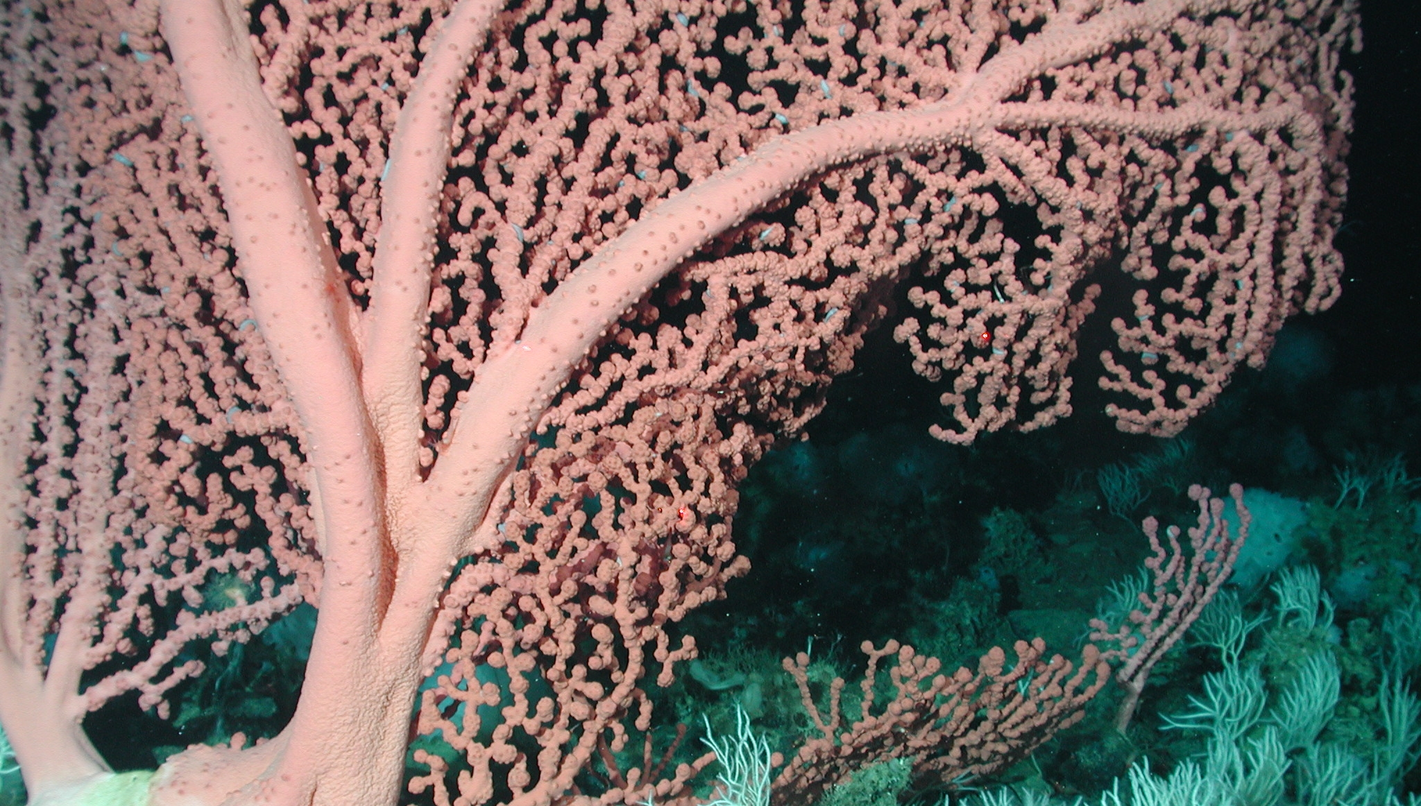
Understanding Scientific Methods
[Play a Deep-Sea Coral Community transect]
Notes:
Choose any of the transects available for download. When the clip is over, ask students the following questions:
What information do you think scientists are interested in when they view a video of a deep sea environment?
What would they count/measure/record in order to gain a better understanding of an ecosystem?
Play the clip for students once more if they request it.
Ask them – Do you think researchers can explore the entire ecosystem using an ROV?
What scientific methods could they use instead?
Let them take a moment to think about these questions and answer them to the best of their ability/knowledge.
The correct answers: Scientists are interested in the type of habitat, the composition of species in terms of abundance (how many individuals) and diversity (how many species) are found in a habitat. They can and do use transects (covered a few slides ahead), which are measured snapshots of a habitat that allow scientists to gain an accurate understanding of the entire ecosystem.

Slide 10

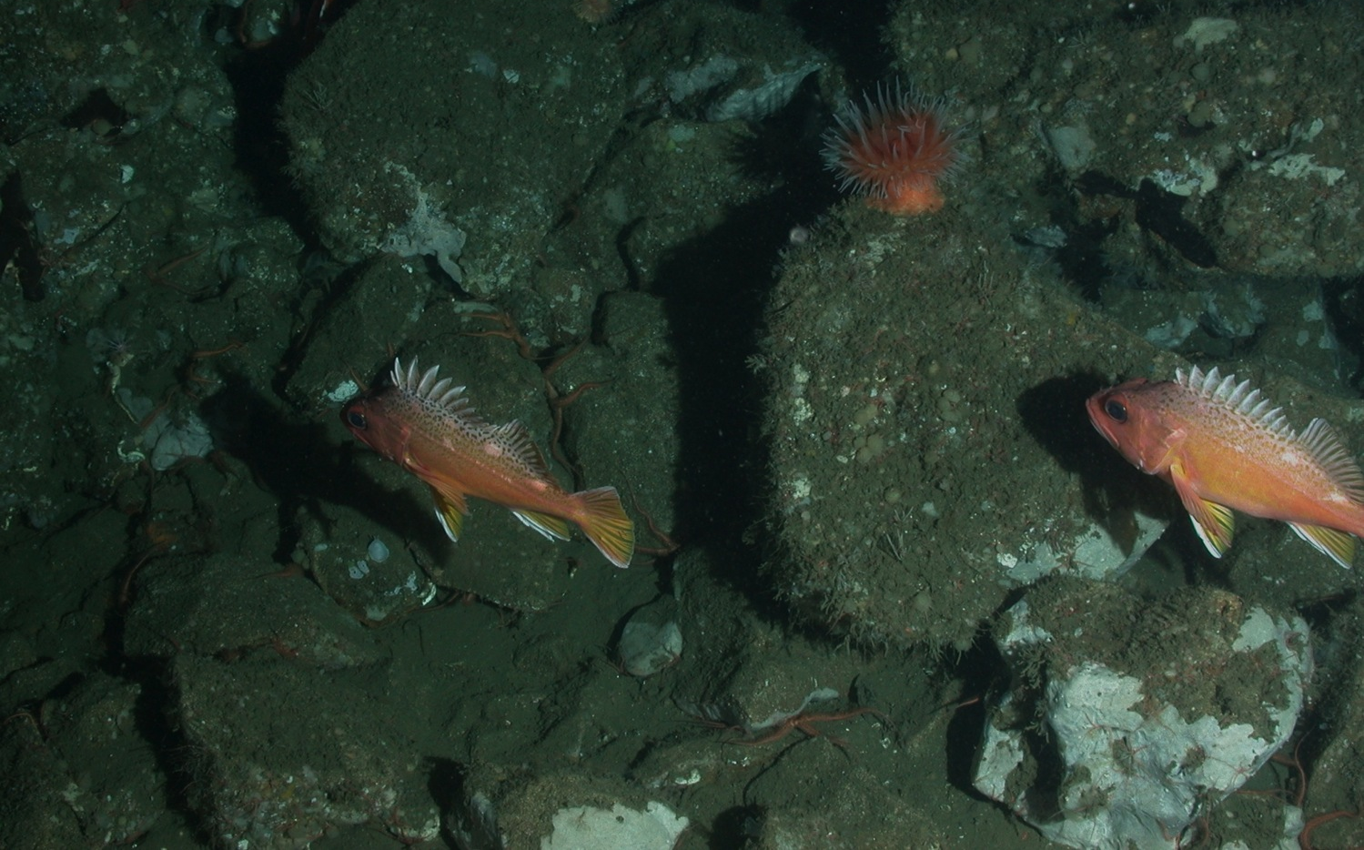
Habitat Types
Rocky bottom: Any area with rocks, boulders, granite or pinnacles
Notes:
Habitat with rocks, boulders, granite or pinnacles is considered rocky bottom or rocky reef. Some of these rocky areas look like boulders, while some are full of cobble-like material. This habitat provides a place for invertebrates to live, grow and survive and also offers essential shelter and habitat for fish.

Slide 11
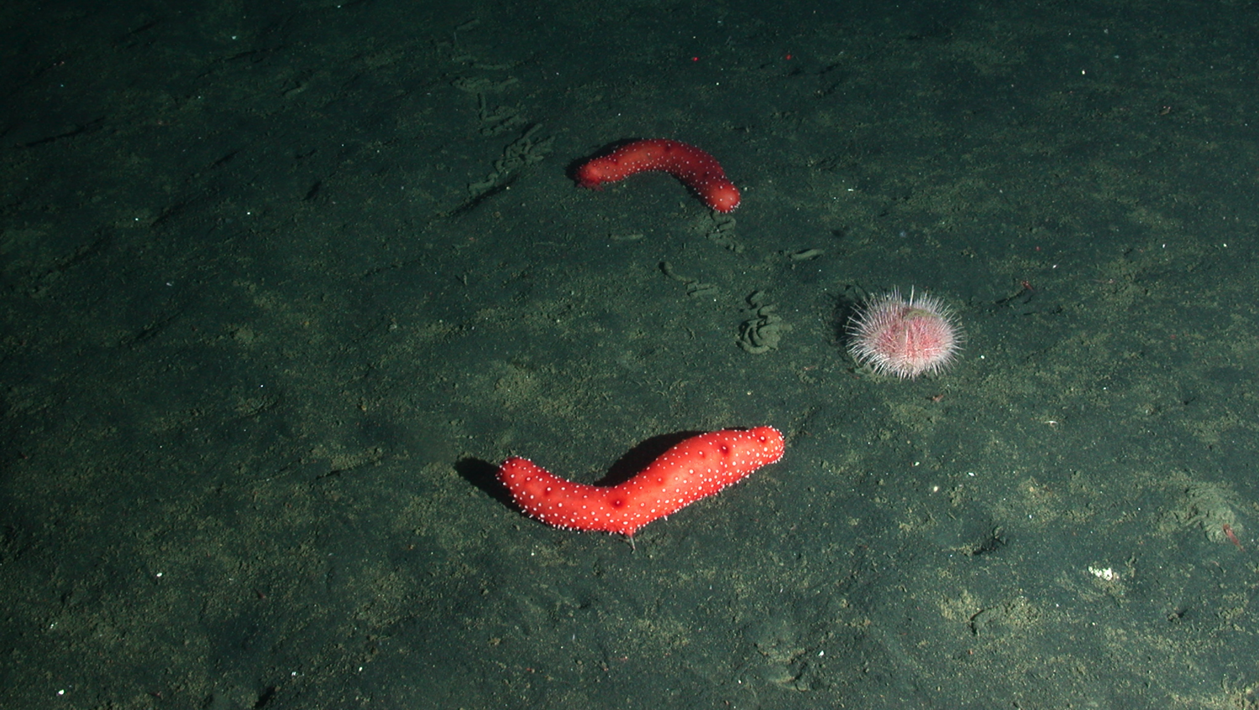
Habitat Types
Soft bottom: Any area that lacks reef material and consists of soft, sandy or muddy substrate
Notes:
The soft bottom habitat varies from sandy to muddy. The sandy areas are made of carbonate material (broken shells and corals) and/or mud.

Slide 12
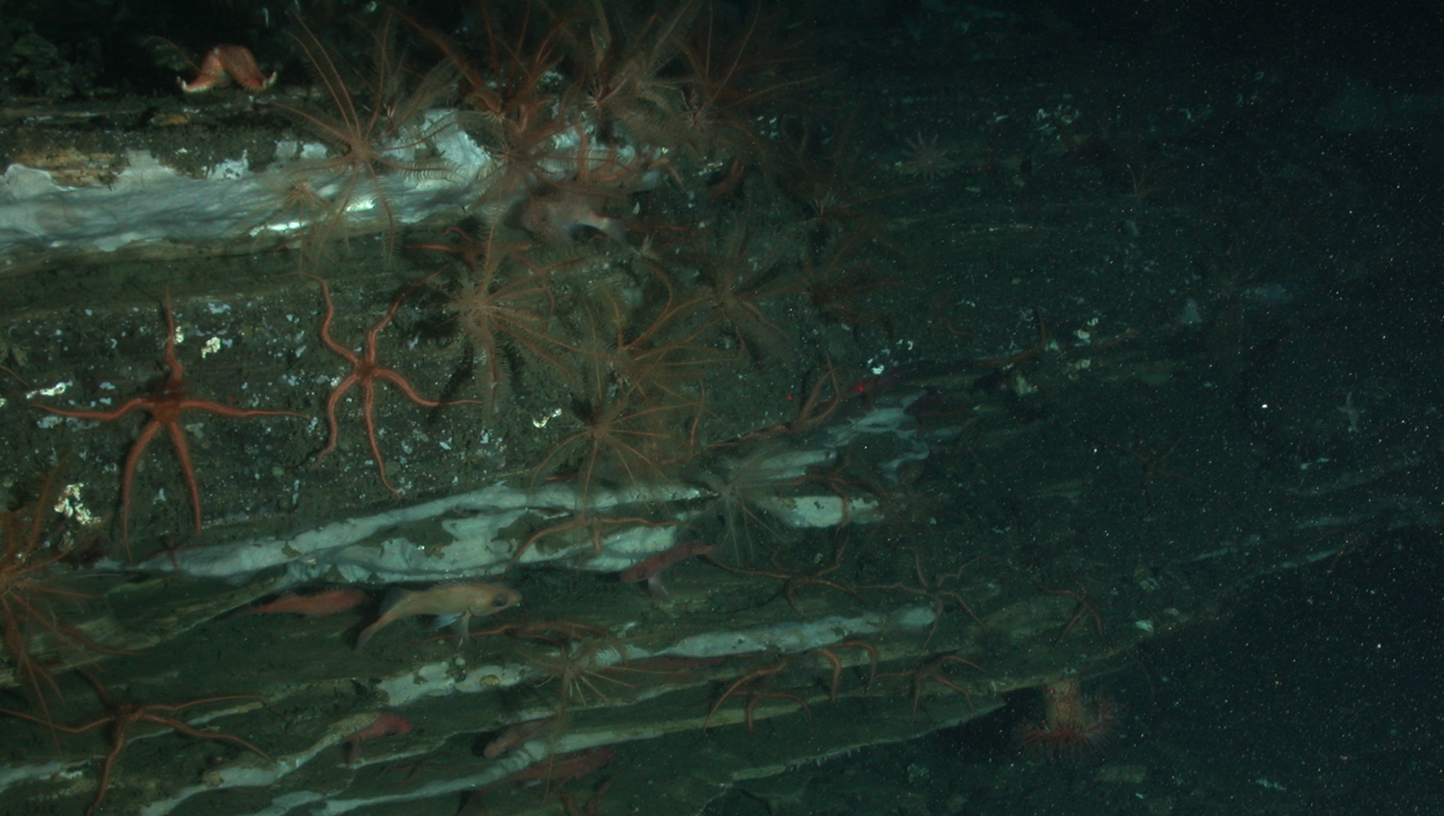
Habitat Types
Ledge: An area with a vertical rocky overhang or stacked shelves
Notes:
Ledge: An area with a vertical rocky overhang or stacked shelves. Ledges provide overhead protection for fish and invertebrates to hide under!

Slide 13
Species Identification
Soft Corals
Sea fans, sea pens, black coral
Hard Corals
Cup corals, reef-building Lophelia
Invertebrates
Sea stars, sea urchins, sea cucumbers, feather stars, crustaceans
Vertebrates
Rockfish, lingcod, rays, other fish
Notes:
Have students take a few minutes to look over their species identification guides. Ask them: What do you look for when you identify organisms? Characteristics that you should pay attention to include: body shape, color, behavior and habitat type. Some species may be masters of camouflage on the soft bottom (flatfish, for example), but stick out in the rocky bottom areas or vice versa.

Slide 14
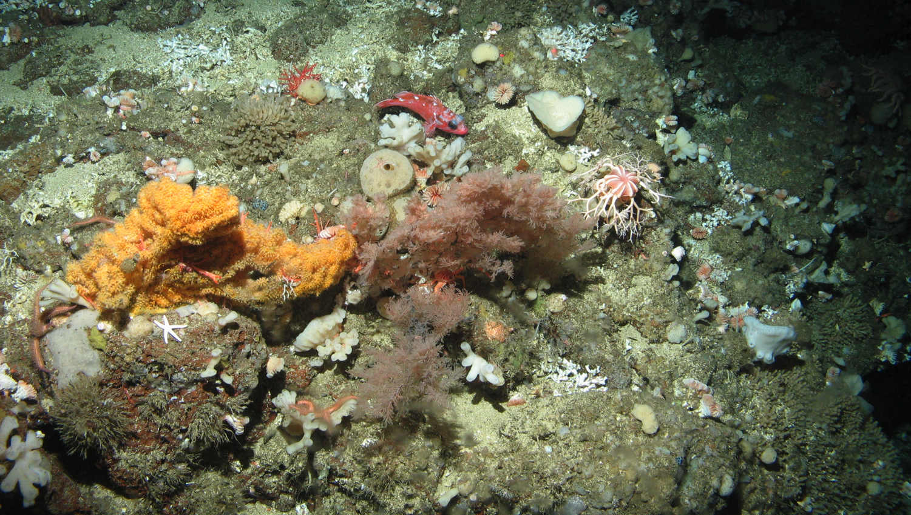
Deep-Sea Corals
Both hard (stony) corals and soft corals are found in deep-sea environments. Both provide vital habitat for fish and invertebrates.
Notes:
Both hard (stony) corals and soft corals are found in deep sea environments, and both provide vital habitat for fish and invertebrates. Here, we see black coral next to a golden sea fan (both soft coral) with Lophelia hard coral scattered around.

Slide 15
Deep-Sea Corals
They are found all around the world in deep waters with temperatures down to -1°C (30.2°F).
There are more than 3,000 species of deep-sea corals and new ones are discovered every year.
They can be extremely long-lived – one colony of deep-sea black coral was found to be more than 4,000 years old!
Notes:
They are found all around the world in deep waters of temperatures down to -1°C (30.2°F). There are over 3,000 species of deep sea corals and new ones are discovered every year. They can live for extremely long periods of time – one colony of deep sea black coral was found to be over 4,000 years old!

Slide 16
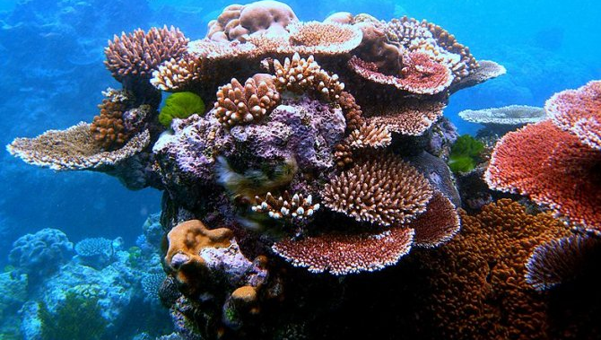
Coral Biology
Most warm-water corals contain symbiotic zooxanthellae, a photosynthetic algae that provide corals with energy in exchange for a protected environment (the corals’ own tissues) to live within.
Notes:
Most warm water corals contain symbiotic zooxanthellae, a photosynthetic algae, that provide corals with energy in exchange for a protected environment (the corals’ own tissues) to live.

Slide 17
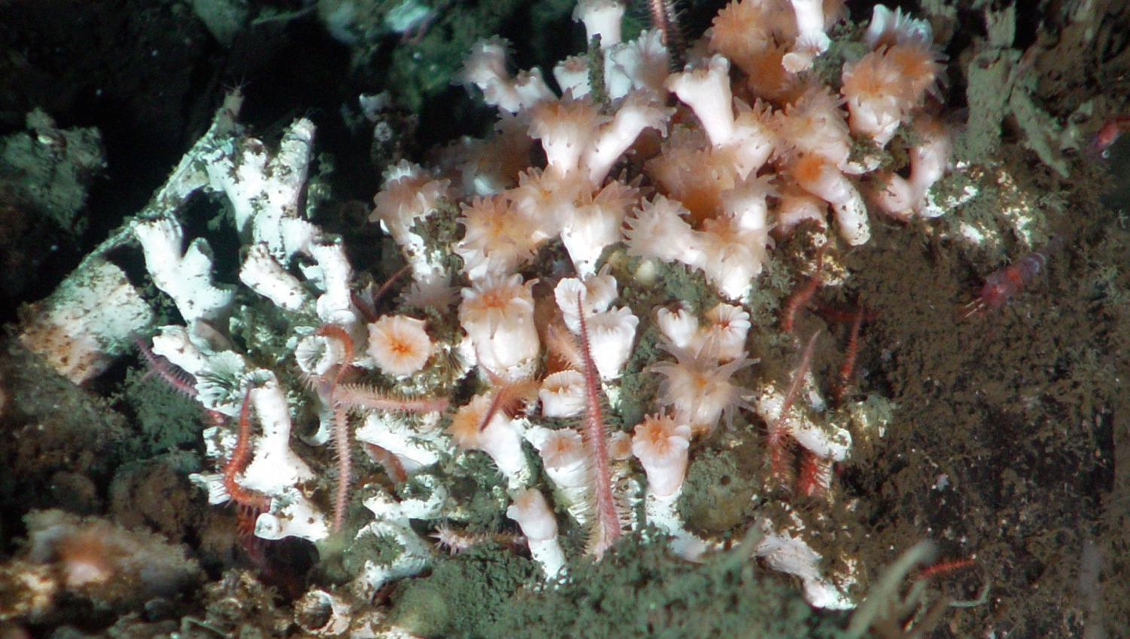
Coral Biology
Deep-sea corals, such as Lophelia pertusa, live in low-light environments and do not rely on zooxanthellae. Instead, they actively capture and consume free floating food, such as zooplankton.
Notes:
Deep sea corals, such as Lophelia pertusa, live in low-light environments and do not rely as much on zooxanthellae; instead, they actively capture and consume free floating food, such as zooplankton.

Slide 18
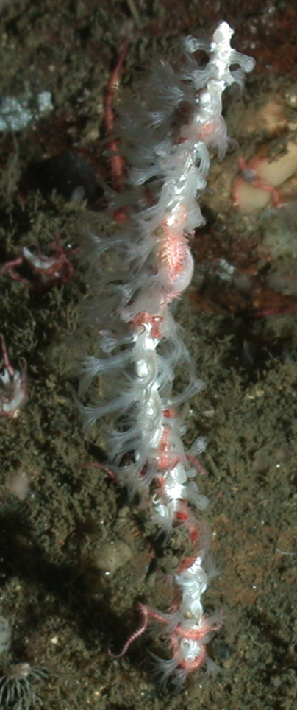
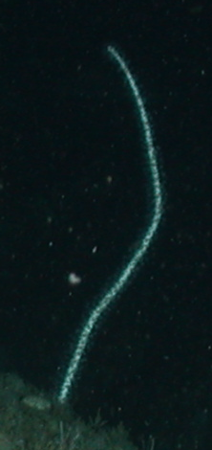
Coral Biology
What we term “corals” are actually colonies of very small individual coral polyps.
Here, you can see the coral polyps of a sea pen, a soft coral, extended and feeding on plankton (left) and a sea pen with the coral polyps retracted (right).
Notes:
Coral Biology — What we term “corals” are actually colonies of very small individual coral polyps. Here, we can see the coral polyps of a sea pen, a soft coral, extended and feeding on plankton (left) and a sea pen with the coral polyps retracted (right).

Slide 19
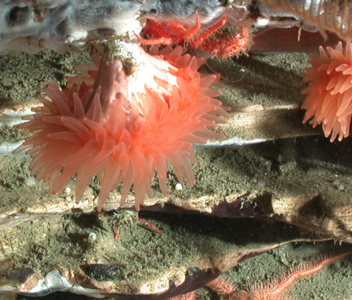
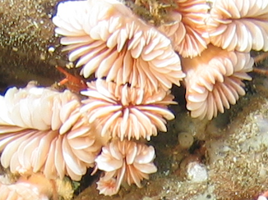
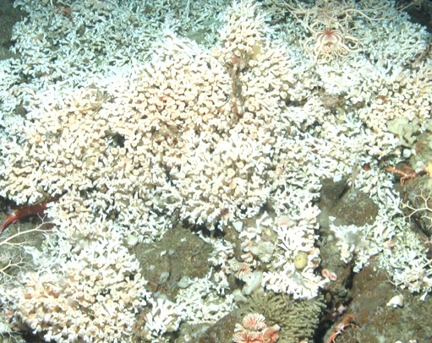
Hard Corals
Hard corals build a calcium carbonate skeleton. Some types of hard coral, such as Lophelia (far right photo), are capable of building reefs over many years.
Notes:
Hard corals build a calcium carbonate skeleton and some types of hard coral, such as Lophelia, (far right photo) are capable of building reefs over many years. Have your students use their ID guides to guess the species! Photos (from left to right): Flabellum cup coral, Desmophyllum cup coral and Lophelia spider hard coral.

Slide 20
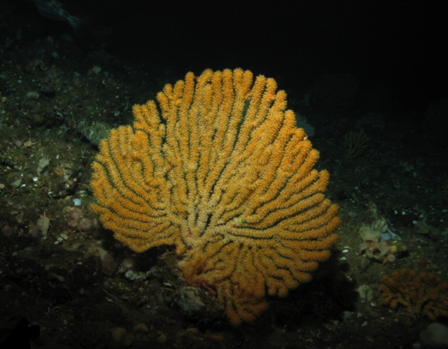
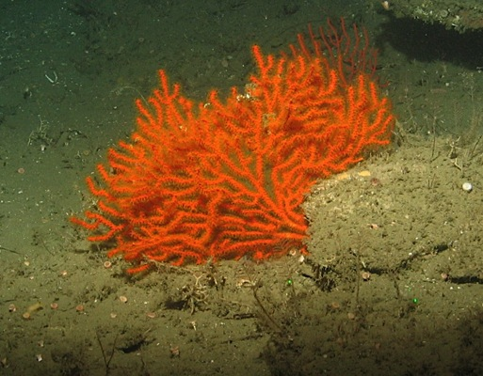
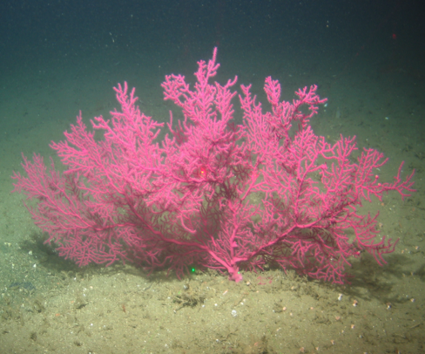
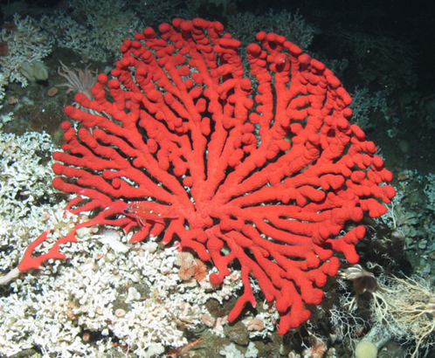
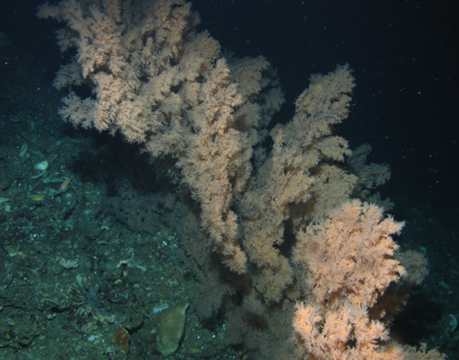
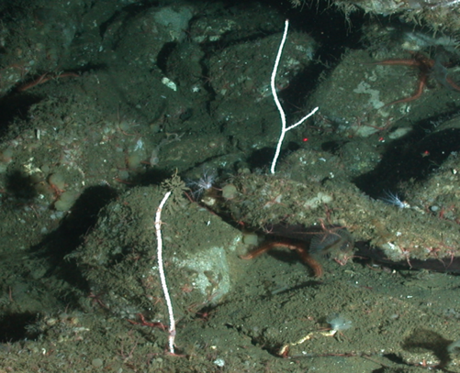
Soft Corals
Unlike hard corals, soft corals do not produce a hard calcium carbonate skeleton.
Notes:
Unlike hard corals, soft corals do not produce a calcium carbonate skeleton. These soft corals thrive in nutrient-rich waters with less light. They are integral members of our deep sea ecosystem and provide essential habitat for fish and invertebrates. Photos (left to right): top – Acanthogogia golden sea fan, Adelogorgia orange sea fan and Eugorgia purple sea fan; bottom – Paragorgia bubblegum sea fan, Antipathes dendrochristos black coral and Leptogorgia sea pen.

Slide 21
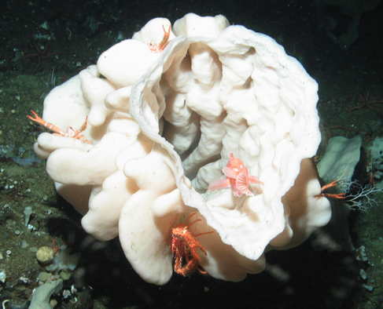
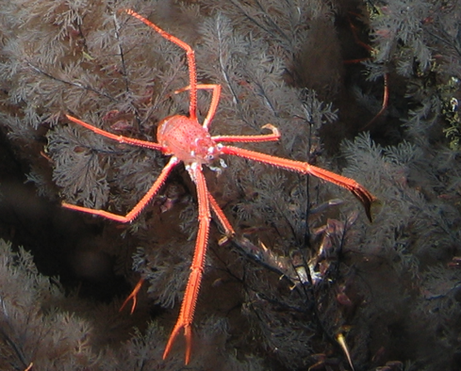
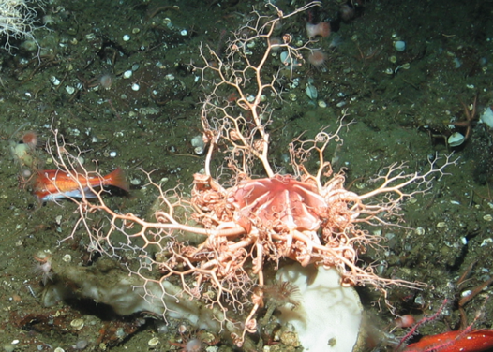
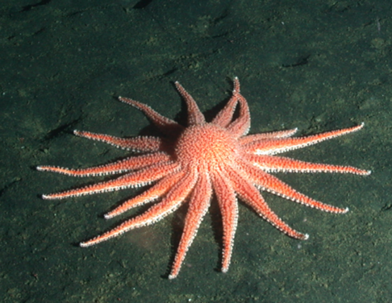
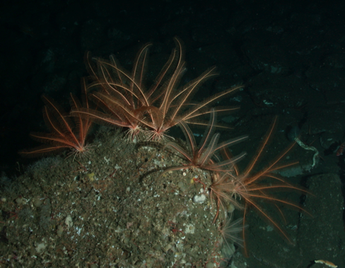
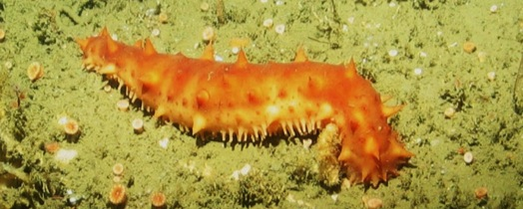
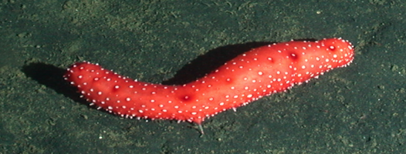
Invertebrates
Deep sea coral communities have incredible biodiversity!
Notes:
Students should be encouraged to identify species, if they can; however, this can be overwhelming during the transect. Simply writing down the common name, such as sponge or sea star, is sufficient for this activity. Photos (left to right): top – Aphrocallistes vastus glass vase sponge, Munida squat lobster and Gorgoncephalus basket star; bottom – Rathbunaster californicus sun star, Florometra serratissima feather star and Parastichopus sea cucumbers.

Slide 22
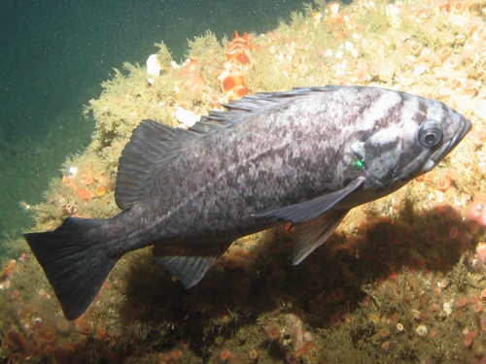
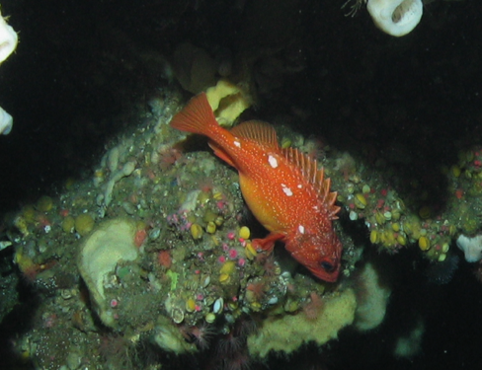
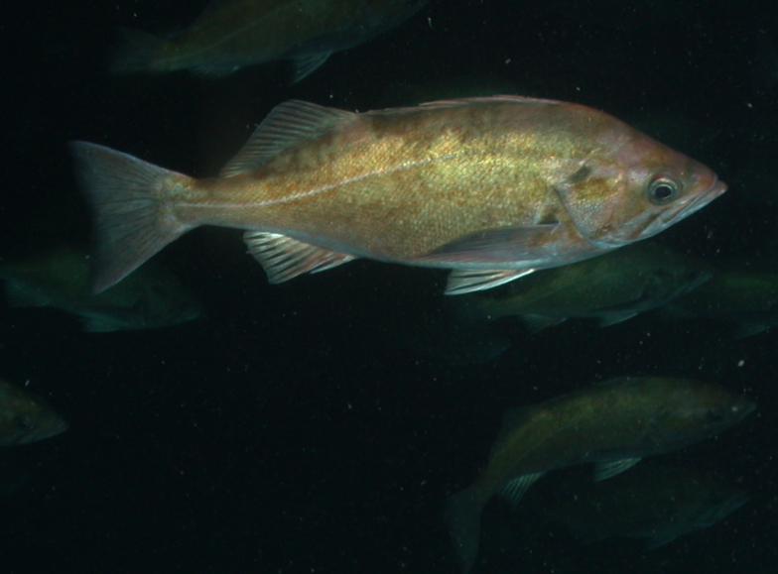
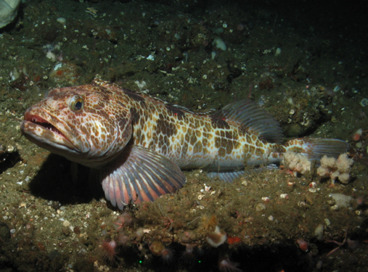
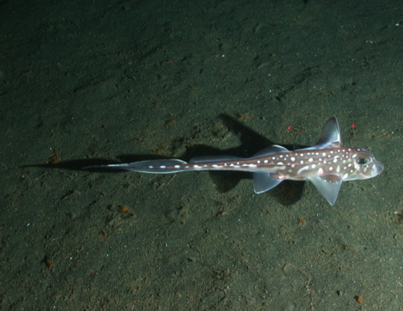
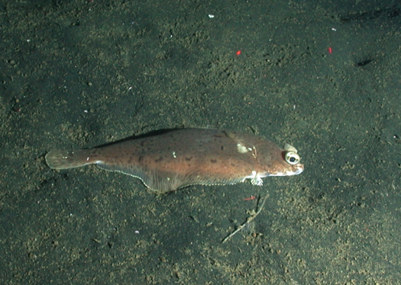
Vertebrates
Look at body shape, behavior and coloring.
Notes:
There are many types of fish in the deep sea environment, but the species pictured here are the main species we will identify in this lesson. Therefore, if a species does not look like anything on your guide, do not record it! We do not have to identify rockfish species – only record that they are rockfish! Photos (left to right): top – Sebastes rockfish (all three top photos); bottom – Ophiodon elongatus lingcod, Hydrolagus colliei spotted ratfish and Citharichthys sordidus pacific sanddab.

Slide 23
You do not have to identify every single organism – each person will only be responsible for identifying one group of organisms!
Notes:
Students do not have to identify every single organism – each person will only be responsible for identifying one group of organisms! Biodiversity is very high in these transects; therefore, it is necessary to assign each student to one group of organisms, or one particular organism, to ID during the transects.

Slide 24
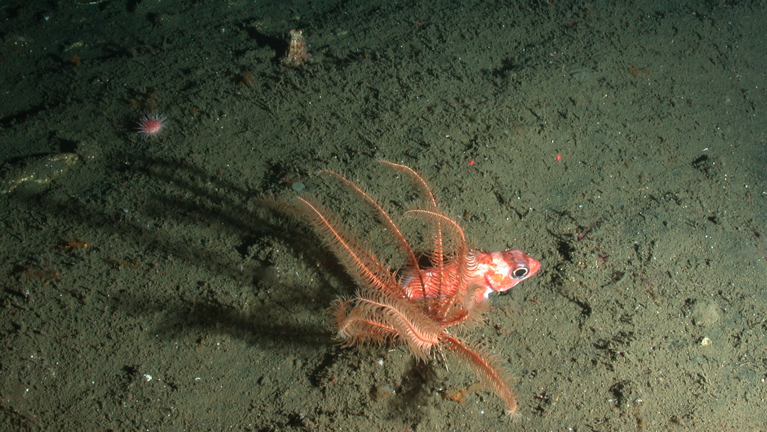
Lasers = 10 cm apart
Researchers can measure the size of organisms, as well as distances and parts of the habitat.
Notes:
When viewing the video transect, you are going to notice two red dots that do not seem to go away; the dots are lasers set at a distance of 10 centimeters apart. These are set to get an accurate measurement of the species you are observing. This is particularly useful for studying rockfish, because it helps researchers to determine the age class of a fish.

Slide 25
How do you rate species abundance?
Single 1
Few 2-10
Many 11-50
Abundant >50
Notes:
Often, it is much easier and more practical for scientists to estimate abundance rather than actually count individuals, especially when biodiversity is dense. For this exercise, we are going to use our best estimate for species abundance, or the number of individuals of a particular species present in each transect.
During the video transect, each member of the group will watch for a different group of organisms or species. After the transect is complete, you will assign an abundance category for the total amount counted during each minute of the transect. Single is for 1 individual by itself, few is for 2-10 individuals, many is for 11-50 and abundant is for >50. Sometimes species are so abundant that they are hard to count. When large groups of corals or fish are seen (greater than 50 or 100), students may mark off “many” or “abundant” on the data sheet immediately.

Slide 26
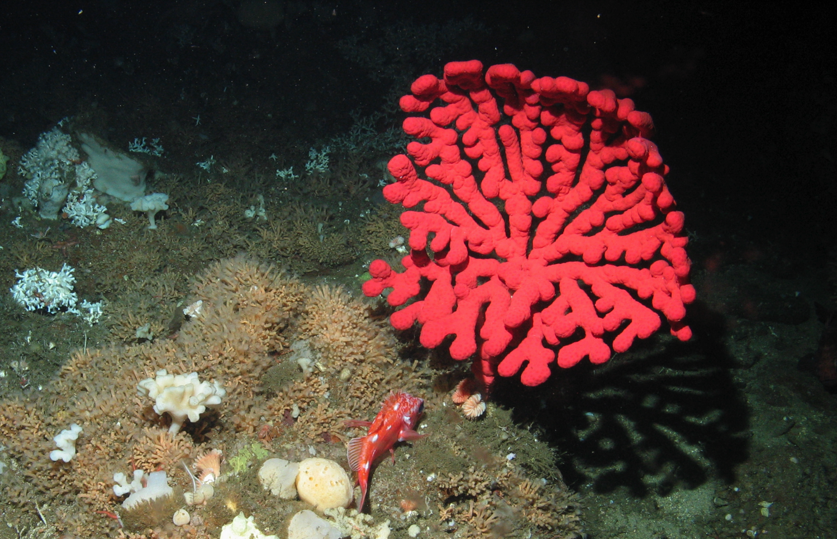
Single (S)
Single Colony
Single Individual
Notes:
When counting fish or invertebrates, find the individuals. When counting coral colonies, look at the base or try to determine the center of the branches to count how many colonies are present. In this photo, the coral colony is Paragorgia bubblegum sea fan and the fish is Sebastes rockfish.

Slide 27
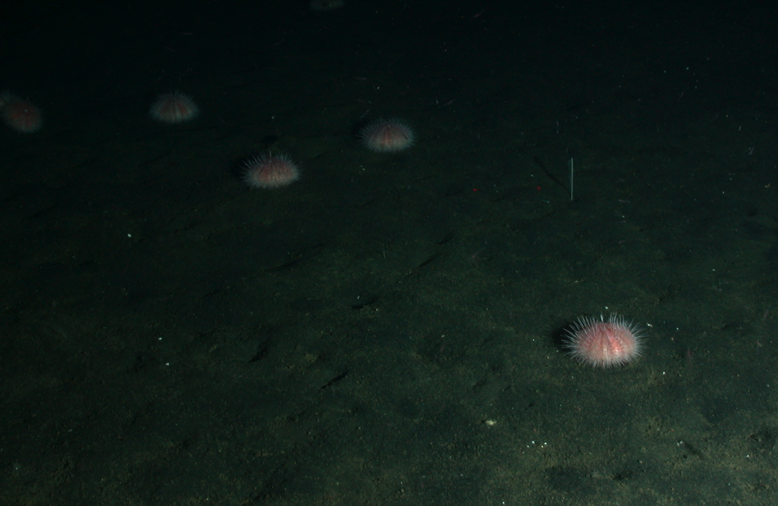
Few (F)
2-10
Notes:
More than one, 10 or less. The urchins are Strongylocentrotus fragilis fragile pink sea urchin.

Slide 28
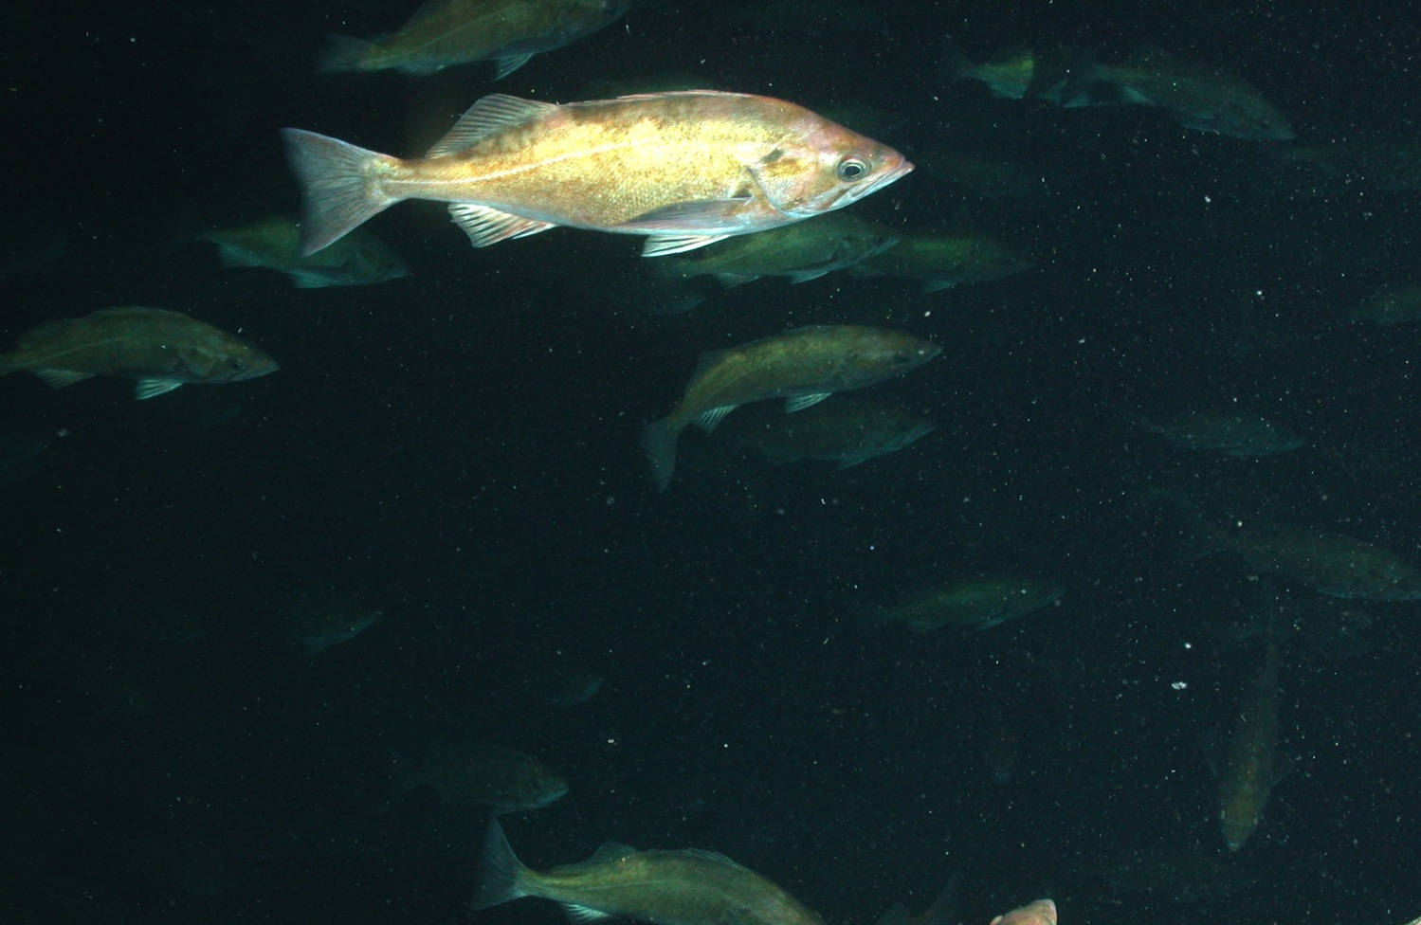
Many (M)
11-50
Notes:
11-50 individuals or colonies. These fish are Sebastes rockfish.

Slide 29
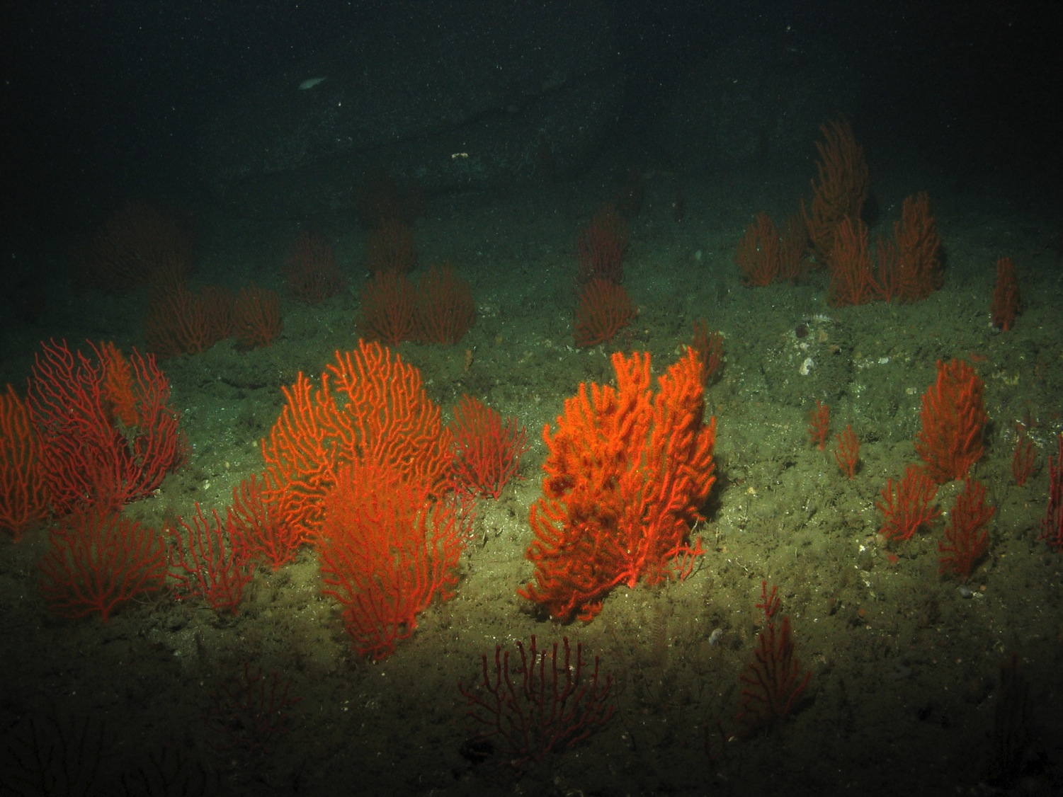
Abundant (A)
50+
Notes:
More than 50 individuals or colonies (which can be hard to count!). The corals are Adelogorgia orange sea fan.

Slide 30
It is easy to count individuals in a still shot, but we have to do it while the ROV is moving!
Visibility
Moving organisms
Limited field of view
Other challenges?
Notes:
It is easy to count individuals in a still shot, but we have to do it while the ROV is moving! Ask your students: What other challenges do you think there are when viewing ROV footage? For instance, sediment or a lack of light can reduce visibility; large schools of fish or other moving organisms can be hard to count; and the ROV field of view is limited.

Slide 31
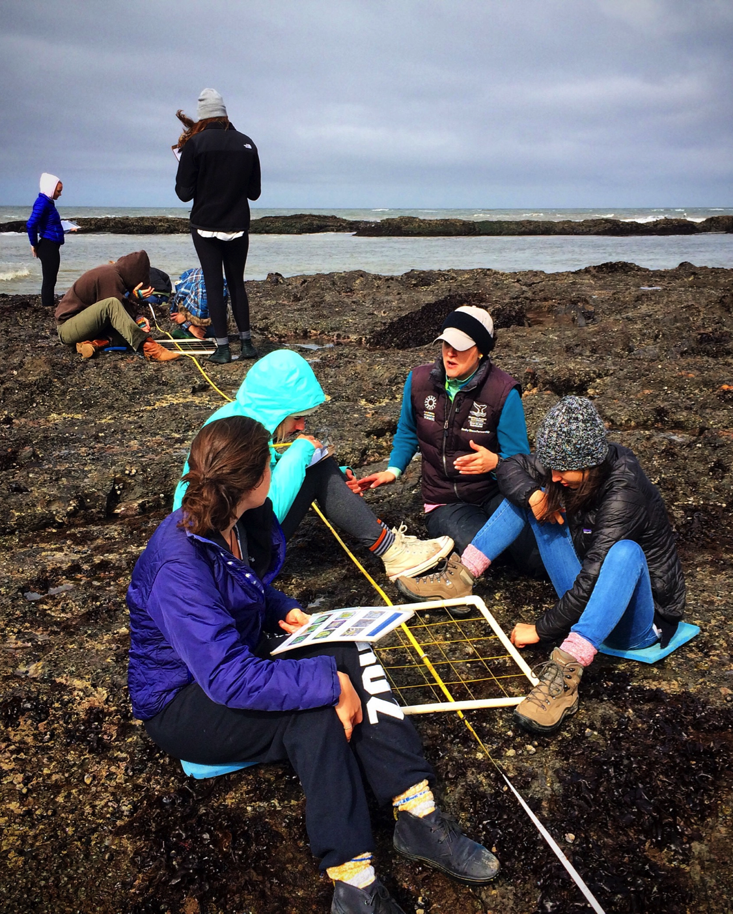
What is a transect?
A transect is a straight line or path through a habitat for a specific distance or length of time along which researchers record species diversity and abundance, as well as habitat type.
Notes:
Can we take an ROV and look at an entire habitat? No! That would be nearly impossible considering time constraints and the limited abilities of an ROV. Plus, it would be a tremendous amount of work for researchers to analyze all that data! Therefore, we need to use a scientific method called a transect.
A transect is a straight line or path through a habitat for a specific distance or length of time along which researchers record species diversity, abundance and habitat type. A transect is a way to profile the physical and biological components of an ecosystem by just looking at one small part. Again, it would be very time consuming and difficult to profile an entire ecosystem, especially because transects generally provide an accurate picture of species diversity, abundance and habitat type.
This photo shows students conducting a transect through a rocky intertidal habitat. They are counting invertebrates and algae that they find along the transect.

Slide 32
Transects
Collecting information from a transect helps us understand how an ecosystem functions.
They may describe the flow of energy through a system and allow us to predict the impacts of natural or human-caused events.
Each of our deep sea transects will be 3 minutes in length.
Notes:
Collecting information from a transect helps us understand how an ecosystem functions. They may describe the flow of energy through a system and allow us to predict the impacts of natural or human-caused events. Each of our transects are 3 minutes in length (with the exception of Olympic Coast which is 1.5 minutes).
*A note for your students: The ROV will often pause to investigate a particular organism, which may take it off of the transect line. Please tell your students to be aware of the potential for such a pause and if one does occur, that they should not re-count organisms when the ROV moves back towards the line.

Slide 33
Points to keep in mind as we conduct our transects:
The ROV’s rate of speed.
The field of vision in which species are counted.
Maintaining consistency among observers.
Notes:
Three points to keep in mind as we conduct our transects:
(1.) The ROV’s speed should remain consistent.
(2.) The field of vision in which species are counted is limited.
(3.) Observations must be consistent. Different people may arrive at different numbers for the same individuals or colonies; however, the data is usable if said numbers are approximately similar. Conversely, if the numbers vary drastically, the transect should be evaluated again.

Slide 34
Our Transects
We will count individuals of certain species during one-minute segments of a transect, then estimate abundance for the entire transect.
Once we graph our abundance, we will look at diversity, or how many different species we found.
Notes:
We will count individuals of a certain species during one minute segments of a transect, then estimate abundance for the entire transect.
Once we graph our abundance, we will look at diversity, or how many different species we found.

Slide 35
Data Sheet
Notes:
Everyone will record their data on a data sheet like this one. The teacher should show each transect in one minute segments, and the students should mark down how many of each species they see during each segment, and then add up totals at the end. Students should at least write down the common name of each species, and the genus and species as well, if they are able to identify it. Students should split up species among the group, so that each person only looks for a couple of species or one group of organisms (Soft Coral, Hard Coral, Invertebrates, Vertebrates). Additionally, at the end, tally the total abundance by adding how many of each species were seen in the transect and mark the overall abundance in the entire transect.
*Note: Depth and temperature may not be available for all transects.

Slide 36
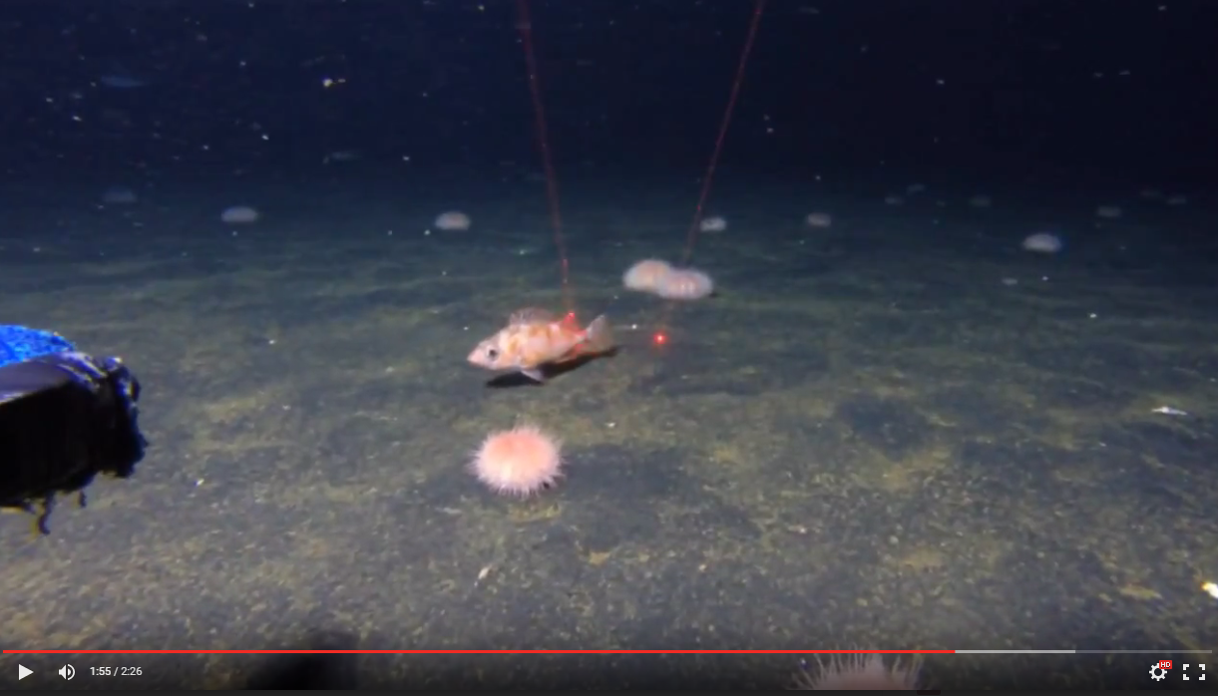
[Play ROV Deployment and Training Transect Video]
Notes:
Students will watch an ROV deployment and then perform a practice transect. The ROV deployment takes place over the first minute and 25 seconds, and the transect spans the last minute of the video.

Slide 37
Practice Transect
What is the habitat type?
What deep-sea species did you observe?
Graph total abundance for the entire transect.
Notes:
Have students break down their experience during the practice transect.
Habitat type: Soft bottom
Data:
Single – Pacific sanddab (flatfish), feather star
Few – Rockfish, sea cucumber
Abundant – Fragile pink sea urchins
Ask students – How would you visually represent this information?
Students may find it difficult to identify species while the ROV is moving; it is also challenging to try to ID so many different species all at once. This is why it is important to split up species identification between members of a group, so that each student only looks for one particular species or group of organisms.
It is recommended that students use Excel or another graphing program to represent their data for the actual transects; however, if access to a computer or classroom time is limited, a graph template is provided.

Slide 38
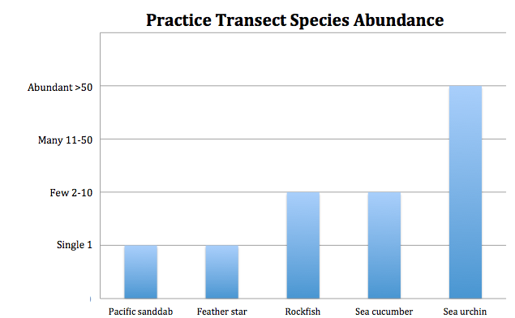
Practice Transect
Notes:
Have students break down their experience with the practice transect. How many different species are there? Which ones are abundant? Did everyone get the same data? Discuss observer consistency and what challenges students encountered.

Slide 39
Transect
We will graph species data from one or more of the national marine sanctuary transects to compare and contrast species abundance and diversity among different sites, habitat types and depths.
Notes:
We will graph species data from one or more transects from the National Marine Sanctuary System’s West Coast Region to compare and contrast species abundance and diversity among different sites, habitat types and depths.
You may choose to pause the slideshow here to conduct the transect activity, and then come back to the threats/solutions to deep sea coral communities afterwards (suggested) OR continue to the end of the slide show to talk about threats/solutions to deep sea coral communities, then conduct the transect activity.

Slide 40
What are the threats to deep-sea coral communities?
(1.) Marine debris (garbage) and derelict (abandoned) fishing gear.
(2.) Harmful fishing methods, such as bottom trawling.
(3.) Exploration for oil and natural gas.
(4.) Ocean acidification.
Notes:
What are the threats to deep sea coral communities?
(1.) Marine debris (garbage) and derelict (abandoned) fishing gear.
(2.) Harmful fishing methods, such as bottom trawling.
(3) Exploration for energy/oil and natural gas often involves drilling/fracking on the deep ocean floor.
(4.) Ocean acidification. Your students may be unfamiliar with ocean acidification; however, the slideshow will talk in-depth about this topic later.

Slide 41
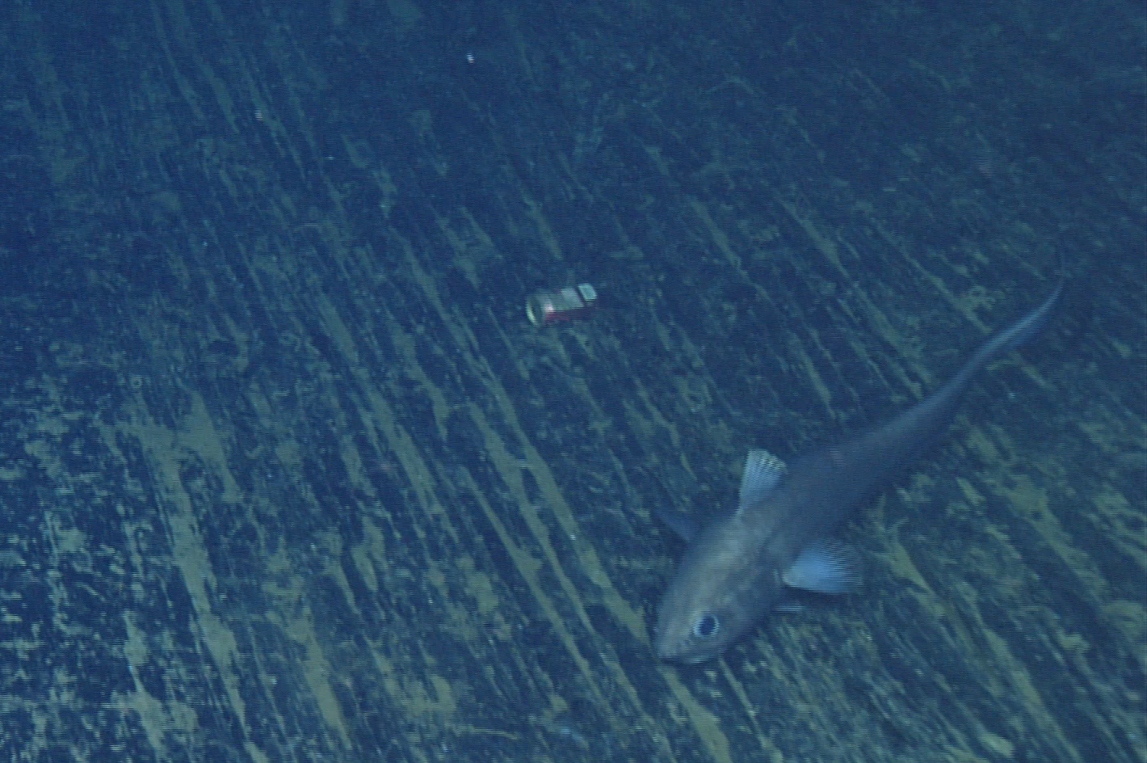
Marine Debris
Notes:
Marine debris is one of the biggest threats to all marine ecosystems; nonetheless, it is also one of the most preventable problems that face our ocean. Debris can cause physical damage to corals, entangle animals or cause harm, or even death, if ingested by marine life. The species seen here is a type of rattail, the giant grenadier, Albatrossia pectoralis.

Slide 42
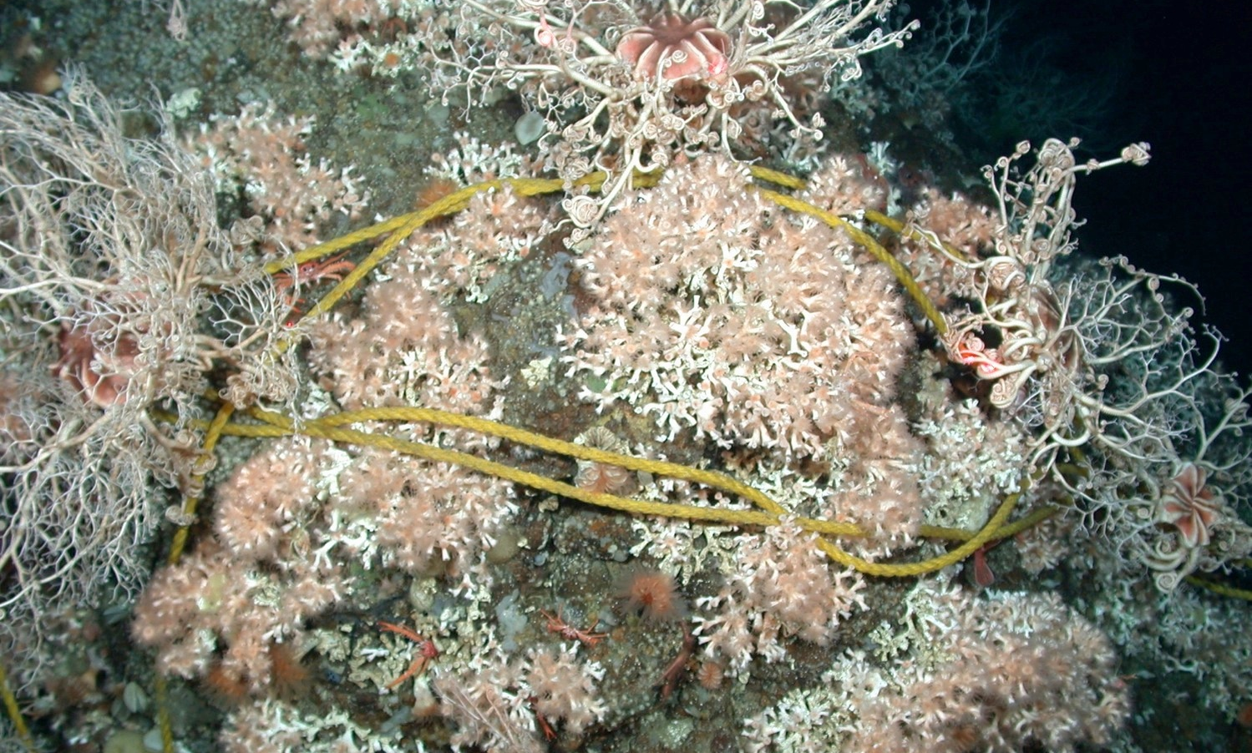
Derelict (abandoned) fishing gear can damage or even completely destroy deep sea coral communities.
Notes:
Derelict (abandoned) fishing gear and marine debris pose a serious threat to deep coral communities.

Slide 43
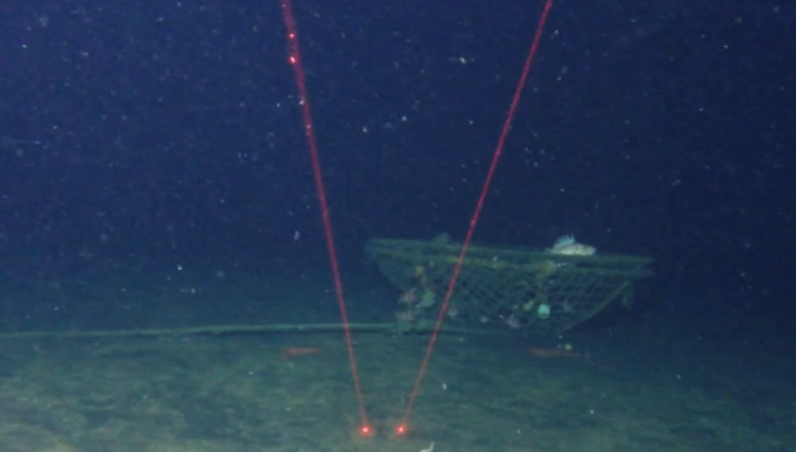
Harmful Fishing Gear
Notes:
Derelict fishing gear can be very harmful for deep sea coral communities. They can crush corals, especially during storms or times of large water movement, and continuously catch fish and invertebrates. Conversely, sometimes derelict fishing gear can be harmless, and even act as an artificial reef, if organisms begin to grow on it and use it as shelter. In these cases, removal of the gear must be carefully evaluated.

Slide 44
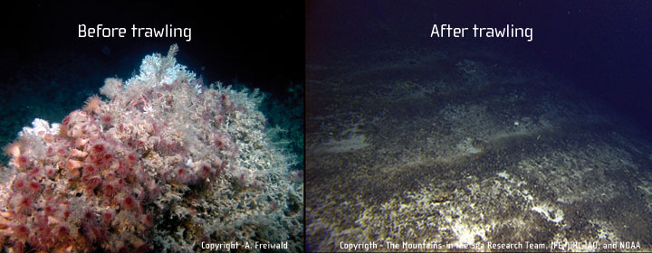
Harmful Fishing Methods
Notes:
Harmful Fishing Methods: Bottom trawling is a fishing method where a net is dragged along the seafloor, scooping up all fish and invertebrates. It can take many years for deep sea communities to recover from damage caused by trawling. Destructive fishing methods, such as bottom trawling, where fishing nets are dragged along the seafloor to catch fish, can destroy hundreds of years of growth in coral communities.

Slide 45
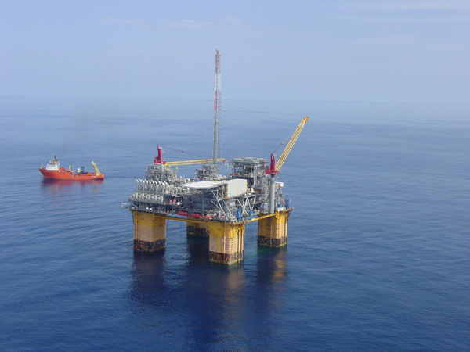
Oil and Natural Gas Exploration
Notes:
The exploration for and production of oil and natural gas resources can have a profound impact on deep sea coral communities. Potential threats include the physical impact of drilling, placement of structures on the seafloor (e.g. platforms, anchors, pipelines, cables, etc.), discharges from rock-cutting during the drilling process and drilling fluids discharges. For instance, in the North Sea, scientists observed how drilling muds and cuttings smothered and killed Lophelia pertusa colonies living on an oil platform close to drilling discharge points. Moreover, once oil platforms are established, there is a risk that accidental oil spills can impact these communities.

Slide 46

Ocean Acidification
Excess CO₂ in the atmosphere absorbed by the ocean causes the ocean to become more acidic. The chemical reaction of CO₂ with seawater also bonds with carbonate, which many marine animals need to build shells and skeletons.
What causes it?
Human carbon emissions!
Notes:
Ocean acidification is caused by excess carbon dioxide (CO₂) in the atmosphere. The ocean acts like a big sponge, absorbing CO₂ from the air. As CO₂ enters the ocean, it reacts with H₂O and carbonate already present in seawater. Shown here: In a lab experiment, a sea butterfly (pteropod) shell was placed in seawater with increased acidity and the shell slowly dissolved over 45 days.

Slide 47


Notes:
Organisms with calcium carbonate shells, such as hard coral, need to absorb carbonate from seawater in order to build their shells and skeletons. The chemical process of ocean acidification depletes seawater of carbonate ions, thereby depriving shelled organisms of the materials they need to grow. An influx of CO₂ also causes a higher concentration of H+ ions, making seawater more acidic/less basic, which may be harmful for animals with calcium carbonate shells, as well as other organisms.
As their shells and skeletons become thinner and weaker, animals impacted by ocean acidification are less likely to be able to find food and shelter, or protect themselves against predators. In regards to corals, they may become more susceptible to injuries, predation or other impacts.
It should be noted that the ocean is not actually becoming acidic, which would indicate a pH below 7; rather, the ocean is becoming less basic. Historically, the ocean has been estimated to have an average pH of 8.3; however, at present, it is closer to an average pH of 8.1.

Slide 48

Coral Injury
Which coral genus is this?
What percentage of this coral is dead?
What caused this injury?
Notes:
Have students guess the coral genus, estimate the percentage of total damage and try to determine the cause of injury.
Answers are on the next slide.

Slide 49

Coral Injury
Genus: Acanthogorgia
Golden sea fan
30% injured (red area)
Predation by nudibranch
Corals weakened by an injury from marine debris, harmful fishing methods or ocean acidification are more vulnerable to predation.
Notes:
The species of coral is part of the genus Acanthogorgia, and its common species name is the golden sea fan. The percentage of total damage to the coral colony is about 30%. The area outlined in red is dead coral, while the area outlined in green is the living coral; the outlines were created using a computer program. The cause of injury is predation by a nudibranch, or sea slug, which actually eats the coral polyps; however, it is very likely that some initial injury weakened the coral and made it more vulnerable to predation. Impacts, such as ocean acidification, can make corals even more susceptible to injury and predation.

Slide 50

Long-term Ecosystem Monitoring
Scientists often study a specific part of a habitat to see how it changes over time. We can use this information to gauge the health of an ecosystem.
Notes:
Scientists will place permanent markers near certain habitat locations and measure the health of those habitats over time. If damage (dead coral, in the case of this Lophelia) increases over time, we know the ecosystem is experiencing negative impacts, and may need additional scientific attention and/or ecosystem protection.

Slide 51

Long-term Ecosystem Monitoring
Notes:
Using the ROV, researchers deploy markers near coral aggregations and take many high quality images of all the coral colonies around the marker. They have navigation data that helps them come back to the same location, and the reflective marker helps researchers return to the exact same coral colonies at a later time. By examining the same coral at multiple points in time, we can learn more about the:
(1.) rate of injury;
(2.) rate of injury progression;
(3.) rate of recovery; and
(4.) rate of growth.
This marker example shows a large aggregation of Lophelia pertusa, a reef building coral. As the ocean absorbs carbon dioxide, a process called ocean acidification, we expect it may get harder for reef building corals, like Lophelia, to build their skeletons. Using the markers, we can track the proportion of live and dead skeletons over time.

Slide 52
What can we do to help protect our deep-sea coral communities?
Reduce carbon dioxide and other greenhouse gas emissions!
Carpool, take public transportation, walk and/or bike.
Marine protected areas (MPAs) and national marine sanctuaries protect the special places in our ocean.
Notes:
What can we do to help protect our deep sea coral communities? Have your students brainstorm ideas and use these bullet points as a way to start a conversation.
Reduce carbon dioxide and other greenhouse gas emissions! Carpool, take public transportation, walk and/or bike — it all helps!
Reducing our carbon footprint, or contributing less carbon dioxide emissions to the atmosphere, is probably the single most important thing that each and every person can do!
Support both the establishment of new and conservation of current marine protected areas (MPAs) and national marine sanctuaries in order to protect the special places in our ocean.

Slide 53
What can we do to help protect our deep-sea coral communities?
Work with regulatory agencies and fishermen to reduce harmful fishing methods and derelict fishing gear.
Support organizations that help protect the special places in our ocean.
“Reduce, reuse, recycle” to keep trash out of the ocean!
Notes:
Work with the government and fishermen to reduce harmful fishing methods and derelict fishing gear.
Support organizations that help protect the special places in our ocean (MPAs, national marine sanctuaries, numerous non-profit organizations).
“Reduce, reuse, recycle” to keep trash out of the ocean!

Slide 54
There are countless other ways to help!
Find out more by visiting:
http://sanctuaries.noaa.gov/involved/youcando.html
or
ThankYouOcean.org.
Notes:
Encourage your students to find other ways to help!

Slide 55
Acknowledgments
We would like to thank the following individuals for their assistance with scientific review, species identification, video and still images that are included in this lesson plan. Peter Etnoyer, PhD, NOAA Marine Biologist, Leslie Wickes, MS, NOAA Affiliate, JHT, Inc., Enrique Salgado, Biologist, NOAA Affiliate, JHT, Inc. and Danielle Lipski, Research Coordinator Cordell Bank National Marine Sanctuary.
The idea for this lesson came from the "Exploring Cordell Bank National Marine Sanctuary by Submersible" activity developed by Jennifer Stock. This lesson was written and developed by Rietta Hohman, Greater Farallones National Marine Sanctuary. The National Marine Sanctuary System's West Coast Region education team developed and reviewed the content for the curriculum.

Slide 56
sanctuaries.noaa.gov/education
Notes:
Marine protected areas, like national marine sanctuaries, safeguard these special areas for the future. Research provides us with information and data to best prepare for potential impacts. A greater knowledge of habitats will help us keep them healthy and thriving.

