Slide 1
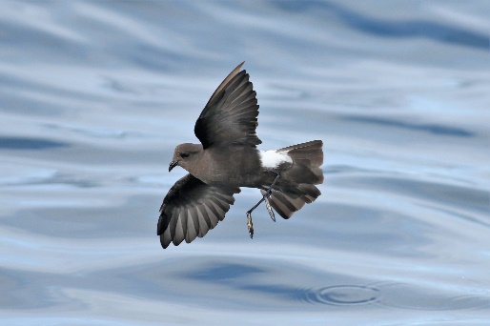
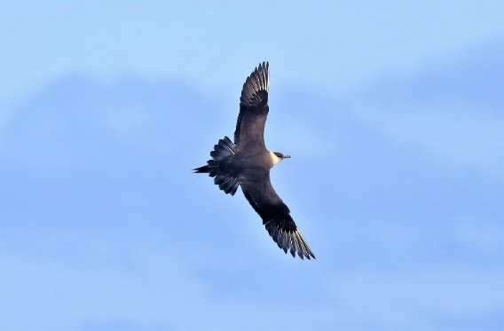
SEABIRDS 101 WITH A SPECIAL FOCUS ON THE SEABIRDS OF STELLWAGEN BANK NATIONAL MARINE SANCTUARY
Mariners Superb
Presented by Wayne R. Petersen

Slide 2
Some seabird factoids?
True seabirds spend most of their lives at sea on the open ocean
Many seabirds only come to land to nest
All seabirds have webbed feet
Many seabirds are mainly dark or some combination of dark and white in color
Many seabirds are colonial nesters, often on remote ocean islands
Many seabirds are long-lived and take a long time to reach maturity
Many seabirds are highly migratory and are exceptional navigators
Examples of seabirds include shearwaters, petrels, gannets, gulls, terns, jaegers, and alcids

Slide 3
Seabird Characteristics and Adaptations
Long wings for sustained gliding (shearwaters, albatrosses)
Counter-shading to increase foraging efficiency in surface divers (e.g. alcids)
Eyes frontally located in plunge divers (gannets)
Salt glands for excreting excess salt in blood
Acute sense of smell, especially in tube-nosed species
Low reproductive rate and long maturation period
Often complex plumages (jaegers, gulls)

Slide 4
Long, slender wings for sustained gliding: Cory’s Shearwater

Slide 5
Counter-shading increases foraging efficiency: Thick-billed Murre

Slide 6
Eyes frontally located in plunge divers: Northern Gannet

Slide 7
Tubular nostrils associated with salt glands and olfactory ability: Northern Fulmar

Slide 8
Complex plumages and long maturation period: Northern Gannet

Slide 9
Polymorphism common in some species: Parasitic Jaegers

Slide 10
Seabird Foraging Strategies
Surface feeding by skimming (storm-petrels)
Surface feeding by swimming (phalaropes)
Diving from surface (shearwaters, alcids)
Plunge diving from air (gannets, terns)
Kleptoparasitism (jaegers)
Scavenging (fulmars, kittiwakes)

Slide 11
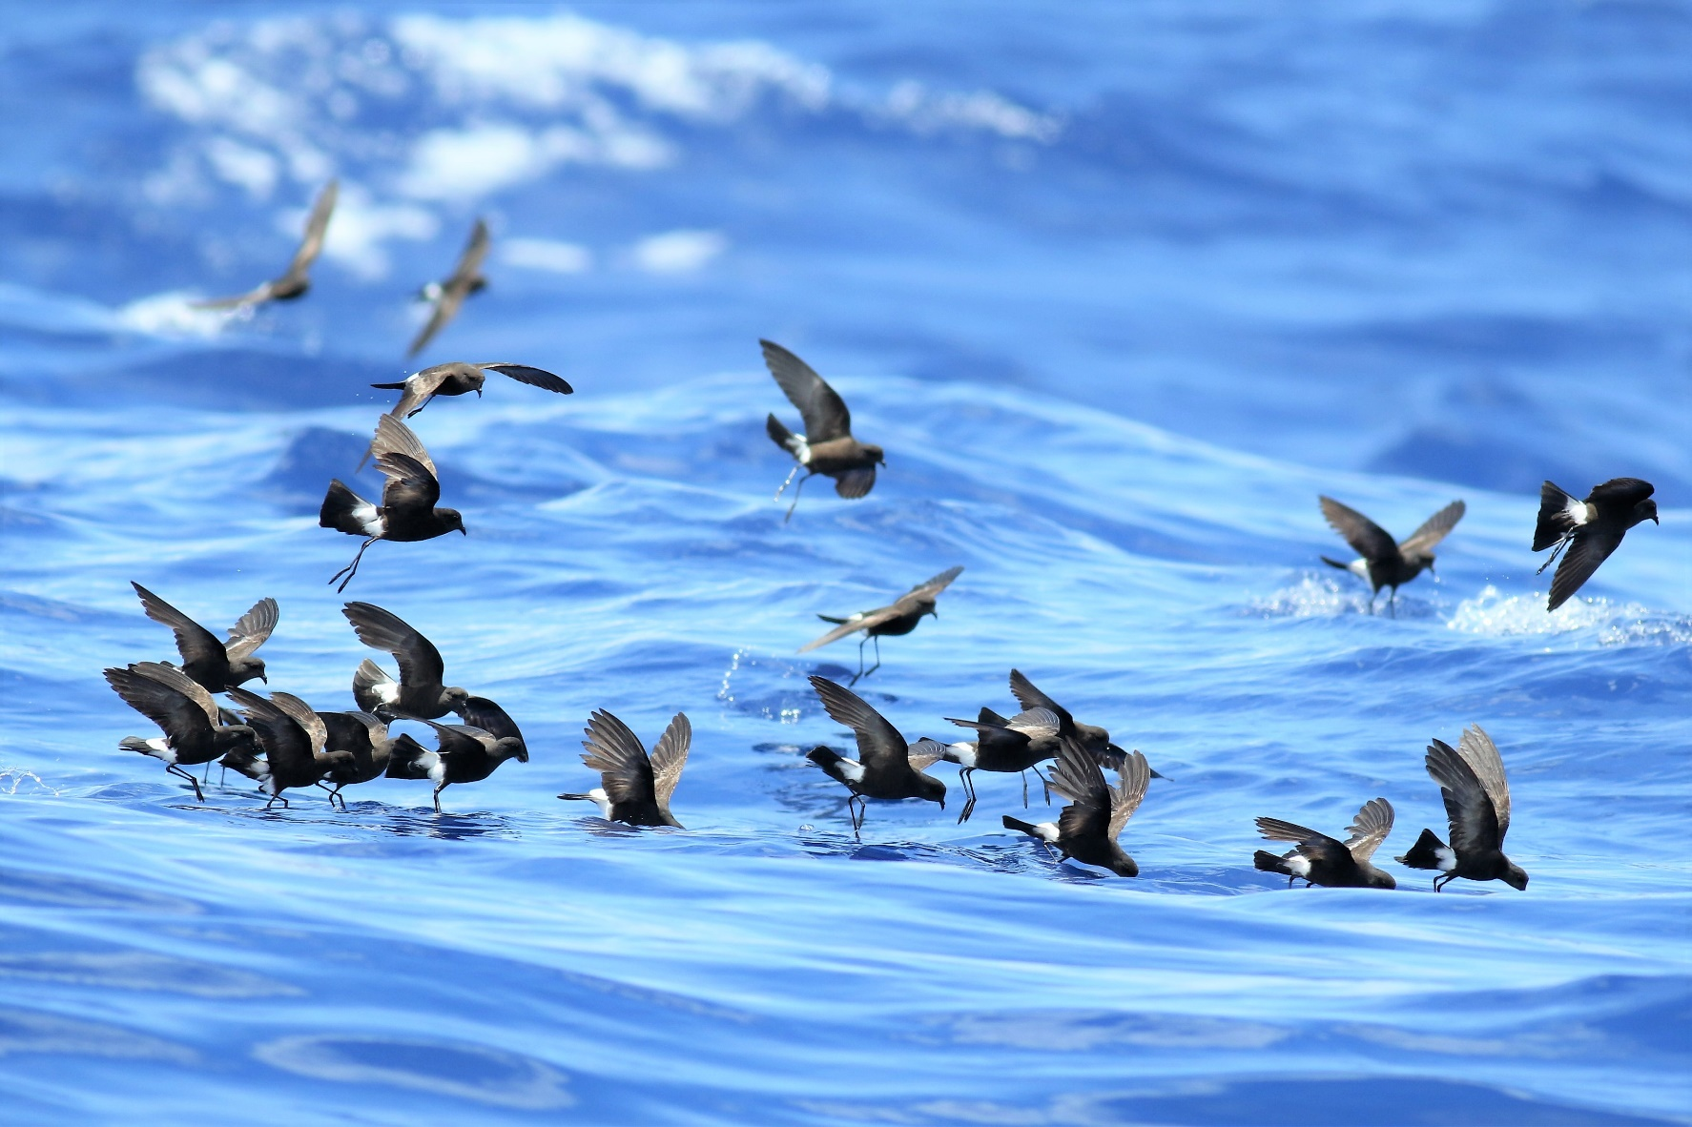
Skim feeding: Wilson’s Storm-Petrels

Slide 12
Surface feeding and dipping with bill: Red-necked Phalaropes

Slide 13
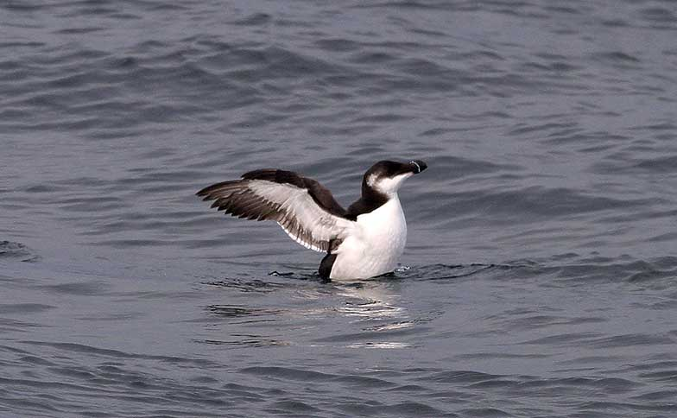
Surface diving using wings for propulsion: Razorbill

Slide 14
Plunge diving by gannets and terns: Northern Gannets

Slide 15
Kleptoparasitism: Parasitic Jaeger pirating from a Laughing Gull

Slide 16
Scavenging behind fishing vessels: Herring and Great Black-backed Gulls

Slide 17
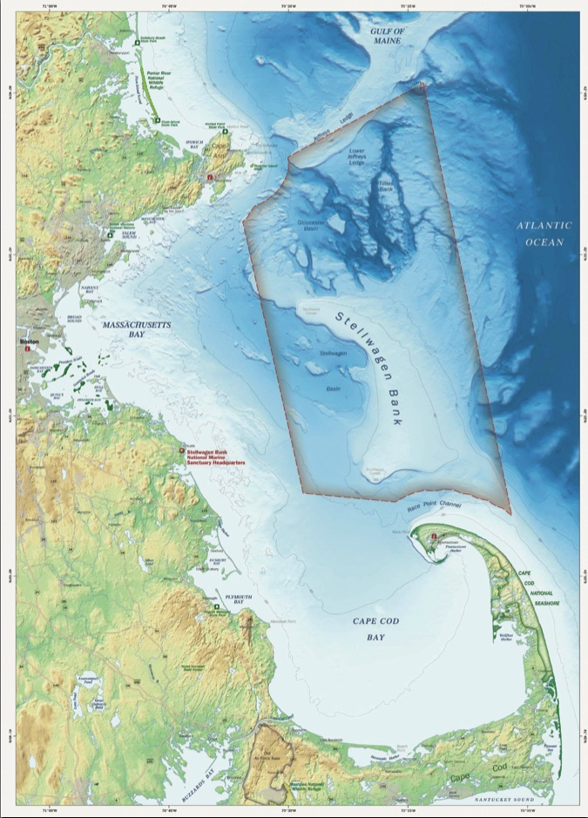
Stellwagen Bank National Marine Sanctuary
-842 Square miles of protected ocean
-Hotspot for prey abundance in the
Gulf of Maine
-Combination of geology, ocean currents,
cold oxygen rich water
-One of the most intensively used whale
habitats in the Northeastern US
-50+ species of birds use the sanctuary,
In addition to fish, whales, turtles

Slide 18
What makes Stellwagen Bank Special?
Abundance of food
Surface temperature and salinity
Nutrient availability (nitrates, phosphates)
Bottom contours that produce upwelling
Ocean fronts and areas of convergence
Commercial fishing activity
Presence of marine predators

Slide 19
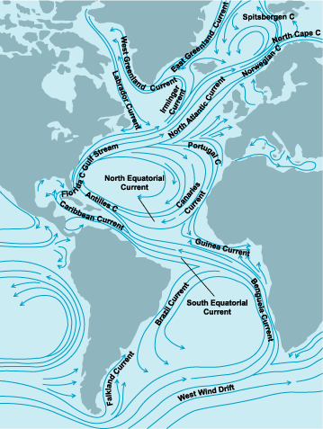
Ocean Circulation Patterns

Slide 20
The Cast of Characters
Who are some of the players and where are they from?

Slide 21
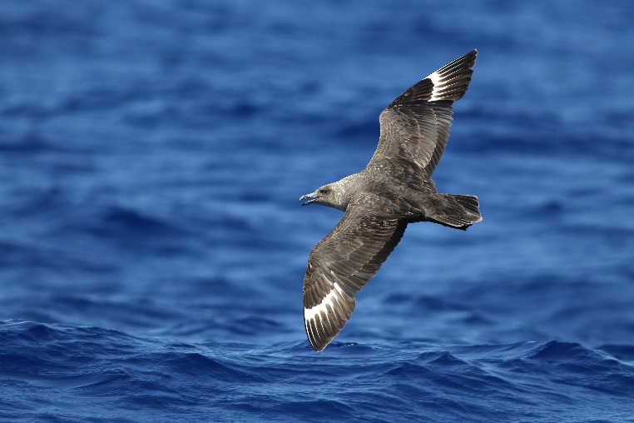
Southern Hemisphere
Great Shearwater
Sooty Shearwater
Wilson’s Storm-Petrel
South Polar Skua

Slide 22
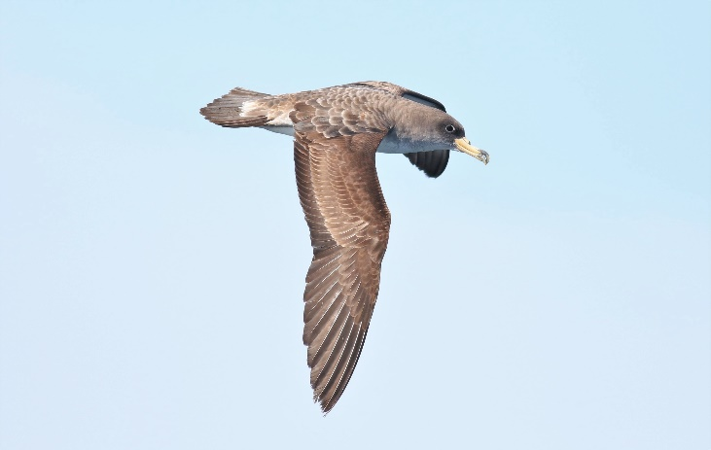
Eastern Atlantic Ocean
Cory’s Shearwater
Manx Shearwater
Great Skua

Slide 23
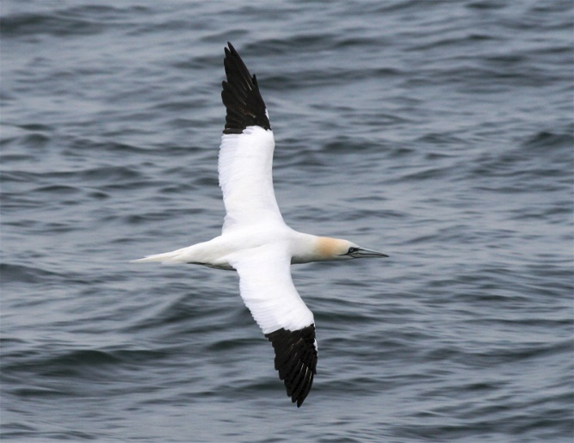
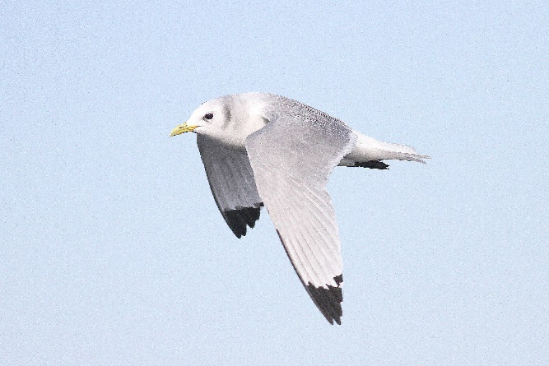
North Atlantic Ocean
Northern Gannet
Black-legged Kittiwake
Leach’s Storm-Petrel
Atlantic Puffin

Slide 24
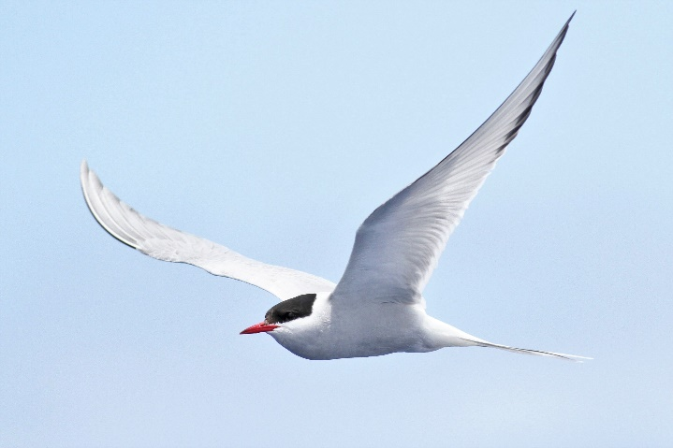
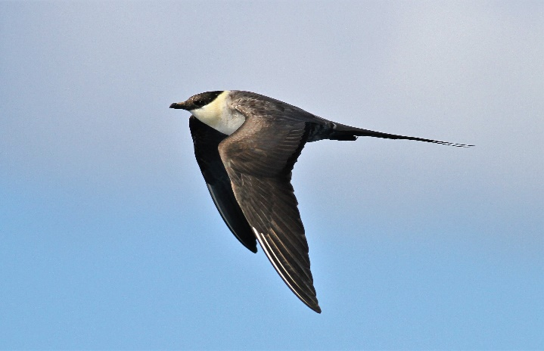
Circumpolar Arctic
Arctic Tern
Long-tailed Jaeger
Parasitic Jaeger
Sabine’s Gull

Slide 25
Seabird Conservation
An increasing problem worldwide…

Slide 26
Oil Spills

Slide 27
Gill Net and Long-line Fishing Entanglement

Slide 28
Ingestion of Plastics and Other Ocean Toxics

Slide 29
Climate Change

Slide 30
Acknowledgement and thanks to the following individuals for information and the use of images.
Peter Flood
Wayne Petersen
Anne-Marie Runfola
Anne Smrcina
Kate Sutherland

