Slide 1
Exploring Ocean & Coastal Acidification Using NOAA’s Data in the Classroom
Amy Dean dataintheclassroom@noaa.gov

Slide 2
WEBINAR: Agenda / Objectives
PART 1: What can we learn about ocean and coastal acidification using data?
PART 2: How might you effectively use data in your teaching or education activities?

Slide 3
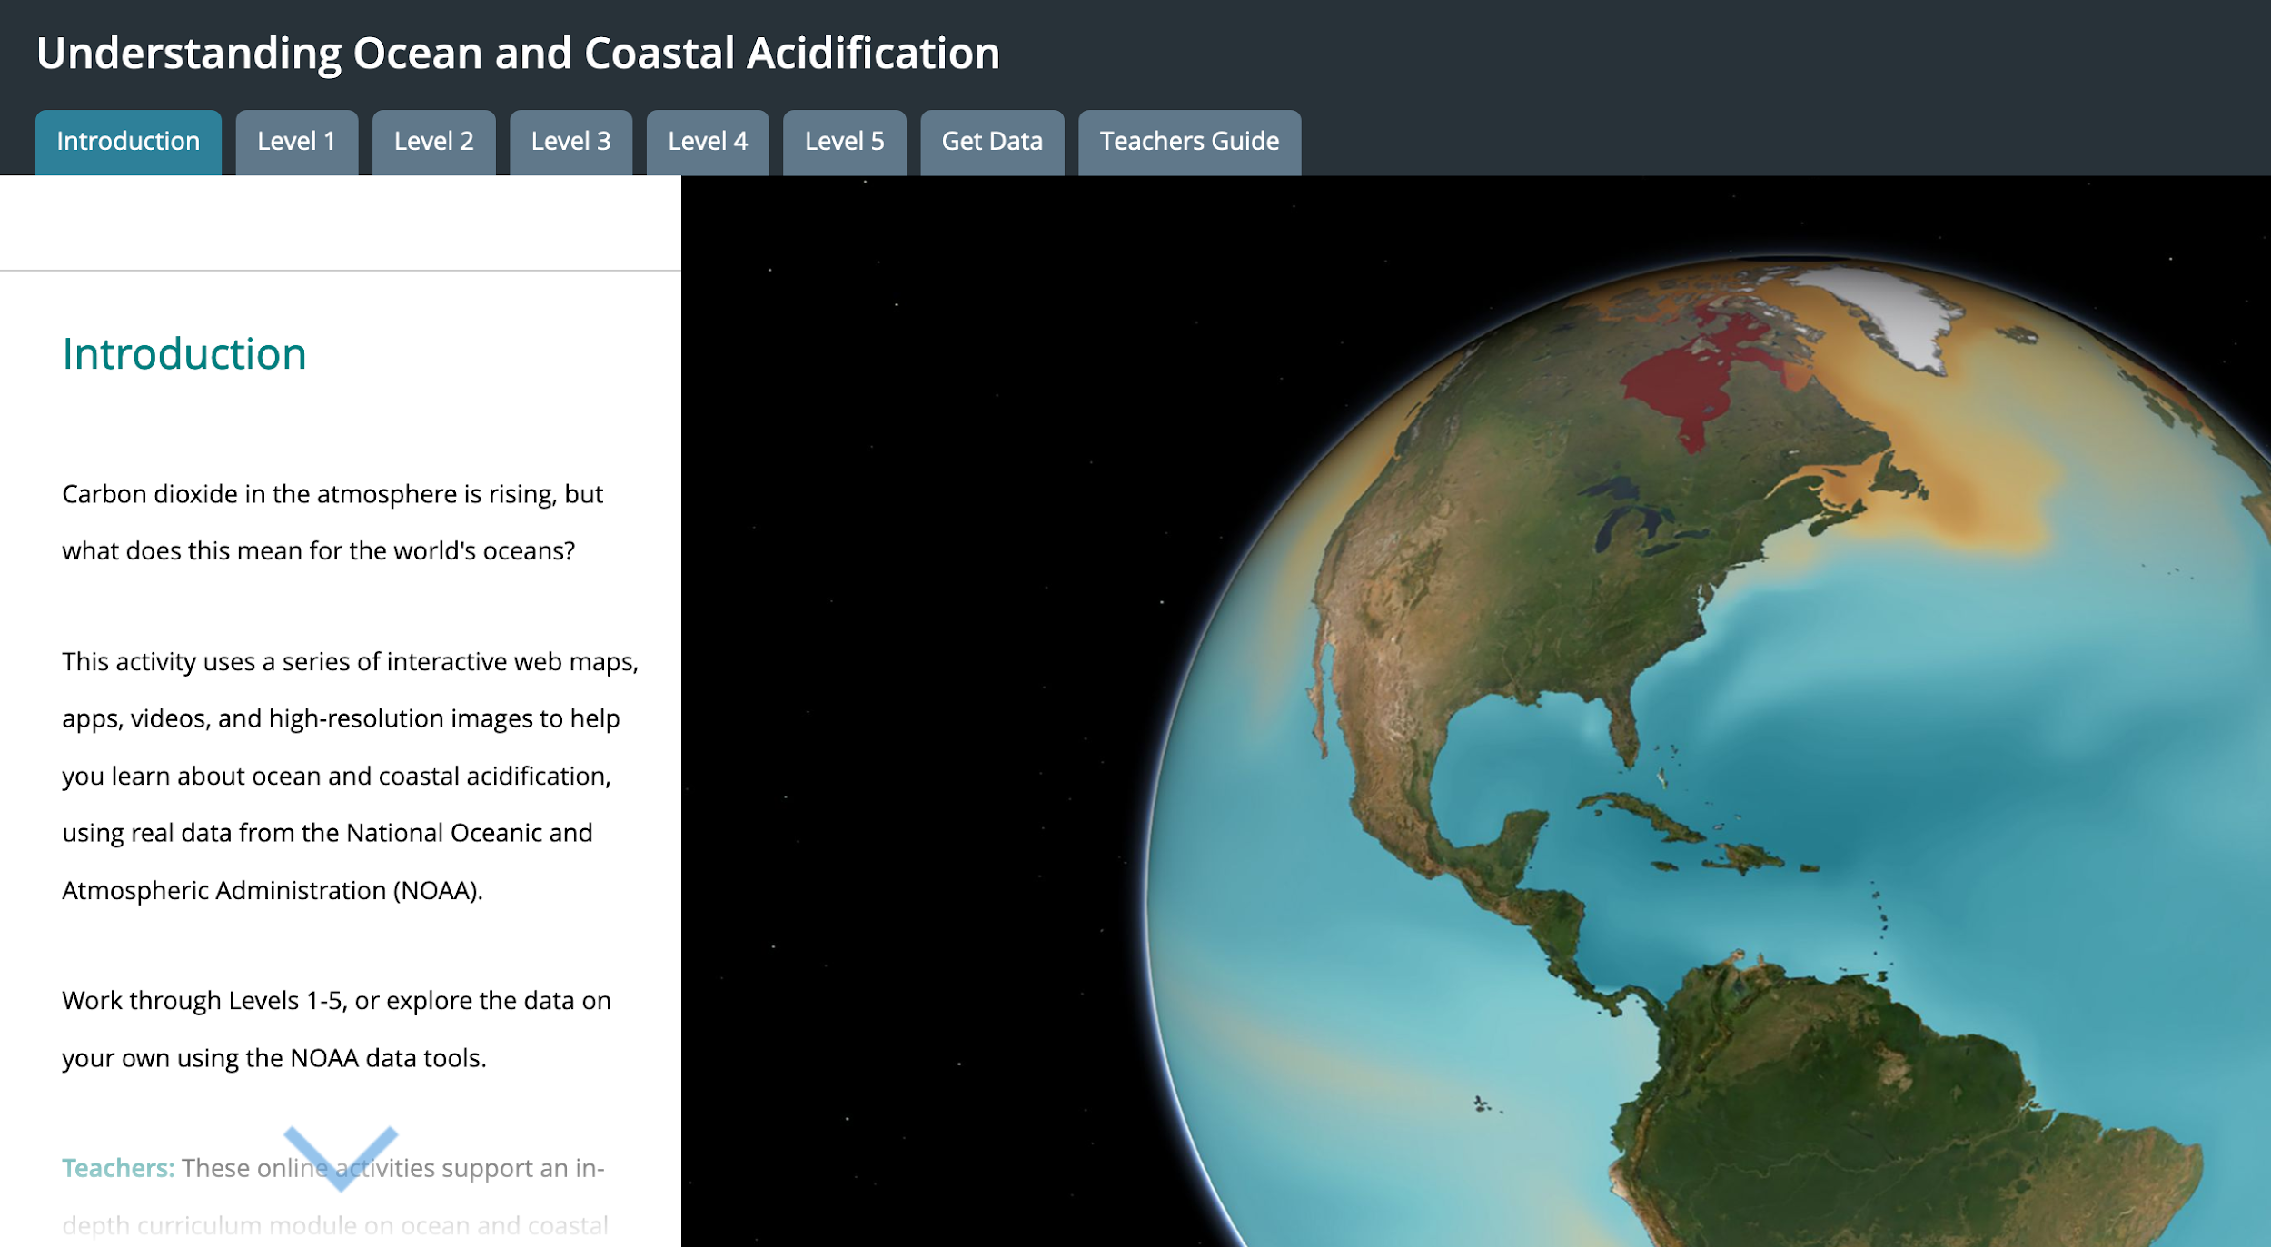
Access to data tools
Lesson plans
Student Activities
Notes:
On the introductory page, you’ll find the guiding question for the module “CO2 in the atmosphere is rising, but what does this mean for the world ocean?” Levels 1-5 contain the student activities. Will show you a sampling of the activities from each level, and we’ll actually do a few together.

Slide 4
How Does Rising CO₂ Impact our Ocean?
Notes:
Even if you don’t know much about acidification, you likely infer that relates to the changing acidity of the ocean.
Let’s begin our data exploration in the atmosphere.

Slide 5
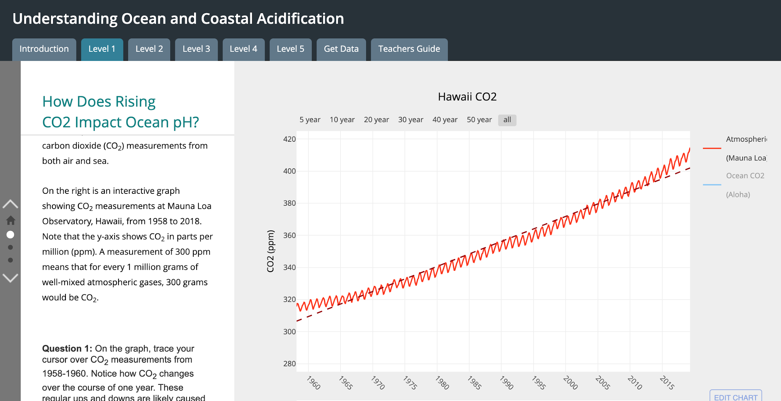
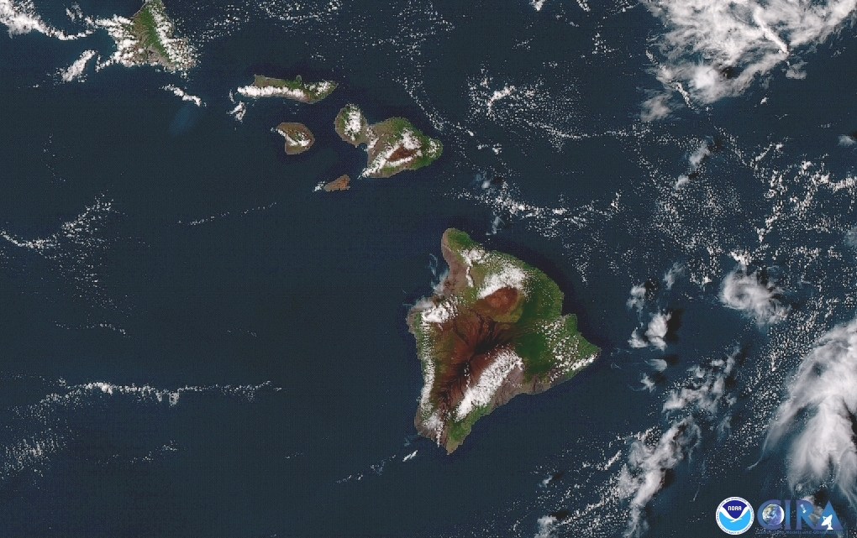
Notes:
Let’s begin by taking a virtual trip to Hawaii – one of the only places in the world where we can explore decades of continuous carbon dioxide (CO2) measurements from both air and sea.
Go to module, Level 1. Model how I’d introduce this to my students…. help them to understand all parts of the graph before they do any interpretation.
Graph shows CO2 measurements at Mauna Loa Observatory, Hawaii.the longest such record in the world. X-axis: Measurements from 1958 to 2018. Y-axis shows CO2 in parts per million (ppm). A measurement of 300 ppm means that for every 1 million grams of well-mixed atmospheric gases, 300 grams would be CO2.
What patterns do you notice?
Two things you might notice: 1) regular short term fluctuations and 2) long-term trend showing increasing CO2
Short term: caused by fluctuation are the result of photosynthetic activity by plants. As plants begin to photosynthesize in the spring and summer, they consume CO2 from the atmosphere and eventually use it as a carbon source for growth and reproduction. This causes the decrease in CO2 levels that begins every year in May. Once winter arrives, plants save energy by decreasing photosynthesis. Without photosynthesis, the dominant process is the exhalation of CO2 by the total ecosystem, including bacteria, plants, and animals.
Long-term: Currently have an observed rate increase of >2 ppm per year… that rate has accelerated.

Slide 6
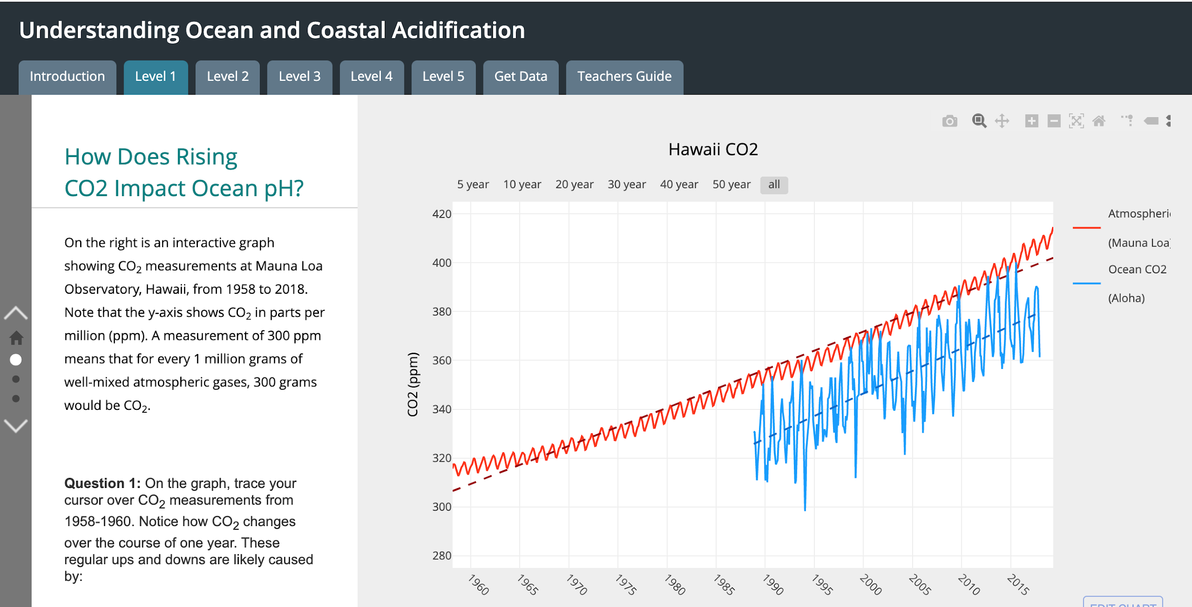
Notes:
Add measurements of CO2 from ocean. These data are from location north of oahu, regularly sampled since 1988.
What patterns do you notice?
similar short and long term trends

Slide 7
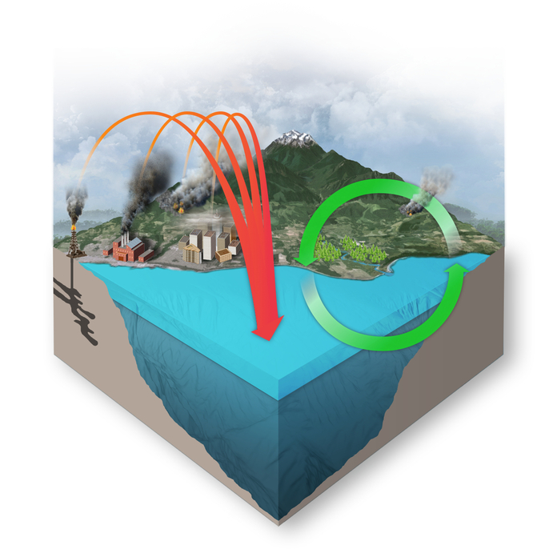
CO₂ Data Summary
Seasonal fluctuations: caused by living things (photosynthesis and respiration)
Long-term increasing trend (↑30%): caused by burning of fossil fuels
↑atmospheric CO₂ correlates with ↑ocean CO₂
caused when partial pressure of CO₂ increases in the atmosphere over a body of water, and CO₂ diffuses into that water until the partial pressures are equilibrated.
Image created by the Center for Environmental Visualization for the PMEL Carbon Group: https://www.pmel.noaa.gov/co2/
Notes:
Add measurements of CO2 from ocean. These data are from location north of oahu, regularly sampled since 1988.
What patterns do you notice?
similar short and long term trends

Slide 8
LeQuere et al, Global carbon budget 2014, Earth Syst. Sci. Data, 7, 47–85, https://doi.org/10.5194/essd-7-47-2015, 2015
Notes:
Not all CO2 from humans ends up in ocean - but about a quarter of it does.

Slide 9
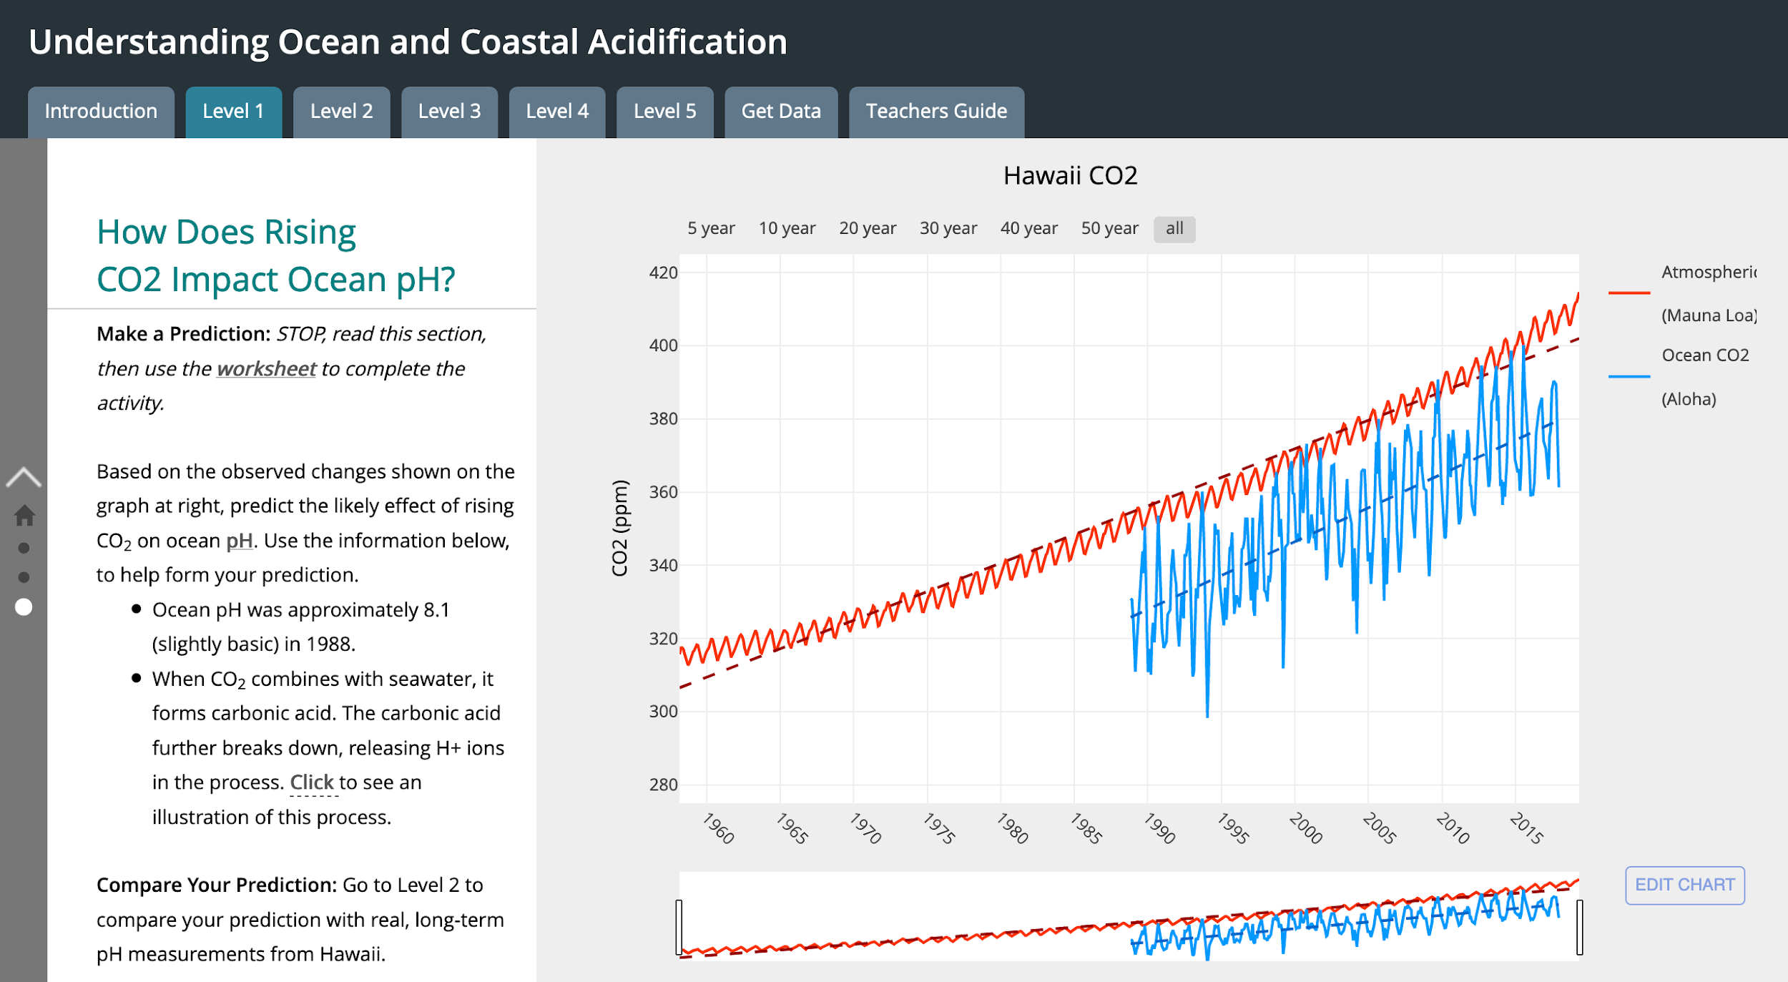
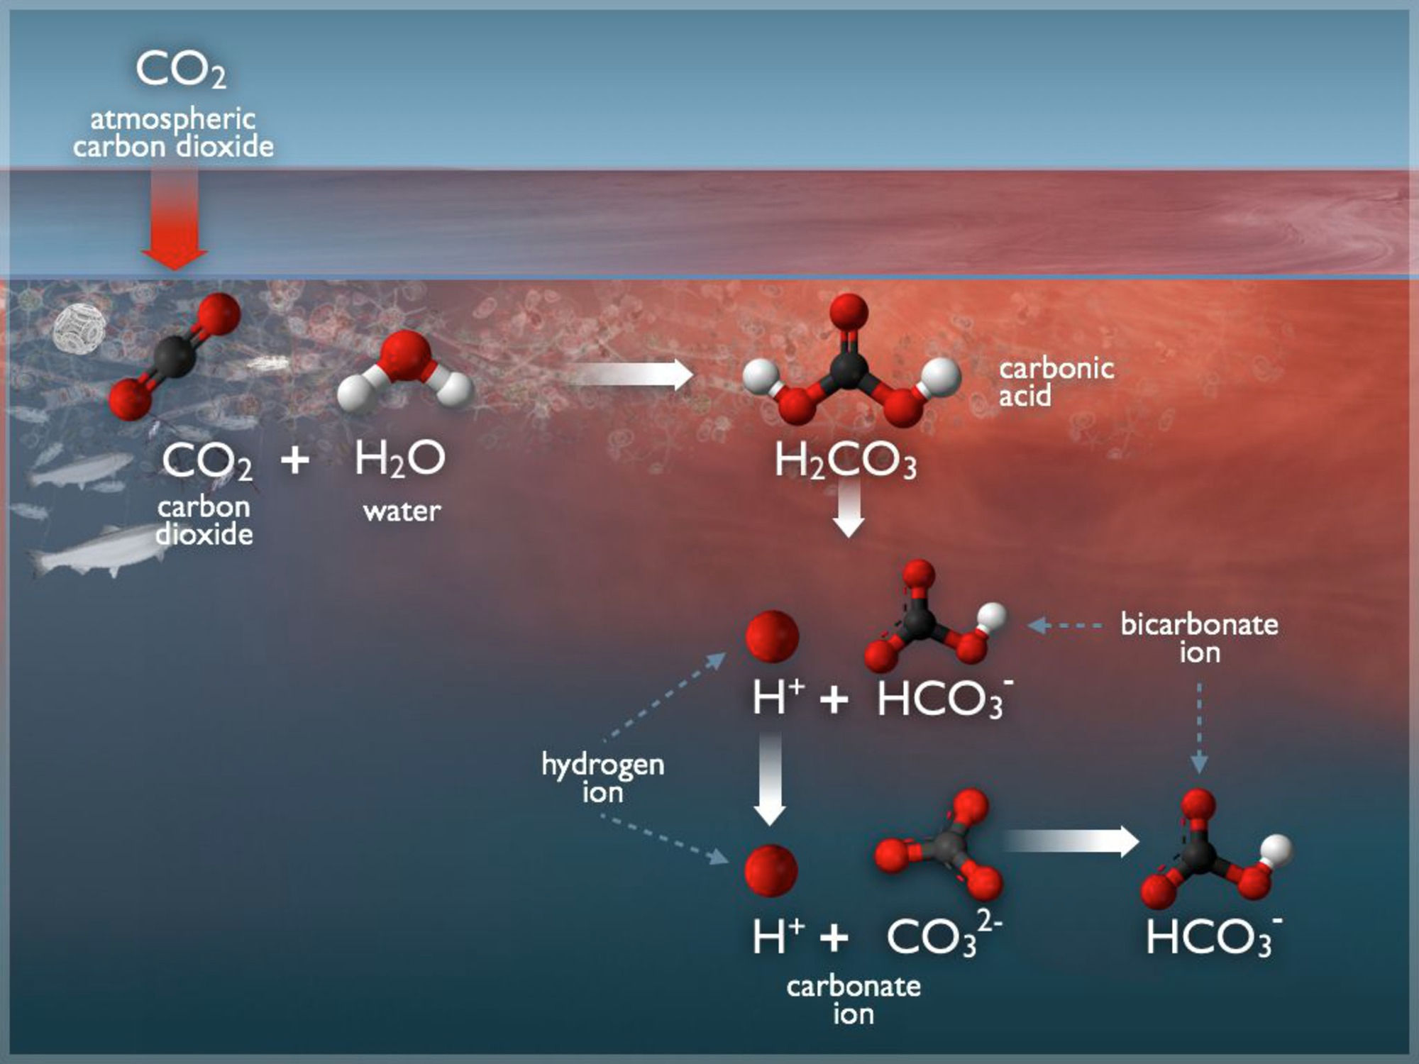
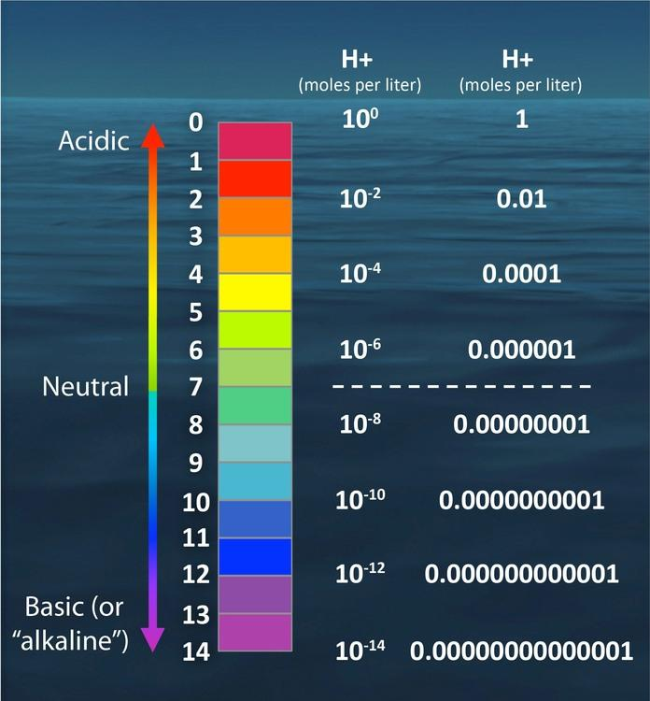
Image credits: NOAA PMEL, https://www.pmel.noaa.gov/co2/story/A+primer+on+pH
How Does Rising CO₂ Impact the Ocean?
What happens when CO₂ combines with seawater? forms carbonic acid which breaks apart resulting in more free H+ ions in water.
What is acidity? Concentration of H+ ions in water. Expressed the pH scale (log scale). A change of one pH unit = a ten-fold change in hydrogen ions
What was the pH of ocean water?
~ 8.16 in recent pre-industrial times

Slide 10
Audience Poll: Make a Prediction
How Much Has Rising CO₂ Impacted the pH of Ocean Water?
Notes:
Use prior knowledge - and what we just briefly talked about regarding pH scale - predict how much rising CO2 has impacted the pH of ocean water. If it was 8.16 in 1988, what is it now?

Slide 11
AUDIENCE POLL
How Much Has Rising CO₂ Impacted the pH of Ocean Water? What is the pH of the global ocean now?

Slide 12
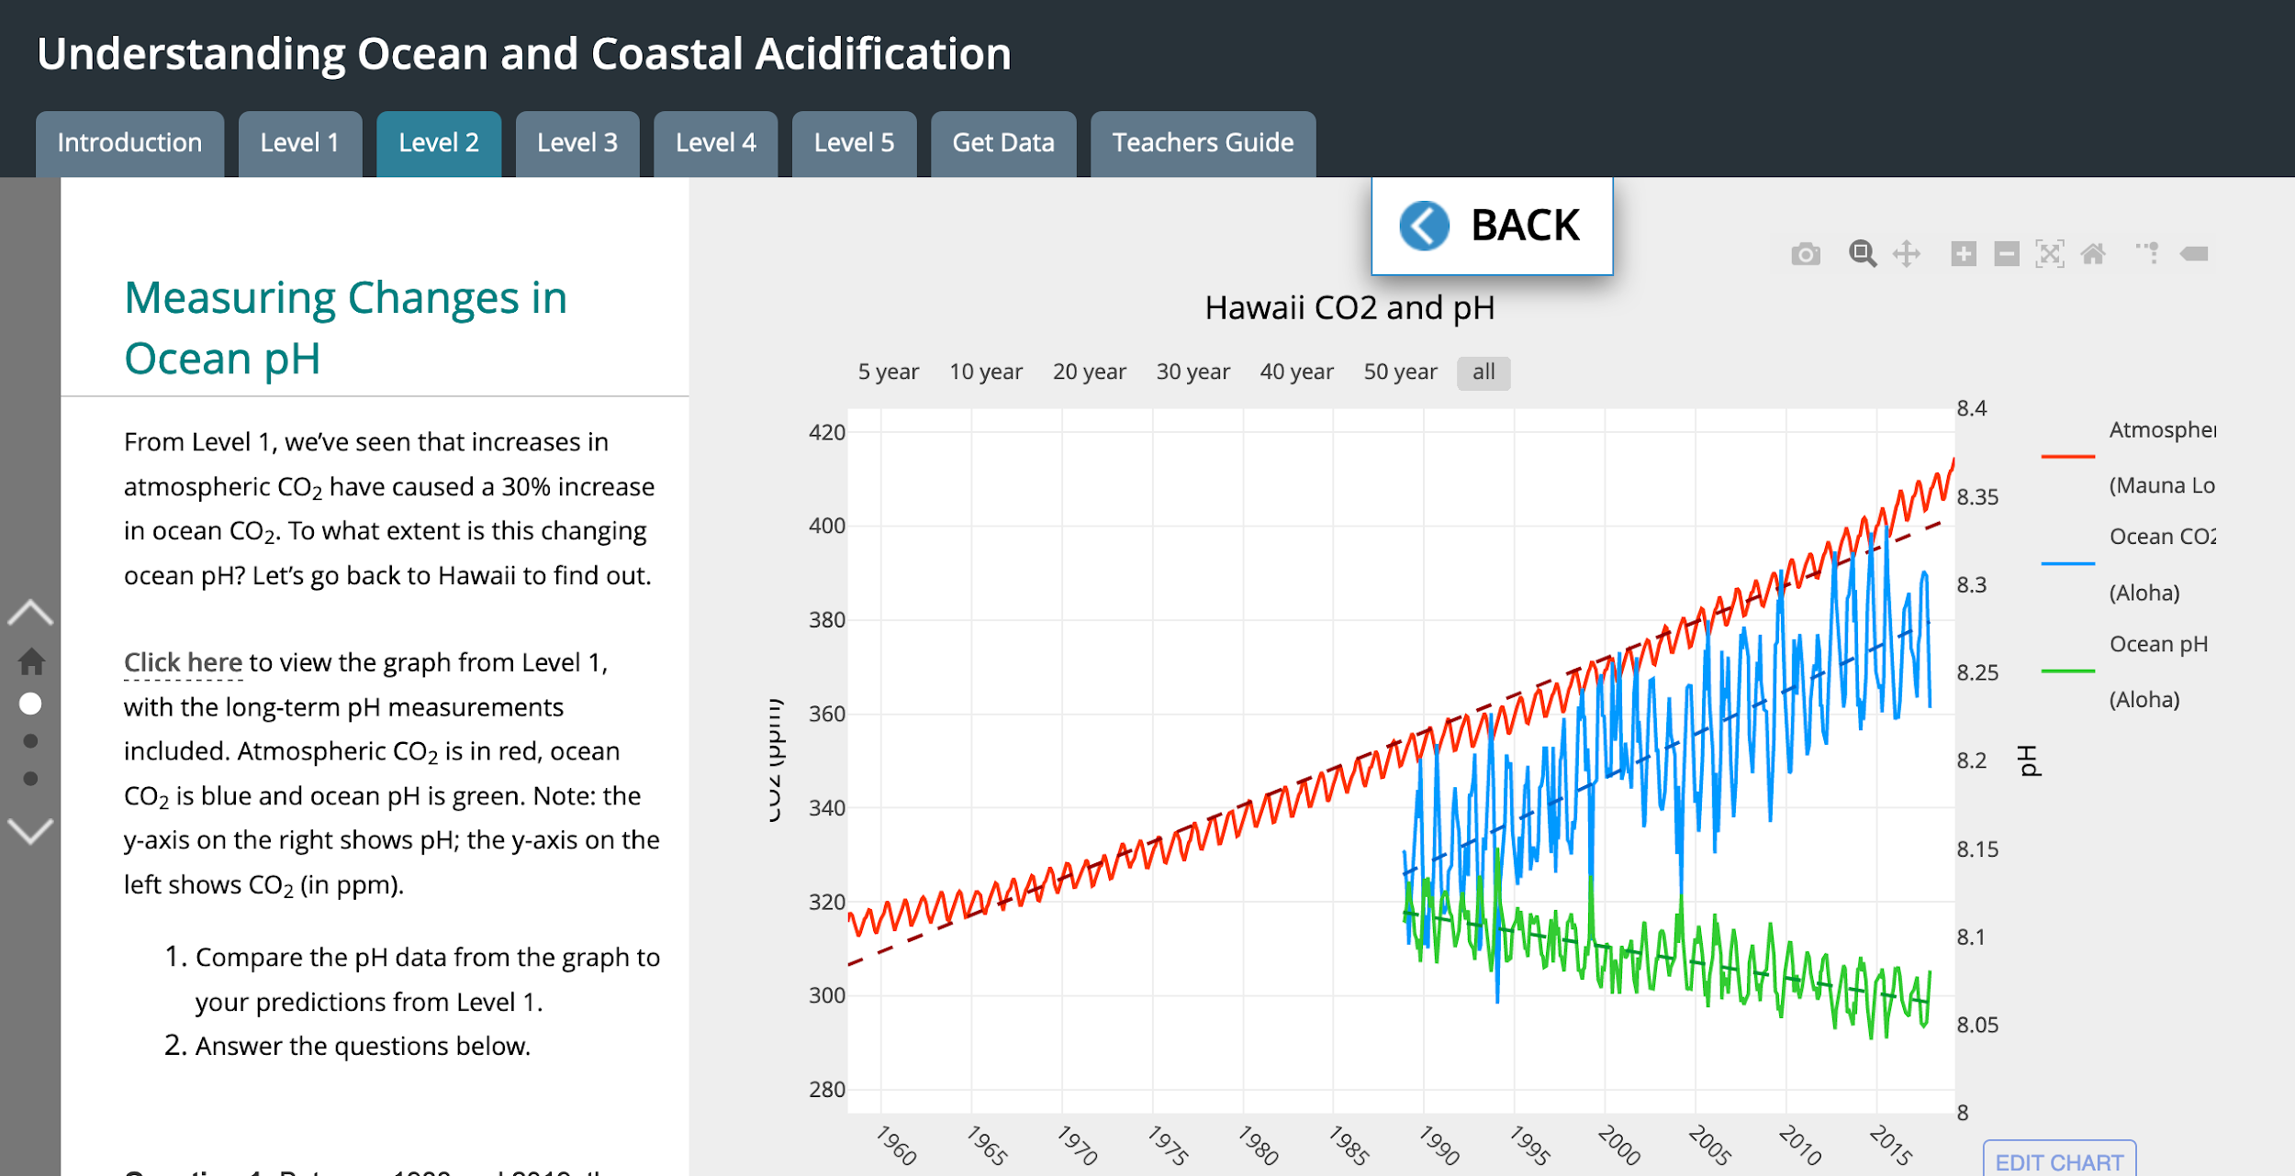
Notes:
Go to live page for Level 2. Point out secondary axis & time series that starts in 1988.
What patterns do you notice?
Two things you might notice: 1) regular short term fluctuations and 2) long-term trend showing decreasing pH.
How much? Only have data from 1988 (not from pre-industrial times) in this data set.

Slide 13
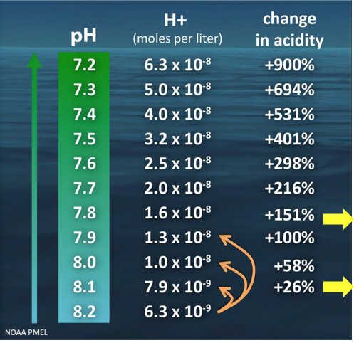
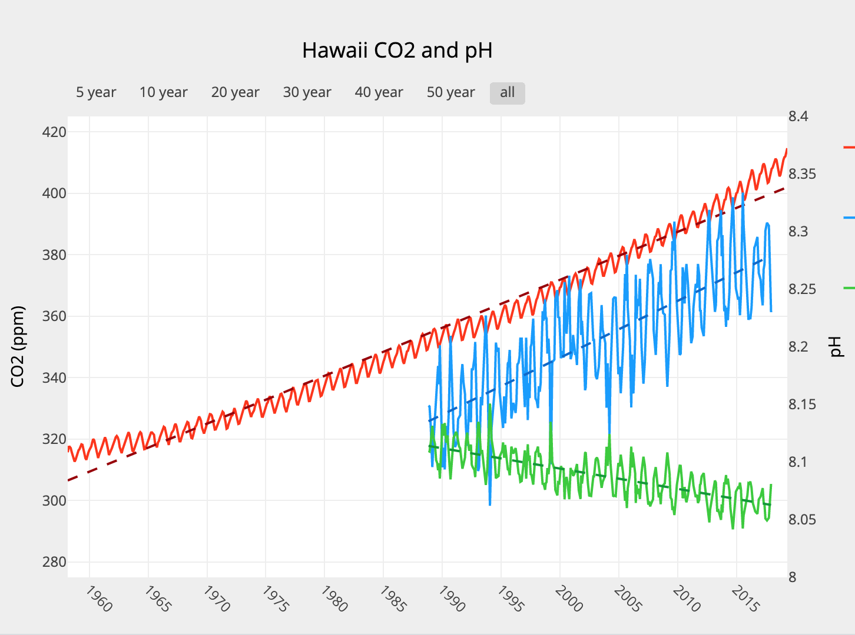
pH Data Summary
The global average pH of the surface ocean has decreased by 0.11
Other ‘fun’ facts:
This tiny change is actually big! Represents a ~ 30% change in acidity.
More changes to come. Models predict by 2100, acidity will ↑150%.
Modelled pH change by 2100
Change since the Industrial Revolution
Feely et al. Oceanography, 2009, www.jstor.org/stable/24861022.
Notes:
Add measurements of CO2 from ocean. These data are from location north of oahu, regularly sampled since 1988.
What patterns do you notice?
similar short and long term trends

Slide 14
AUDIENCE POLL
Ocean acidification – how would you best define it?

Slide 15
How Is Acidification Different Closer to Shore?

Slide 16
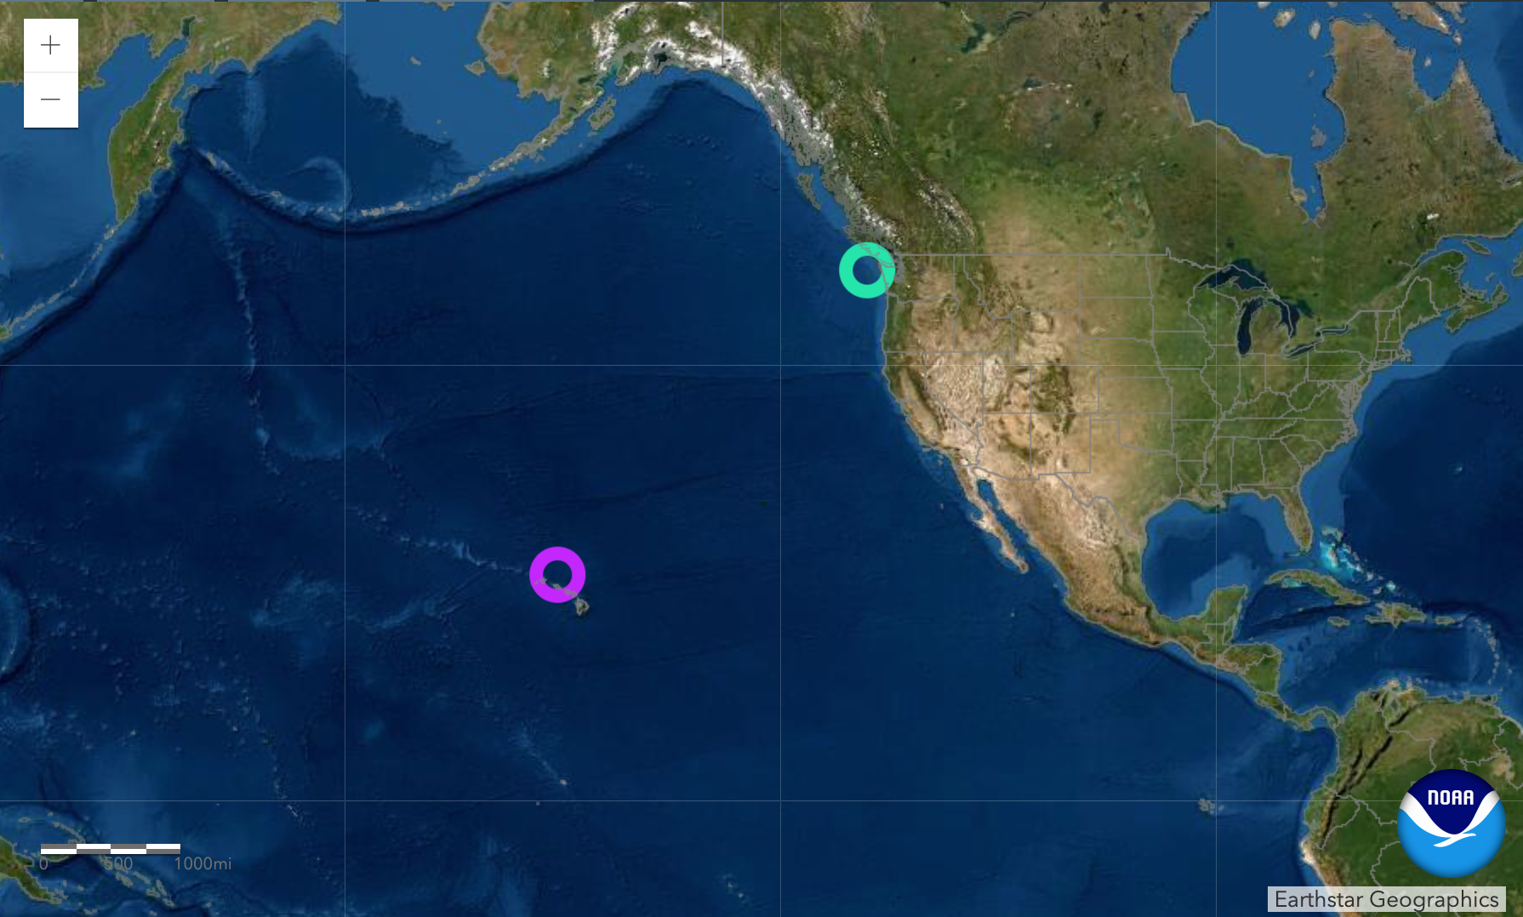
Notes:
Travel from Hawaii to coastal Washington. Investigate whether ocean acidification is occurring in Washington, in the same way that it is in Hawaii.
The data that we are about to look at comes from a mooring. This is one mooring NOAA’s Pacific Marine Environmental Laboratory has established in collaboration with others – and there are many other moorings that have similar data sets that you and your students can access that might be closer to where you live. I’ll show you where you can find these other locations at the end of the webinar.
The coastal ocean pH graphs from these moorings can be tricky to interpret. You have probably noticed that the data has gaps. It’s removed for maintenance during winter months and there are occasional sensor failures. One feature on this graph are two annotated points. Your students can scroll over the points to help get a sense for what might be causing the large seasonal changes in pH. What students are asked to focus on here is the range of values over time series. They are asked to compare this to the range of values in Hawaii over the same time period. So let’s do it.

Slide 17
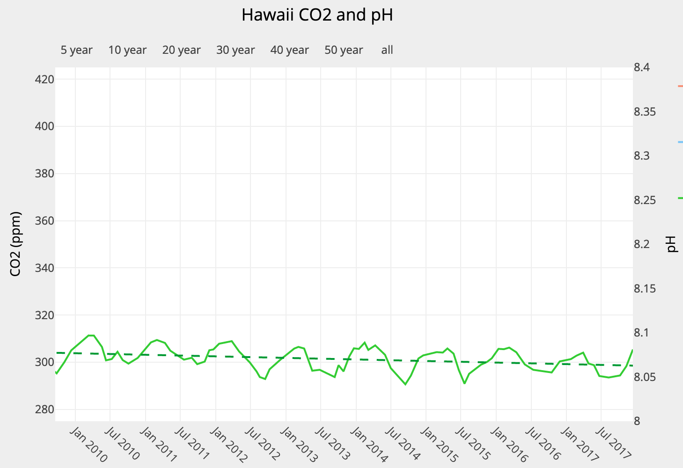
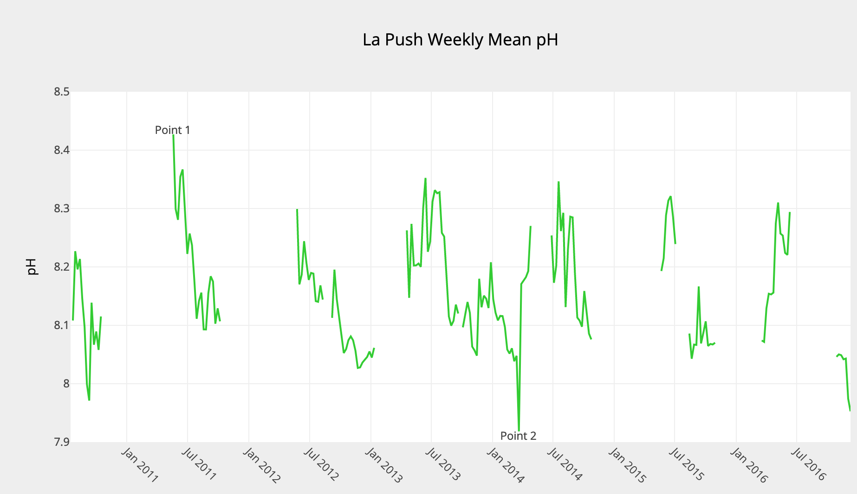
OPEN OCEAN versus COASTAL OCEAN
Range ~ 0.05 versus Range ~ 0.5
Notes:
What’s the difference in range of values over this 7 year period? 10 fold difference in variation in pH.
Students should be able to conclude that ocean pH near the coast of WA is more variable with more extreme seasonal highs and lows in pH.

Slide 18
Coastal pH Data Summary
High variability, large seasonal fluctuations: Range (from 7.9 - 8.4) is 10x greater than in Hawaii.
Causes of extreme variability
Lots of life + upwelling (natural)
Excess inputs of nutrients from shore:
* fertilizers
* wastewater
* animal manure
Long-term trends????? Not enough data ….. yet.
Notes:
Add measurements of CO2 from ocean. These data are from location north of oahu, regularly sampled since 1988.
What patterns do you notice?
similar short and long term trends

Slide 19
AUDIENCE POLL
Coastal acidification – how would you best define it?

Slide 20
How Does Acidification Impact Marine Life?

Slide 21
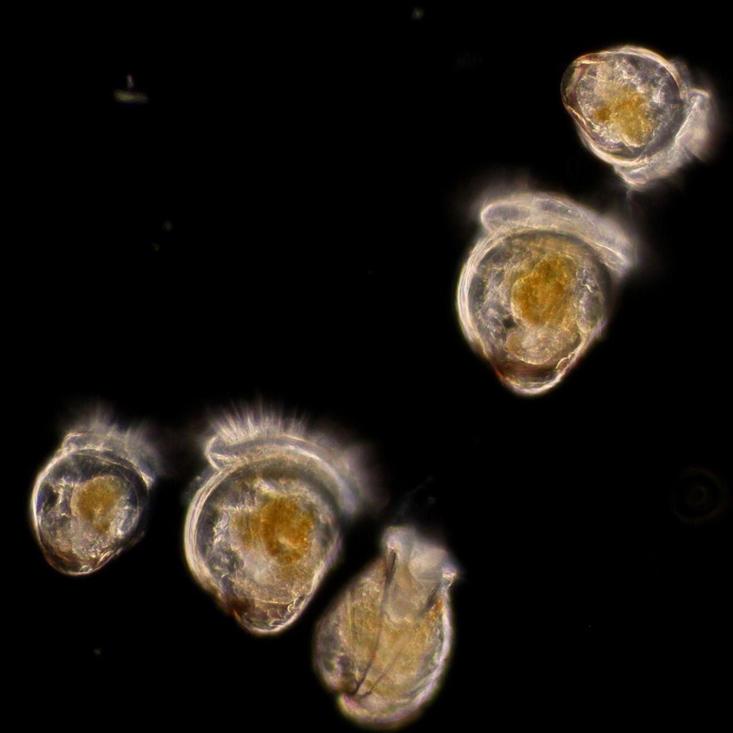
AUDIENCE QUESTION: Type your ideas into the question box
What are the marine organisms shown in the photo?
Photo credit: T.-C. Francis Pan.
Journal of Experimental Biology 2018

Slide 22
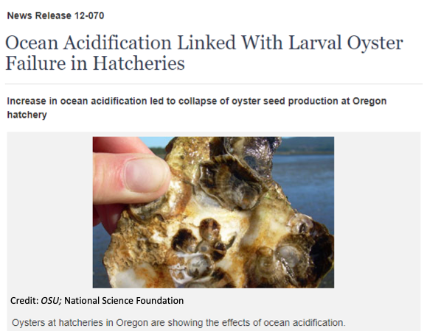
How Does Acidification Impact Pacific Oysters?
In the mid-2000’s, larval “baby” oysters kept dying in shellfish hatcheries along the Pacific Northwest
The cause – low seawater pH!

Slide 23
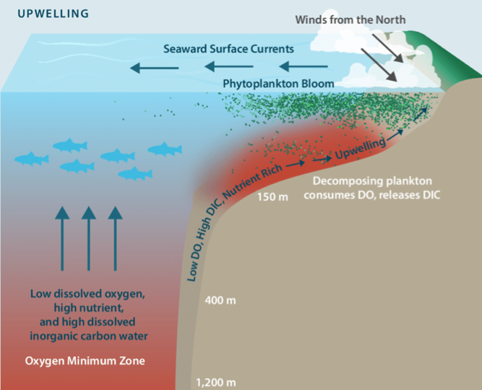
Caused By ….. Upwelled Waters With Low pH
Deep ocean water is already high in dissolved CO₂ and low in pH.
Ocean acidification is starting to make deep water more acidic.

Slide 24
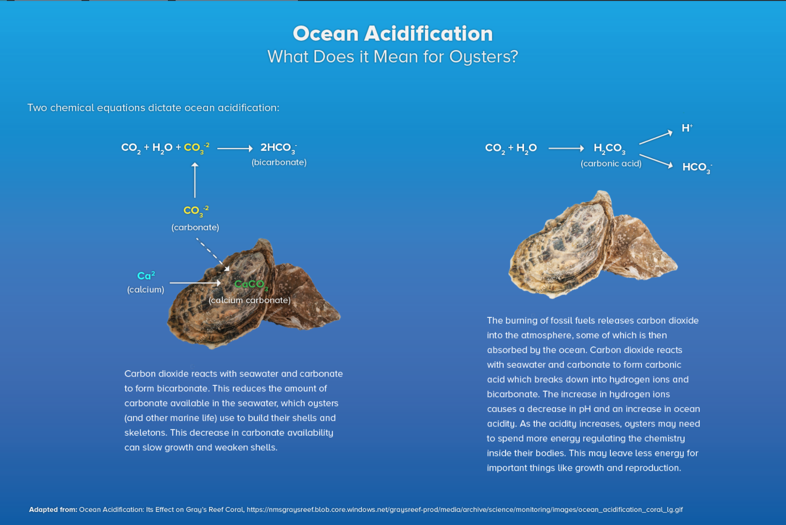
Chemistry of Shell Building
Oysters use a form of calcium carbonate to build shells.
More CO₂ leads to less available carbonate.
Can slow growth & weaken shells.

Slide 25
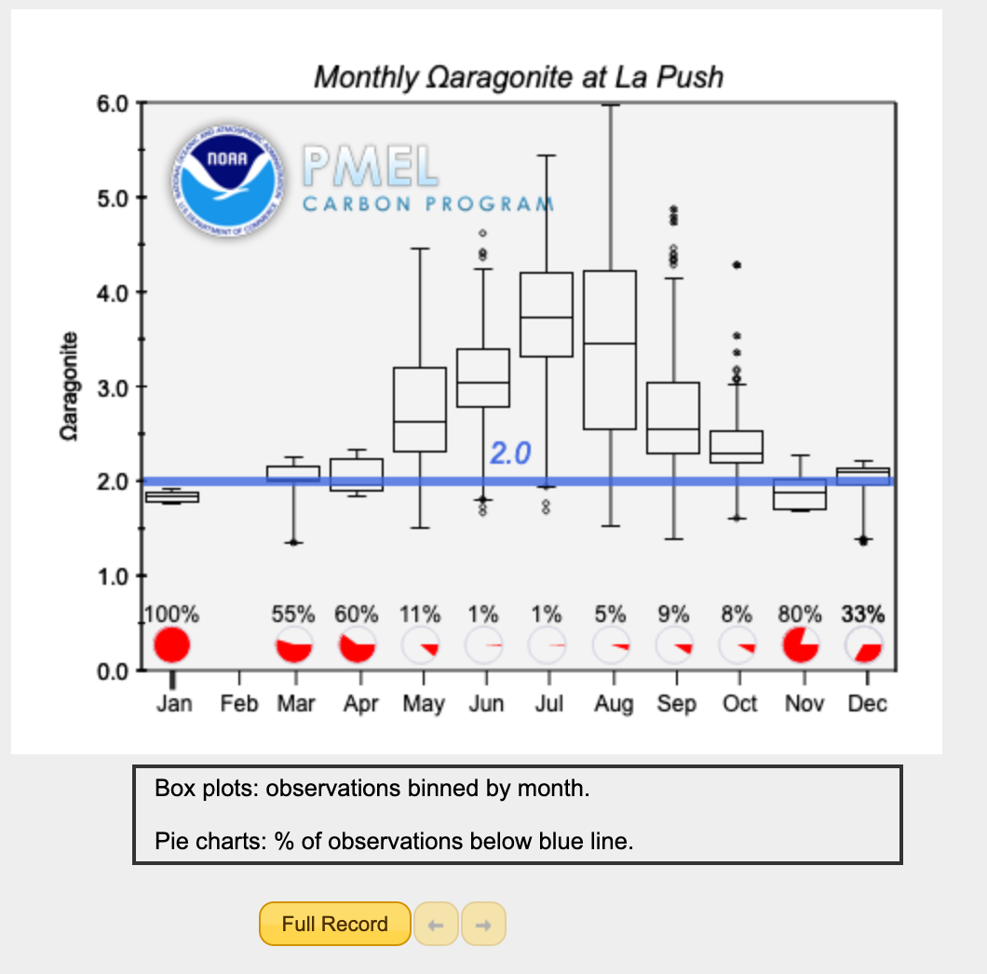
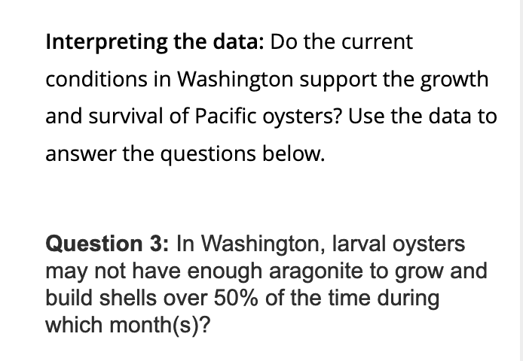
Do the current conditions in coastal Washington support the growth & survival of oysters?
Aragonite saturation state (Ω)
describes the tendency for calcium carbonate to form or to dissolve.
Survival threshold: When Ω is less than 1.5, Pacific oyster larvae can die.
Growth threshold: When Ω is less than 2.0, Pacific oyster larvae have trouble growing and building their shells.
Notes:
It may be that this was happening episodically in the Pacific Northwest & causing the oyster die offs in the hatcheries.
But what can we find out about conditions using data?

Slide 26
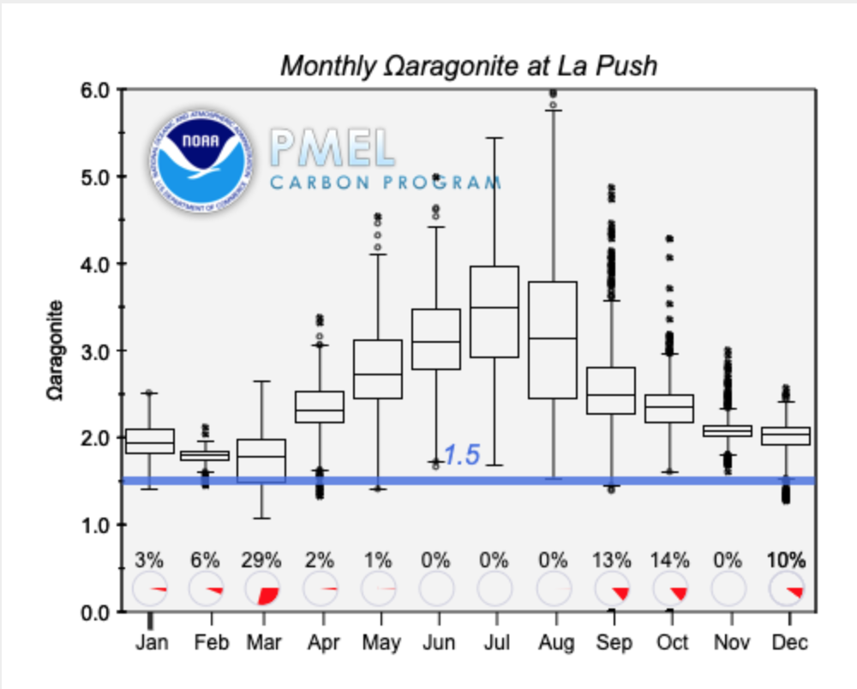
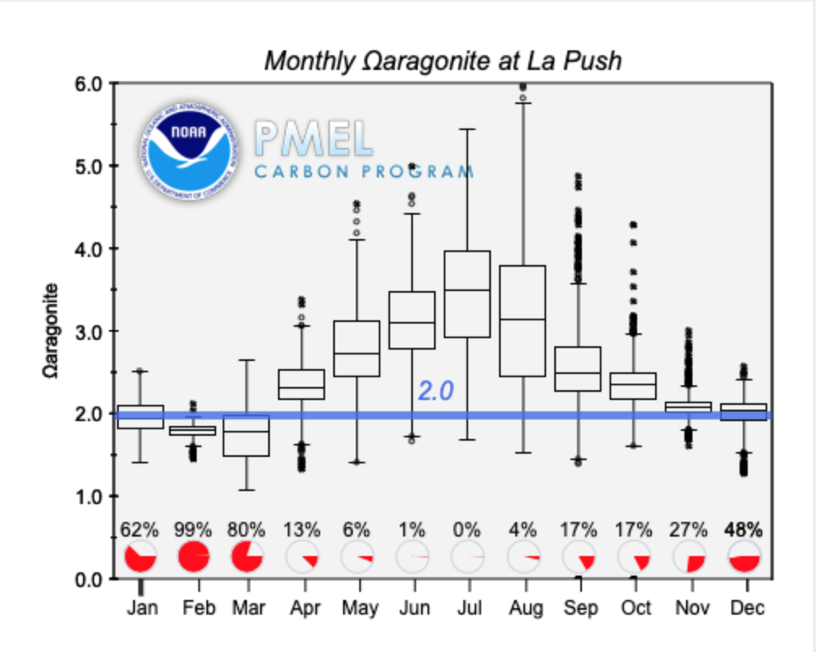
Impacts to Pacific Oysters:
Data Summary
Survival: May be higher mortality during certain times of year (eg March)
Growth:
May grow more slowly. Devote more time building shells; less time for other key activities.
Impacts to Local Economies (eg 270 million in Washington)
Impacts to Ecosystems? (eg disruptions to food webs)

Slide 27
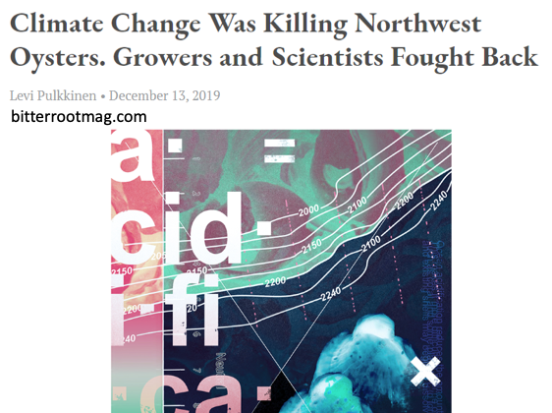
SOLUTIONS? SCIENCE & INDUSTRY PARTNERSHIPS Monitor for pH¹
Add water buffers^{1,2}
Bioremediation³
Develop oysters more resistant to OA effects¹

Slide 28
PART 2: How might you effectively use data in your education activities?
Notes:
Even if you don’t know much about acidification, you likely infer that relates to the changing acidity of the ocean.
Let’s begin our data exploration in the atmosphere.

Slide 29
WHAT IS DATA IN THE CLASSROOM? dataintheclassroom.noaa.gov
Currently 5 MODULES
Coastal & Ocean Acidification
Sea Level
Coral Bleaching
Water Quality
El Niño
Teacher’s Guide
Lesson plans & student worksheets
Web-based Student Activities
Data Tools
Query tools for the creation of maps and graphs
Website
Informational hub for teachers and educators
Resources for Data in the Classroom modules

Slide 30
PEDAGOGY
Invention: Students design their own
investigation.
Levels of scaled interaction
4 Interactivity: Students will access and interpret data to
investigate a question.
Adaptation: Students will apply data skills to examine a question
related to a real ‘data story’
2 Adoption: Teacher-directed activity that applies pre-existing models and
provides practice reading data.
1 Entry: Teacher-led discussion and activity. Basic data & graph interpretation
Notes:
Modules all have the same pedagogical approach. There are 5 scaled levels of interaction in every module, beginning with relatively basic, teacher-led discussion and lessons how to read and interpret graphs. Building towards lessons that challenge students to acces and data to investigate a question, and finally designing their own investigations.
The levels can often stand alone and teachers can engage their students in any one or more of the levels – depending on the teacher’s learning objectives.

Slide 31
Notes:
But first, I want to take you to the DITC website to show you the teaching resources that are available.

Slide 32
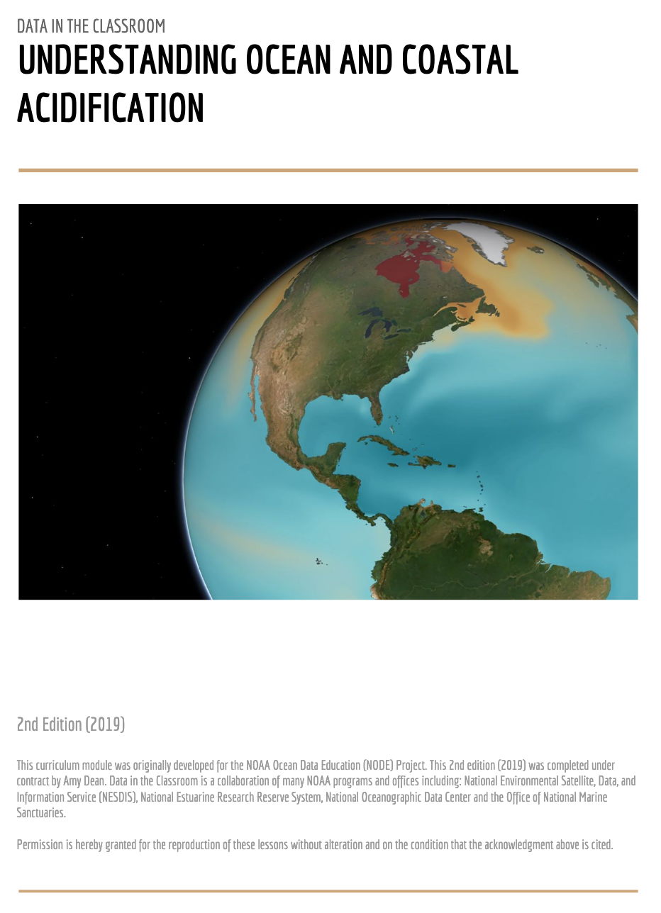
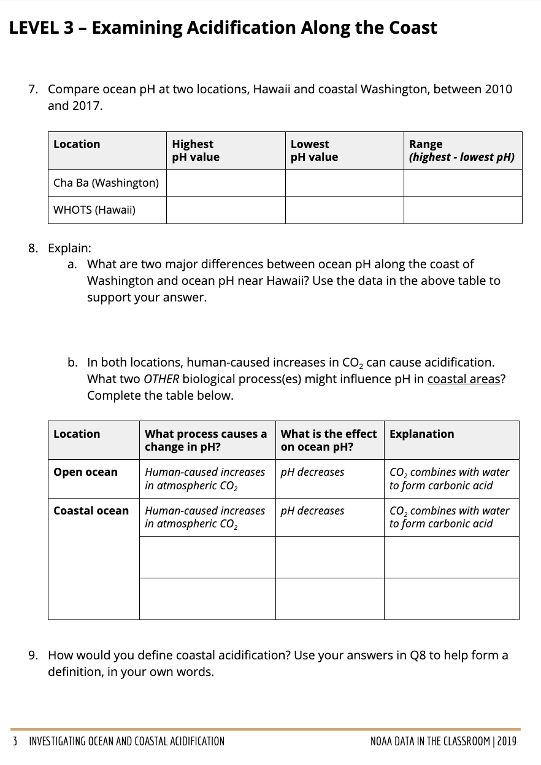
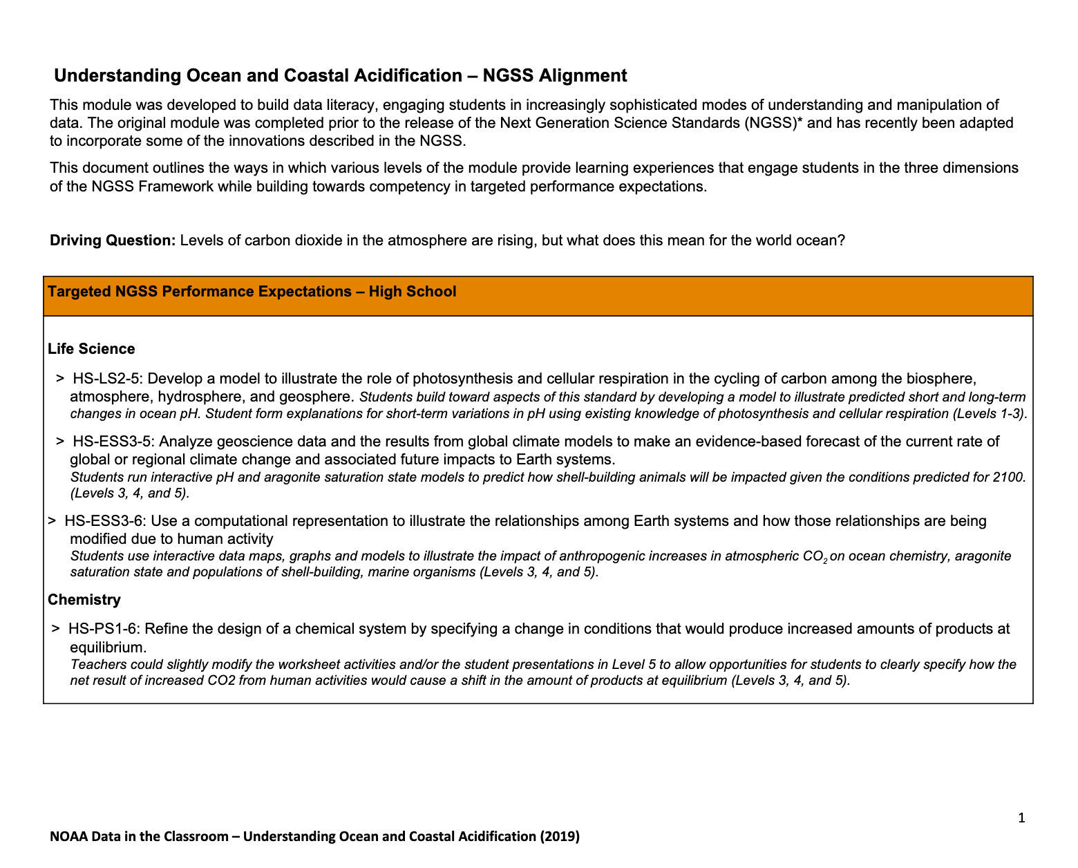
Notes:
There’s a Teachers Guide that contains the lesson plans for each of the 5 levels (right). There are also student paper and pencil worksheets (middle). And alignments to HS NGSS performance expectations (right).

Slide 34
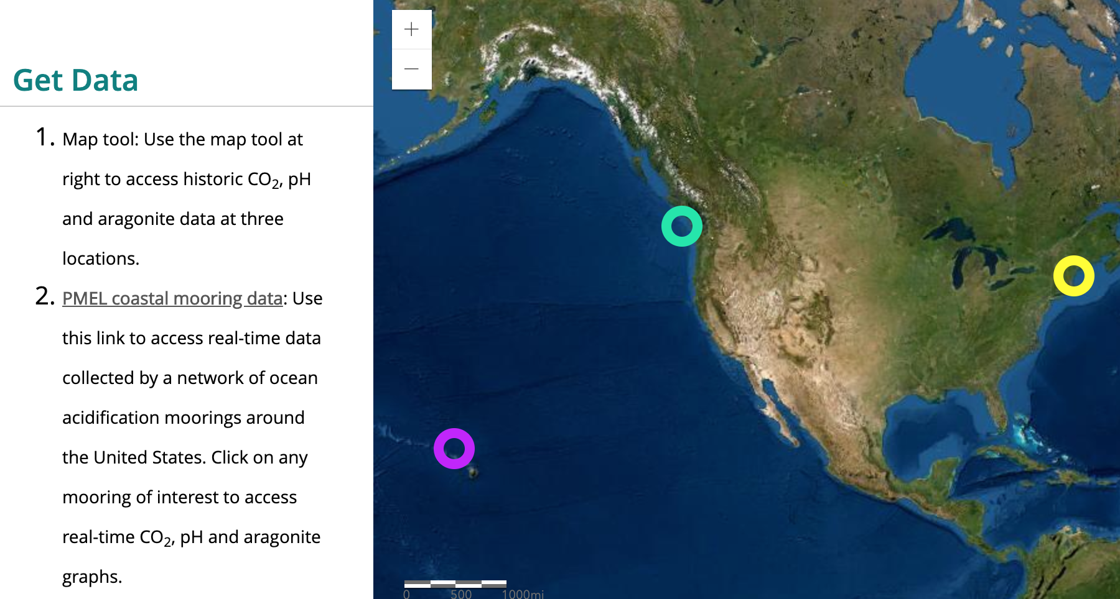
Student Activities
Lesson plans
Access to data tools
Notes:
On the introductory page, you’ll find the guiding question for the module “CO2 in the atmosphere is rising, but what does this mean for the world ocean?” Levels 1-5 contain the student activities. Will show you a sampling of the activities from each level, and we’ll actually do a few together.

Slide 35
Join the Online Community
Notes:
Mention NSTA and upcoming OA webinar in October

Slide 36
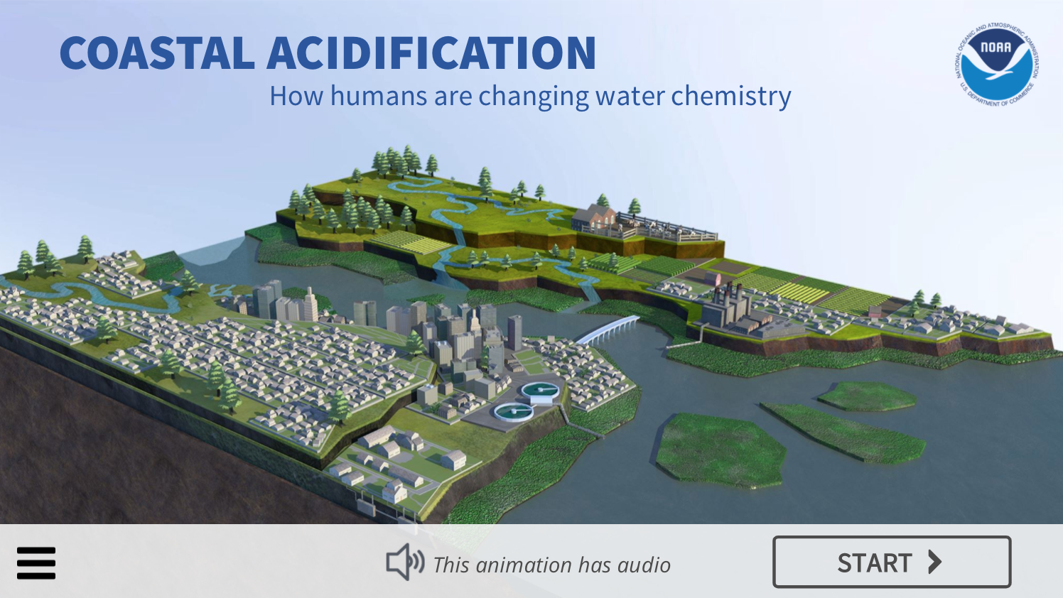
Other Resources
Coastal Acidification Animation:
Causes, effects and solutions related to coastal acidification

Slide 37
QUESTIONS?
Amy Dean: dataintheclassroom@noaa.gov

