Slide 1
Boiling Over: Marine Heatwaves
2019 North Pacific
Marine Heatwave
Dillon Amaya & Mike Jacox
dillon.amaya@noaa.gov
michael.jacox@noaa.gov
@DillonAmaya

Slide 2
Boiling over: Marine heatwaves
What are marine heatwaves and why do they happen?
What marine heatwave research are we doing?
What are the impacts of marine heatwaves?
Can we predict marine heatwaves?
How are marine heatwaves related to climate change?
2019 North Pacific
Marine Heatwave
Dillon
Mike
Dillon Amaya & Mike Jacox
dillon.amaya@noaa.gov
michael.jacox@noaa.gov
@DillonAmaya

Slide 3
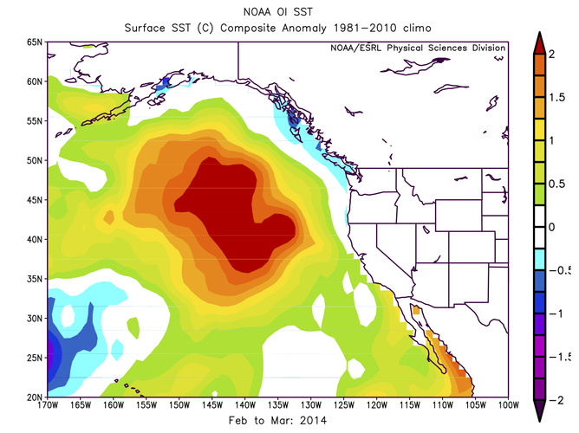
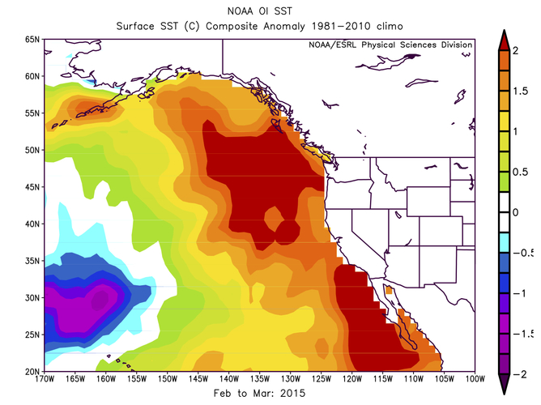
The 2013-2015 North Pacific Warm “Blob”
Feb-Mar 2014
Feb-Mar 2015
Ecosystem impacts of the “Blob”
Extreme ocean warming
(>90th percentile)
Colors: Sea surface temperature anomaly (red = warmer than normal)
Why does the ocean change temperature?
What is a marine heatwave?
Notes:
All the maps I show you today are going to show anomalies – conditions that are warmer or colder than “normal”

Slide 4
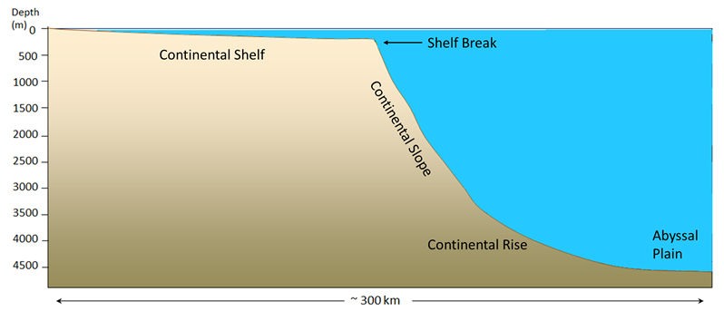
Depends on where in the ocean…
Marine heatwaves happen up here!

Slide 5
Depends on where in the ocean…
Marine heatwaves happen up here!

Slide 6
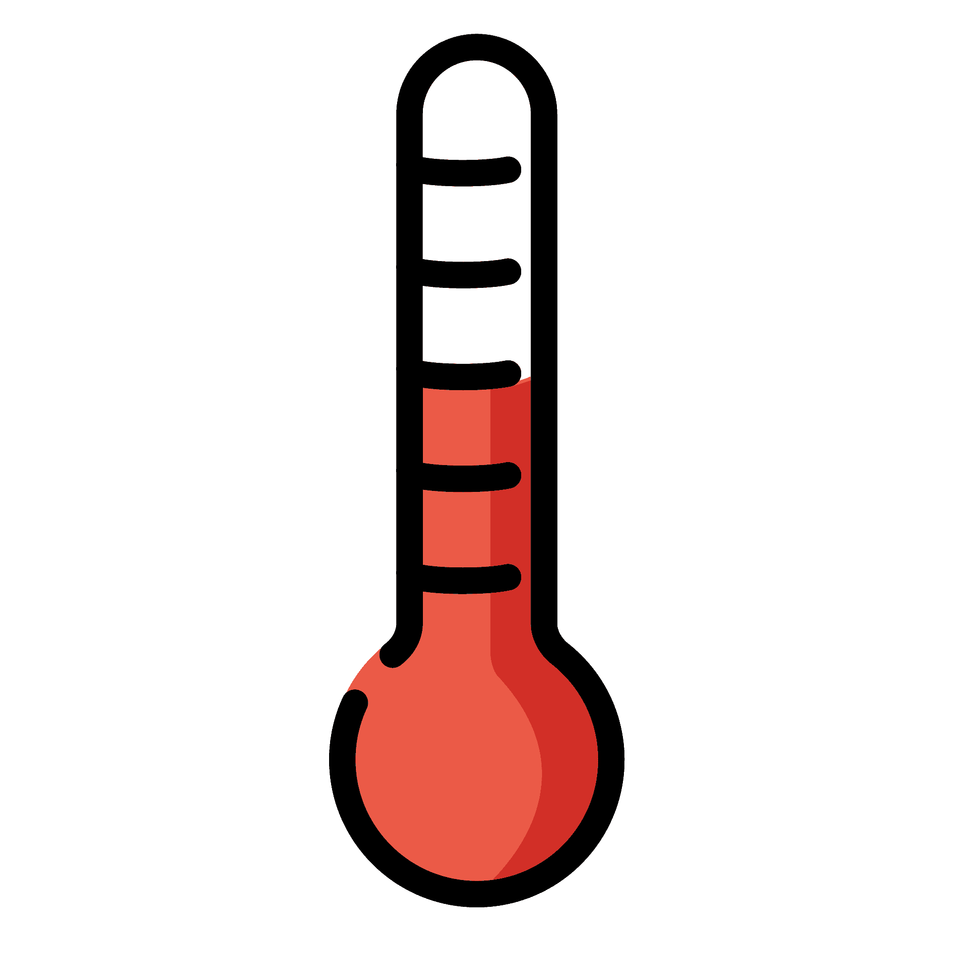
Solar radiation
Sensible heat
Latent heat
0
50
Longwave radiation
Depth (m)
100
Ocean currents move water around
150
200
What is “normal”?
Notes:
What happens normally? Why is the ocean any given temperature?

Slide 7
Solar radiation
Sensible heat
Latent heat
0
50
Longwave radiation
Depth (m)
100
Mixed Layer Depth
Warm upper ocean
Mixed Layer
Mixing
Cold deep ocean
150
200

Slide 8
Solar radiation
Sensible heat
Latent heat
0
50
Longwave radiation
Depth (m)
100
Warm upper ocean
Mixed Layer
150
Mixed Layer Depth
Mixing
Cold deep ocean
200
Notes:
Like adding more water to a pot that you are trying to boil

Slide 9
Solar radiation
Sensible heat
Latent heat
0
50
Longwave radiation
Depth (m)
100
Mixed Layer Depth
Warm upper ocean
Mixed Layer
Mixing
Cold deep ocean
150
200

Slide 10
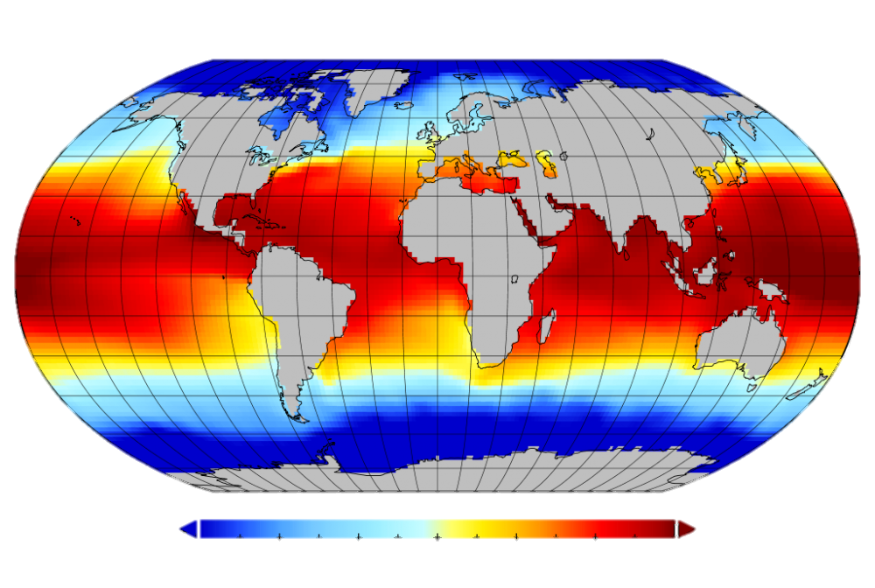
“Normal” surface ocean temperature
32˚F
41˚F
50˚F
59˚F
68˚F
77˚F
86˚F

Slide 11
Solar radiation
Sensible heat
Latent heat
0
50
Longwave radiation
Depth (m)
100
Mixed Layer Depth
Warm upper ocean
Mixed Layer
Mixing
Cold deep ocean
150
200
Change anything here, change ocean temperature

Slide 12
Solar radiation
Weaker winds (than normal)
Fewer low clouds (than normal)
Sensible heat
Latent heat
0
More solar heating
(than normal)
Less cooling from evaporation
(than normal)
50
Longwave radiation
Depth (m)
100
Mixed Layer Depth
Warm upper ocean
Mixed Layer
Mixing
Cold deep ocean
2019 North Pacific Marine Heatwave
150
200
Amaya et al. (2020) Nature Communications

Slide 13
Solar radiation
Weaker winds (than normal)
Fewer low clouds (than normal)
Latent heat
0
More solar heating
(than normal)
Less cooling from evaporation
(than normal)
50
Depth (m)
100
Mixed Layer Depth
Extreme upper ocean warming → marine heatwave
150
2019 North Pacific Marine Heatwave
200
Amaya et al. (2020) Nature Communications

Slide 14
Take-home points:
Physical processes control “normal” upper ocean temperature (radiation, evaporation, currents, etc.)
Changes to any of these processes results in a temperature change
Intense, compounding, and/or prolonged changes to these processes results in extreme temperature changes (i.e., marine heatwaves)

Slide 15
Depends on where in the ocean…
Marine heatwaves happen up here!

Slide 16
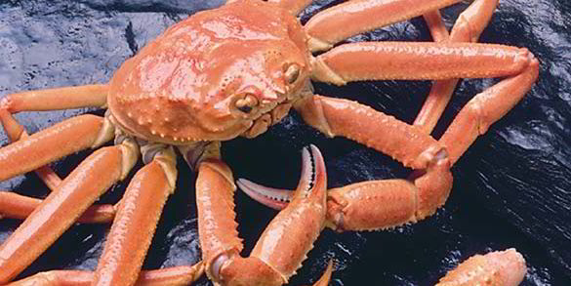
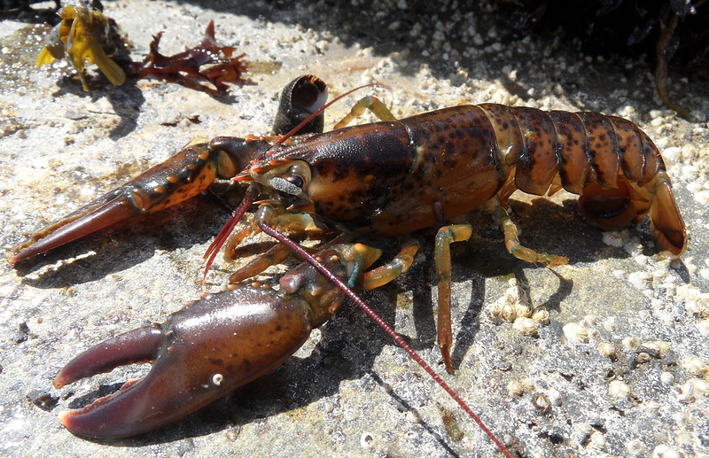
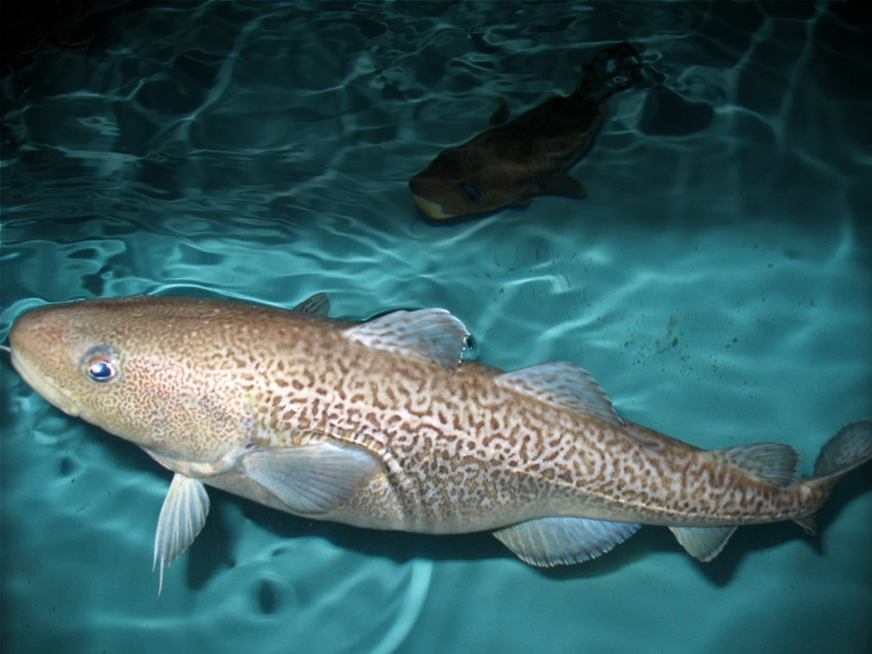
Depends on where in the ocean…
What about marine heatwaves along the coast?
Snow Crab
How do marine heatwaves unfold along the ocean bottom?
Lobster
Pacific cod

Slide 17
Bottom marine heatwaves
North American Shelf Bathymetry
White = deeper than 400m or 1312ft
Amaya et al. (2023), Nature Comm.

Slide 18
Bottom marine heatwaves
Bottom
Marine Heatwave
(BMHW)
Amaya et al. (2023), Nature Comm.
Bottom Temp. Anom. (˚C)

Slide 19
BMHW
avg. intensity
Avg. intensities of 5˚C or 9˚F!
Avg. intensities of 7˚C or 12.6˚F!
Variations with bathymetry
BMHW = Bottom Marine Heatwave
Amaya et al. (2023)
0
1
2
3
4
5
BMHW average intensity (˚C)

Slide 20
BMHW – SMHW avg. intensity
Many locations where avg. BMHW intensity > avg. SMHW intensity
BMHW = Bottom Marine Heatwave
SMHW = Surface Marine Heatwave
Surface warmer
Bottom warmer
Amaya et al. (2023)
-2.5
-2
-1
1
2
2.5
BMHW – SMHW average intensity (˚C)

Slide 21
Boiling over: Marine heatwaves
What are marine heatwaves and why do they happen?
What marine heatwave research are we doing?
What are the impacts of marine heatwaves?
Can we predict marine heatwaves?
How are marine heatwaves related to climate change?
2019 North Pacific
Marine Heatwave
Dillon
Mike
Dillon Amaya & Mike Jacox
dillon.amaya@noaa.gov
michael.jacox@noaa.gov
@DillonAmaya

