Slide 1
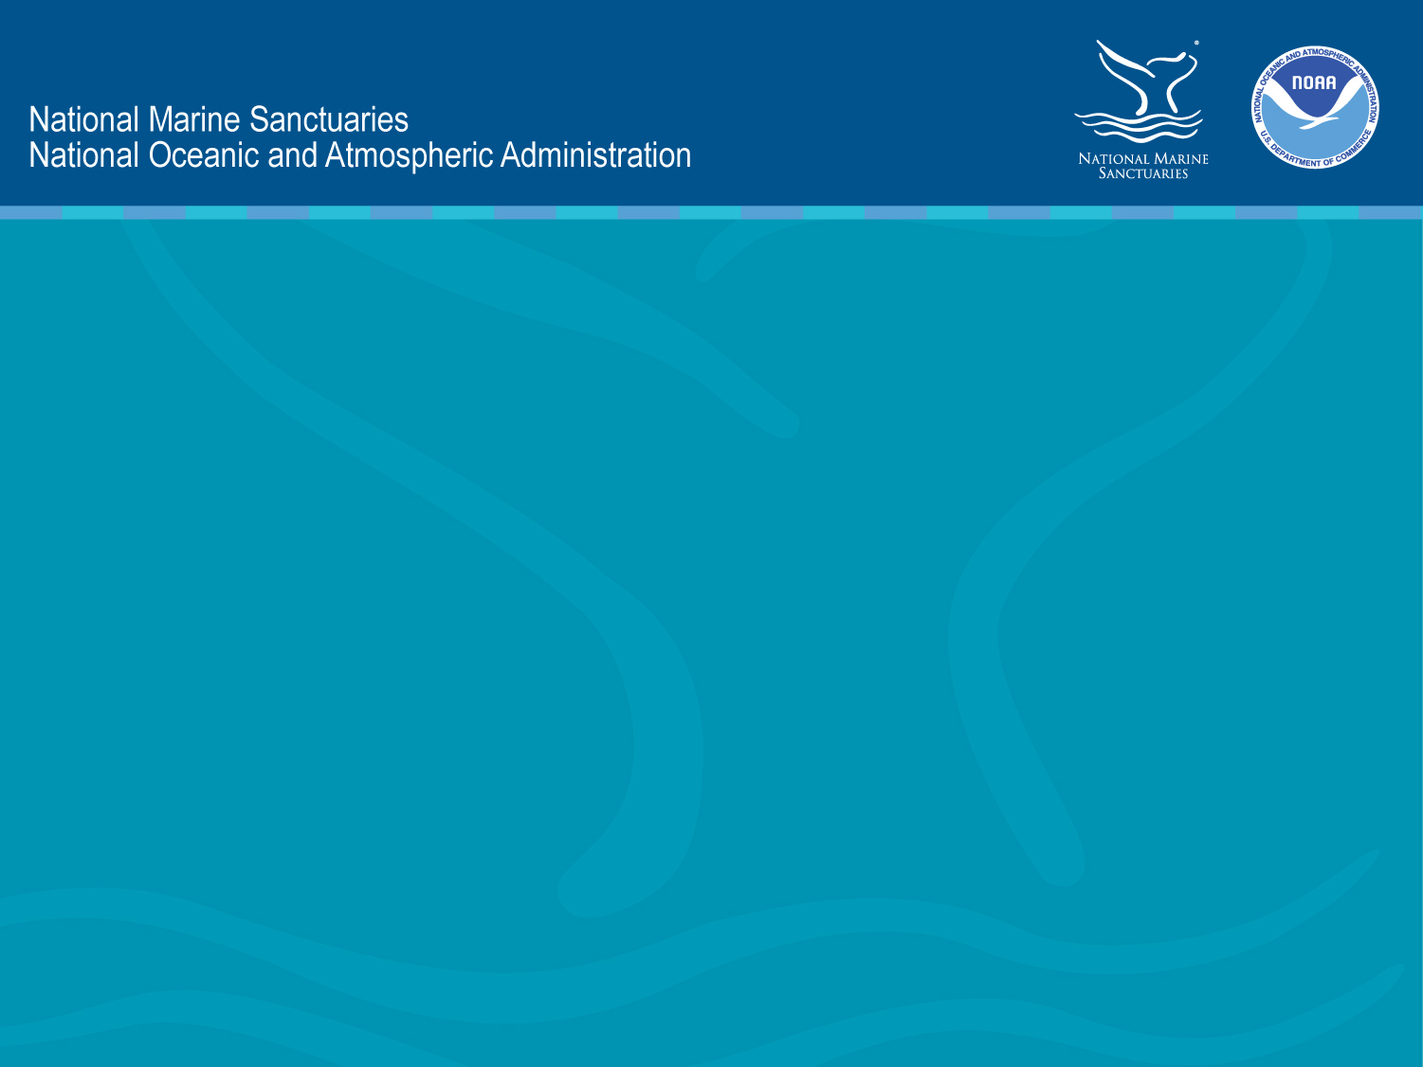
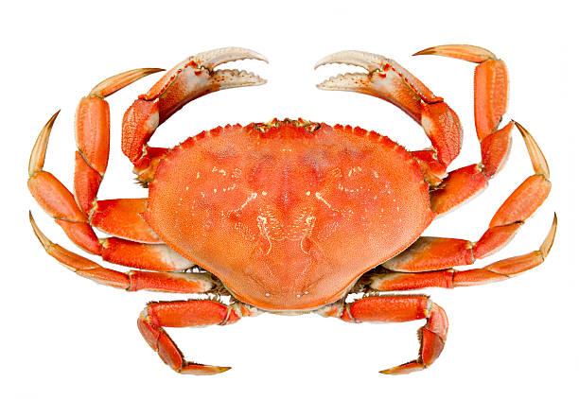
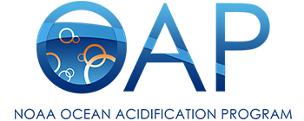
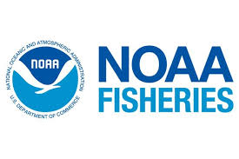
Ocean Acidification Impact on
Dungeness Crabs
A case study examining how ocean acidification affects Dungeness crab
Notes:
This slide show is part of a communication tool kit produced by the West Coast Region Education Team of the NOAA Office of National Marine Sanctuaries. The information presented in these slides and corresponding fact sheet and video sequence were reviewed by NOAA scientists and reflect what we know as of April 2018 about ocean acidification and its impact on Dungeness crab.
Dungeness crab is a valuable species throughout the entire West Coast and throughout the five national marine sanctuaries of the West Coast. Crab are important to the ecosystem and important to humans due to its high food value. Ocean acidification is occurring worldwide, but the West Coast of the United States is seeing advanced conditions due to its oceanographic upwelling system. The West Coast region of the National Marine Sanctuary System is working to inform communities about this impact and encourage participation in solutions to help slow down affects of rampant carbon emissions on ocean ecosystems.
Please feel free to use any and all of this material and credit: NOAA Office of National Marine Sanctuaries

Slide 2
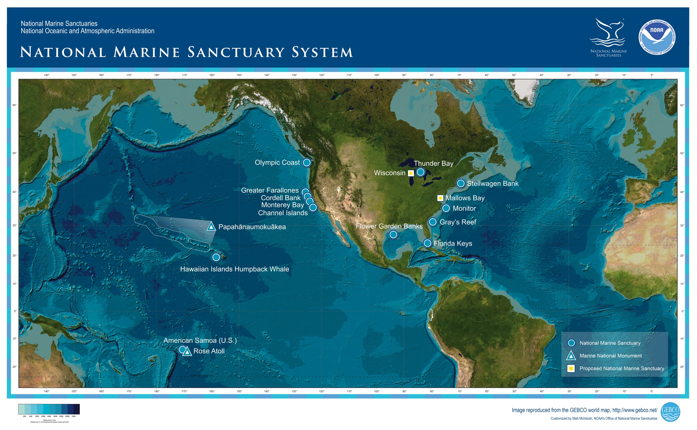
National Marine Sanctuary System
Notes:
National marine sanctuaries are areas of the marine or Great Lakes environment of special national, and sometimes international, significance warranting protection and management under the National Marine Sanctuaries Act. As a steward of coastal and ocean resources, NOAA protects and manages sanctuaries through the Office of National Marine Sanctuaries.
The NOAA Office of National Marine Sanctuaries is a leader in ocean stewardship, conservation, and protection of America’s ocean and Great Lakes treasures for future generations through strong science-based management. National marine sanctuaries protect our nation’s most vital coastal and marine natural and cultural resources. Through active research, management, education, and public engagement, we sustain healthy environments that are foundations for thriving communities and stable economies.
Reference:
https://sanctuaries.noaa.gov/

Slide 3
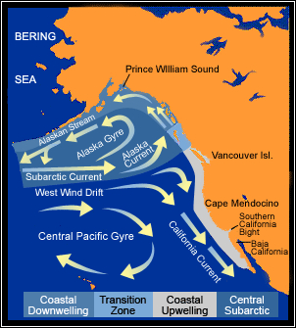
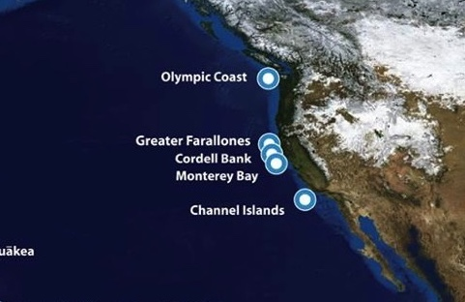
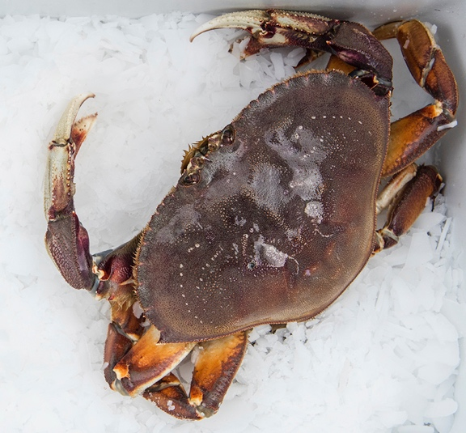
West Coast
National Marine Sanctuaries
Notes:
The national marine sanctuaries along the West Coast are connected by the California Current Large Marine Ecosystem and is one of the most biologically productive ocean environments in the world due to its oceanographic conditions. It also is experiencing advanced ocean acidification conditions due to these oceanographic conditions. Dungeness crab are ecologically, economically, and culturally significant species from Washington to California and are fishery valued at $220M annually. Dungeness crab are vulnerable to the acidifying ocean environment. Follow along to learn more about Dungeness crab and what we currently know about how they respond to low pH conditions.
References:
https://www.dfw.state.or.us/mrp/shellfish/crab/lifehistory.asp
https://wdfw.wa.gov/fishing/commercial/crab/
http://www.adfg.alaska.gov/index.cfm?adfg=dungenesscrab.main
https://www.wildlife.ca.gov/conservation/marine/invertebrates/crabs
https://www.nwfsc.noaa.gov/research/divisions/cb/ecosystem/marineecology/ocean-acidification.cfm
http://westcoastoah.org/wp-content/uploads/2016/04/OAH-Panel-Key-Findings-Recommendations-and-Actions-4.4.16-FINAL.pdf

Slide 4
Ocean chemistry is changing

Slide 5
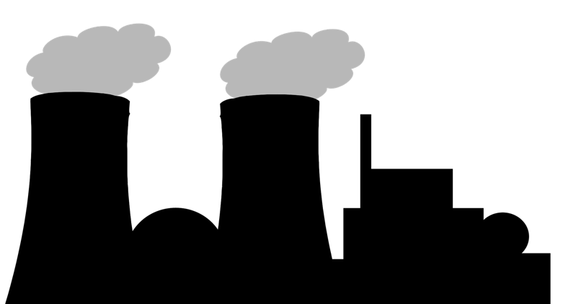


Ocean chemistry is changing
Since the industrial revolution, the concentration of carbon dioxide in the atmosphere has increased due to the burning of fossil fuels such as coal, gas, and oil, along with deforestation.
Notes:
Human activities like deforestation and the burning of fossil fuels change the amount of carbon dioxide in the atmosphere, with fossil fuel burning causing the most change. When we burn fossil fuels like coal, oil, and natural gas to make energy, we add more carbon dioxide into the atmosphere. When we deforest, we reduce the amount of land that can help absorb carbon dioxide from the atmosphere.
Reference:
Le Quere C. et al. (2016) The Global Carbon Budget 2016. Earth System Science Data. DOI:10.5194/essd-8- 605-2016. Retrieved from https://www.earth-syst- sci-data.net/8/605/2016/

Slide 6
Ocean chemistry is changing
Every year the ocean absorbs about 25% of human-caused carbon dioxide emissions, and this is changing the ocean’s chemistry.
Notes:
Every year the ocean absorbs about 25% of human-caused carbon dioxide emissions, and this is changing the ocean’s chemistry.
One way we monitor ocean chemistry change is through pH, a numeric scale based on the amount of hydrogen ions. Because hydrogen ions are tiny and there are many of them, converting to the pH scale makes it easier for us to understand the changes in hydrogen ions.
As carbon dioxide mixes with ocean water, carbonic acid forms and there is an increase in hydrogen ions. On the pH scale, an increase in hydrogen ions converts to a decrease in pH.
References:
Le Quere C. et al. (2016) The Global Carbon Budget 2016. Earth System Science Data. DOI:10.5194/essd-8- 605-2016.
https://www.nwfsc.noaa.gov/research/hottopics/oceanacidification.cfm
http://www.noaa.gov/resource-collections/ocean- acidification

Slide 7
Ocean chemistry is changing
This decrease in ocean pH over time is called ocean acidification.
Notes:
This decrease in ocean pH over time is called ocean acidification.

Slide 8
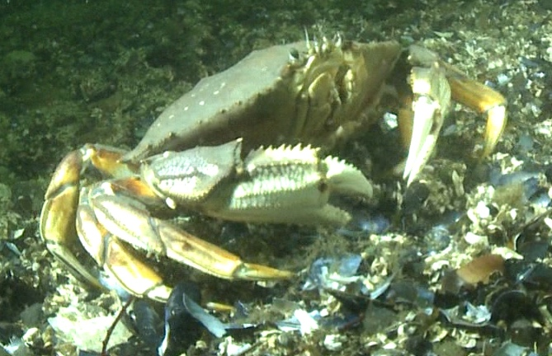
Ocean chemistry is changing
Ocean acidification stresses calcifying animals like the Dungeness crab, making it more challenging for them to thrive.
Photo credit: Paul Hillman, NOAA Fisheries
Notes:
A calcifying animal takes calcium carbonate out of the water it lives in to make its shell. This process requires energy from cells.
Animal (including humans!) cells convert food, and food that our bodies have stored into energy. Energy fuels our cells to be able to do certain things like protect us from infections and viruses, grow, think, breathe, etc. The machines in our cells that convert food molecules into energy can only make so much energy, like how car engines can only burn so much gas over time until they run out and stop working.
Dungeness crabs, like humans, have a limited amount of energy their bodies can produce. A certain amount of energy has to be used for breathing, sensing, and necessary processes for keeping us alive. Environmental stress, like ocean acidification, diverts some of this energy to help an animal survive in a stressful environment.
But it may not leave enough energy, for example, for growth so the animal may no longer grow as big, or for protecting against infection so the animal may become sick more often or not live as long. These are all areas we want to scientifically investigate to understand how the crab will tolerate the changing ocean chemistry.
Reference:
http://www.whoi.edu/website/OCB-OA/FAQs

Slide 9
Dungeness crab are important
Ocean chemistry is changing

Slide 10
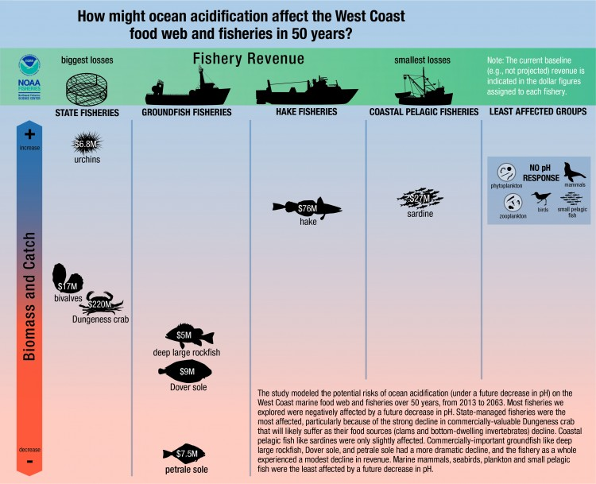
Dungeness crab are
important economically
least
decline
K.N. Marshall et al. 2017 Global Change Biology.
most
decline
Notes:
The figure shows a modeling study by NOAA that looked at how West Coast fisheries might respond to ocean acidification in the future. Animals are plotted in relation to their predicted biomass decline, with the blue area at the top being the least decline and the red area at the bottom being the most decline. The annual revenue in US dollars is superimposed on animals.
While projected dramatic biomass decline was found for ground fish fisheries, the most affected fishery projected was Dungeness crab due to the magnitude of both revenue and biomass loss. The biomass decline in both ground fish and Dungeness crab fisheries was observed because of projected declines in their diet.
References:
Marshall KN, Kaplan I, Hodgson E, Hermann A, Busch DS, McElhany P, Essington TE, Harvey CJ,Fulton, EA (2017) Risks of ocean acidification in the California Current food web and fisheries: ecosystem model projections. Global Change Biology 23:1525-1539.
Milstein, Michael. (2017) Ocean acidification to hit west coast Dungeness crab fishery, new assessment shows. https://www.nwfsc.noaa.gov/news/features/ocean_acidification_west_coast_dungeness_crab_fishery/index.cfm

Slide 11
Dungeness crab are
important economically
Dungeness crabs eat bivalves like clams and mussels, and other bottom-dwelling calcifying invertebrates that also show sensitivity to excess CO₂ exposure in the lab.
Notes:
Dungeness crab prey on clams, mussels, and other bottom dwelling calcifying organisms, which show sensitivity to laboratory ocean acidification conditions. Compounding prey loss and physiological stress from ocean acidification suggest a hard road ahead for the crab.
Reference:
Marshall KN, Kaplan I, Hodgson E, Hermann A, Busch DS, McElhany P, Essington TE, Harvey CJ,Fulton, EA (2017) Risks of ocean acidification in the California Current food web and fisheries: ecosystem model projections. Global Change Biology 23:1525-1539

Slide 12
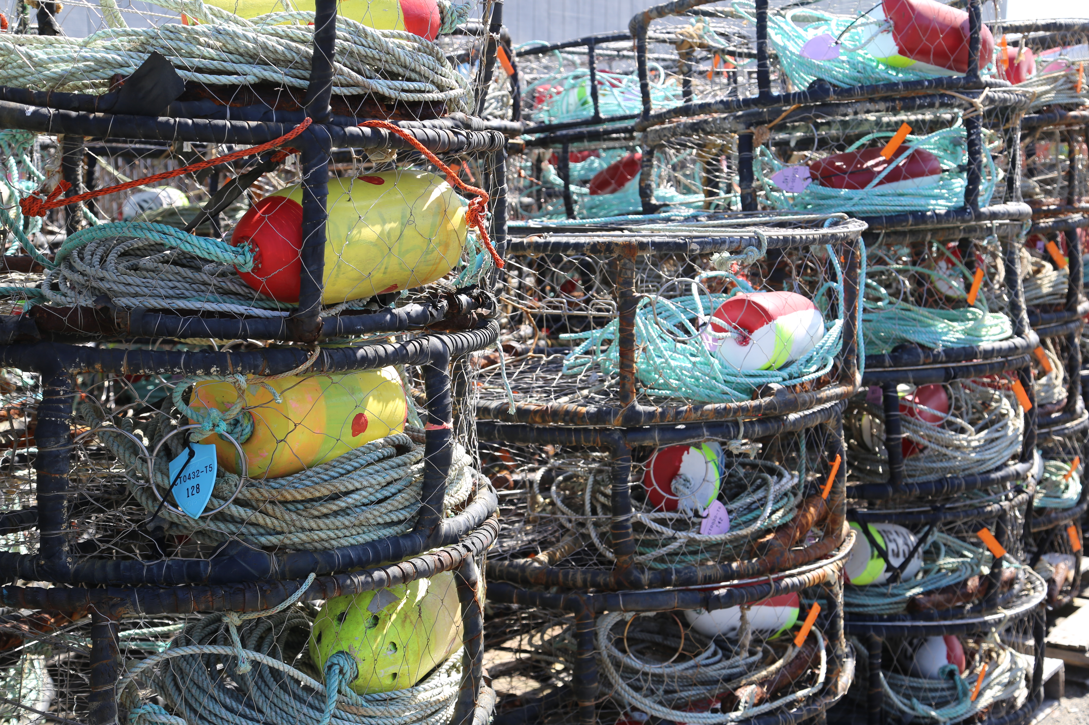
Dungeness crab are
important economically
With less prey available for Dungeness crab, complex modeling projects a decline in Dungeness crab biomass and loss in economic revenue in the next 50 years due to ocean acidification
K.N. Marshall et al. 2017 Global Change Biology.
Photo credit: NOAA/Jennifer Stock
Notes:
NOAA studies show with less prey available for Dungeness crab, complex modeling projects a decline in Dungeness crab biomass and loss in economic revenue in the next 50 years due to ocean acidification
Reference:
Marshall KN, Kaplan I, Hodgson E, Hermann A, Busch DS, McElhany P, Essington TE, Harvey CJ,Fulton, EA (2017) Risks of ocean acidification in the California Current food web and fisheries: ecosystem model projections. Global Change Biology 23:1525-1539

Slide 13
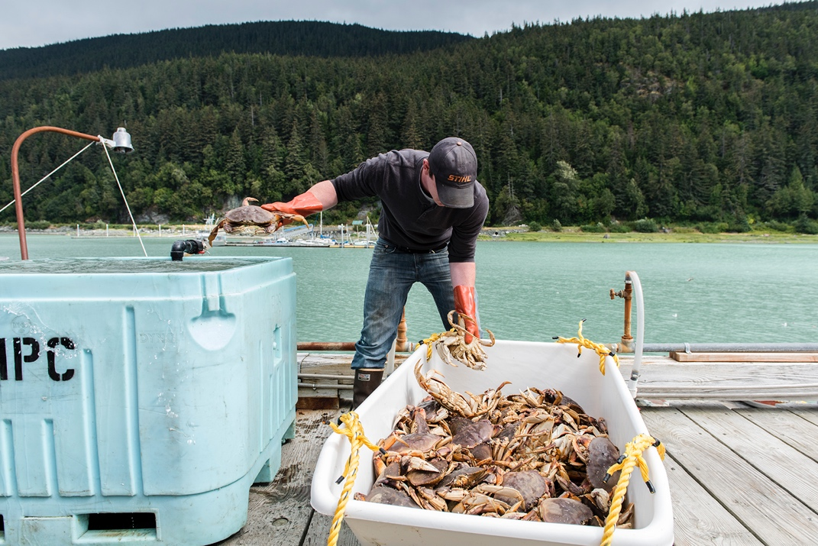
Dungeness crab are
important economically
Dungeness crabs support the jobs and livelihood of many
fishermen, restaurant workers, and seafood retailers.
“Dungeness crab is one of the most valuable commercial fisheries on the West Coast. Crab is the top player if not second to the top fishery for fisherman in California. It has been the only lucrative fishery for 8 or 10 years.”
-- John Mellor, fisherman
Photo credit: Austin Trigg, NOAA Fisheries
Notes:
The next two slides offer a quote from John Mellor, a fisherman, about the value of the Dungeness crab fishery.
References:
Drummond B and Steele S (2015) High Hopes: The future of Dungeness crab. Ocean Conservancy. https://oceanconservancy.org/ocean-acidification/take-deep-dive/high-hopes-future-dungeness-crab/
Milstein, Michael. (2017) Ocean acidification to hit west coast Dungeness crab fishery, new assessment shows. https://www.nwfsc.noaa.gov/news/features/ocean_acidification_west_coast_dungeness_crab_fishery/index.cfm

Slide 14
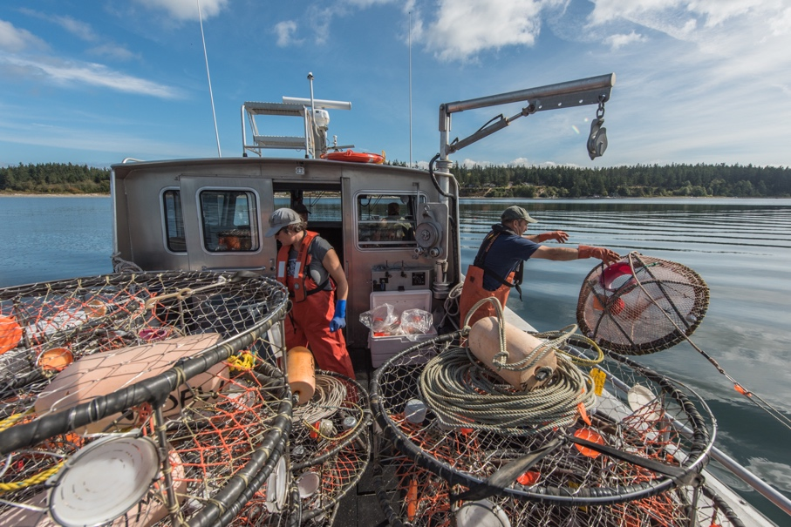
Dungeness crab are
important economically
Dungeness crabs support the jobs and livelihood of many
fishermen, restaurant workers, and seafood retailers.
“If crabs were to disappear from the picture, it would be the end of my fishing career at this point, and I think that a lot of other fisherman on the west coast would be in the same boat. I think you’d see a mass die off of the fishing industry. My whole life depends on there being a healthy crab fishery.”
-- John Mellor, fisherman
Photo credit: Austin Trigg, NOAA Fisheries
Notes:
This slide continues John Mellor’s quote about the value of the Dungeness crab fishery.
Reference:
Drummond B and Steele S (2015) High Hopes: The future of Dungeness crab. Ocean Conservancy. https://oceanconservancy.org/ocean-acidification/take-deep-dive/high-hopes-future-dungeness-crab/

Slide 15
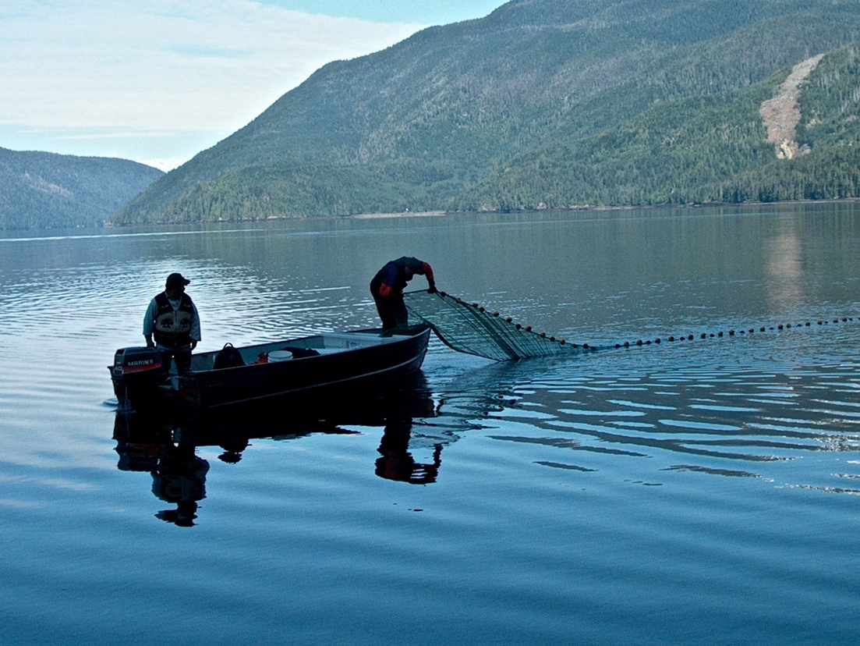
Dungeness crab are
embedded in culture
West Coast tribal Dungeness crab fisheries provide food,
income, and communal activity for many Native Americans.
“My son, David, has been on my boat since he was 8 years old. Being able to spend summers with him is a big thing for our family.”
-- Cliff Prince, Jamestown S'Klallam Tribe, Washington
NOAA Fisheries West Coast
Notes:
This slide offers a quote from fisherman, Cliff Prince from the Jamestown S'Klallam Tribe in Washington state.
References:
http://old.seattletimes.com/html/outdoors/2002049590_nwwdungeness30.html
De la Harpe, J (2013) Geoducks, crabs and sea slugs for food and profit. Indian Country Today https://newsmaven.io/indiancountrytoday/archive/geoducks-crabs-and-sea-slugs-for-food-and-profit-lsVwwV7AXESrPJNW-WAlTA/

Slide 16

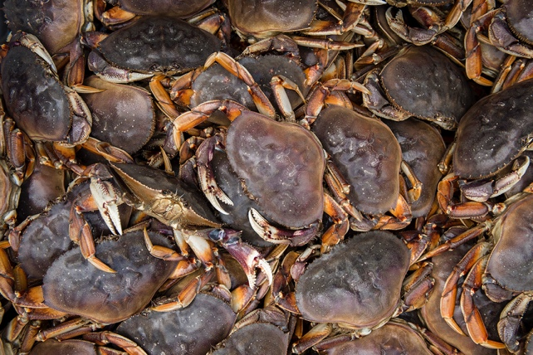
Dungeness crab are
embedded in culture
“Most of the money I’ve ever had came from crabbing. I learned about work from going out with my dad, getting up at 4 in the morning and getting home at 7 pm at night. It’s the kind of thing that’s shaped a lot of my life. It’s a few thousand hours I wouldn’t have had otherwise (with my dad), being out there every day. (For the tribe, Dungeness crab is) life, meaning everything. It’s what you’ve got, it’s that and fish, and it’s why we’re still here. Going out on the water to get fish and crab, it’s what sustained the tribe back as far as anyone can remember. ”
-- David Prince, Jamestown S'Klallam Tribe, Washington
NOAA
Austin Trigg, NOAA Fisheries and National Marine Sanctuaries
Notes:
This slide offers a quote from David Prince, Cliff Prince’s son from the previous page’s quote.
References:
http://old.seattletimes.com/html/outdoors/2002049590_nwwdungeness30.html
De la Harpe, J (2013) Geoducks, crabs and sea slugs for food and profit. Indian Country Today https://newsmaven.io/indiancountrytoday/archive/geoducks-crabs-and-sea-slugs-for-food-and-profit-lsVwwV7AXESrPJNW-WAlTA/

Slide 17

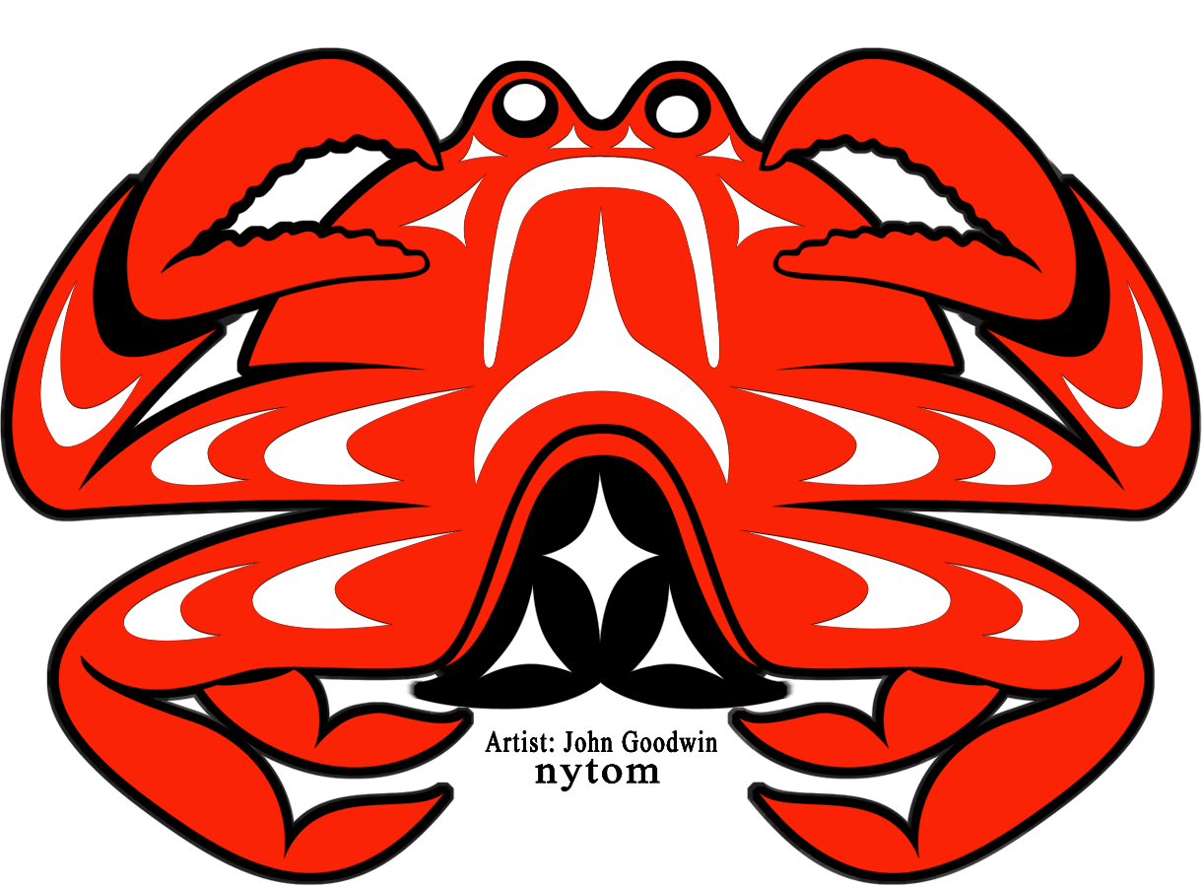
Dungeness crab are
embedded in culture
"In the old days, before the world came to be the way it is today, a giant crab blocked the entrance to the bay. This prevented the people living nearby from making use of their accustomed fishing grounds.
“A physically weak boy who lived in the village set out to outsmart the crusty crustacean.
"He saw the giant crab there, and he sneaked along the ocean floor in a way so that the crab was unable to see him. By doing this, he was able to attack the crab from behind, rendering the huge and fearless creature powerless. After having chewed up the monstrous crab, he spit the pieces into the bay, saying: 'May these pieces turn into small crabs, and be a means of livelihood to all the people in the future.’ ”
Dungeness Crab Festival, Artist: John Goodwine “Nytom”
  -- Indian legend, narrated on a plaque at a Highway 101 turnout on the Jamestown S'Klallam Reservation, overlooking Sequim Bay, Washington
Notes:
Dungeness crab have been a valuable specific for many cultures including our indigenous populations that depend on food from the ocean. Legends and stories include the value of the crab and show how important they are to people.
References:
http://old.seattletimes.com/html/outdoors/2002049590_nwwdungeness30.html
De la Harpe, J (2013) Geoducks, crabs and sea slugs for food and profit. Indian Country Today https://newsmaven.io/indiancountrytoday/archive/geoducks-crabs-and-sea-slugs-for-food-and-profit-lsVwwV7AXESrPJNW-WAlTA/

Slide 18
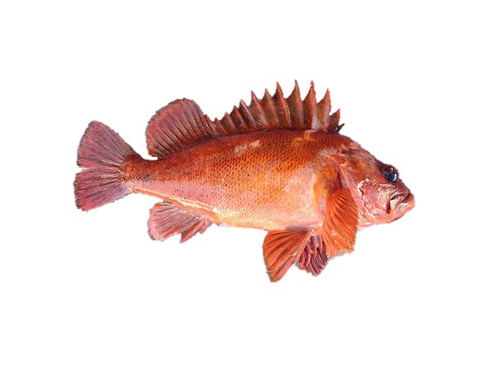
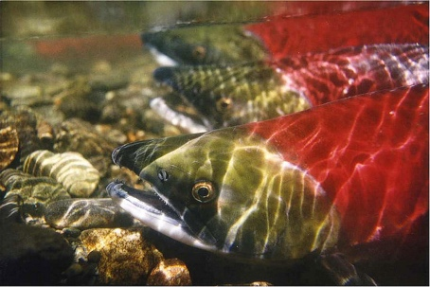
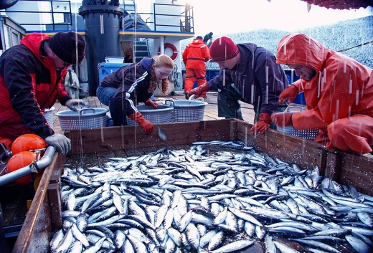
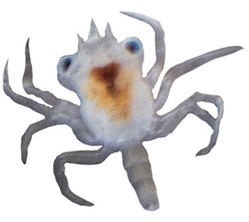
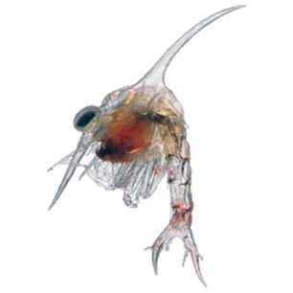
Dungeness crab are
important ecologically
Dungeness crab, especially during their larval stage, are a major food source for many fish species.
Sockeye Salmon (2015)
NOAA Fisheries West Coast
Copper Rockfish (2015)
NOAA Fisheries West Coast
Herring from Alaska trawl (2004)
David Csepp, NOAA Fisheries West Coast
Will these fish be affected by a potential decline in Dungeness crab?
Dungeness crab
megalopa larvae
Dungeness crab
zoea larvae
Notes:
Many fish species including salmon, rockfish, and herring have been found with bellies full of crab larvae (1,2). Research is ongoing to understand how a potential decline in the Dungeness crab population might impact other fish species.
References:
Rasmuson, L. K. The Biology, Ecology and Fishery of the Dungeness crab, Cancer magister. Adv. Mar. Biol. 65, 95–148 (2013).
Kemp, I.M., Beauchamp, D.A., Sweeting, R., Cooper, C., 2013. Potential for competition among herring and juvenile salmon species in Puget Sound, Washington. North Pacific Anadromous Fish Commission Technical Report No. 9: 139-143.

Slide 19
How will ocean acidification affect Dungeness crab?
Ocean chemistry is changing
Dungeness crab are important

Slide 20
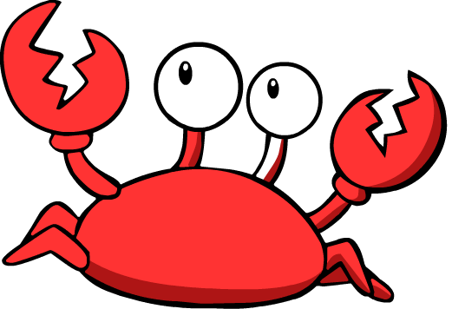
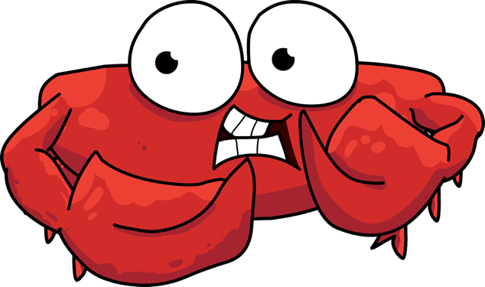
Will Dungeness crab be able to tolerate global ocean change?
Like humans, crabs are sensitive to environmental conditions. When pushed beyond their limits, they can become stressed.
Notes:
Hyperthermia is when their body temperature becomes too warm because water temperatures are higher than their bodies can normally tolerate. Acidosis is when their body pH drops below what their normal physiology can properly buffer, and sea water at pH 7.4 has shown to induce acidosis in crabs in laboratory experiments. Hypoxia is when there isn’t enough oxygen in the water for the crabs to breathe, and can lead to die offs of crab. Over the last 150 years, the global average pH of the surface ocean has decreased by 0.11, which corresponds to approximately a 30% increase in the hydrogen ion concentration. Over the next 80 years (by 2100), the ocean pH is projected to decline by 0.2-0.3. The pH scale is logarithmic, meaning that an increase or decrease of a whole number is actually a tenfold change in hydrogen ion concentration.
References:
McLean, KM and Todgham, AE (2015) Effect of food availability on the growth and thermal physiology of juvenile Dungeness crabs (Metacarcinus magister). Conservation Physiology 3:10.1093/conphys/cov013
De Wachter B and Wilkens JL (1996) Comparison of temperature effects on heart performance of the Dungeness crab, Cancer magister, in vitro and in vivo. The Biological Bulletin 190:385-395.

Slide 21
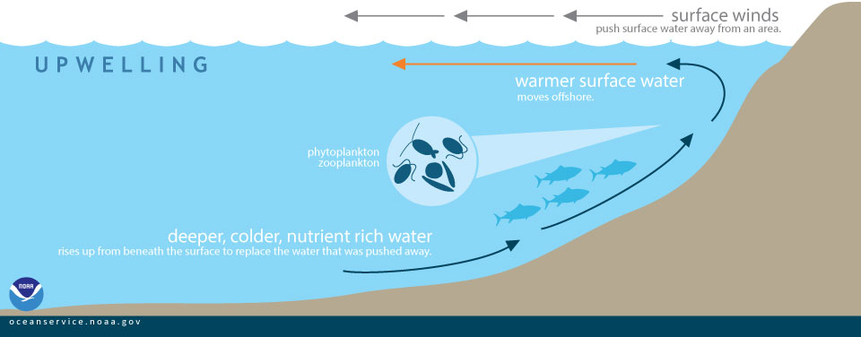
How will ocean acidification affect Dungeness Crab?
• Dungeness crab are commonly found from Alaska to southern California
• They live in seagrass beds or on the sandy ocean floor commonly from the seashore to over 300 feet deep
• The Pacific Northwest coast is naturally more acidic than other coastal regions
• Regional wind currents cause local upwelling of seawater high in CO₂ and low in pH
• Ocean acidification in this region will lead to more extreme conditions
CO₂ from
the
atmosphere
Notes:
Dungeness crab are commonly found from Alaska to southern California. They live in seagrass beds or on the sandy ocean floor commonly from the seashore to 300 feet deep (refs 1-4). The Pacific Northwest coast is naturally more acidic than other coastal regions (refs 5-7) . Regional wind currents cause local upwelling of seawater high in CO₂ and low in pH. Deep ocean water that gets upwelled is rich in nutrients and in CO₂ because it collects waste from animal processes (i.e. digestion and respiration). Ocean acidification in the Pacific Northwest will lead to more extreme conditions for crab.
References:
http://www.dfw.state.or.us/mrp/shellfish/crab/lifehistory.asp
http://wdfw.wa.gov/fishing/commercial/crab/
http://www.adfg.alaska.gov/index.cfm?adfg=dungenesscrab.main
https://www.wildlife.ca.gov/conservation/marine/invertebrates/crabs
https://www.nwfsc.noaa.gov/research/divisions/cb/ecosystem/marineecology/ocean-acidification.cfm
https://cen.acs.org/articles/91/i12/Acidic-Ocean-Hits-Pacific-Northwest.html
http://oceantippingpoints.org/oyster-pacific-northwest-usa

Slide 22
Will Dungeness crab be able to tolerate global ocean change?
Crabs are most likely vulnerable during these stages.
Molting from one stage to the next and carrying fertilized eggs require a lot of energy, as does dealing with stress from ocean chemistry change.
Life cycle of the Dungeness crab. Life stages and stage duration noted in outer circle. Seasonal abundance noted in Inner circle.
Notes:
Will crabs be able to divert energy to dealing with ocean acidification stress without compromising developmental and physiological processes?
Scientists think that crabs are most vulnerable to ocean acidification during larval stages because they are under pressure to grow bigger so they don’t get eaten. The pressure to grow does not leave much wiggle room to deal with other pressures like ocean acidification and this is why crab larvae are thought to be most vulnerable.
Research in NOAA labs is beginning to show that low pH conditions can negatively impact Dungeness crab larvae. Other Dungeness crab life stages may also be vulnerable to ocean acidification, but have not yet been tested.
References:
http://www.whoi.edu/website/OCB-OA/FAQs
http://www.dfw.state.or.us/mrp/shellfish/crab/lifehistory.asp

Slide 23
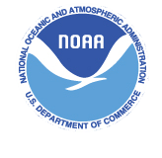
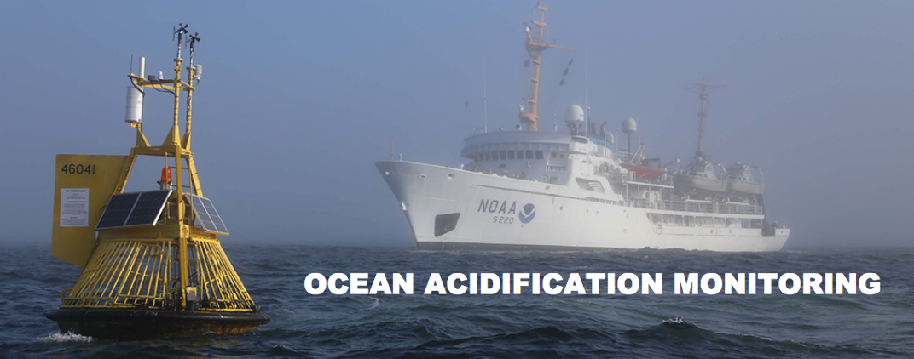
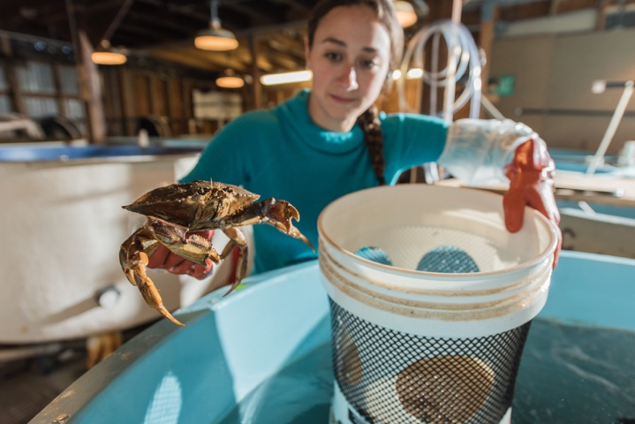
NOAA studies global ocean change
National Oceanic and Atmospheric Administration
NOAA supports global ocean change research by:
Extensive ocean chemistry monitoring through a national buoy system and research cruises.
Providing grants and fellowships that support global ocean change research.
Operating NOAA national science center laboratories and staffing top-tier scientists that conduct field and laboratory research to understand how global ocean change is affecting ecosystems and animals.
Global ocean change effect on Dungeness crabs is being studied at the NOAA Northwest Fisheries Science Center in Washington state.
Ongoing Dungeness crab ocean acidification research at the Northwest Fisheries Science Center Mukilteo Research Station
Photo credit: Austin Trigg, NOAA Fisheries
Notes:
23
NOAA studies global ocean change by conducting:
Extensive ocean chemistry monitoring through a national buoy system and research cruises.
Providing grants and fellowships that support global ocean change research.
Operating NOAA national science center laboratories and staffing top-tier scientists that conduct field and laboratory research to understand how global ocean change is affecting ecosystems and animals.
Global ocean change effect on Dungeness crabs is being studied at the NOAA Northwest Fisheries Science Center in Washington state.
References:
Global Ocean Acidification Observing Network. (2017). [Interactive map of global ocean acidification monitoring sites September 5, 2017]. GOA-ON Data Portal. http://portal.goa-on.org/Explorer
https://www.pmel.noaa.gov/co2/story/Ocean+Acidification
https://oceanacidification.noaa.gov

Slide 24
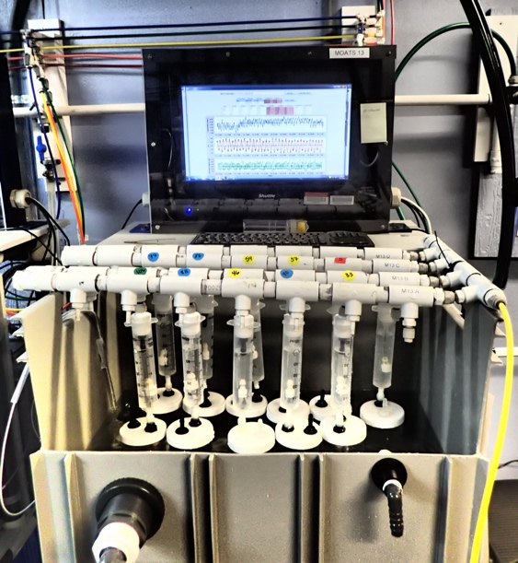
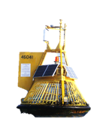

NOAA field and laboratory experiments
Field Experiments
Laboratory Experiments
compare crab population that live in environments that differ in pH
• track how individual crabs respond
• fine-tuned control over pH,
temperature, dissolved gases, etc.
Photo credit: Austin Trigg, NOAA Fisheries
MOATS: Mobile Ocean Acidification Treatments Systems
Notes:
24
We can study how crabs are dealing with ocean chemistry change by doing field experiments comparing populations that grow in environments that differ pH like the Hood Canal in Washington compared to Southern California. We can do this by using data from buoys that monitor pH to determine the different pH ranges that the populations are exposed to.
Because there are many differences between these regions besides pH (like temperature, dissolved oxygen, types of pollution in the area, etc.), it is helpful to also do laboratory experiments where these types of differences can be eliminated.
Laboratory experiments are also very helpful in tracking how individuals respond, where in nature it is very hard to keep track of one crab as it may wander away at will and/or lose its tracking device.
Reference:
http://www.noaa.gov/resource-collections/ocean-acidification

Slide 25
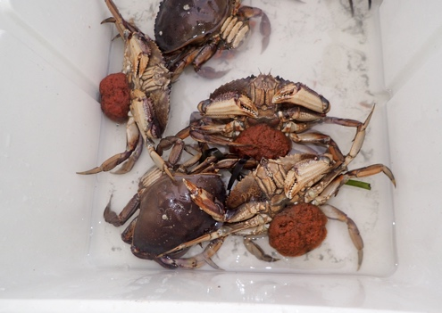
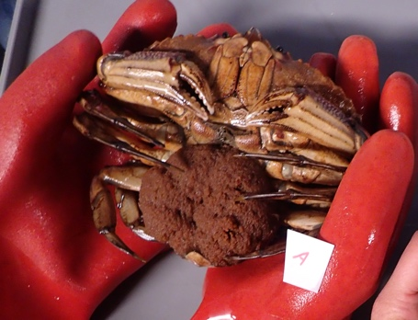
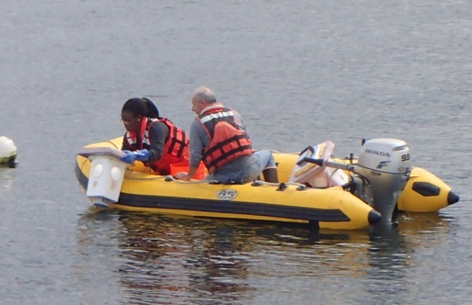
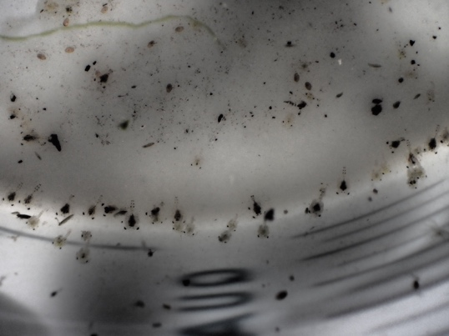
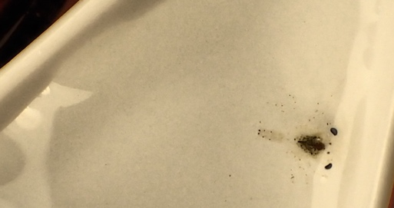
NOAA CO₂ sensitivity experiments to assess Dungeness crab response
1) Collect crabs
Egg-bearing females – January 2017
Megalopa catch – June 2017
Photo credits: Austin Trigg, NOAA Fisheries
Notes:
25
Some NOAA laboratory experiments include looking at crabs that are developing from larvae. The reason these life stages are being primarily studied now is because during these stages of development the crab undergoes big, energy-demanding, transformational changes. Notice the different appearances between the zoea, megalopa, and juvenile. Larvae undergo an entire body shape change, where as once they get to the juvenile stage, their body shape stays more or less the same.
We want to know if crabs are stressed by a high CO2 environment, will they still have enough energy to develop and transition from larvae to juvenile crab.
Reference:
https://www.pmel.noaa.gov/co2/story/Ocean+Acidification

Slide 26
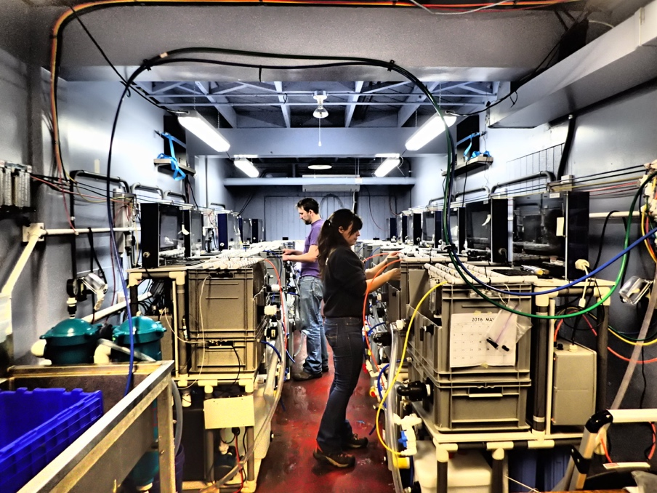

An ocean time machine
2) Rear larvae in lab simulated ocean acidification conditions
MOATS = Mobile Ocean Acidification Treatment Systems
• MOATS act as an ocean time machine, where past, current, and future ocean chemistry conditions can be simulated over a period of time.
• Observations can then be made, like counting the number of surviving crabs in each condition.
NOAA scientists at Mukilteo Research Station
Each jar contains 1 megalopa, or 1-5 zoea
Photo credit: Austin Trigg, NOAA Fisheries
Notes:
One laboratory method that we use for simulating different ocean pH conditions is called MOATS (Mobile Ocean Acidification Treatment Systems). Crab larvae can be held in individual jars and be exposed to the same conditions, except NOAA scientists can adjust the pH, dissolved gases, and temperature of each system.
This allows NOAA scientists to precisely study how each larvae does when held under current and future ocean conditions. After crabs are held under treatment for a length of time, NOAA scientists can compare the number of crabs that survived or died.
Reference:
https://oceanacidification.noaa.gov/WhatWeDo/EducationOutreach/SOARCEWebinars/TabId/3463/ArtMID/16157/ArticleID/11499/Innovative-Lab-Gauges-Acidification-Effects-on-Marine-Snails.aspx

Slide 27
Dungeness crab are likely vulnerable
A NOAA study shows low pH decreases Dungeness crab larval survival and development.
Measuring zoea
Zoea developmental stage and size are determined with a microscope.
Notes:
A NOAA study shows that low pH decreases Dungeness crab larval survival and development to become adult crabs. The graph shows how many survive after 45 days in more acidic conditions. More zoea developed to a later stage in the high pH group compared to the low pH group. While these results help to understand how ocean acidification might affect the species in the wild, there are still many unanswered questions. Like why does a lower pH lead to smaller larvae that can't survive as well?
Reference:
Miller JJ, Maher M, Bahaboy E, Friedman CS, McElhany P (2016) Exposure to low pH reduces survival and delays development in early life stages of Dungeness crab (Cancer magister). Marine Biology 163:118

Slide 28
NOAA CO₂ sensitivity experiments to assess Dungeness crab response
measure how much energy larvae are producing throughout treatment (metabolic rate)
MOATS ‘ocean time machine’ experiments
count survivors,
measure size
Make more accurate predictions of whether the species will be able to acclimate
measure activity of different cell pathways to see which pathways are working hard, working normally, or not working at all (metabolomics)
> 45 days
check DNA for changes (genetics, epigenetics)
Notes:
To better understand these results, we want to look beyond those that survive and die, and their sizes. We want to know what is happening in these crabs that is making them not grow as large or survive as well.
To go deeper, NOAA is currently carrying out similar experiments over longer lengths of time. This time not only measuring survival and size, but also using molecular techniques to see if DNA changes or physiological measurements might help reveal why the experimental outcome was observed. These experiments will help provide insight into whether the species will eventually be able to acclimate and/or adapt to the changing ocean.
Reference:
https://oceanacidification.noaa.gov/WhatWeDo/EducationOutreach/SOARCEWebinars/TabId/3463/ArtMID/16157/ArticleID/11499/Innovative-Lab-Gauges-Acidification-Effects-on-Marine-Snails.aspx

Slide 29
How can we help protect Dungeness Crab?
Ocean chemistry is changing
Dungeness crab are important
How will ocean acidification affect Dungeness crab?

Slide 30
NOAA is helping
NOAA prioritizes understanding adaption to the changing ocean environment and created the Ocean Acidification Program (OAP).
The mission of the OAP is to better prepare society to respond to changing ocean conditions and expand understanding of ocean acidification through interdisciplinary partnerships, nationally and internationally.
OAP achieves its mission through funding projects on:
  Ocean acidification monitoring
  Biological response
  Education and outreach
  Human connections
Notes:
NOAA created the Ocean Acidification Program to better prepare society to respond to changing ocean conditions
Reference:
https://oceanacidification.noaa.gov/

Slide 31
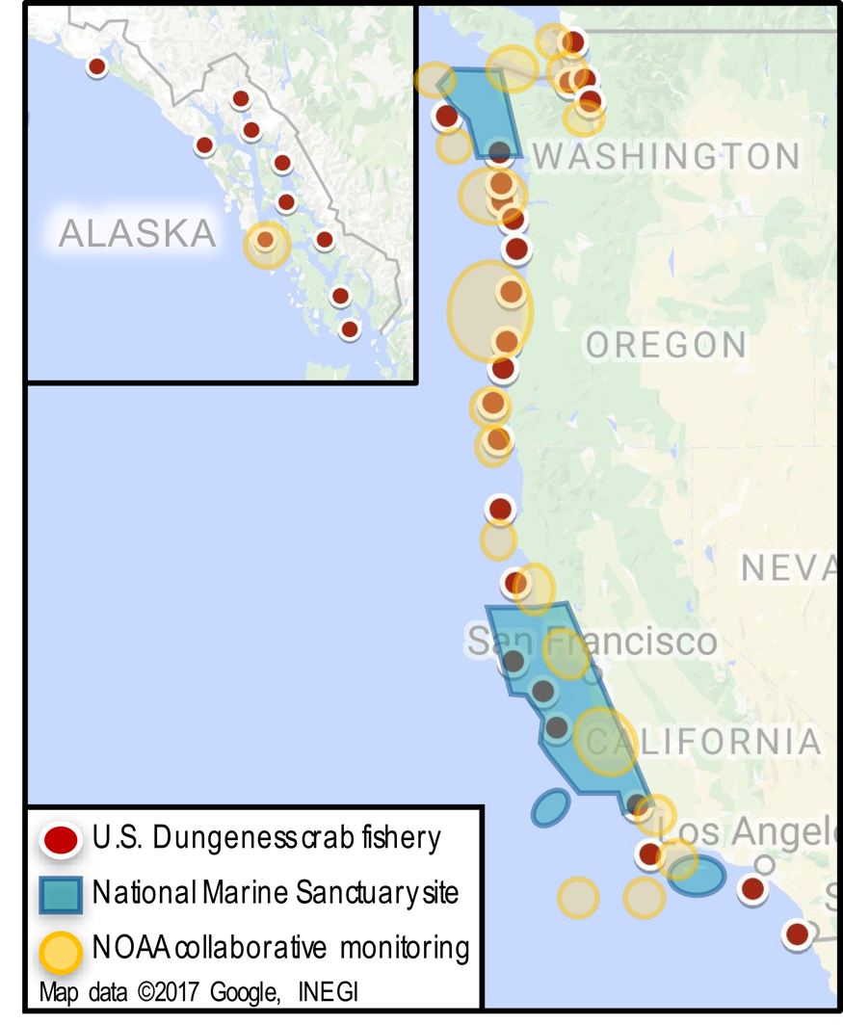
NOAA National Marine Sanctuaries
On the West Coast where Dungeness crab live, national marine sanctuaries actively:
  • eliminate and reduce risks to the ocean by
  working closely with stakeholder communities;
  • support and conduct research that brings
  experts together to safeguard habitats and
  maintain healthy fisheries for people; and
  • protect crab habitat encompassed in >15,000
  sq. miles of ocean conservation space by
  prohibiting oil/gas exploration and extraction,
  deep sea mining, and reducing water pollution.
Geographic map of Dungeness crab fisheries, national marine sanctuary sites, and NOAA collaborative monitoring on the U.S. west coast.
Notes:
NOAA Office of National Marine Sanctuaries serves as the trustee for an extensive network of marine protected areas. Dungeness crab range from Alaska to Southern California and Dungeness crab are found throughout all five national marine sanctuaries of the West Coast: Olympic Coast (Washington state), Cordell Bank (off Point Reyes, California) Greater Farallones (near San Francisco, California), Monterey Bay, and Channel Islands national marine sanctuaries (off Santa Barbara and Ventura counties). Major landing ports for the crab fishery are the Port of Los Angeles, Monterey, San Francisco, and Bodega Bay. Through focus groups, advisory councils, education and outreach programs, and resource protection programs, sanctuaries work with communities to take active steps to better protect species and ecosystems.
References:
https://sanctuaries.noaa.gov/science/sentinel-site-program/climate-change-ocean-acidification.html
https://sanctuaries.noaa.gov/science/sentinel-site-program/olympic-coast/climate-change-ocean-acidification.html
https://sanctuaries.noaa.gov/news/apr16/ocean-acidification.html

Slide 32
Here’s how you can help
Choose to use less energy generated by fossil fuel. Burning less
fossil fuel will reduce CO₂ emissions, making the ocean less stressed.
Understand your personal energy consumption choices.
Calculate where you, your family, and community can reduce use
of fossil fuel energy.
Find out what local government, businesses, and schools are doing to
reduce use of fossil fuels and transition to renewable, clean energy.
Ask questions, learn the facts, and get involved.
Educate others about the negative impact of rampant CO₂ emissions on
ocean life.
Support agencies and university research to understand the biological
response of Dungeness crab to ocean acidification.
Notes:
We believe in being responsible with our natural resources when it comes to the environment and encourage you to be part of the solutions to lower carbon emissions to help Dungeness crab and all ocean life.
These are just a few ideas to get you started.
References:
https://climateinterpreter.org/content/humans-can-take-action-slow-process-ocean-acidification
https://sanctuaries.noaa.gov/involved/
33

Slide 33

https://sanctuaries.noaa.gov/education/OA

Slide 34
Credits and Usage
The information presented in this presentation is available to use for creation of other educational products and/or programs. Please reference NOAA Office of National Marine Sanctuaries if using parts of this presentation.
This package was assembled by intern Shelley Wanamaker Trigg, NOAA National Marine Fisheries Service in collaboration with NOAA Office of National Marine Sanctuaries West Coast Region, NOAA National Marine Fisheries and NOAA Ocean Acidification Program.
Funded by the National Marine Sanctuary Foundation
Notes:
35

