Slide 1
Tidal Tales: Monitoring Marine Life

Slide 2
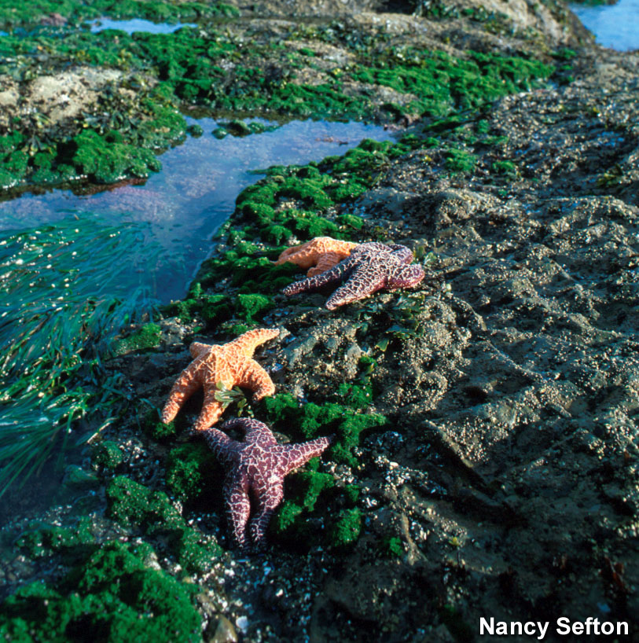
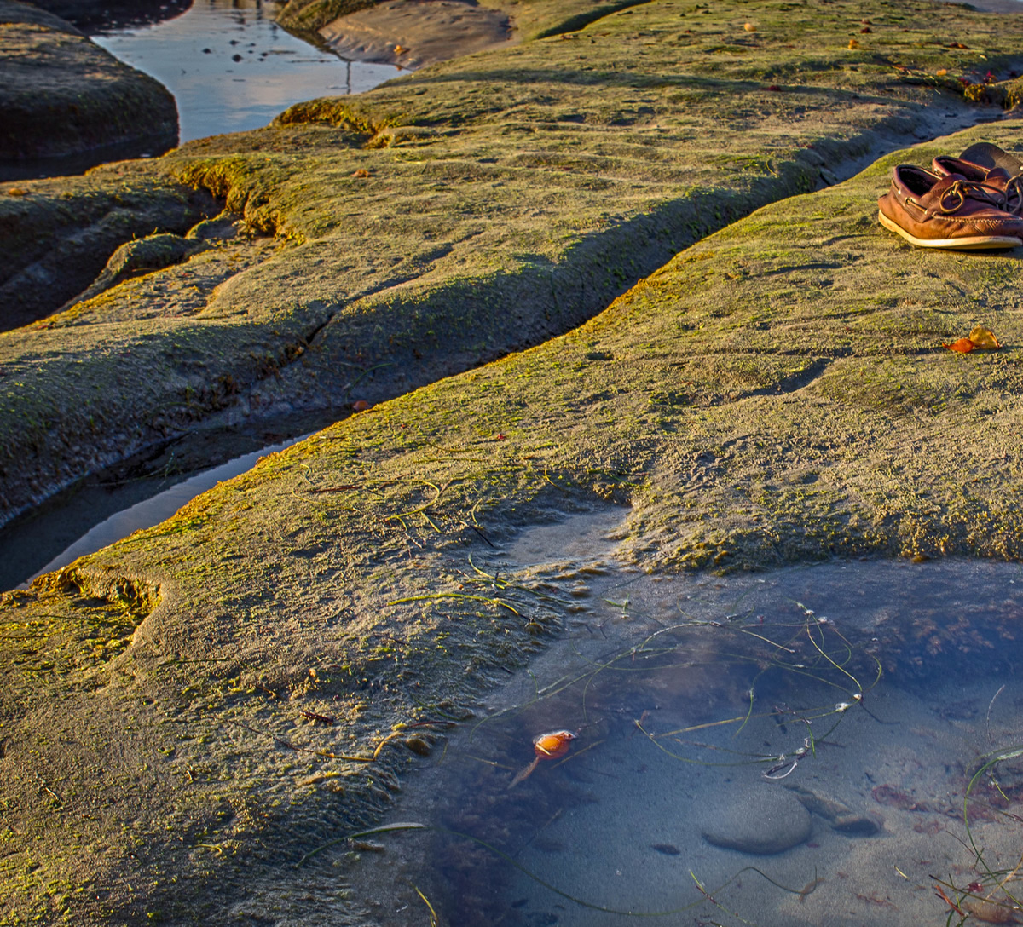
Which rocky intertidal area looks healthier? Why?
Notes:
Olympic Coast National Marine Sanctuary shown on left; Photo by Nancy Sefton: https://sanctuaries.noaa.gov/pgallery/pgolympic/habitats/habitats_8.html
A California rocky shore is on the right; Photo by Clark CC-BY-NC 2.0: https://flic.kr/p/N8ySVL

Slide 3
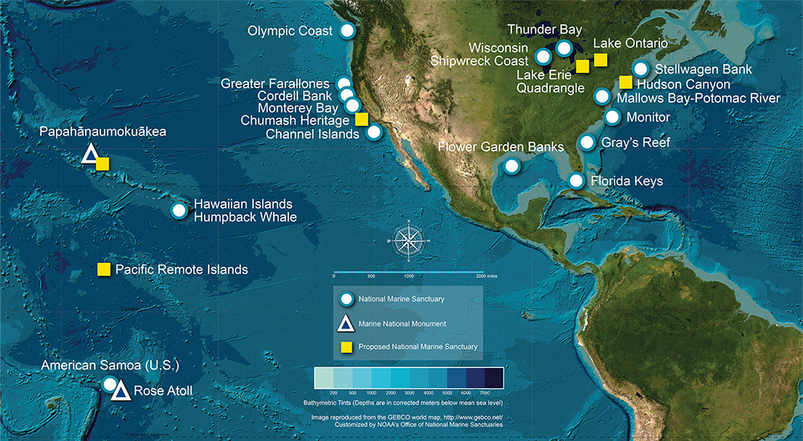
National Marine Sanctuaries and Monuments
Notes:
NOAA’s National Marine Sanctuaries protect more than just water. They protect cultural resources, coastlines, reefs, benthic (bottom) environments etc. Along the west coast of North America lie 5 sanctuaries that are in some of the most productive waters in the world. This is due to the Eastern Boundary Current called the California current. It provides abundant nutrients for the marine food web. The bottom environment is valuable habitat both at the intertidal zone and subtidal zone.
Map: NOAA

Slide 4
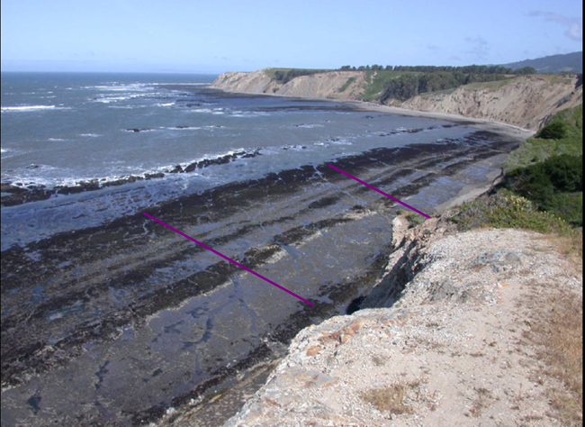
Duxbury Reef: One Monitored Site Greater Farallones National Marine Sanctuary
Notes:
Greater Farallones National Marine Sanctuary protects the waters surrounding Point Reyes and the Farallon Islands and the near shore waters of Bolinas Lagoon and Tomales Bay and all along the Sonoma coast up to just above Point Arena, CA. Here is Duxbury Reef which is the area where the intertidal photos were taken.
Photo: J. Saltzman

Slide 5
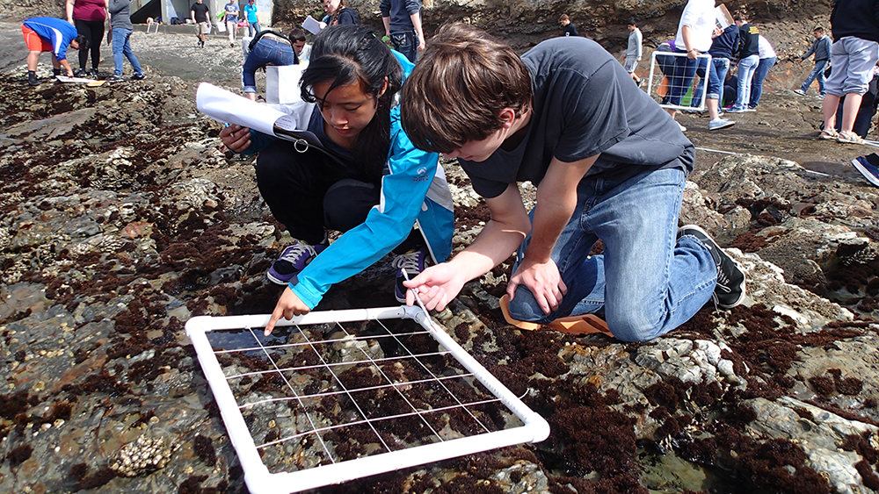
Rocky Intertidal Habitat (Tide Pools)
Notes:
The photo on left shows rocky intertidal habitat at Greater Farallones National Marine Sanctuary. The rocky intertidal and subtidal habitats on the West Coast are packed with life. Students are helping the national marine sanctuaries protect these marine habitats by monitoring the life in these zones. Rocky intertidal habitat comprises much of West Coast sanctuary shorelines, including 56 percent of the Monterey Bay National Marine Sanctuary coast. Photo: J. Pearse
Photo on right: Students monitor a rocky intertidal community with a quadrat at a national marine sanctuary in California. Photo: Jessie Altstatt
Today you will learn how and why we monitor the rocky intertidal and subtidal habitats.

Slide 6
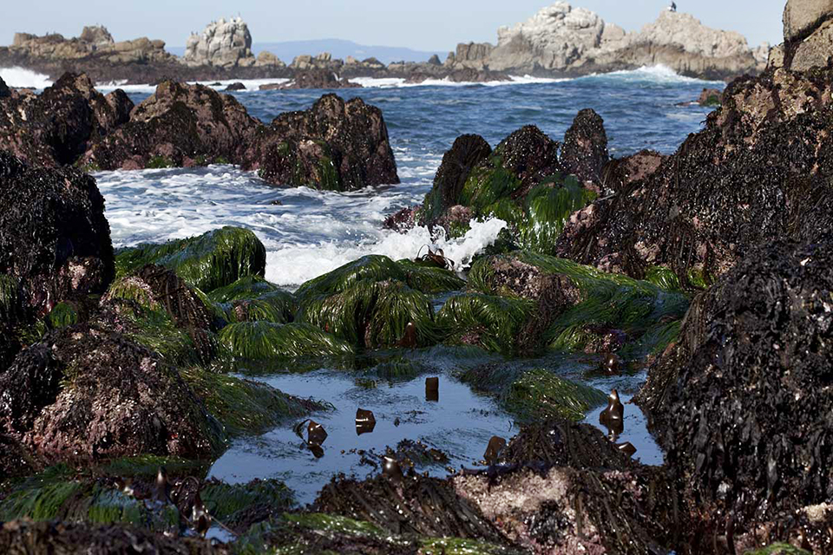
Why is monitoring intertidal life (tide pools) over time important?
Notes:
The reason we monitor is to find out how our intertidal life changes over time. How is it affected by climate changes, pollution, coastal development, human trampling and harvesting? We need to monitor specific sites to follow these changes over time. If we discover that changes are occurring, studies can be focused on the causes and whether action should be taken to counter the changes. But first it is necessary to have some good rigorous data.
Photo: Monterey Bay National Marine Sanctuary/NOAA

Slide 7
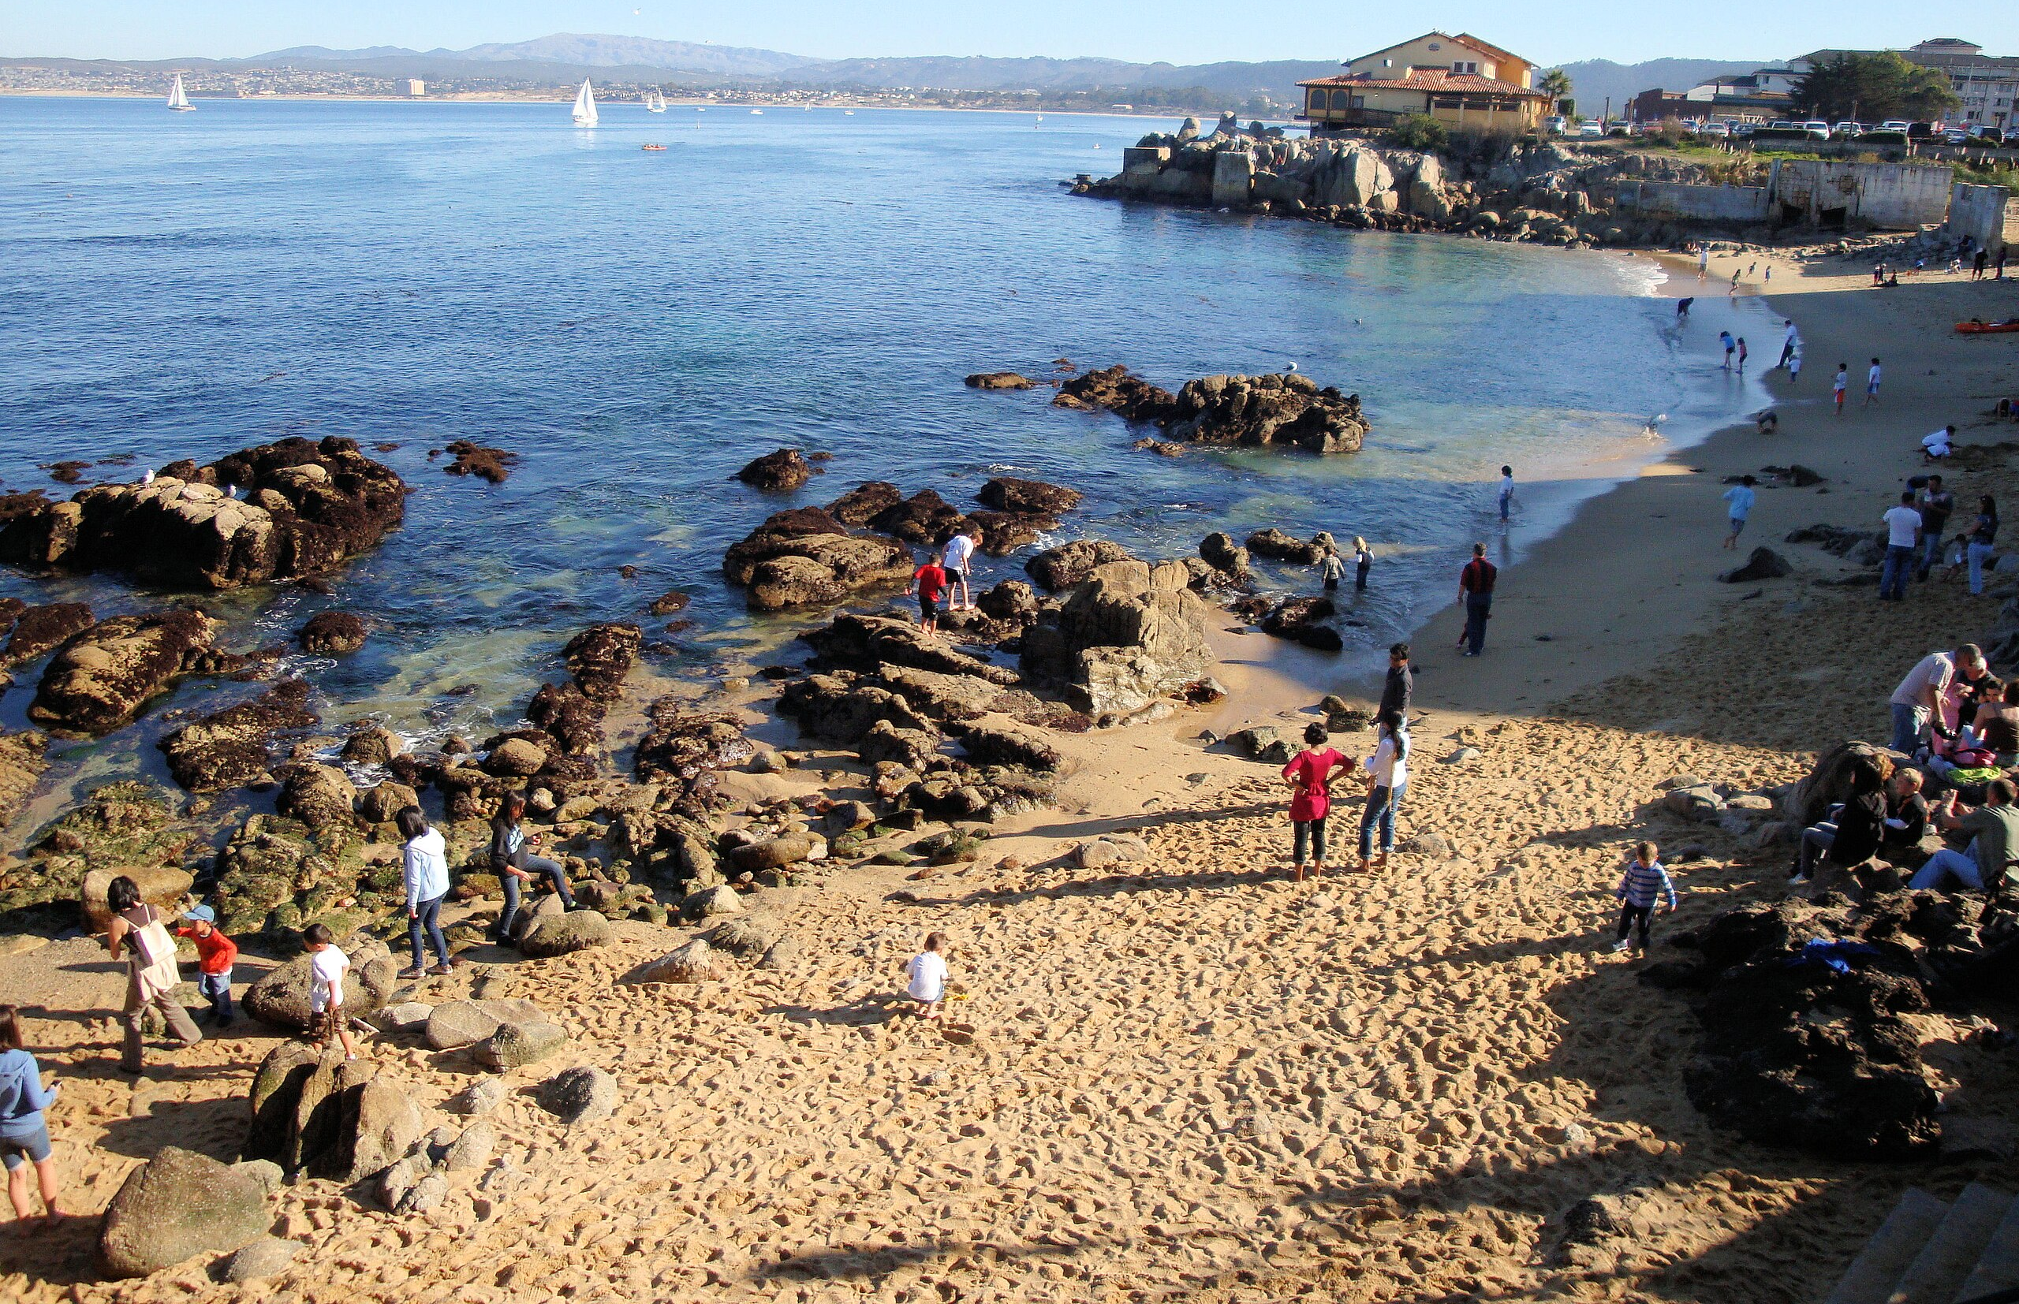
Tourism and pollution impacts rocky intertidal zones everywhere!
Notes:
One impact on rocky intertidal species is people walking, investigating and having fun looking around tidepools.
Photo is of beach at Cannery Row, Monterey Bay National Marine Sanctuary, Monterey, California
Photo: Jim G. CC BY 2.0; learn more: https://www.flickr.com/photos/jimg944/6799489813

Slide 8
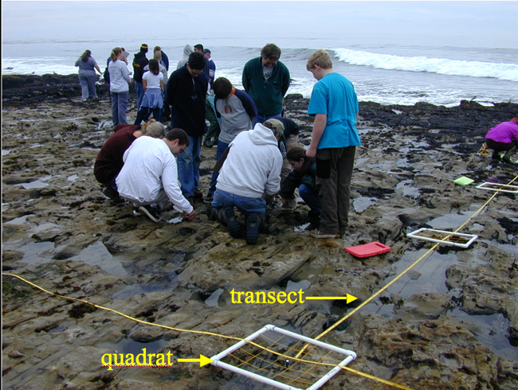
Students conduct a line transect
Notes:
Students in the field use a few different pieces of equipment. The first is the transect tape. At Duxbury Reef there are two permanently marked transects. A long tape is used to mark the transect.
The quadrat is a plastic square that is a half meter by a half meter which means it covers an area of a quarter of a square meter (0.25 m2).
When in the field we have kneepads in order to get close to the ground to see what wonderful creatures are living there!
Photo: J. Pearse

Slide 9
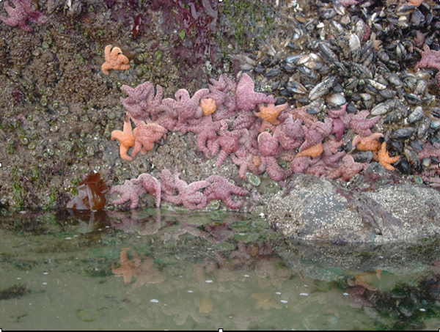
Can you identify intertidal animals?
Sea Anemones
Mollusks
Chitons
Snails
Limpets
Mussels
Barnacles
Sea Stars
Notes:
There are many groups of organisms that we will be identifying and counting. They are sea anemones, several mollusks, barnacles and sea stars.
Photo: K. Soave

Slide 10
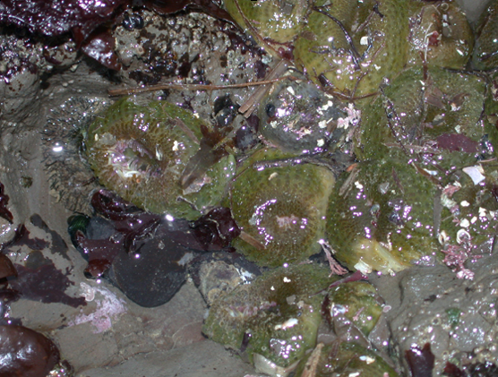
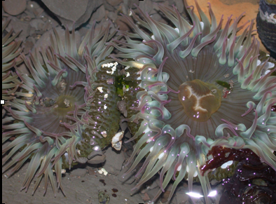
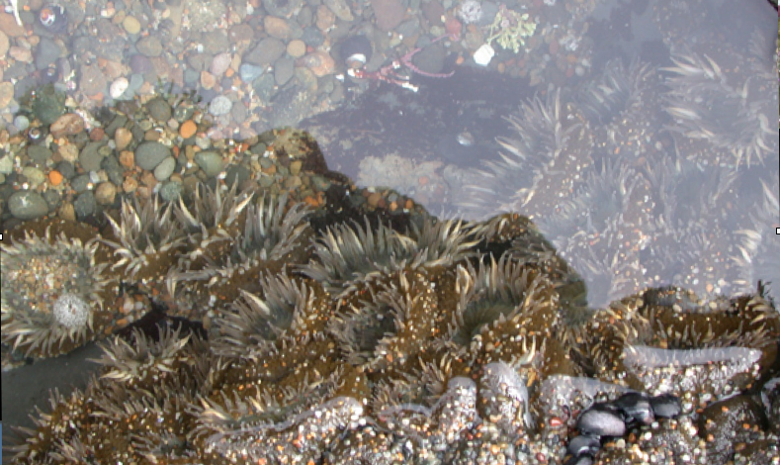
Aggregating Anemone Anthopleura elegantissima
Notes:
There are three species of anemones found at Duxbury Reef. The most abundant one is the aggregating anemone, about an inch in diameter. The top picture shows them open, when under water. And the photo below shows them when exposed to the air. They are the green little blobs. They often cover themselves with small rocks and sand to help keep the moisture in during the low tide period.
The brooding anemone is a small brownish anemone that is rare. It gets its name from the way it reproduces. New anemones bud off from the adult and are seen on the base of the animal. (The identification card has a nice picture of this.)
Photos: K. Soave

Slide 11
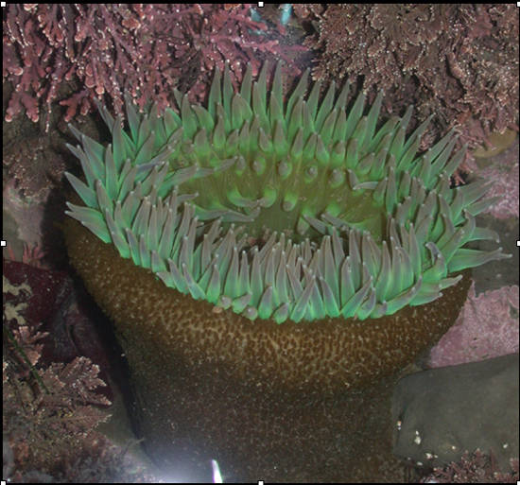
Giant Green Anemone Anthopleura xanthogrammica
Notes:
The Giant Green Anemone is hard to miss. Its huge! Sometimes you will see them all curled up with sand and small rocks attached to their body to prevent drying out.
Giant green anemones are often solitary while the aggregating ones are found in groups of clones. The giant greens live in the mid- to lowtide zone and are not that abundant in the simulated monitoring.
New anemones bud off from the adult and are seen on the base of the animal. (The identification card has a nice picture of this.)
Photo: K. Soave

Slide 12
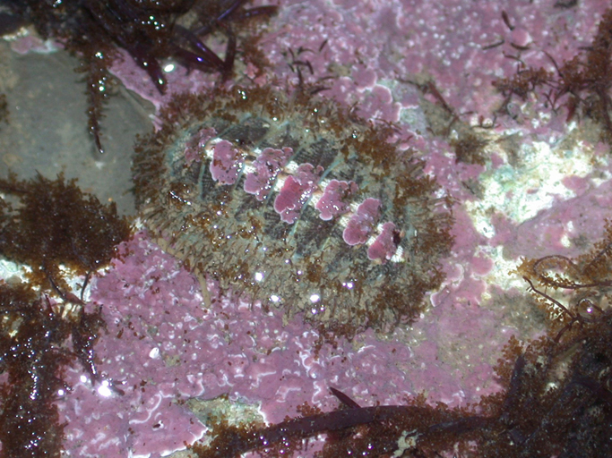
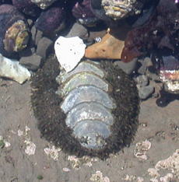
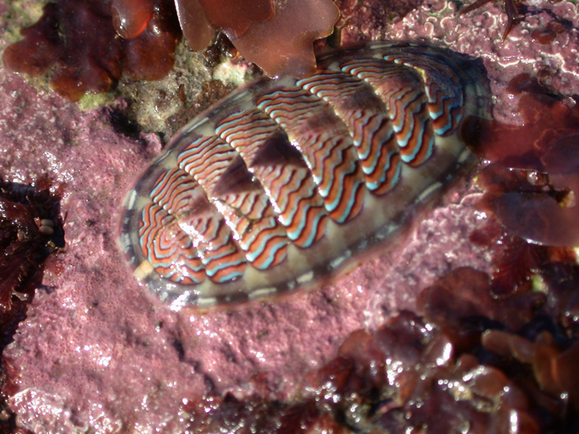
Chitons
Notes:
Chitons are mollusks. Mollusks are often shelled animals with a large muscular foot. This phylum includes snails, mussels and clams. Chitons are a more primitive group of mollusks with eight separate plates, rather than one shell. They use the foot to hold on tightly to the rocks as the waves crash around. They can easily be overlooked.
Photos: K. Soave and J. Saltzman

Slide 13
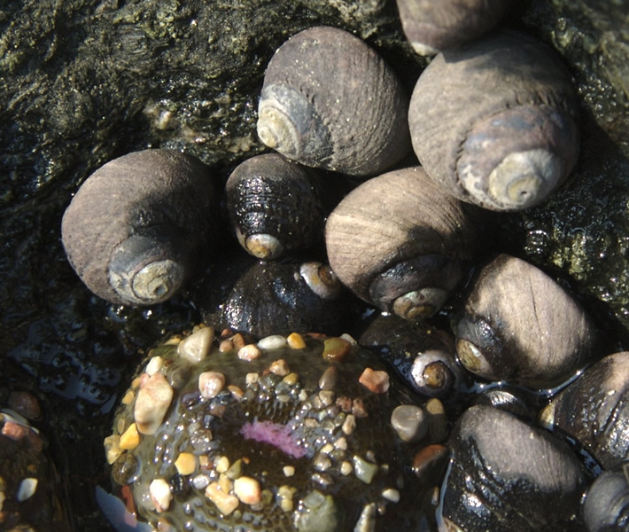
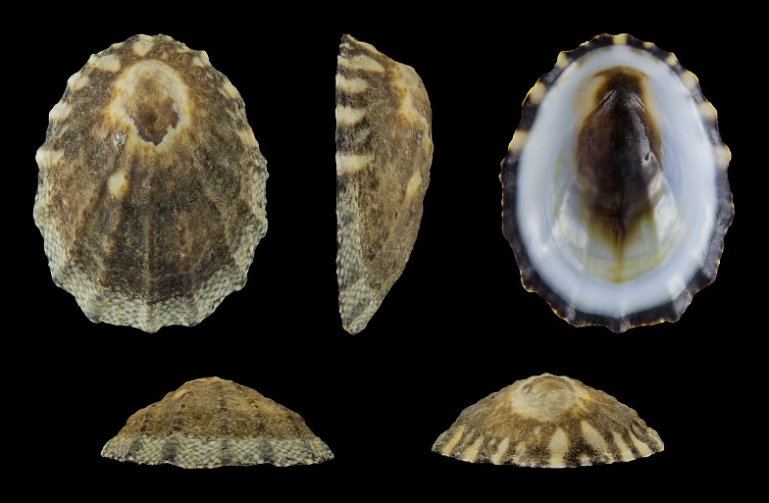
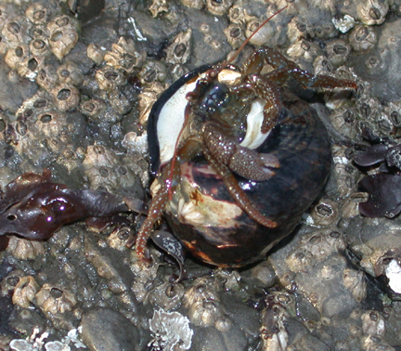
Snails
Hermit crabs use their shells, too!
Turban Snails
Tegula spp.
Whelks
Acanthinucella spp/ Nucella spp.
Notes:
There are two species of snails to monitor at Duxbury. The abundant turban snail lives in the high to mid zone. It has a very round shell and is generally brown to black in color. The turban snail is an herbivore and grazes on the algae. The whelks are predatory and have an elongated shell. They are gray in color.
Hermit crabs live in snail shells and may be difficult to identify in photos. Photos: K. Soave and A. Devitt

Slide 14
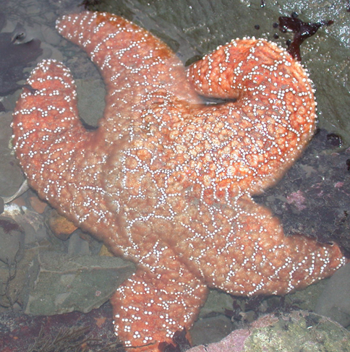
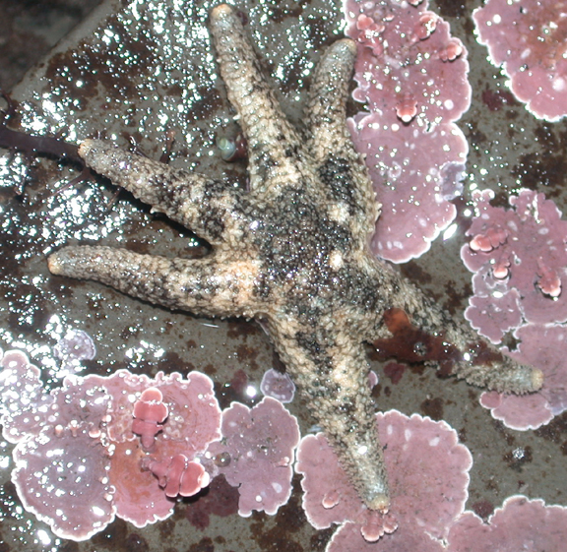
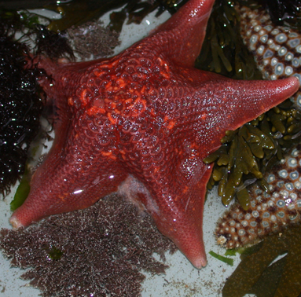
Sea stars
Ochre sea star
Pisaster ochraceus
Six-armed star
Aleptasterias hexactis
Bat star
Asterina miniata
Notes:
Sea stars are the most well known and easily identified species in the rocky intertidal habitat. The most abundant species is the ochre (o-ker) sea star. It grows up to 10 inches in diameter and has a few color morphs – orange, brown and purple. Sea stars are predators and are very important in the dynamics of the rocky intertidal zone.
On the smaller side are six-armed sea stars. They grow only to an inch in diameter.
Very rare at Duxbury, yet much more abundant at other rocky intertidal zones, are bat stars. They are very colorful and grow to about 5 inches in diameter. The name comes from the webbing between the arms of the bat star.
Photos: K. Soave

Slide 15
Limpets Lottia spp./ Macclintockia spp.
Notes:
Limpets are another interesting group of mollusks. They only have one shell that covers their muscular foot. The limpets monitored at Duxbury are small in size - a quarter to a half an inch in diameter. Some people think they look like little volcanoes. Another species that is found on the outer reefs in the high wave action area are owl limpets. They grow much larger, up to 2 inches in diameter.
Large photo: Photo: H. Zell CC BY-SA 3.0: https://en.wikipedia.org/wiki/Lottia_digitalis

Slide 16
Sea Mussels Mytilus californianus
Notes:
Mussels hang on tight to the rocks with threads that glue onto the rocks. They open their shells slightly when the tide is high to filter feed for plankton. When the tide is out, the shells close up to retain moisture. They are usually clustered together like in this photo in the intertidal zone.
Photo: NOAA

Slide 17
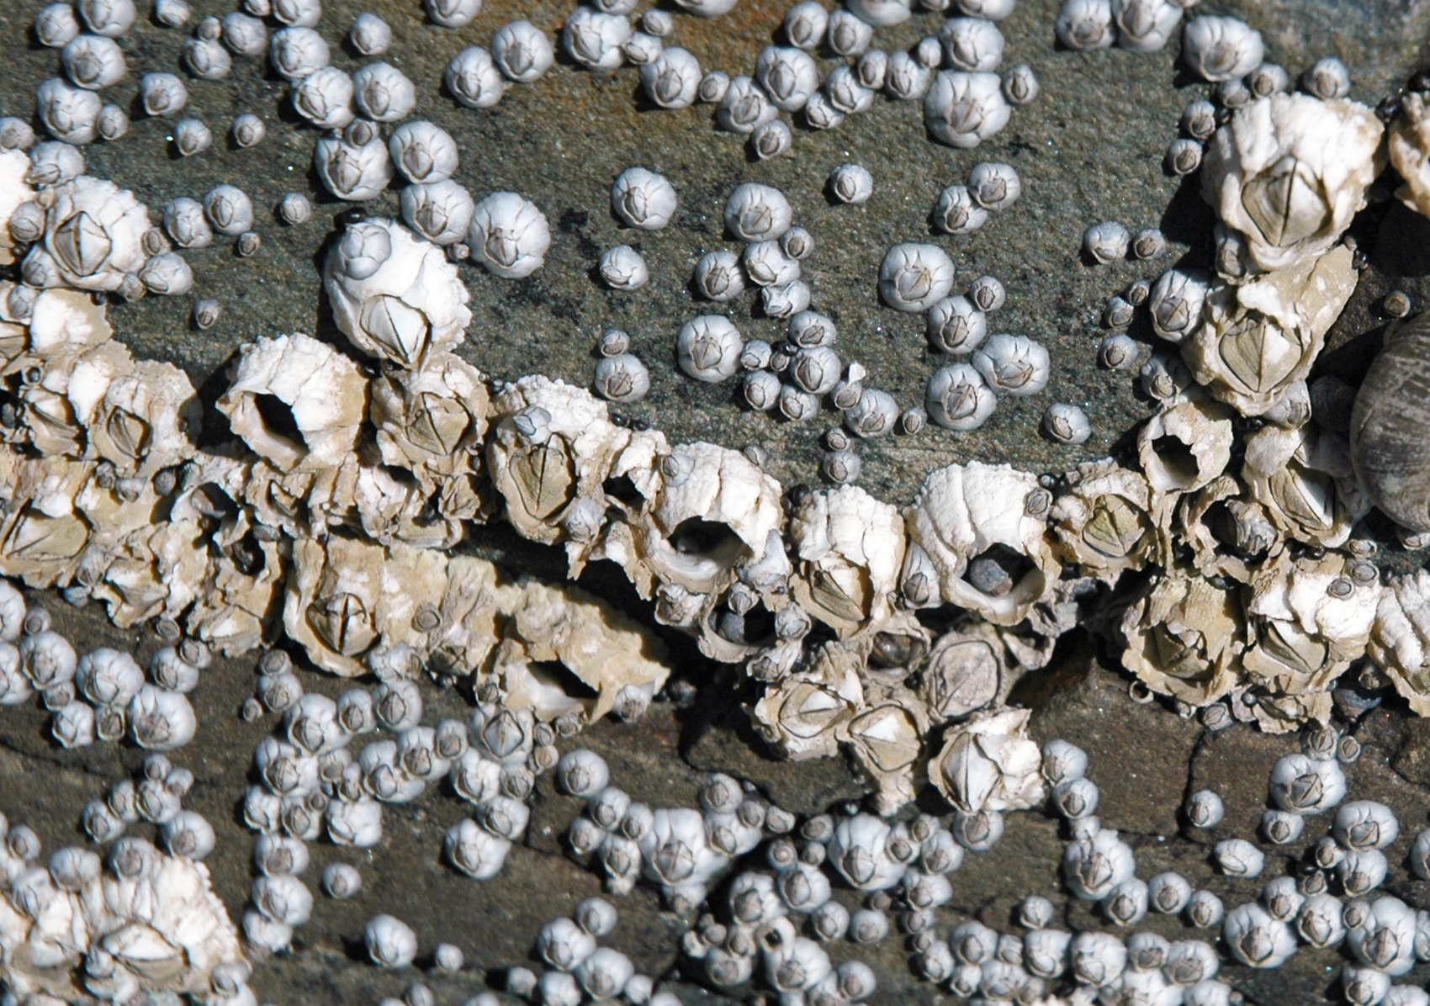
Barnacles Balanus and Chthamalus spp.
Notes:
Barnacles are not in the mollusk group although they may appear similar to some mollusks. They do have a shell, but not a muscular foot. Barnacles are actually closely related to shrimp. A fun way to think about barnacles is that they are shrimp that have glued their heads to the rock, built a strong home around themselves, with doors that shut when the tide is out. They open the doors, called plates, under the water so they can kick their legs to filter food out of the water. The barnacles here are small - less than the width of your pinky finger (less than 1 cm in diameter). They are abundant in the high zone of the rocky intertidal habitat. You will not have to count all the barnacles in your quadrat, just how many squares are they present in.
Photo: James St. John CC BY 2.0; learn more: https://www.flickr.com/photos/47445767@N05/50642365548/

Slide 18
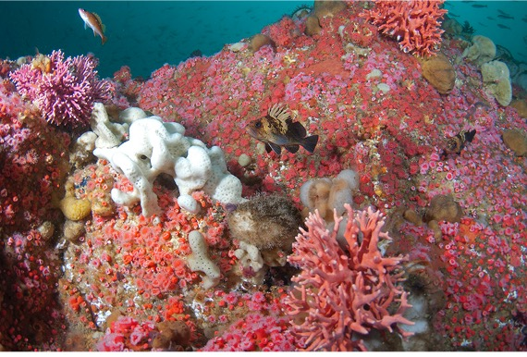
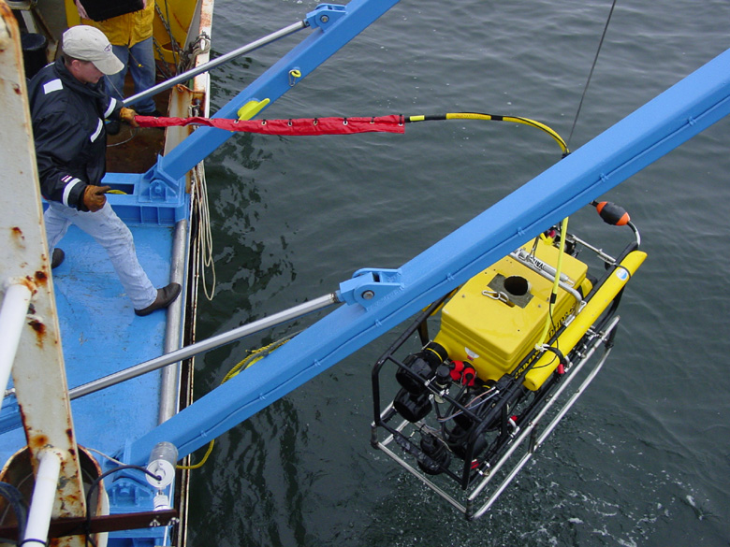
How can we explore and study subtidal habitat?
A remotely operated vehicle (ROV)
Notes:
Students and researchers can easily study the rocky intertidal habitat because its accessible from shore. But how about under the water in the subtidal zone? In the shallower depths, researchers use quadrats when SCUBA diving, but how about at deeper depths, where scuba is not a safe or efficient option? At Cordell Bank National Marine Sanctuary, scientists use remotely operated vehicles to get below the surface and use video and photos to estimate the abundance of fishes and invertebrates.
Photos: NOAA

Slide 19
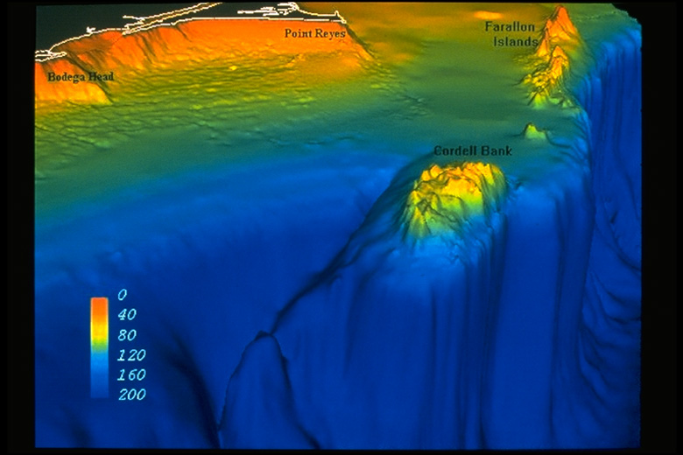
Subtidal habitat
Notes:
The pictures you will be looking at today come from Cordell Bank, an underwater island/rocky reef about 20 miles west of Point Reyes and Bodega Head. Most of the bank sits on the continental shelf at 400 feet, while some of it rises to peaks of 115 feet below the surface of the water.
Image: NOAA

Slide 20
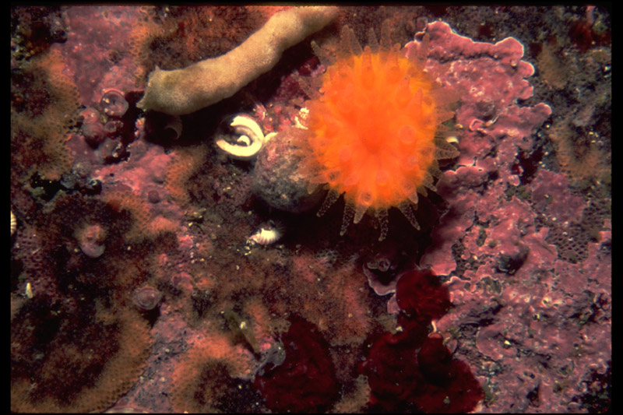
Subtidal Species: Cordell Bank
Orange Cup Coral Balanopyllia elegans
Notes:
Orange Cup Coral is a stony coral, its tentacle tips are hard. It filter feeds for plankton, and is typically solitary, although, they can be abundant in certain areas. You will count these as individuals in the photos.
Photo: NOAA

Slide 21
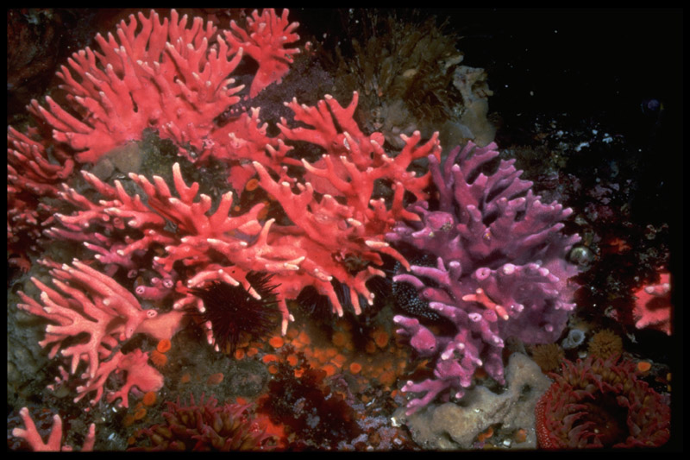
Hydrocoral Stylaster californicus
Notes:
Hydrocoral is another stony coral that that can be pink or purple. It is very fragile and slow growing. It can take 25 years to grow 1.5 inches! They filter feed for plankton and are solitary, but like orange cup coral, can be abundant in areas. Count these individually also.
Photo: NOAA

Slide 22
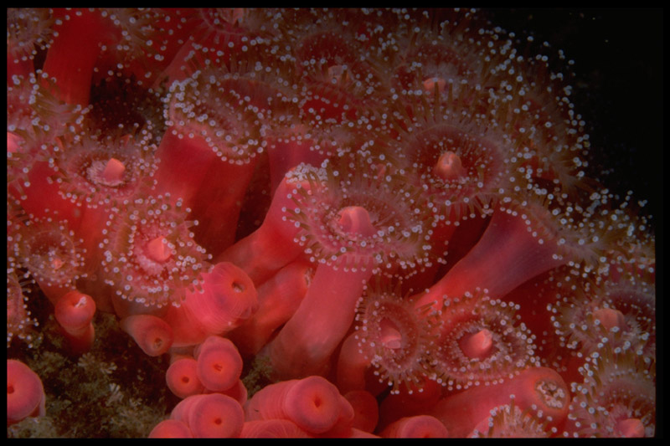
Strawberry Anemones
Corynactis californica
Notes:
Strawberry anemones are bright pink and sometimes orange. They stand by themselves, but are very abundant. They use their stinging tentacle tips to catch plankton in the currents. They thrive in strong current areas. These would be too hard to count individually, so this species you will count and record the number of squares they appear in.
Photo: NOAA

Slide 23
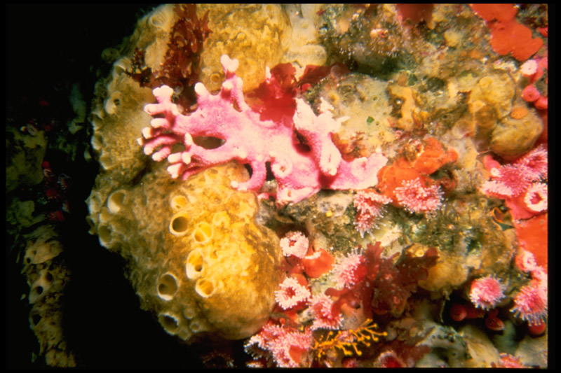
Sponges
Sponge
Notes:
Sponges come in a variety of shapes and sizes and are very difficult to identify to species. There are over 5,000 species in the world’s ocean and fresh water areas. They eat plankton by filter feeding. The small holes in sponges take in water. This body part is known as Ostia. The water goes through the sponge and is sent out the large holes known as Oscula. Plankton, bacteria and detritus are left behind in the sponge for it to consume! Since there are so many species, just look for organisms that look like a sponge.
Photo: NOAA

Slide 24
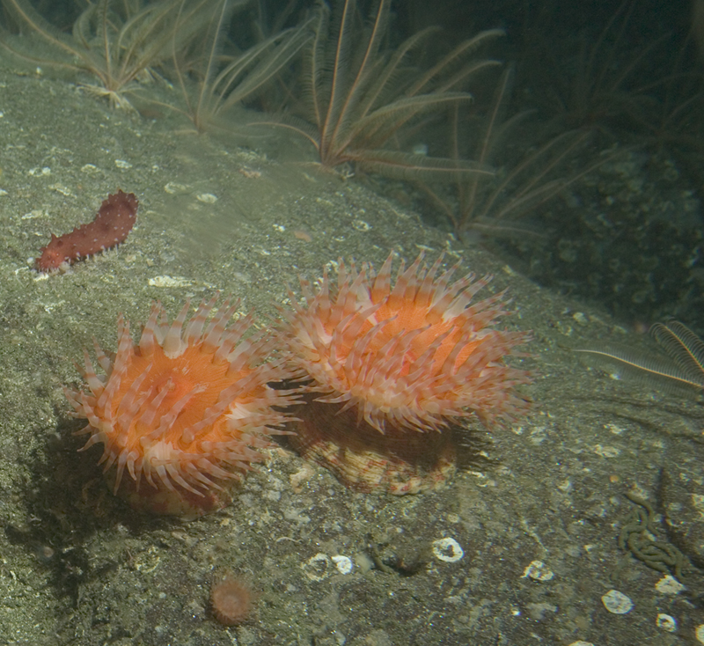
Stomphia Anemone
Notes:
One of the categories on the data sheet is bare rock. The depths of the bank determine the type of marine life that live there and their abundance. The bottom habitat of Cordell Bank is mostly granite rock. It provides a place offshore for species to live on. Hundreds of different invertebrates use this habitat as a home.
Photo: NOAA

Slide 25
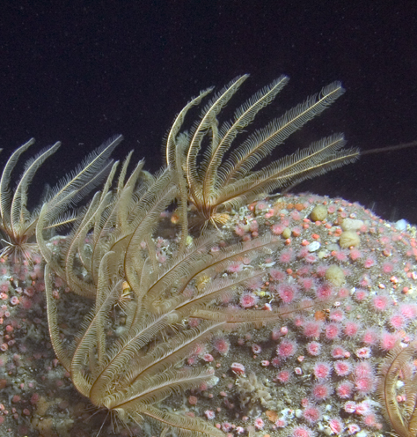
Crinoids Florometra serratisima
Notes:
Crinoids are also known as Feather Stars. They are related to sea stars and sea cucumbers. Crinoids can live as deep as 3,300 ft! They feed on plankton, detritus and bacteria. They can detach and drift in the currents to land in a new home.
Photo: NOAA

Slide 26
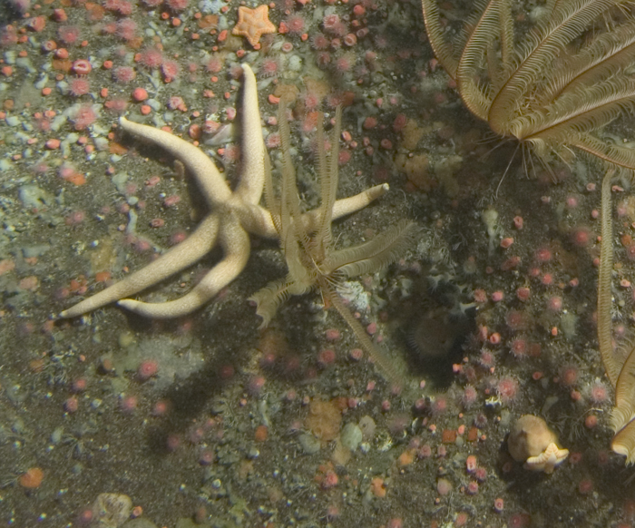
There are also many sea star species in the subtidal habitat.
Notes:
There are numerous species of sea stars at Cordell Bank. They are radially symmetrical and are cousins to crinoids, sea urchins and sea cucumbers.
Photo: NOAA

Slide 27
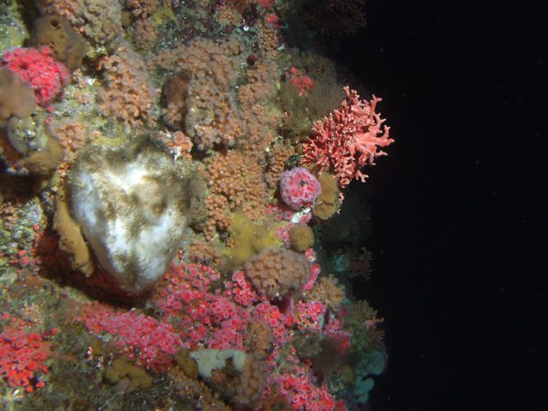
What species are here?
hydrocoral
strawberry anemones
sponge
Notes:
Here’s a quick quiz: What species do you see?
There are strawberry anemones (lighter pink and fluorescent pink), sponge and hydrocoral.
(On click, arrows point to the strawberry anemones, sponge, and hydrocoral)
Photo: NOAA

Slide 28
And here?
sponge
sea cucumber
strawberry anemones
sea star
Notes:
What do you see in this photo? Press the space bar to see arrows point to animals.
Strawberry anemones, sponge, sea star and a sea cucumber. We are not counting the sea cucumber on our data sheet. You can include it on the unidentified/other category to take note of it.
Photo: NOAA

Slide 29
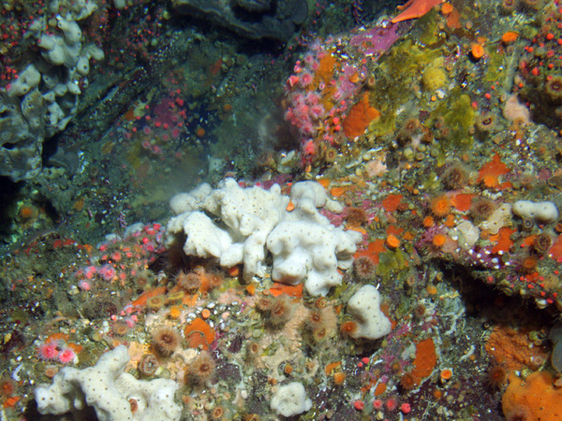
Species here?
sea star
strawberry anemone
orange cup coral
sponge
Notes:
Here you should see sponges, orange cup corals, strawberry anemones and a sea star (upper right), as well as some bits of hydrocoral.
Photo: NOAA

Slide 30
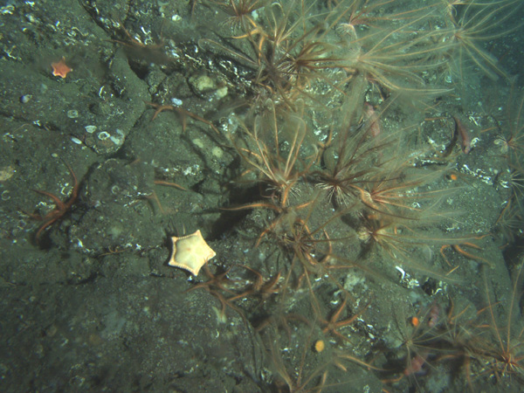
Identify these?
crinoid
orange cup coral
bare rock
sea star
Notes:
Bare rock, sea star, crinoids, orange cup coral
Photo: NOAA

Slide 31
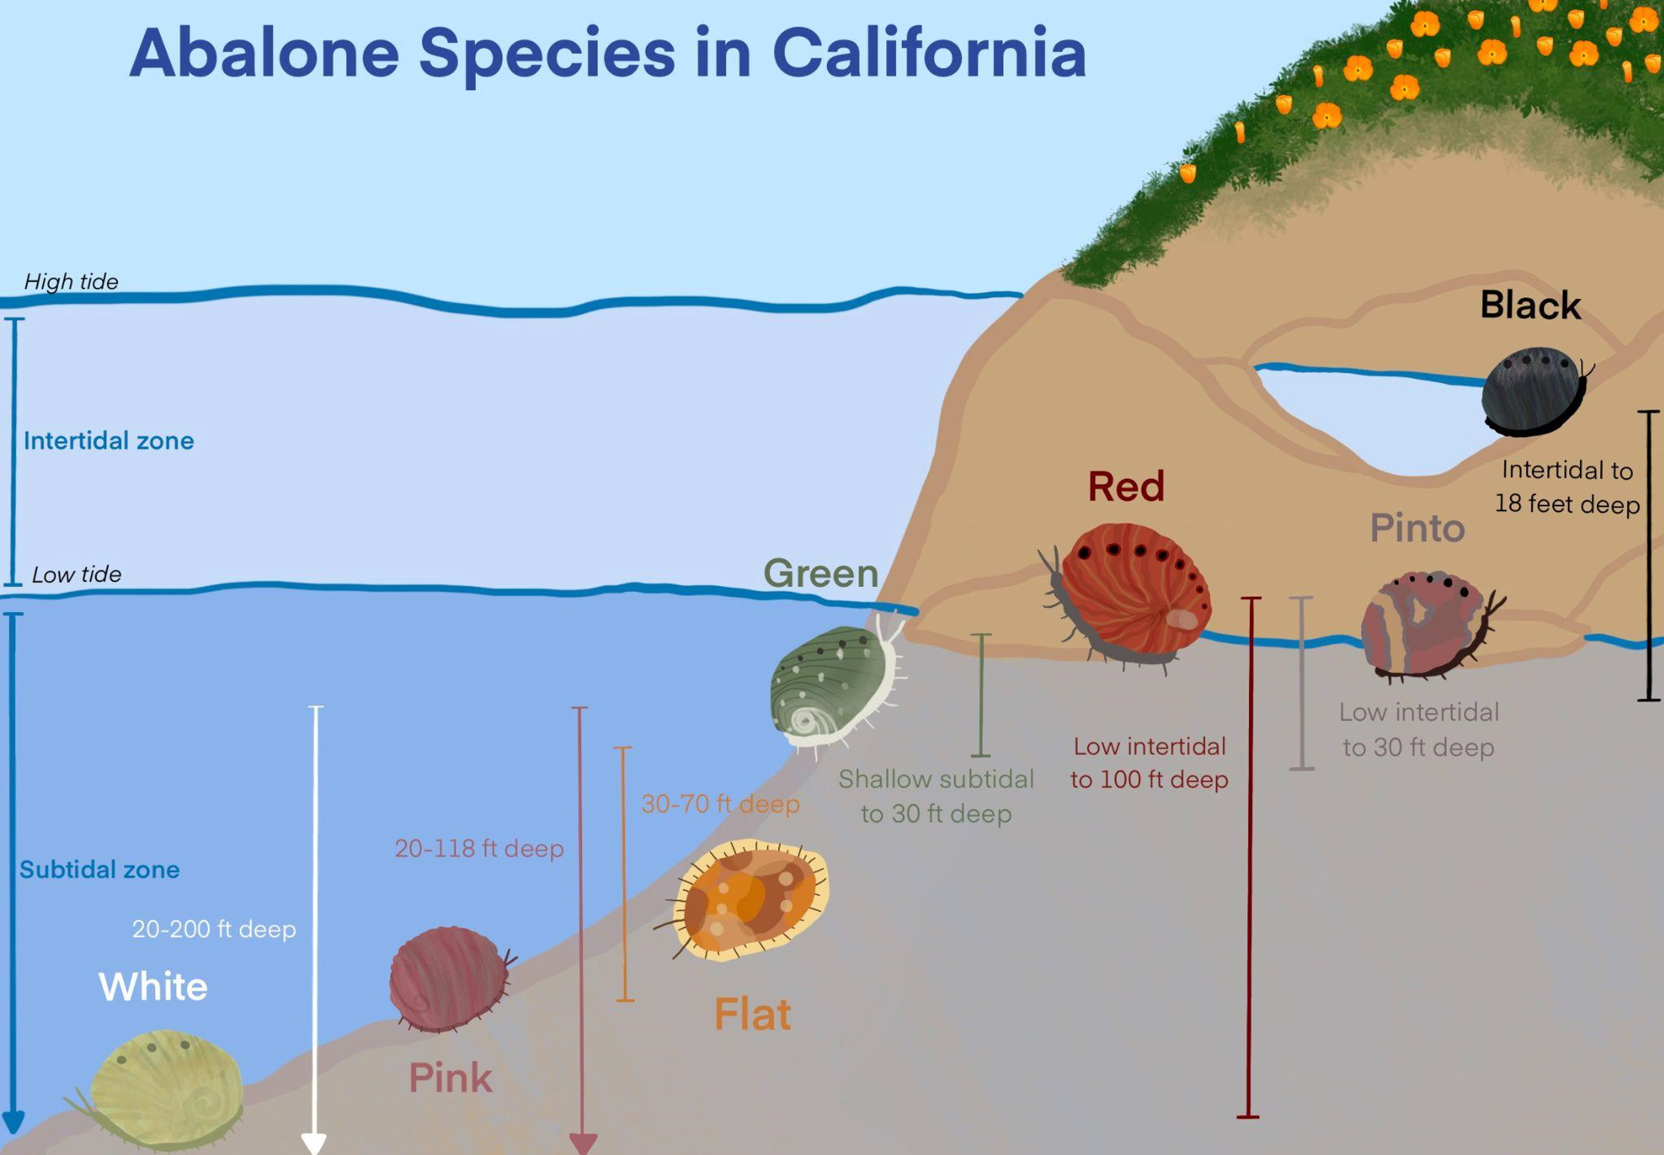
Abalone species in California
Notes:
Abalone are not monitored in this activity, but this graphic helps to understand vertical zonation patterns in the intertidal and subtidal zones. The black abalone is one of seven species of abalone at the California coast. It is one of two abalone species currently listed as federally endangered, alongside white abalone. Decades of overharvesting in California, coupled with disease, have devastated black and white abalone populations.
Illustration: Theodora Mautz / Point Reyes National Seashore / NPS
Learn more: https://www.nps.gov/articles/000/sfanblog_why-black-abalone.htm

Slide 32
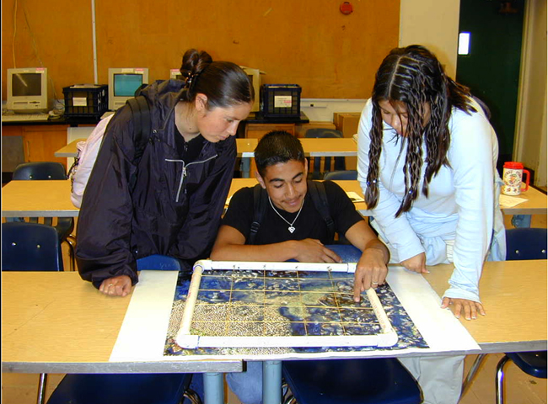
Your turn to practice monitoring marine life!
Notes:
It is your turn to practice monitoring with life-size photos and quadrats. You will learn to better identify species while practicing the data collection method.
Photo: J. Pearse

Slide 33
Funding support provided by: National Geographic Society + Adapted from a presentation by Jennifer Stock, Education and Outreach Coordinator / Media Liaison for Greater Farallones and Cordell Bank National Marine Sanctuaries by Rick Reynolds, M.S.Ed. + Krista Reynolds, MLIS, M.Ed. Engaging Every Student In collaboration with NOAA’s Office of National Marine Sanctuaries, National Marine Sanctuary Foundation and National Geographic Society
sanctuaries.noaa.gov

Slide 34
Contact Tracy Hajduk National Education Coordinator Office of National Marine Sanctuaries National Oceanic and Atmospheric Administration Phone: 240-533-0663 Email: sanctuary.education@noaa.gov
sanctuaries.noaa.gov

Slide 35
Credits
cordellbank.noaa.gov

