Slide 1
The Mysterious Ocean
What do you think the deep ocean looks like? What type of environment is it?
How would you explore the deep ocean? What technology would you use?
What types of organisms live there? How might you research and measure the health of their ecosystems?
Notes:
A deep-sea coral community at Greater Farallones National Marine Sanctuary off the coast of California: Can you identify these three organisms?
A Venus fly trap sea anemone is shown on the left.
A white primnoid coral is covered in brittle stars, which use the corals’ structure to gather nutrients from the water currents.
Photo: Ocean Exploration Trust/NOAA Office of National Marine Sanctuaries

Slide 2
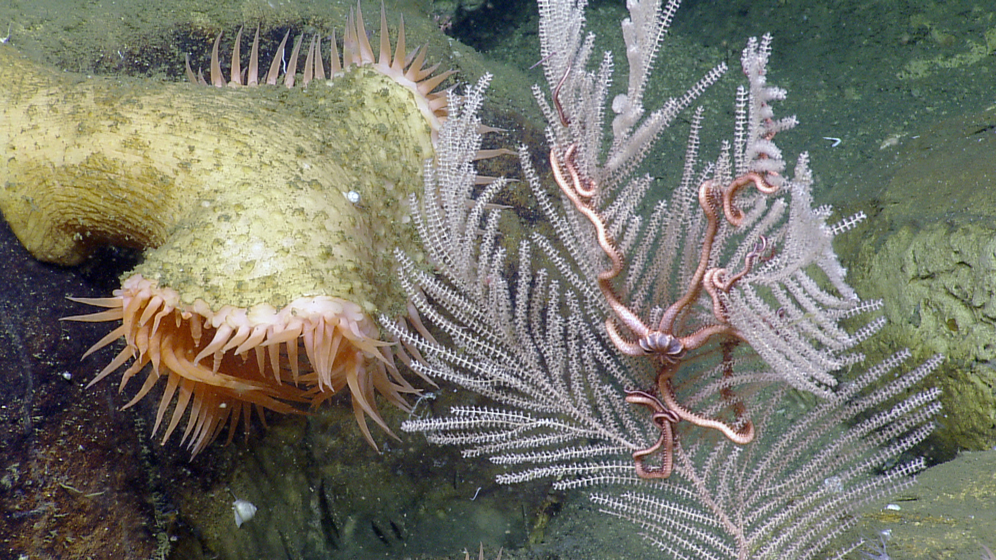
What do you observe?
Where might this photo have been taken?
Notes:
A deep-sea coral community at Greater Farallones National Marine Sanctuary off the coast of California: Can you identify these three organisms?
A Venus fly trap sea anemone is shown on the left.
A white primnoid coral is covered in brittle stars, which use the corals’ structure to gather nutrients from the water currents.
Photo: Ocean Exploration Trust/NOAA Office of National Marine Sanctuaries

Slide 3
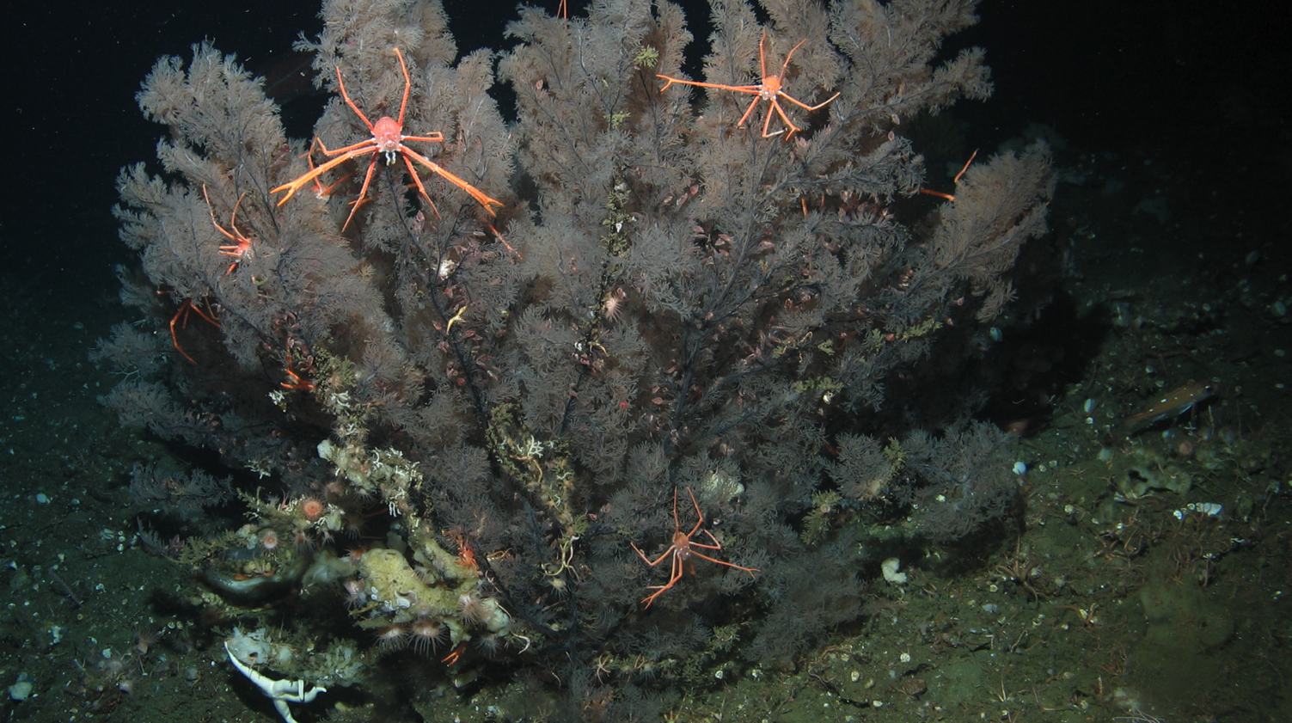
What do you observe?
What organisms are the foundation of this deep-ocean ecosystem?
Notes:
Black coral with several squat lobsters. Deep sea coral communities provide habitat for fish and invertebrates at depths from 50 meters to over 2,000 meters (160 feet-6,500 feet). Deep coral communities contain incredible biodiversity, which is why they are such important ocean habitats. Many species thrive in these habitats, including commercially and recreationally important fish and invertebrate species, such as rockfish, lingcod and crabs. Without these communities, our fisheries would suffer along with the entire ecosystem.

Slide 4
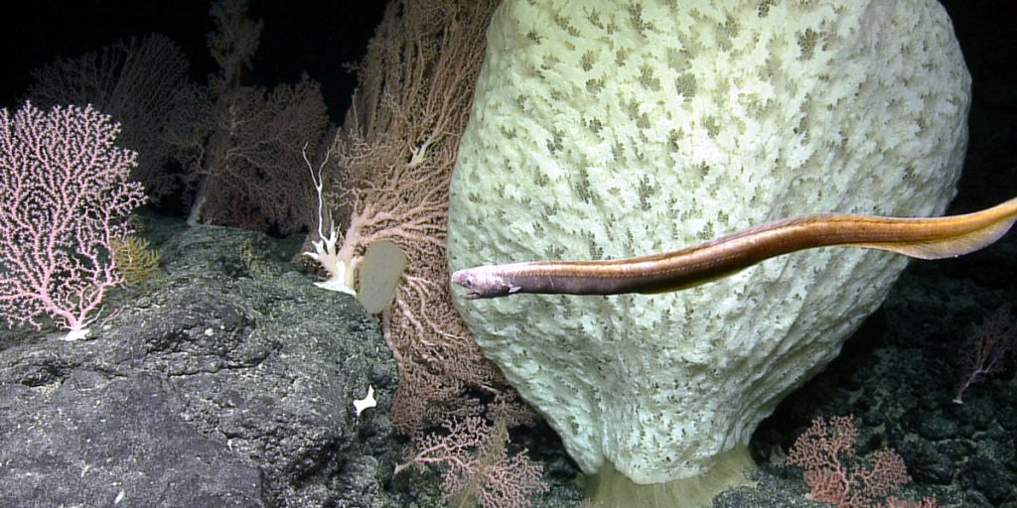
What do you observe?
What organisms are the foundation of this other deep-ocean ecosystem?
Notes:
A meter-wide Poliopogon glass sponge and a snubnosed eel are surrounded by pink Hemicorallia deep-sea corals on Tamana Seamount in Papahānaumokuākea Marine National Monument. Photo: Ocean Exploration Trust/NOAA

Slide 5
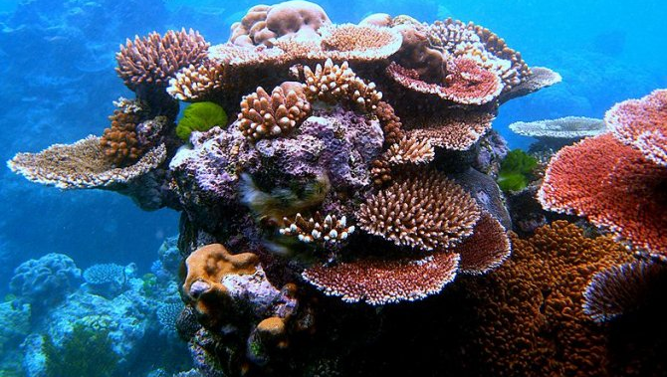
What are these and how do they eat?
Corals!
Most warm-water corals contain photosynthetic algae.
Algae provide corals with energy in exchange for a protected environment (the corals’ own tissues) to live within.
Notes:
Most warm water corals contain symbiotic zooxanthellae, a photosynthetic algae, that provide corals with energy in exchange for a protected environment (the corals’ own tissues) to live.

Slide 6
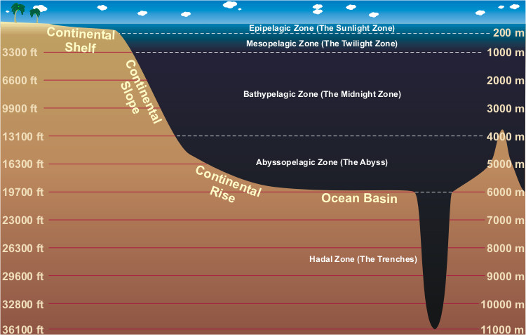
How deep does sunlight travel in the ocean depths?
Notes:
These are the zones of the ocean. Sunlight only penetrates the first 200 meters of the ocean (Epipelagic Zone or the Sunlight Zone). Most of the coral communities (but not all) we are going to look at today fall within the Mesopelagic or Twilight Zone, or the area found between 200 meters and 1,000 meters; however, deep sea corals can be found at much deeper depths (up to 2,000 meters!). The organisms found within these communities are specially adapted to withstand the high pressure and low light of the deep sea environment.

Slide 7
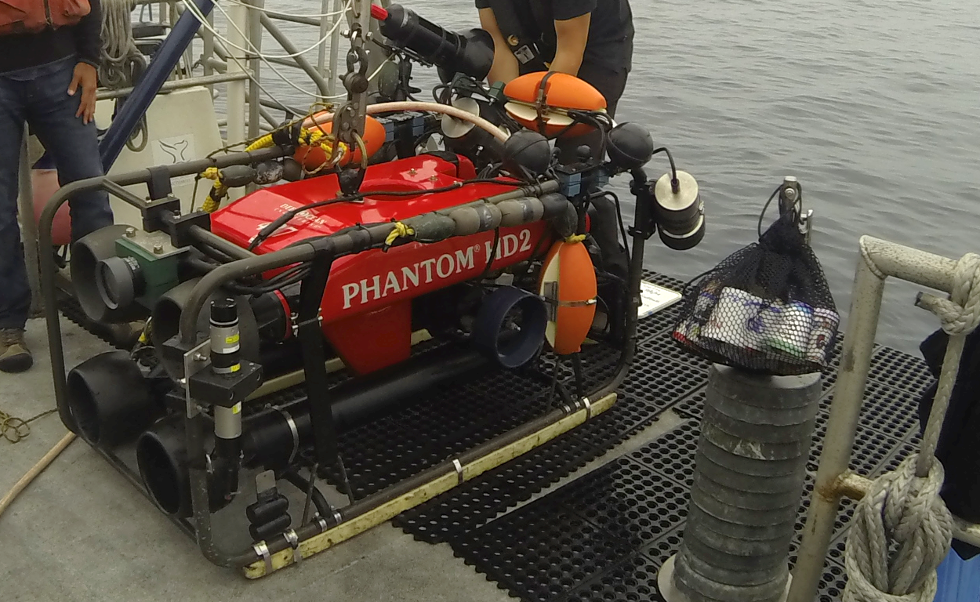
What is this? Why is it important?
A Remotely Operated Vehicle (ROV)!
Allows researchers to study the deep-sea environment
Notes:
Due to the challenges of reaching the deep ocean, less than 5% of our ocean has been explored. Remotely Operated Vehicles (ROVs) have made it possible to explore farther and deeper than ever before. ROVs are designed to withstand the pressures of the deep sea and are equipped with video cameras. This allows scientists to view species diversity and abundance in deep sea communities while staying above water. There is often a tether that connects the ROV to a research vessel, and researchers view live footage from the camera mounted on an ROV. An ROV is also equipped with lights to illuminate the deep ocean environment. Video transects and still photos are recorded throughout each dive so that researchers can go through them in detail at a later time in order to identify deep sea species and characterize habitat.

Slide 8
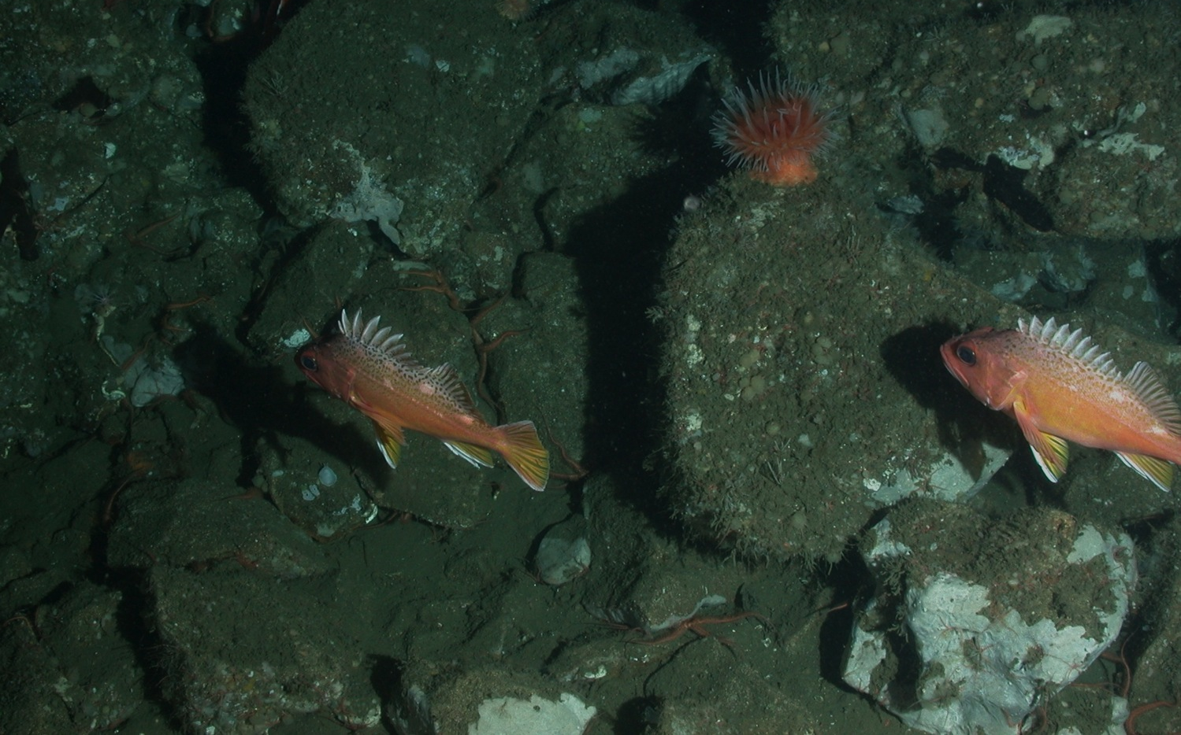
How would you describe this habitat type?
Rocky bottom: Any area with rocks, boulders, or pinnacles
Notes:
Habitat with rocks, boulders, granite or pinnacles is considered rocky bottom or rocky reef. Some of these rocky areas look like boulders, while some are full of cobble-like material. This habitat provides a place for invertebrates to live, grow and survive and also offers essential shelter and habitat for fish.

Slide 9
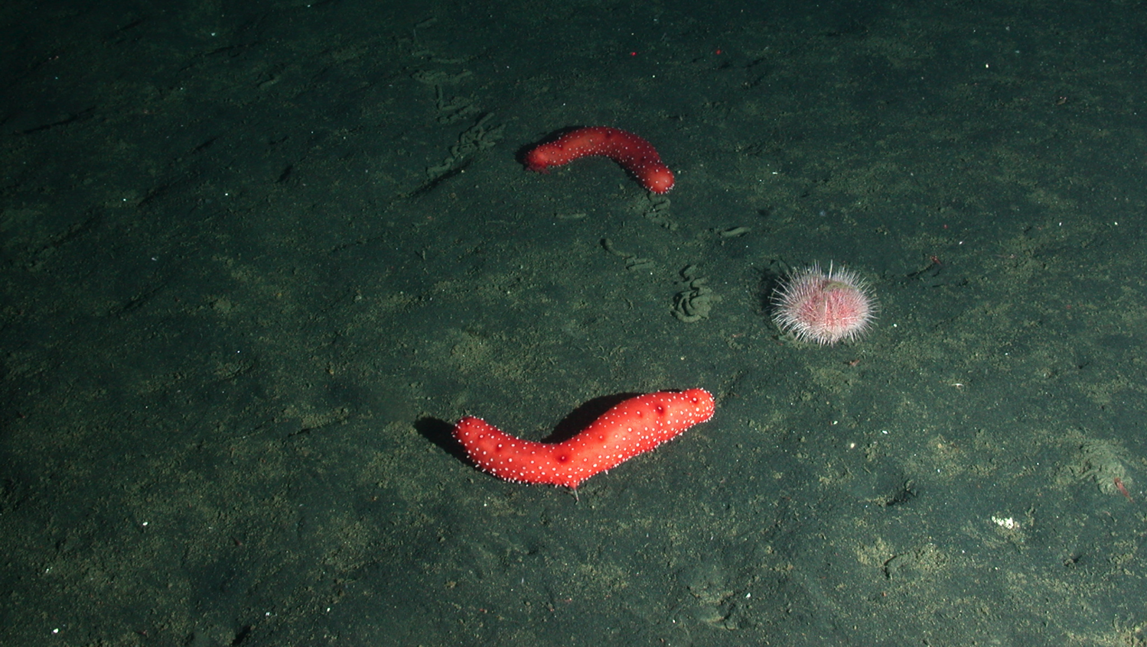
What type of habitat is this?
Soft bottom: Any area that lacks reef material and consists of soft, sandy or muddy substrate
Notes:
The soft bottom habitat varies from sandy to muddy. The sandy areas are made of carbonate material (broken shells and corals) and/or mud.

Slide 10
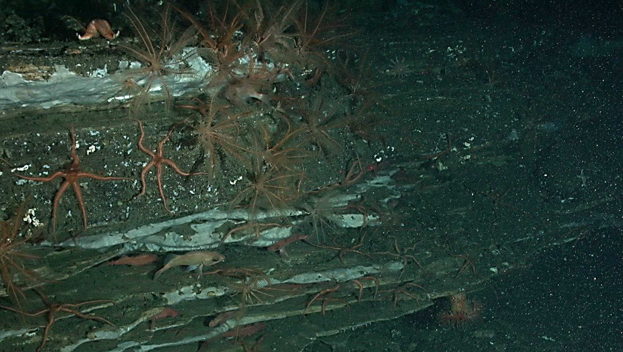
What is this habitat type?
Ledge: An area with a vertical rocky overhang or stacked shelves
Notes:
Ledge: An area with a vertical rocky overhang or stacked shelves. Ledges provide overhead protection for fish and invertebrates to hide under!

Slide 11
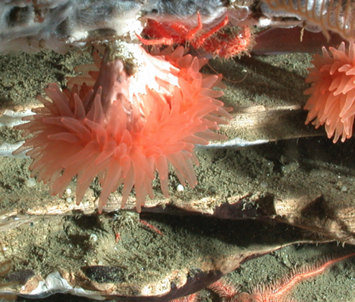
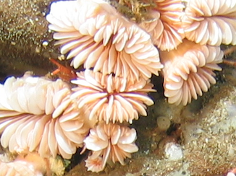
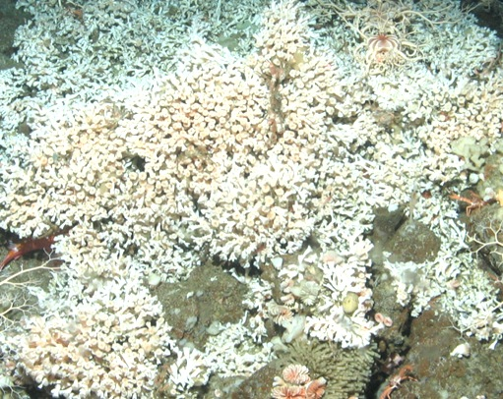
What are these and how do they grow?
Hard Corals!
Build a skeleton of calcium carbonate
Some build reefs over MANY years
Notes:
Hard corals build a calcium carbonate skeleton and some types of hard coral, such as Lophelia, (far right photo) are capable of building reefs over many years. Have your students use their ID guides to guess the species! Photos (from left to right): Flabellum cup coral, Desmophyllum cup coral and Lophelia spider hard coral.

Slide 12
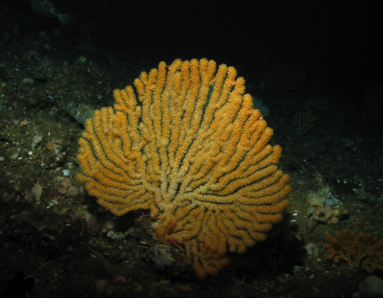
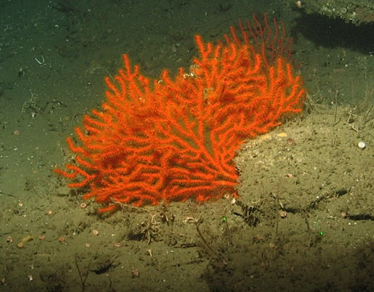
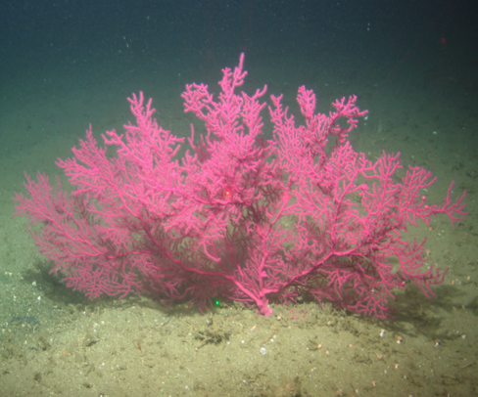
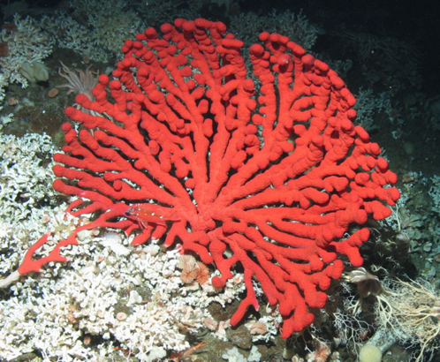
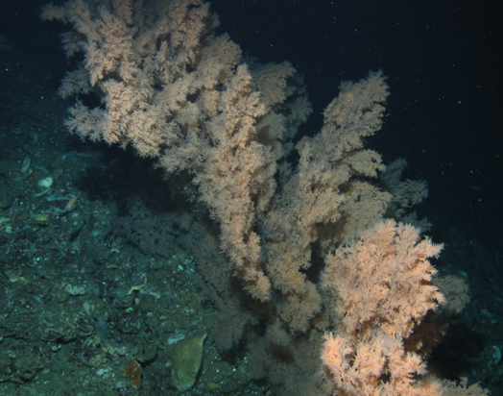
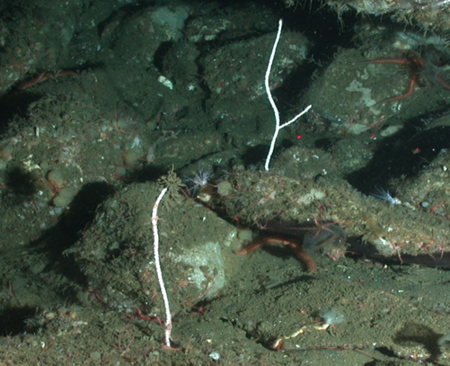
What are these? How are they different?
Soft Corals!
Do not produce a hard calcium carbonate skeleton
Notes:
Unlike hard corals, soft corals do not produce a calcium carbonate skeleton. These soft corals thrive in nutrient-rich waters with less light. They are integral members of our deep sea ecosystem and provide essential habitat for fish and invertebrates. Photos (left to right): top – Acanthogorgia golden sea fan, Adelogorgia orange sea fan and Eugorgia purple sea fan; bottom – Paragorgia bubblegum sea fan, Antipathes dendrochristos black coral and Leptogorgia sea pen.

Slide 13
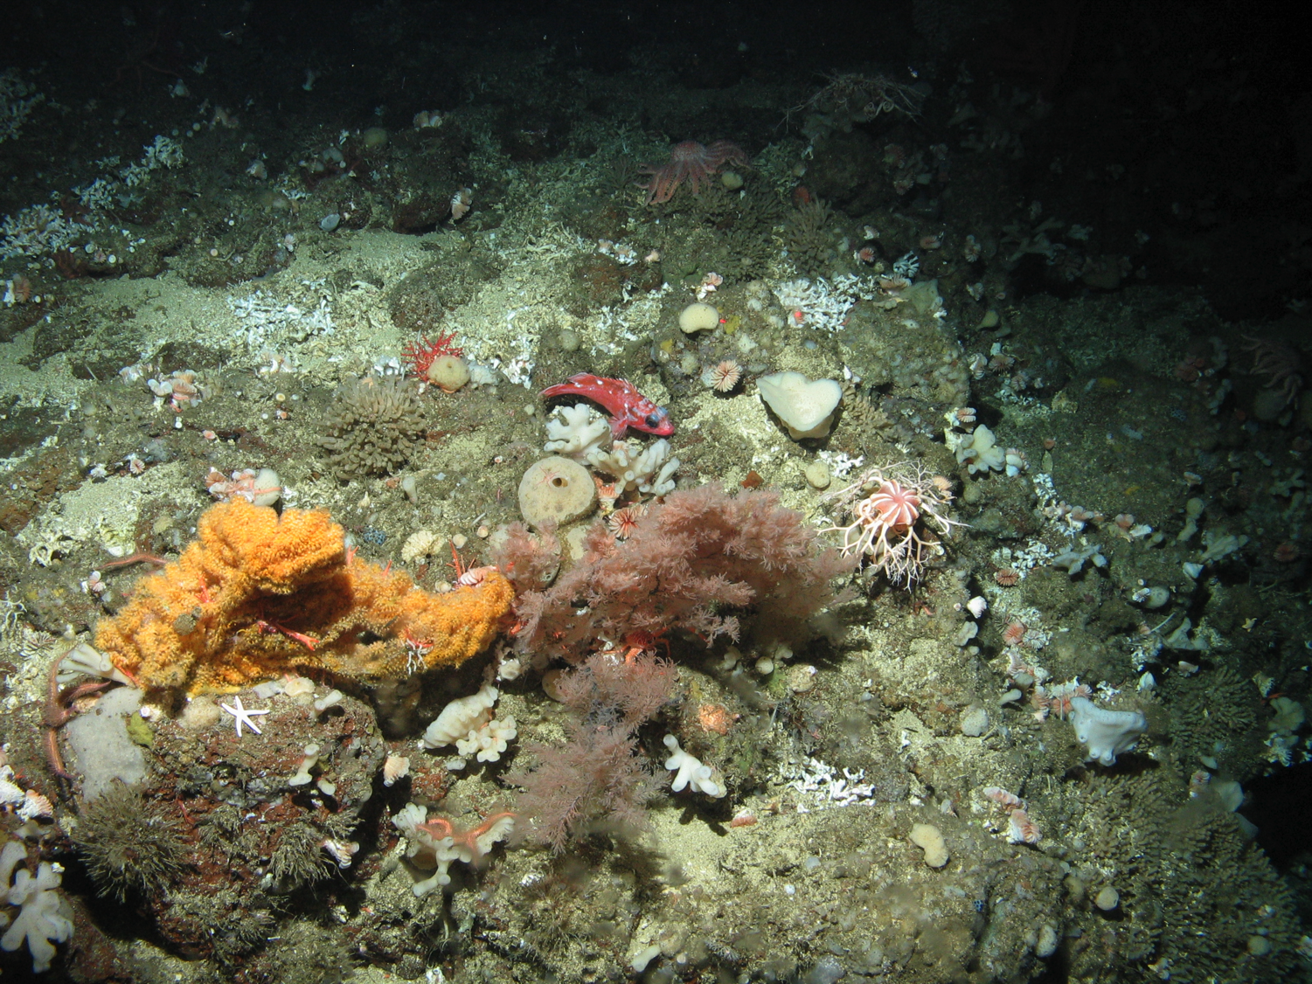
Both provide habitat for fish and invertebrates.
How many can you find?
Notes:
Both hard (stony) corals and soft corals are found in deep sea environments, and both provide vital habitat for fish and invertebrates. Here, we see black coral next to a golden sea fan (both soft coral) with Lophelia hard coral scattered around.

Slide 14
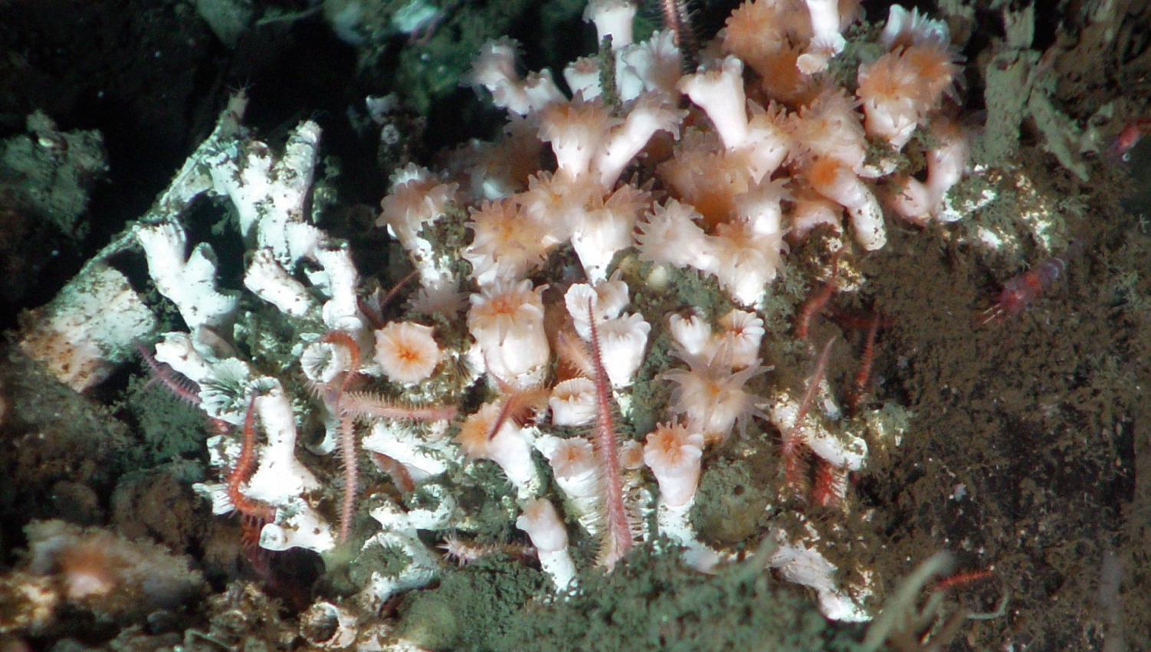
How do deep-sea corals eat?
Think about it while you explore them!
Notes:
Deep-sea corals, such as Lophelia pertusa, live in low-light environments and do not rely as much on the algae zooxanthellae; instead, they actively capture and consume free floating food, such as zooplankton and “marine snow.” Learn more about marine snow and its importance as food in the deep sea: https://oceanservice.noaa.gov/facts/marinesnow.html
A simpler way to explain this later in the Explain part of the lesson: They capture and consume free-floating food, such as zooplankton and “marine snow.”

Slide 15
How many types of deep-sea corals are there?
How long can they live?
3,000+ species!
Found all around world
New species discovered every year
Can be 4,000+ years old!
Can live in frigid temperatures of -1 degree Celsius (30.2°F)!
Notes:
They are found all around the world in deep waters of temperatures down to -1°C (30.2°F). There are over 3,000 species of deep sea corals and new ones are discovered every year. They can live for extremely long periods of time – one colony of deep sea black coral was found to be over 4,000 years old!

Slide 16
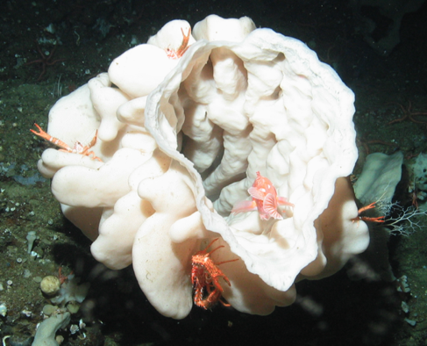
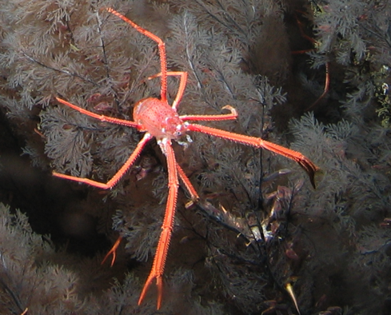
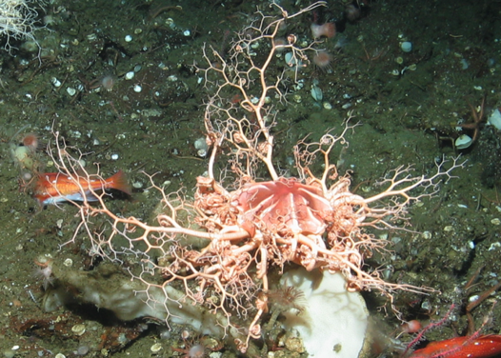
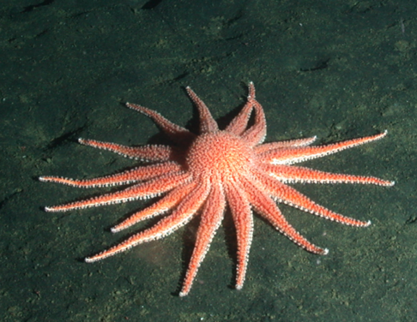
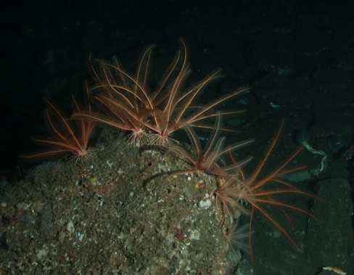
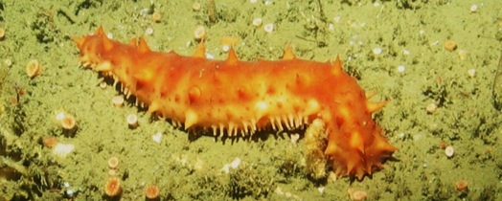
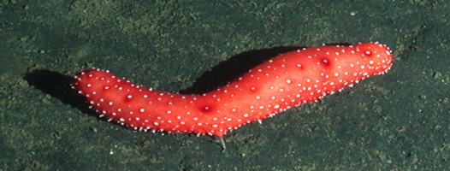
Invertebrates
Incredible Biodiversity in Deep-sea Coral Communities!
Notes:
Students should be encouraged to identify species, if they can; however, this can be overwhelming during the transect. Simply writing down the common name, such as sponge or sea star, is sufficient for this activity. Photos (left to right): top – Aphrocallistes vastus glass vase sponge, Munida squat lobster and Gorgonocephalus basket star; bottom – Rathbunaster californicus sun star, Florometra serratissima feather star and Parastichopus sea cucumbers.

Slide 17
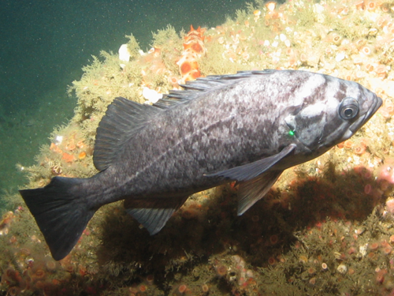
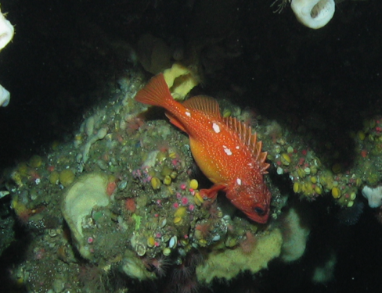
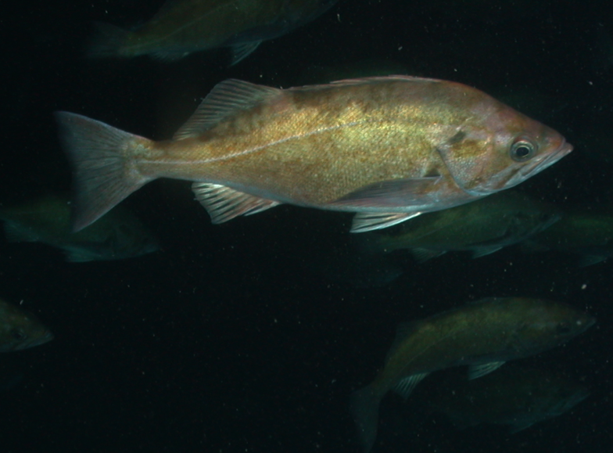
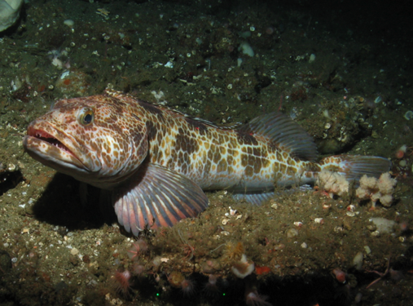
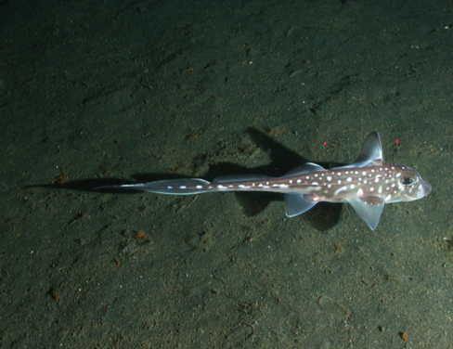
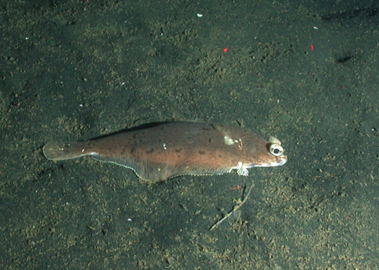
Vertebrates
Look at body shape, behavior and coloring.
Notes:
There are many types of fish in the deep sea environment, but the species pictured here are the main species we will identify in this lesson. Therefore, if a species does not look like anything on your guide, do not record it! We do not have to identify rockfish species – only record that they are rockfish! Photos (left to right): top – Sebastes rockfish (all three top photos); bottom – Ophiodon elongatus lingcod, Hydrolagus colliei spotted ratfish and Citharichthys sordidus Pacific sanddab.

Slide 18
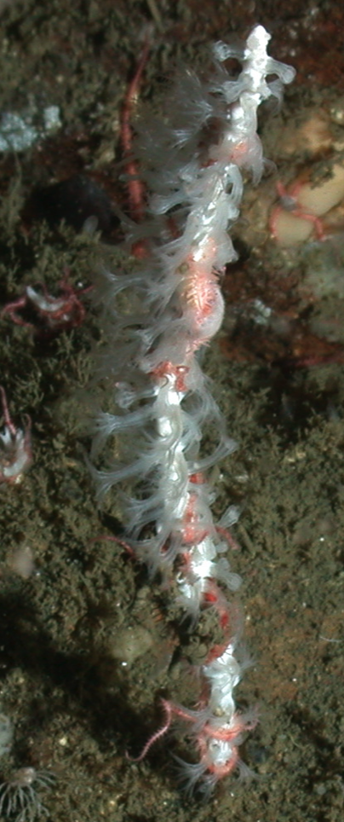
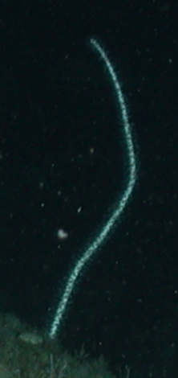
Coral Biology
Corals are colonies of small individual coral polyps
Left: Coral polyps of a sea pen extended and feeding on plankton
Right: A sea pen with the coral polyps retracted
Notes:
Coral Biology — What we term “corals” are actually colonies of very small individual coral polyps. Here, we can see the coral polyps of a sea pen, a soft coral, extended and feeding on plankton (left) and a sea pen with the coral polyps retracted (right).

Slide 19
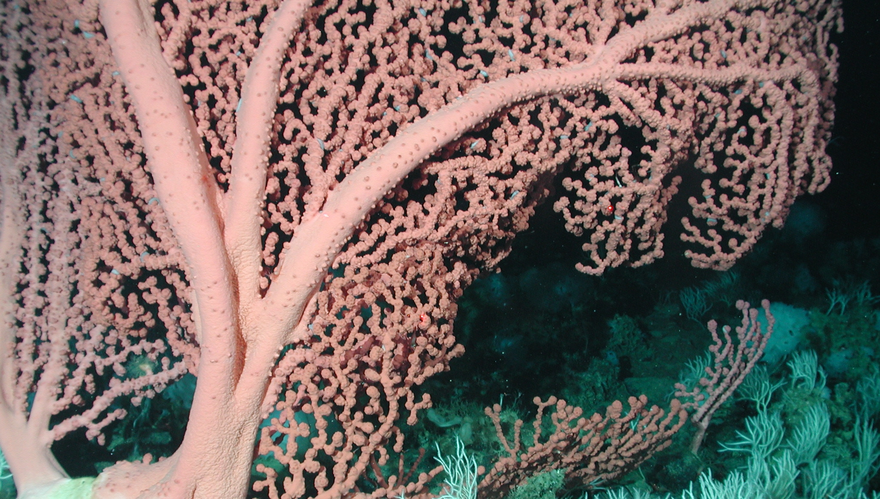
Understanding Scientific Methods
[Play a Deep-Sea Coral Community transect]
Notes:
Choose any of the transects available for download. One option is Channel Islands – Deep 1 – The Footprint video (>100 meters deep; rocky): https://nmssanctuaries.blob.core.windows.net/sanctuaries-prod/media/archive/education/teachers/deep-coral-communities/deep1.mp4
When the clip is over, ask students the following questions:
What information do you think scientists are interested in when they view a video of a deep sea environment?
What would they count/measure/record in order to gain a better understanding of an ecosystem?
Play the clip for students once more if they request it.
Ask them – Do you think researchers can explore the entire ecosystem using an ROV?
What scientific methods could they use instead?
Let them take a moment to think about these questions and answer them to the best of their ability/knowledge.
The correct answers: Scientists are interested in the type of habitat, the composition of species in terms of abundance (how many individuals) and diversity (how many species) are found in a habitat. They can and do use transects (covered a few slides ahead), which are measured snapshots of a habitat that allow scientists to gain an accurate understanding of the entire ecosystem.

Slide 20
Species Identification
Soft Corals
Sea fans, sea pens, black coral
Hard Corals
Cup corals, reef-building Lophelia
Invertebrates
Sea stars, sea urchins, sea cucumbers, feather stars, crustaceans
Vertebrates
Rockfish, lingcod, rays, other fish
Notes:
Have students take a few minutes to look over their species identification guides. Ask them: What do you look for when you identify organisms? Characteristics that you should pay attention to include: body shape, color, behavior and habitat type. Some species may be masters of camouflage on the soft bottom (flatfish, for example), but stick out in the rocky bottom areas or vice versa.

Slide 21
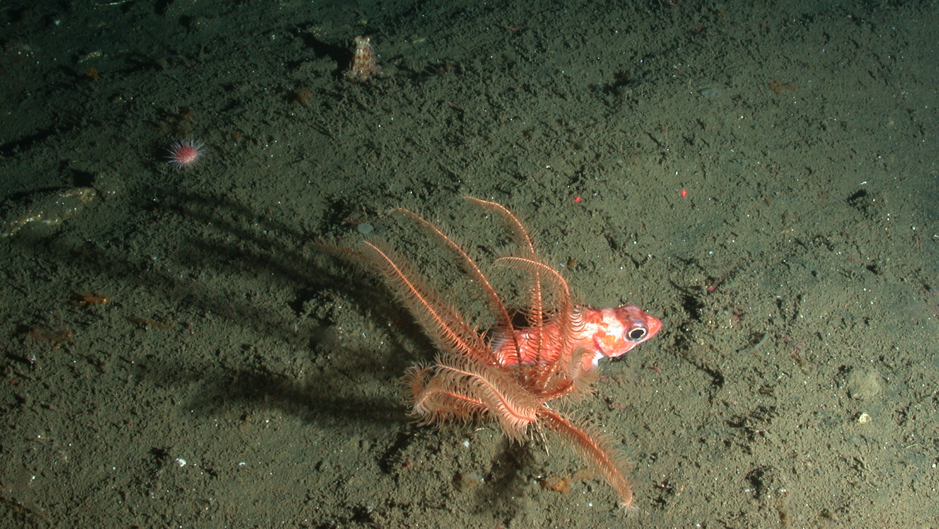
Laser dots are 10 cm apart. Can you spot them?
Researchers can measure the size of organisms, as well as distances and parts of the habitat.
Notes:
When viewing the video transect, you are going to notice two red dots that do not seem to go away; the dots are lasers set at a distance of 10 centimeters apart. These are set to get an accurate measurement of the species you are observing. This is particularly useful for studying rockfish, because it helps researchers to determine the age class of a fish.

Slide 22
How do you rate species abundance?
Single 1
Few 2-10
Many 11-50
Abundant >50
Notes:
Often, it is much easier and more practical for scientists to estimate abundance rather than actually count individuals, especially when biodiversity is dense. For this exercise, we are going to use our best estimate for species abundance, or the number of individuals of a particular species present in each transect.
During the video transect, each member of the group will watch for a different group of organisms or species. After the transect is complete, you will assign an abundance category for the total amount counted during each minute of the transect. Single is for 1 individual by itself, few is for 2-10 individuals, many is for 11-50 and abundant is for >50. Sometimes species are so abundant that they are hard to count. When large groups of corals or fish are seen (greater than 50 or 100), students may mark off “many” or “abundant” on the data sheet immediately.

Slide 23
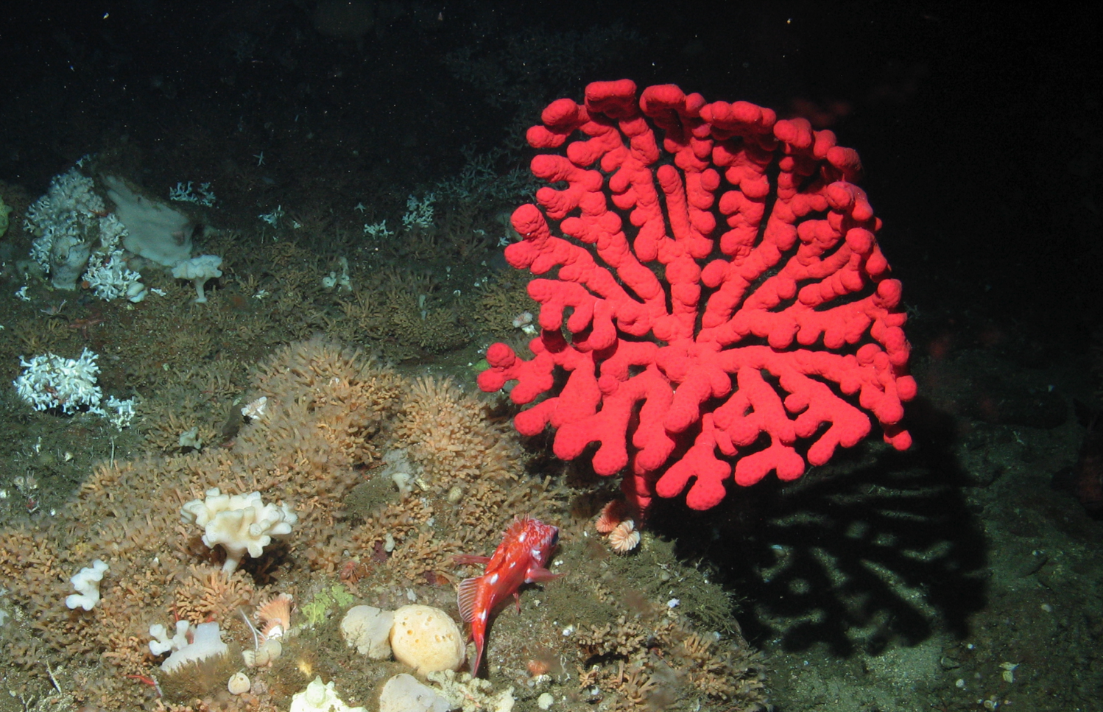
Single (S)
Single Colony
Single Individual
Notes:
When counting fish or invertebrates, find the individuals. When counting coral colonies, look at the base or try to determine the center of the branches to count how many colonies are present. In this photo, the coral colony is Paragorgia bubblegum coral and the fish is Sebastes rockfish.

Slide 24
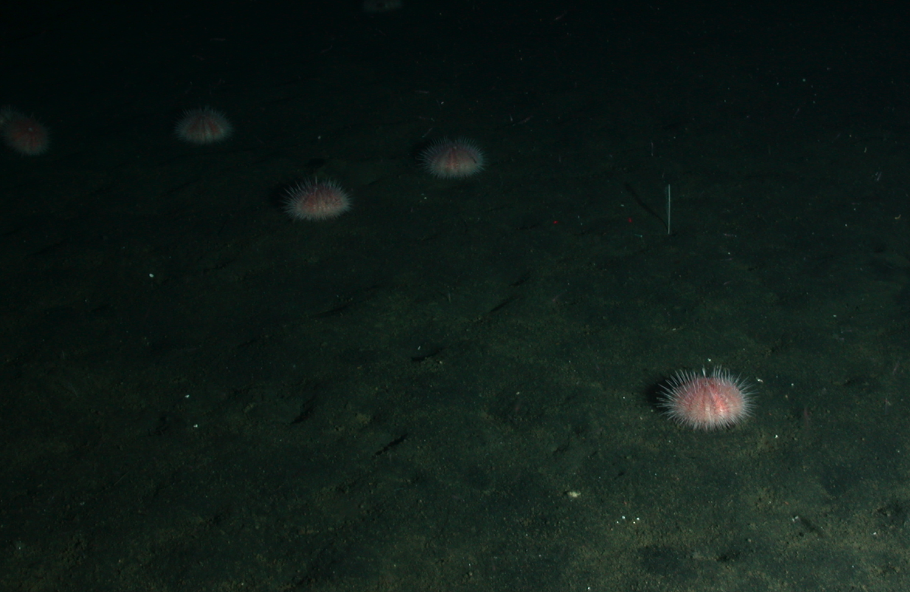
Few (F)
2-10
Notes:
More than one, 10 or less. The urchins are Strongylocentrotus fragilis fragile pink sea urchin.

Slide 25
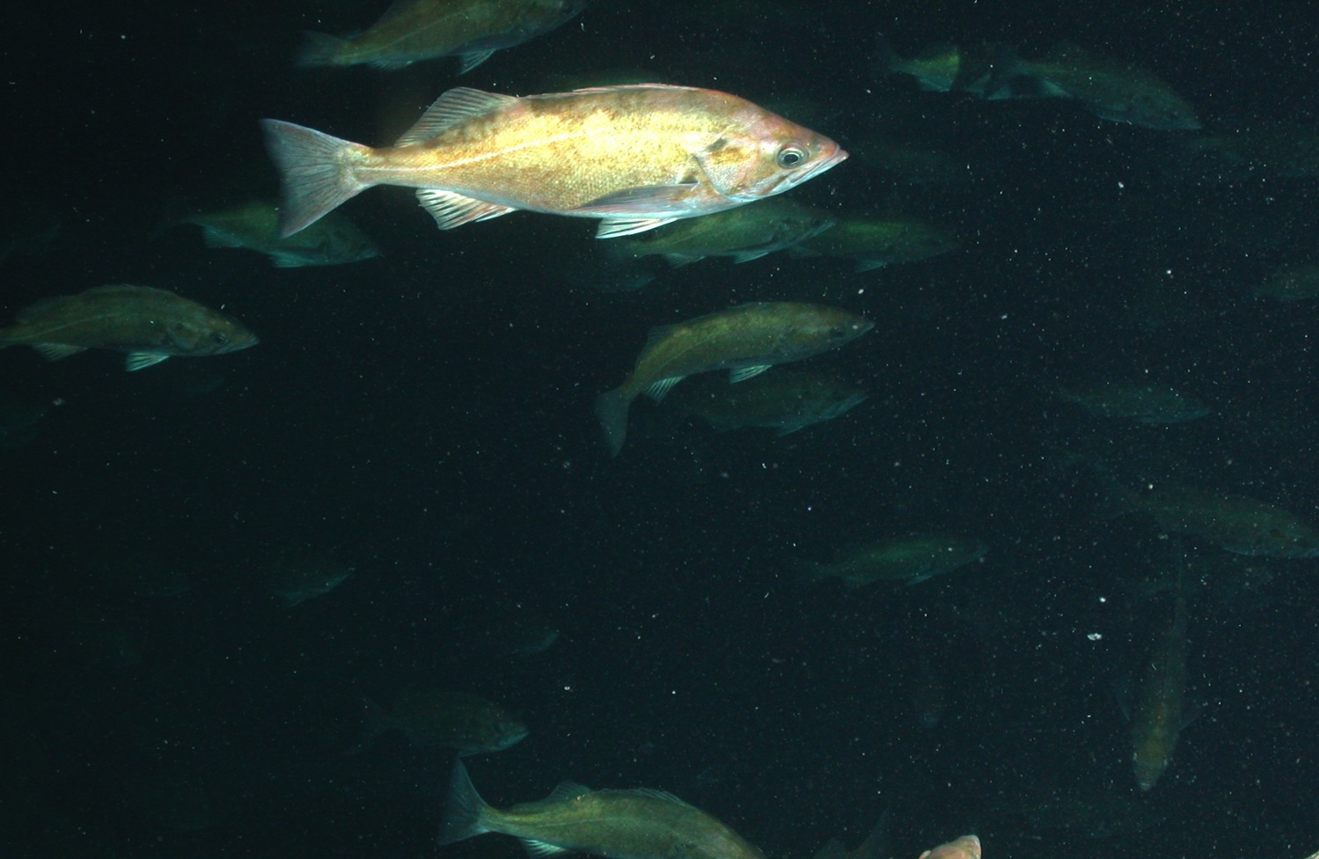
Many (M)
11-50
Notes:
11-50 individuals or colonies. These fish are Sebastes rockfish.

Slide 26
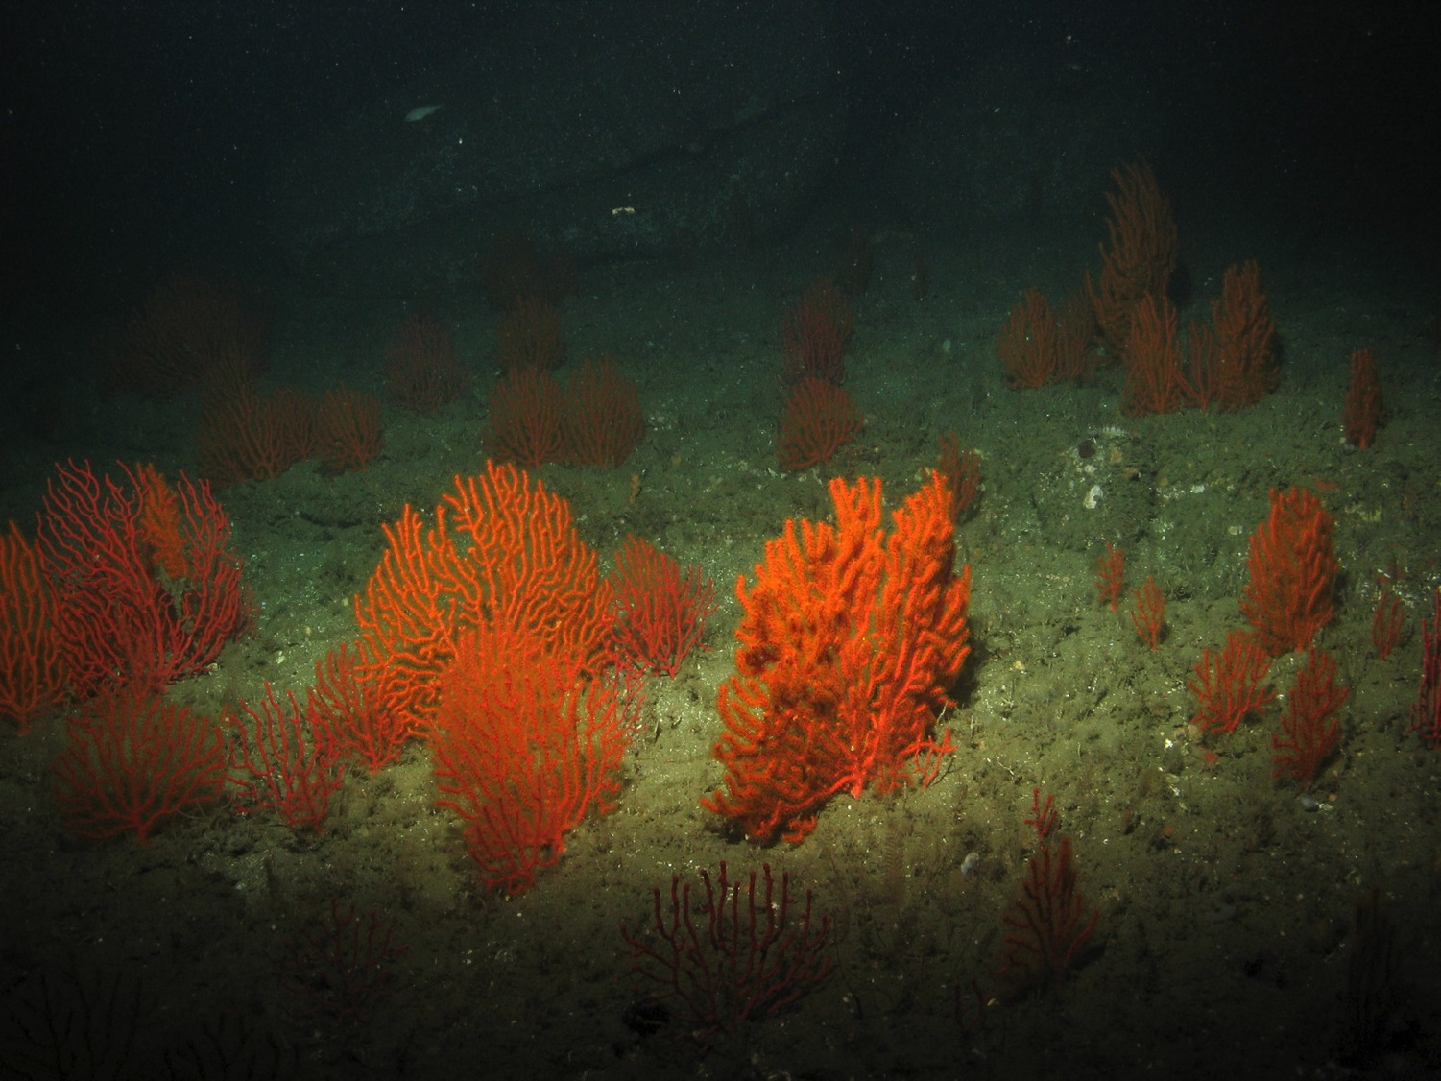
Abundant (A)
50+
Notes:
More than 50 individuals or colonies (which can be hard to count!). The corals are Adelogorgia orange sea fan.

Slide 27
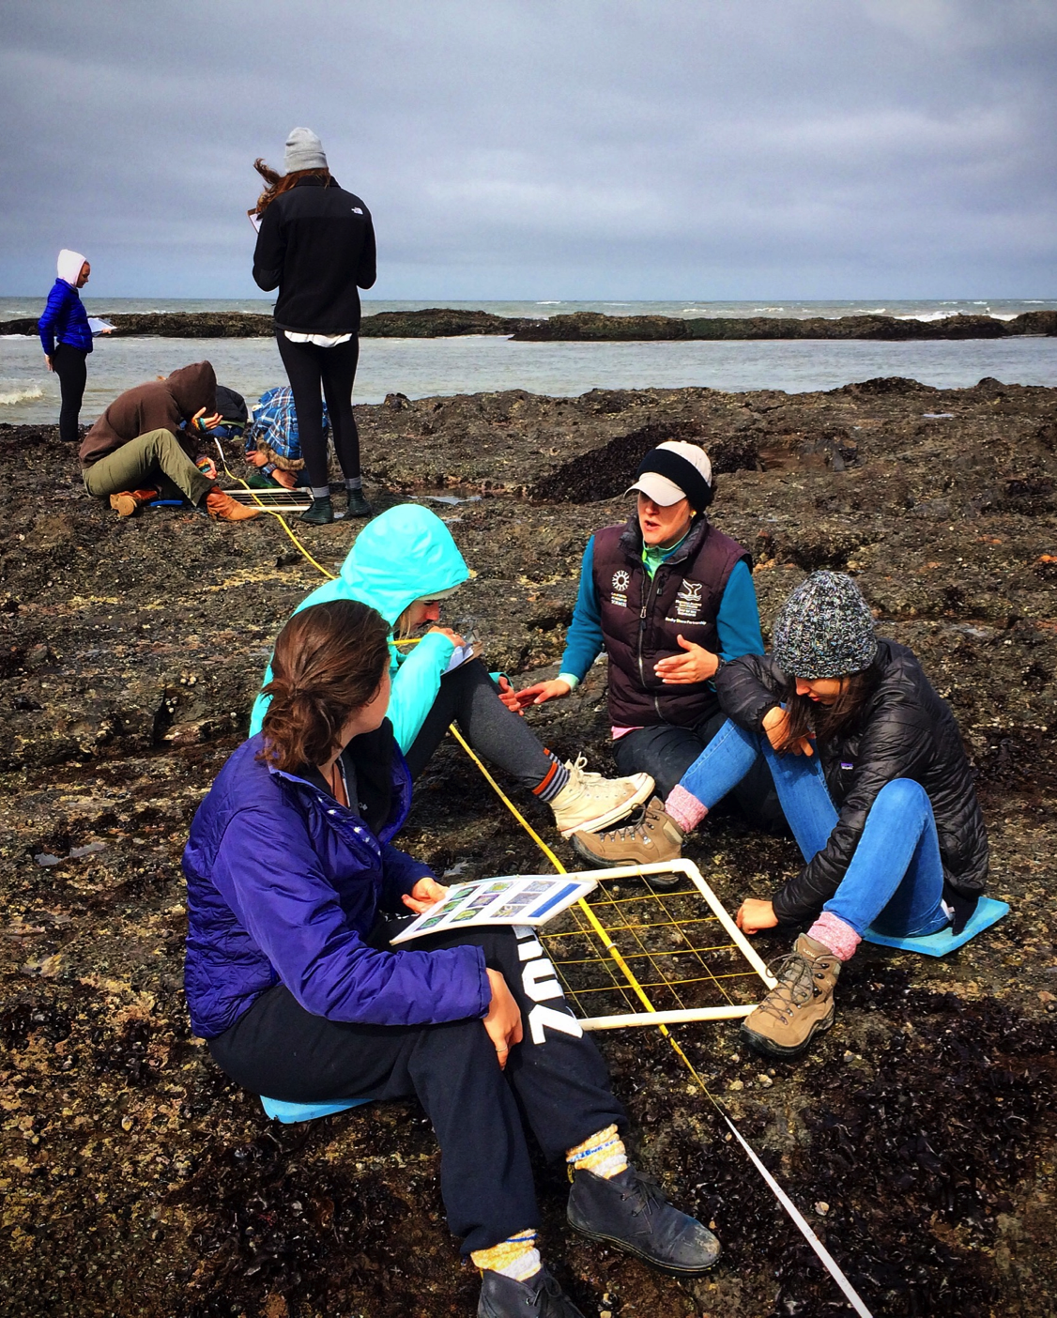
What’s a Transect?
A straight line through a habitat for a specific distance or length of time
Researchers record species diversity and abundance, as well as habitat type.
Notes:
Can we take an ROV and look at an entire habitat? No! That would be nearly impossible considering time constraints and the limited abilities of an ROV. Plus, it would be a tremendous amount of work for researchers to analyze all that data! Therefore, we need to use a scientific method called a transect.
A transect is a straight line or path through a habitat for a specific distance or length of time along which researchers record species diversity, abundance and habitat type. A transect is a way to profile the physical and biological components of an ecosystem by just looking at one small part. Again, it would be very time consuming and difficult to profile an entire ecosystem, especially because transects generally provide an accurate picture of species diversity, abundance and habitat type.
This photo shows students conducting a transect through a rocky intertidal habitat. They are counting invertebrates and algae that they find along the transect.

Slide 28
Why Transects?
Help us understand how an ecosystem functions
May describe flow of energy through a system
Helps predict impacts of natural or human-caused events
Notes:
Collecting information from a transect helps us understand how an ecosystem functions. They may describe the flow of energy through a system and allow us to predict the impacts of natural or human-caused events. Each of our transects are 3 minutes in length (with the exception of Olympic Coast, which is 1.5 minutes).
*A note for your students: The ROV will often pause to investigate a particular organism, which may take it off of the transect line. Please tell your students to be aware of the potential for such a pause and if one does occur, that they should not re-count organisms when the ROV moves back towards the line.

Slide 29
Our Transects
Count individuals of certain species during one-minute segments of a transect
Then estimate abundance for the entire transect
Once we graph our abundance, we will look at diversity (how many different species found)
Notes:
We will count individuals of a certain species during one minute segments of a transect, then estimate abundance for the entire transect.
Once we graph our abundance, we will look at diversity, or how many different species we found.

Slide 30
You Can Do It!
You do not have to identify every single organism. Each group member will only be responsible for identifying one group of organisms! ☺
Notes:
Have students take a few minutes to look over their species identification guides. Ask them: What do you look for when you identify organisms? Characteristics that you should pay attention to include: body shape, color, behavior and habitat type. Some species may be masters of camouflage on the soft bottom (flatfish, for example), but stick out in the rocky bottom areas or vice versa.

Slide 31
Think About It!
Do species abundance and biodiversity vary with depth and habitat?
What threats face these habitats? How can we help protect them?
Notes:
1. To explore deep sea coral communities, researchers utilize Remotely Operated Vehicles (ROVs) that are designed to withstand deep sea pressures. ROVs are tethered to a vessel and operated from a boat via remote control. They are equipped with lights and a live feed camera so researchers on the vessel can observe and record the deep sea habitat.
2. We will explore various habitat types at different depths and measure species abundance and diversity found within deep sea coral communities. We will become familiar with the unique organisms that live in these communities and learn real scientific methods that researchers use to gauge the health of these habitats.
3. Depth and habitat type definitely influence these communities – and this lesson provides only a small snapshot!
4. Many threats face these habitats including fishing, marine debris and ocean acidification.

Slide 32
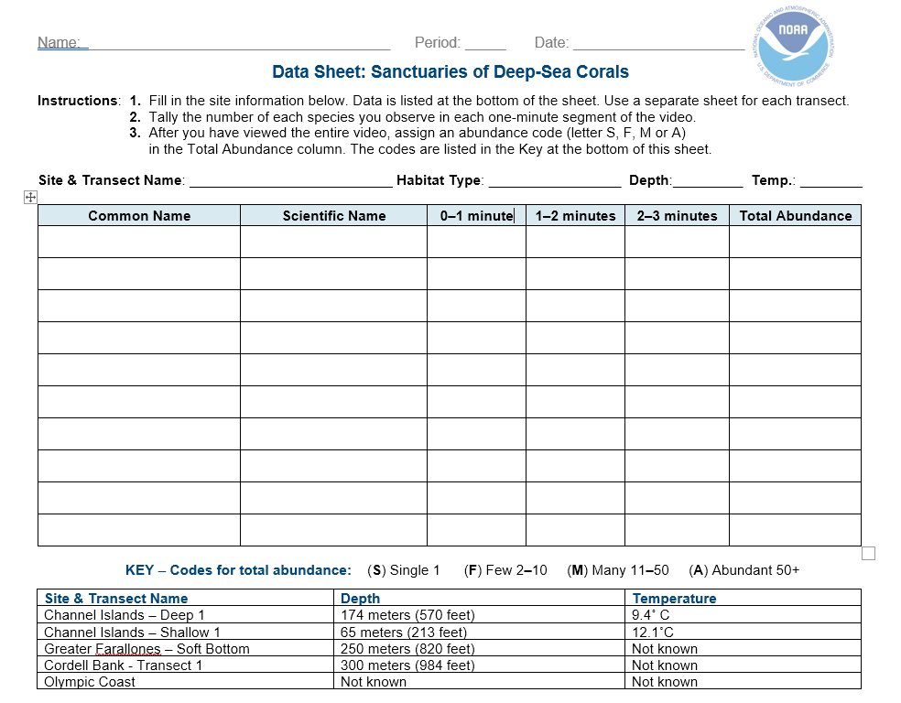
Data Sheet
Notes:
Everyone will record their data on a data sheet like this one. The teacher should show each transect in one minute segments, and the students should mark down how many of each species they see during each segment, and then add up totals at the end. Students should at least write down the common name of each species, and the genus and species as well, if they are able to identify it. Students should split up species among the group, so that each person only looks for a couple of species or one group of organisms (Soft Coral, Hard Coral, Invertebrates, Vertebrates). Additionally, at the end, tally the total abundance by adding how many of each species were seen in the transect and mark the overall abundance in the entire transect.
*Note: Depth and temperature may not be available for all transects.

Slide 33
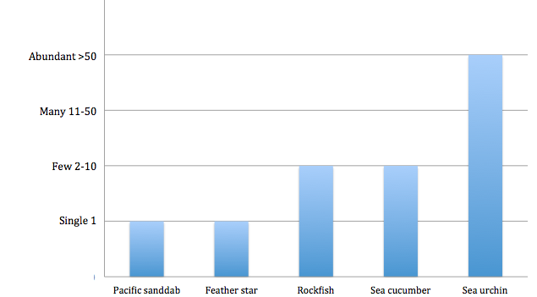
Transect Graphing
Graph species data from one or more transects
Compare and contrast species abundance and diversity among different sites, habitat types and depths
Notes:
We will graph species data from one or more transects from the National Marine Sanctuary System’s West Coast Region to compare and contrast species abundance and diversity among different sites, habitat types and depths.
It is recommended that students use Excel or another graphing program to represent their data for the actual transects; however, if access to a computer or classroom time is limited, a graph template is provided.

Slide 34
What threatens deep-sea coral communities?
Marine debris
Harmful fishing methods, such as bottom trawling
Notes:
What are the threats to deep sea coral communities?
(1.) Marine debris (garbage) and derelict (abandoned) fishing gear. Marine debris is one of the biggest threats to all marine ecosystems; nonetheless, it is also one of the most preventable problems that face our ocean. Debris can cause physical damage to corals, entangle animals or cause harm, or even death, if ingested by marine life. The species seen here is a type of rattail, the giant grenadier, Albatrossia pectoralis.
(2.) Harmful fishing methods, such as bottom trawling.
(3) Exploration for energy/oil and natural gas often involves drilling/fracking on the deep ocean floor.
(4.) Ocean acidification. Your students may be unfamiliar with ocean acidification; however, the slideshow will talk in-depth about this topic later.

Slide 35
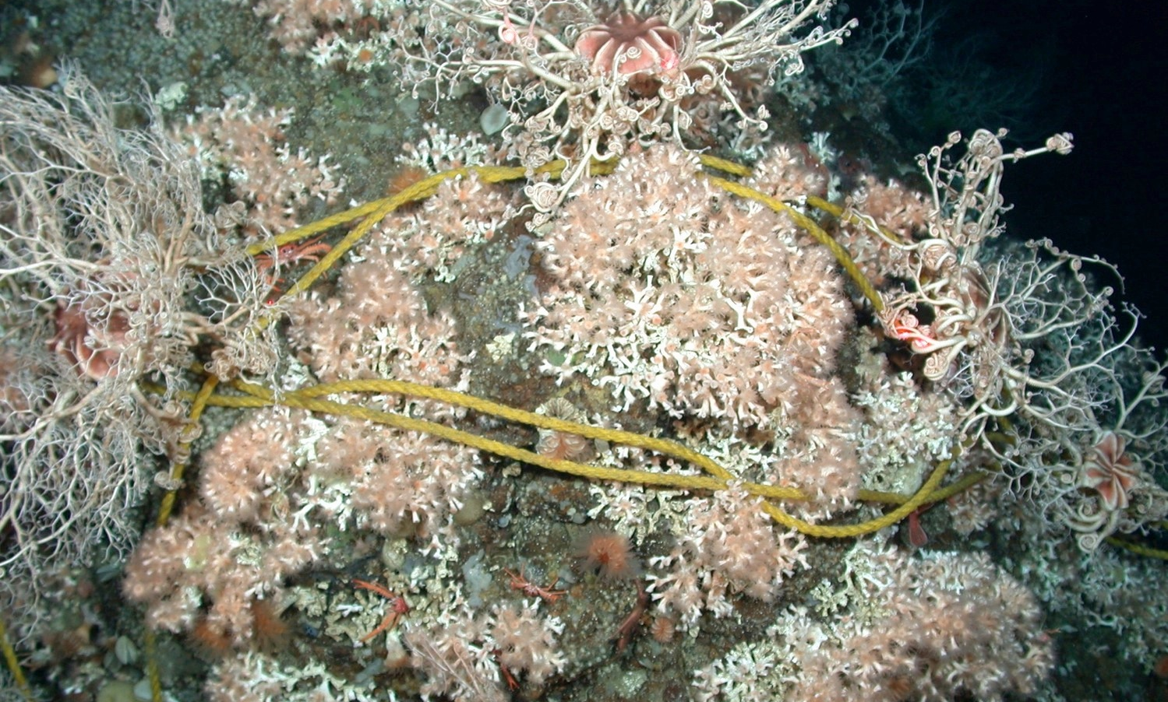
Abandoned fishing gear can damage or even completely destroy deep sea coral communities.
Notes:
Derelict (abandoned) fishing gear and marine debris can be very harmful for deep sea coral communities. They can crush corals, especially during storms or times of large water movement, and continuously catch fish and invertebrates. Conversely, sometimes derelict fishing gear can be harmless, and even act as an artificial reef, if organisms begin to grow on it and use it as shelter. In these cases, removal of the gear must be carefully evaluated.

Slide 36
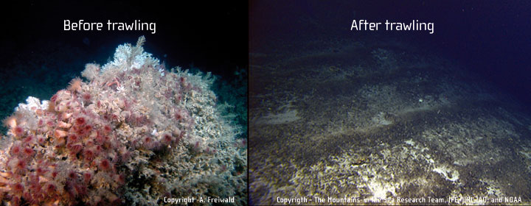
Bottom Trawling
Notes:
Harmful Fishing Methods: Bottom trawling is a fishing method where a net is dragged along the seafloor, scooping up all fish and invertebrates. It can take many years for deep sea communities to recover from damage caused by trawling. Destructive fishing methods, such as bottom trawling, where fishing nets are dragged along the seafloor to catch fish, can destroy hundreds of years of growth in coral communities.

Slide 37
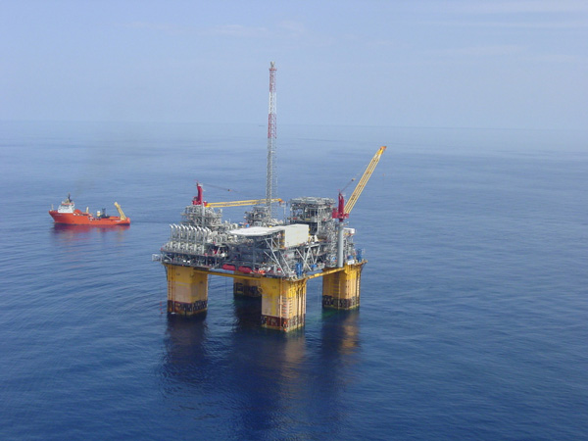
Oil and Natural Gas Exploration
Notes:
The exploration for and production of oil and natural gas resources can have a profound impact on deep sea coral communities. Potential threats include the physical impact of drilling, placement of structures on the seafloor (e.g. platforms, anchors, pipelines, cables, etc.), discharges from rock-cutting during the drilling process and drilling fluids discharges. For instance, in the North Sea, scientists observed how drilling muds and cuttings smothered and killed Lophelia pertusa colonies living on an oil platform close to drilling discharge points. Moreover, once oil platforms are established, there is a risk that accidental oil spills can impact these communities.

Slide 38
Ocean Acidification
Excess CO₂ absorbed by ocean → makes it more acidic
Chemical reaction of CO₂ with seawater bonds with carbonate, which many marine animals need to build shells and skeletons
What causes it?
Human carbon emissions
Notes:
Ocean acidification is caused by excess carbon dioxide (CO₂) in the atmosphere. The ocean acts like a big sponge, absorbing CO₂ from the air. As CO₂ enters the ocean, it reacts with H₂O and carbonate already present in seawater.
Shown here: In a lab experiment, a sea butterfly (pteropod) shell was placed in seawater with increased acidity and the shell slowly dissolved over 45 days. The first shell is clear and healthy. After 15 days the shell has turned a cloudy white color. After 30 days the shell appears cracked in places. After 45 days the shell structure has collapsed.

Slide 39
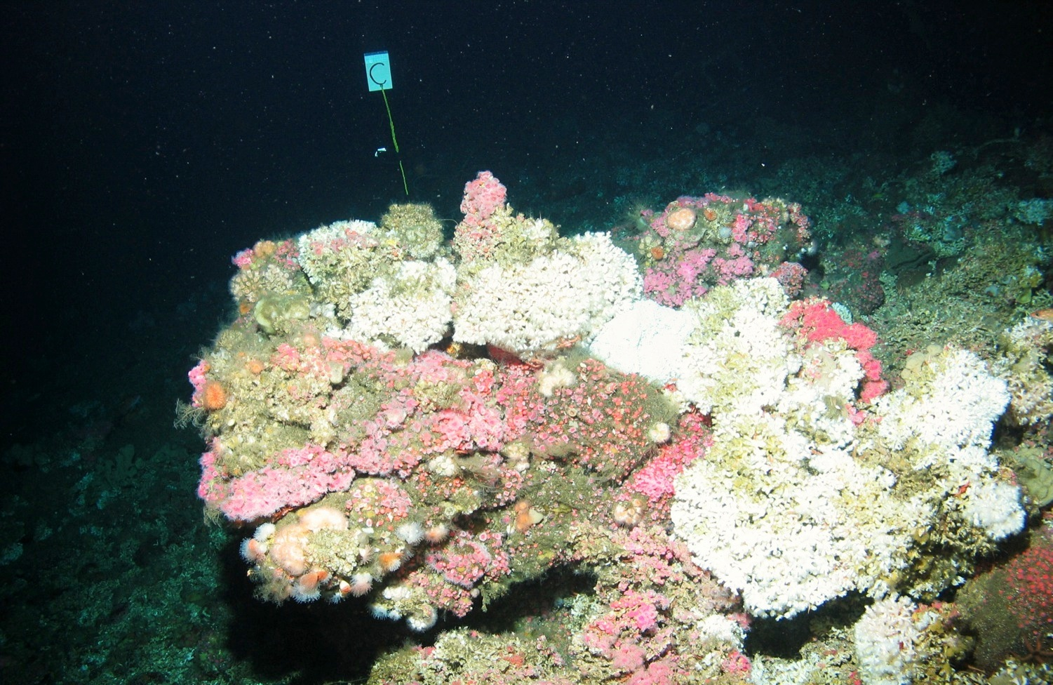
Long-term Monitoring
Notes:
Scientists often study a specific part of a habitat to see how it changes over time. They use this information to gauge the health of an ecosystem.
Scientists will place permanent markers near certain habitat locations and measure the health of those habitats over time. If damage (dead coral, in the case of this Lophelia) increases over time, we know the ecosystem is experiencing negative impacts, and may need additional scientific attention and/or ecosystem protection.
Using the ROV, researchers deploy markers near coral aggregations and take many high quality images of all the coral colonies around the marker. They have navigation data that helps them come back to the same location, and the reflective marker helps researchers return to the exact same coral colonies at a later time. By examining the same coral at multiple points in time, we can learn more about the:
(1.) rate of injury;
(2.) rate of injury progression;
(3.) rate of recovery; and
(4.) rate of growth.
This marker example shows a large aggregation of Lophelia pertusa, a reef building coral. As the ocean absorbs carbon dioxide, a process called ocean acidification, we expect it may get harder for reef building corals, like Lophelia, to build their skeletons. Using the markers, we can track the proportion of live and dead skeletons over time.

Slide 40
How can we help protect deep-sea coral communities?
Reduce fossil fuel emissions
Carpool, take public transportation, walk and/or bike
Clean up trash at beaches and in your community
Reduce household pollutants
Marine protected areas (MPAs) and national marine sanctuaries protect special places in our ocean
Notes:
What can we do to help protect our deep sea coral communities? Have your students brainstorm ideas and use these bullet points as a way to start a conversation.
Reduce carbon dioxide and other greenhouse gas emissions! Carpool, take public transportation, walk and/or bike — it all helps!
Reducing our carbon footprint, or contributing less carbon dioxide emissions to the atmosphere, is probably the single most important thing that each and every person can do!
Support both the establishment of new and conservation of current marine protected areas (MPAs) and national marine sanctuaries in order to protect the special places in our ocean.

Slide 41
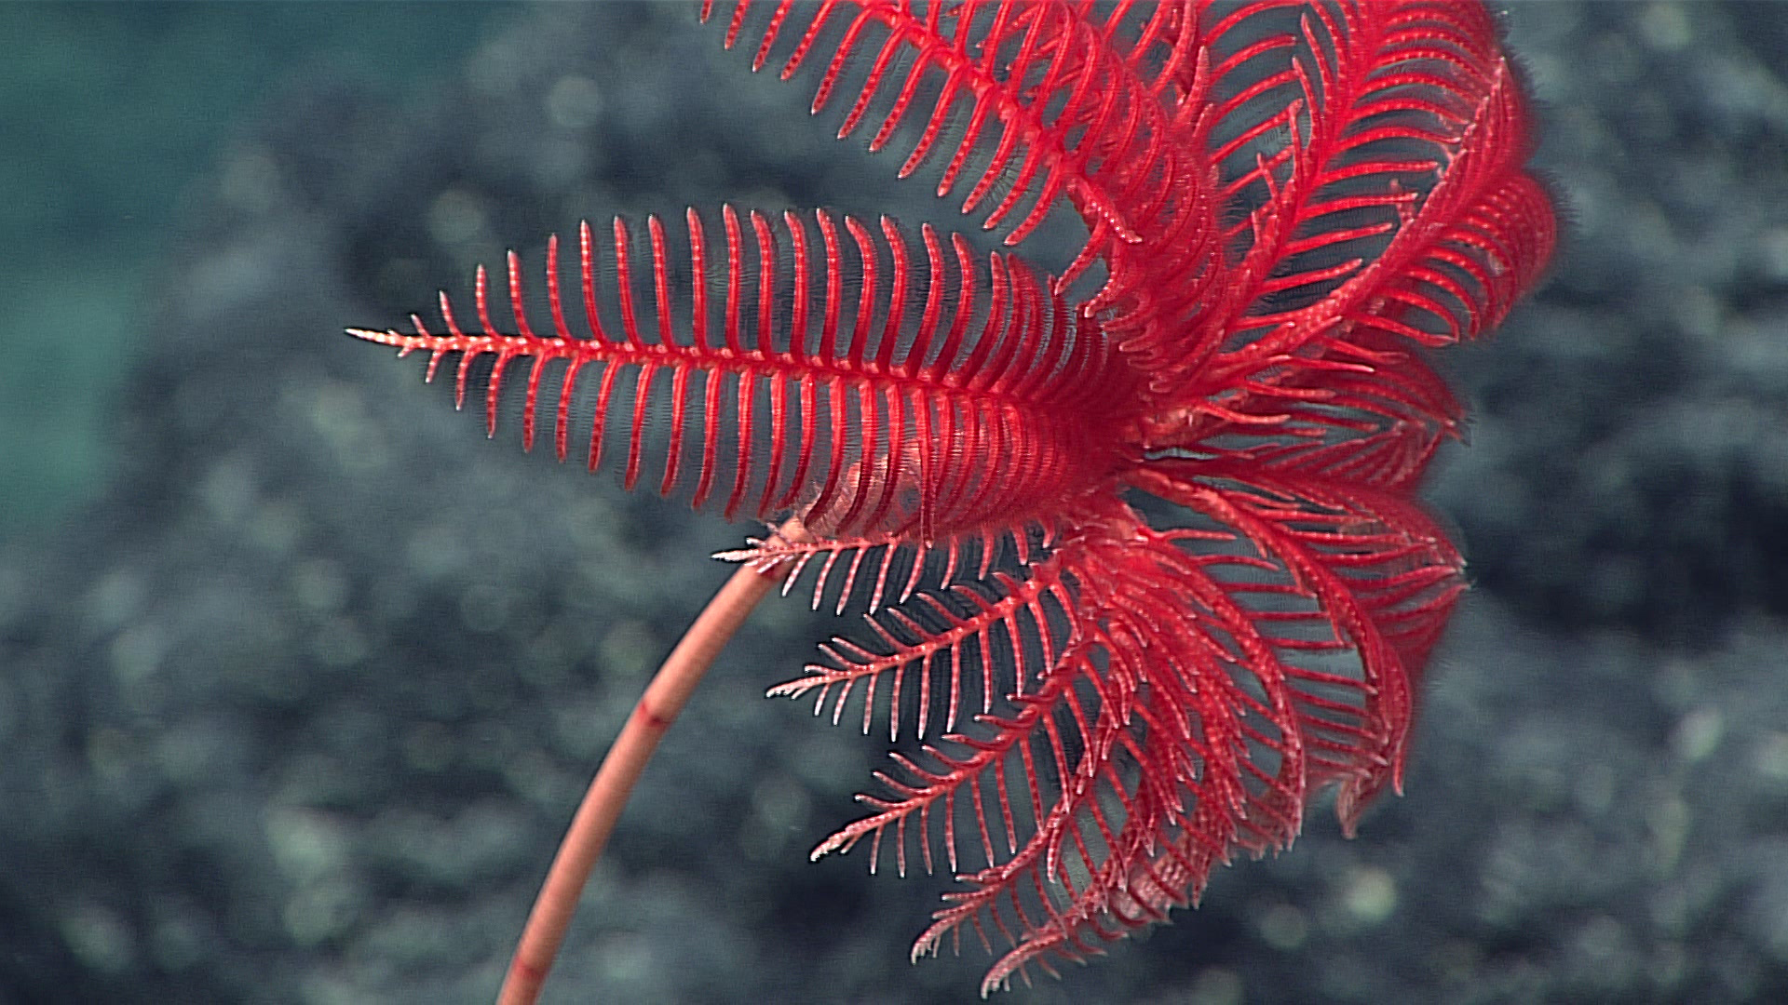
There are countless other ways to help!
More ideas at:
http://sanctuaries.noaa.gov/involved
Notes:
Encourage your students to find other ways to help!
Image of a sea lily from a deep-sea exploration: NOAA

Slide 42
Learn More
sanctuaries.noaa.gov/education

Slide 43
Thank You
We would like to thank the following individuals for their assistance with scientific review, species identification, video and still images that are included in this lesson plan. Peter Etnoyer, PhD, NOAA Marine Biologist, Leslie Wickes, MS, NOAA Affiliate, JHT, Inc., Enrique Salgado, Biologist, NOAA Affiliate, JHT, Inc. and Danielle Lipski, Research Coordinator Cordell Bank National Marine Sanctuary.
The idea for this lesson came from the "Exploring Cordell Bank National Marine Sanctuary by Submersible" activity developed by Jennifer Stock. This lesson was written and developed by Rietta Hohman, Greater Farallones National Marine Sanctuary. The National Marine Sanctuary System's West Coast Region education team developed and reviewed the content for the curriculum.

Slide 44
Acknowledgments
Funding support provided by: National Geographic Society +
Latest Version of Lesson Plan + Supporting Resources Created by Rick Reynolds, M.S.Ed. + Krista Reynolds, MLIS, M.Ed. Engaging Every Student In collaboration with NOAA’s Office of National Marine Sanctuaries, National Marine Sanctuary Foundation and National Geographic Society

Slide 45
Contact Tracy Hajduk National Education Coordinator Office of National Marine Sanctuaries National Oceanic and Atmospheric Administration Phone: 240-533-0663 Email: sanctuary.education@noaa.gov
sanctuaries.noaa.gov/education

