Slide 1
Mapping Friendly Floatees

Slide 2
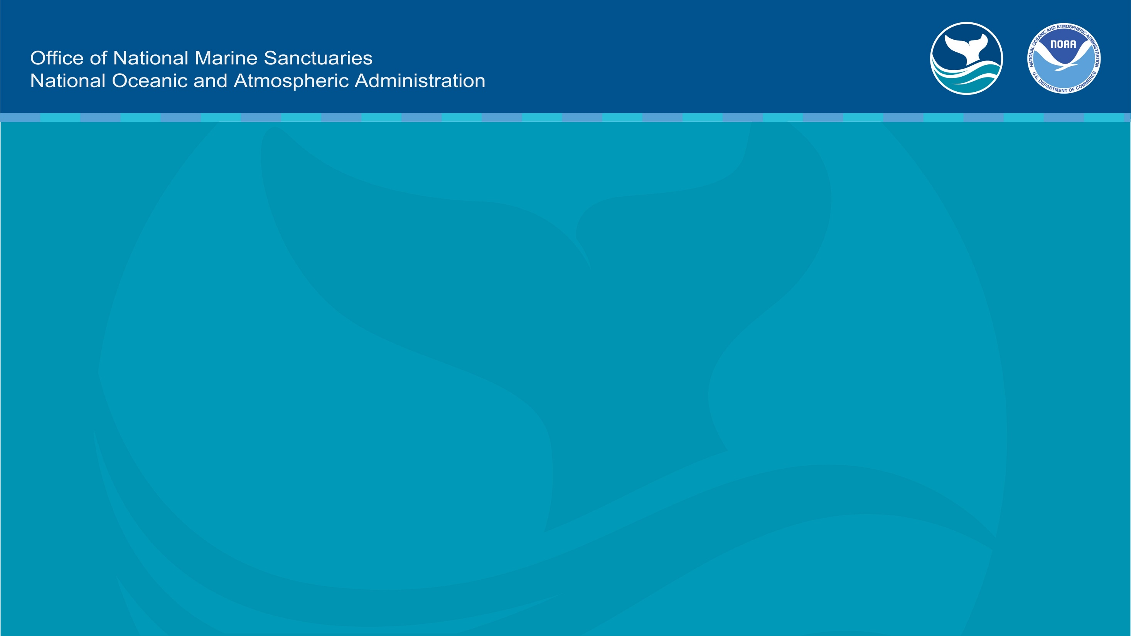
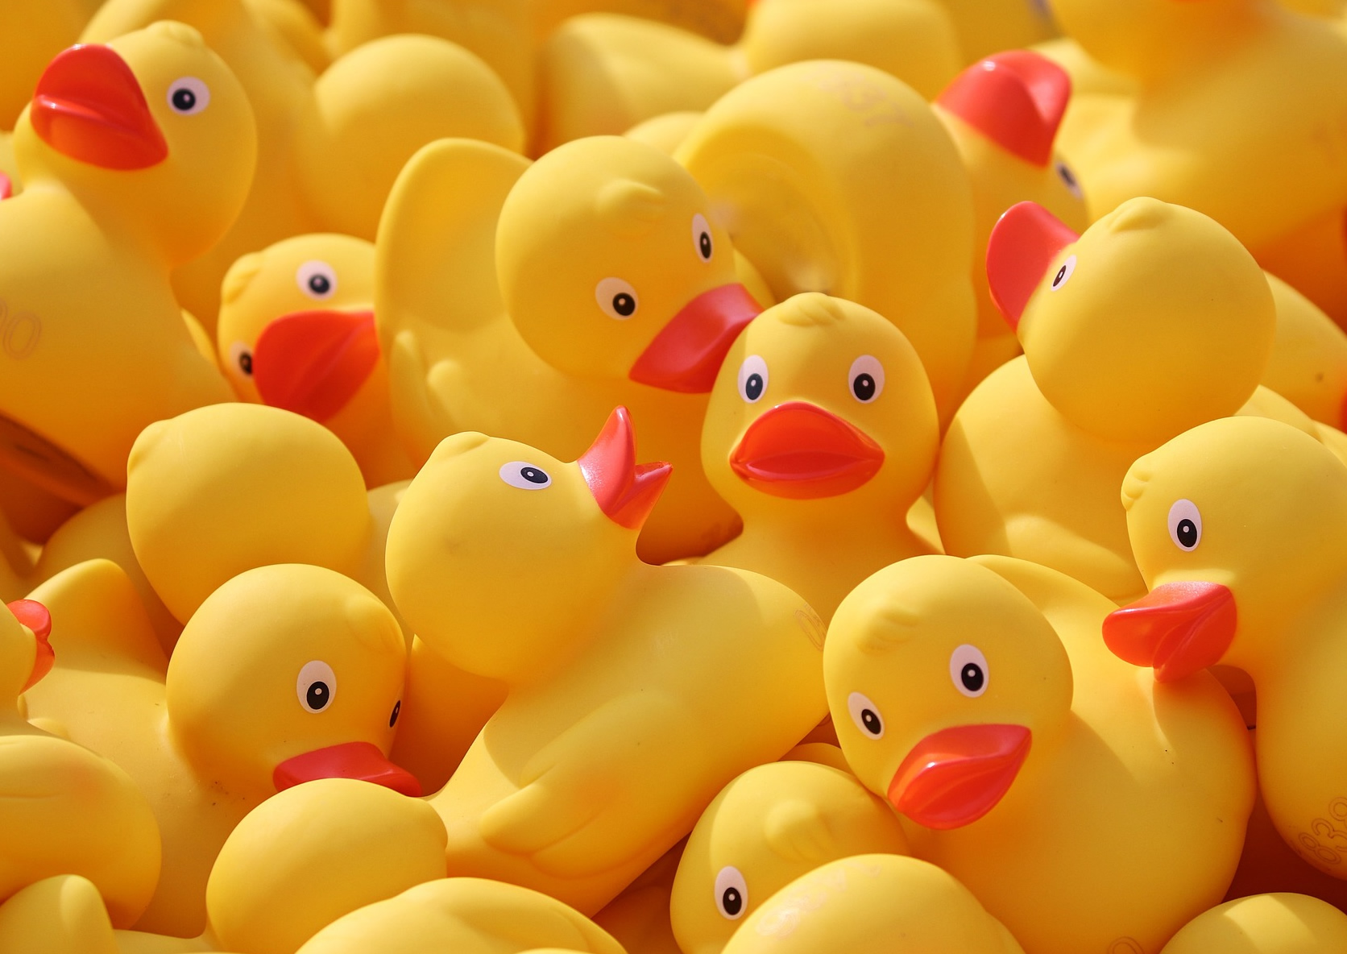
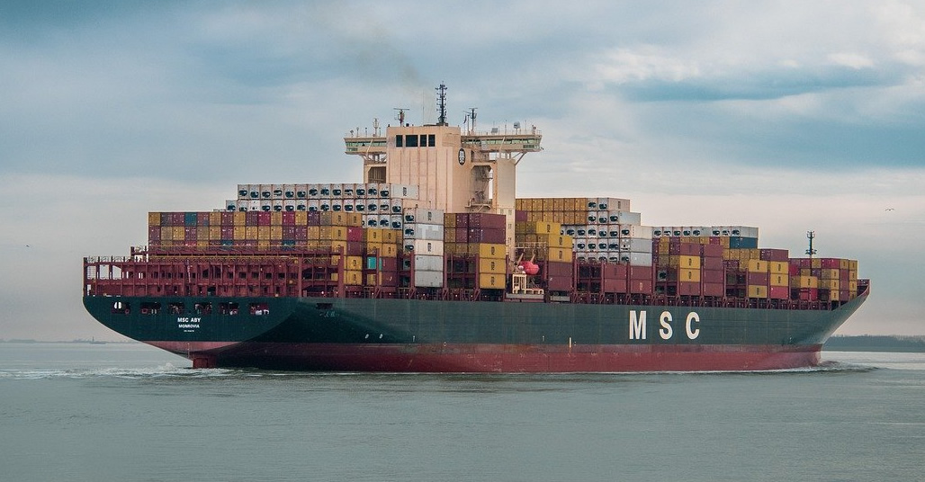
Cargo Ship
Notes:
See the lesson plan for talking points.
Rubber duck photo: Manfredrichter from Pixabay
Cargo ship photo: Freddy from Pixabay

Slide 3
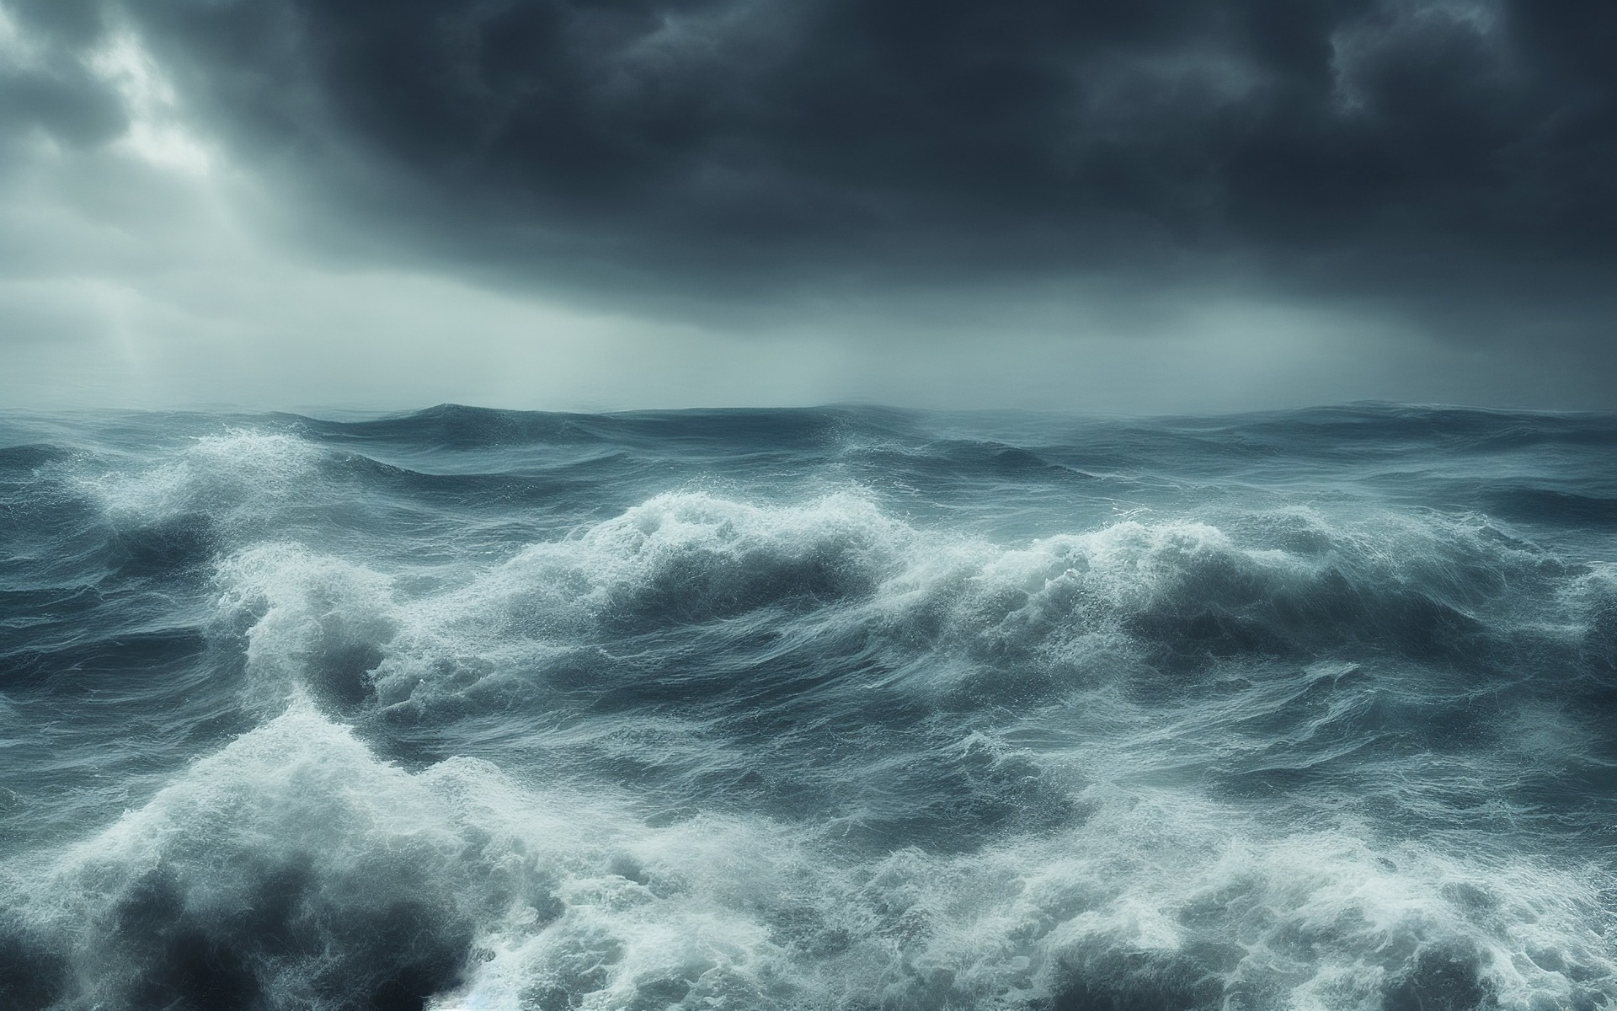
Friendly Floatees at Sea!
Notes:
Image by Joe from Pixabay: https://pixabay.com/photos/ocean-storm-waves-cloudy-weather-7461792

Slide 4
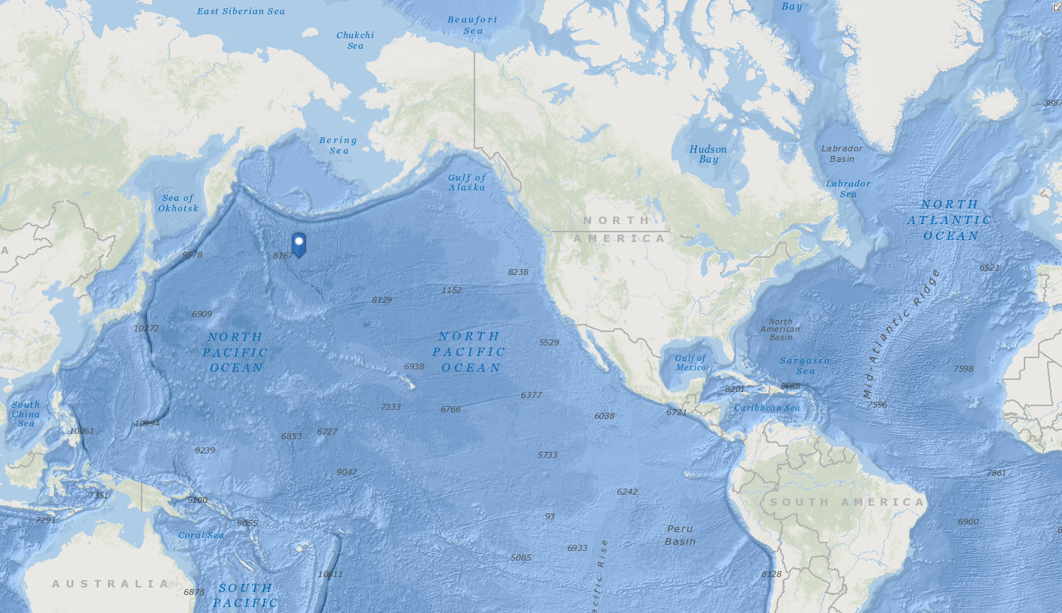
About 29,000 Floatees overboard! (44.7° N, 178.1° E)
Where might you and other Floatees go and why?
Record your ideas on the map or in science notebooks.
Notes:
Map: Screenshot from ArcGIS Online
Rubber duck image: Maman Suryaman from Vecteezy

Slide 5
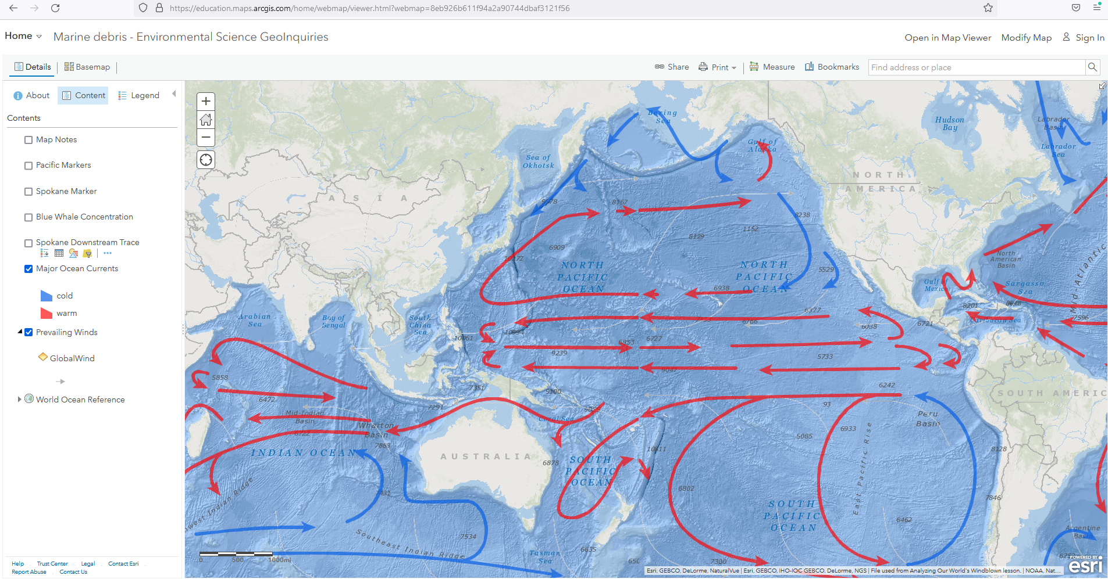
What are these arrows showing? Why are these forces important?
Notes:
Map: Screenshot from ArcGIS Online

Slide 6
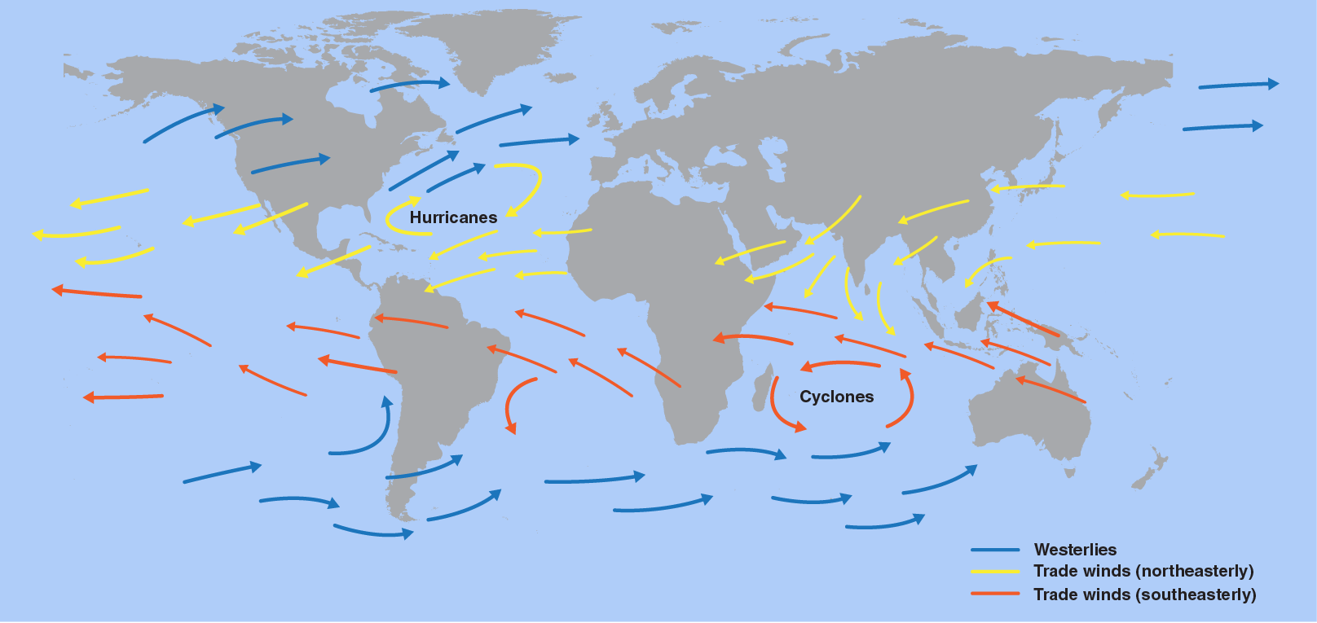
What are these arrows showing?
How might these and other forces matter to Floatees and the Earth?

Slide 7
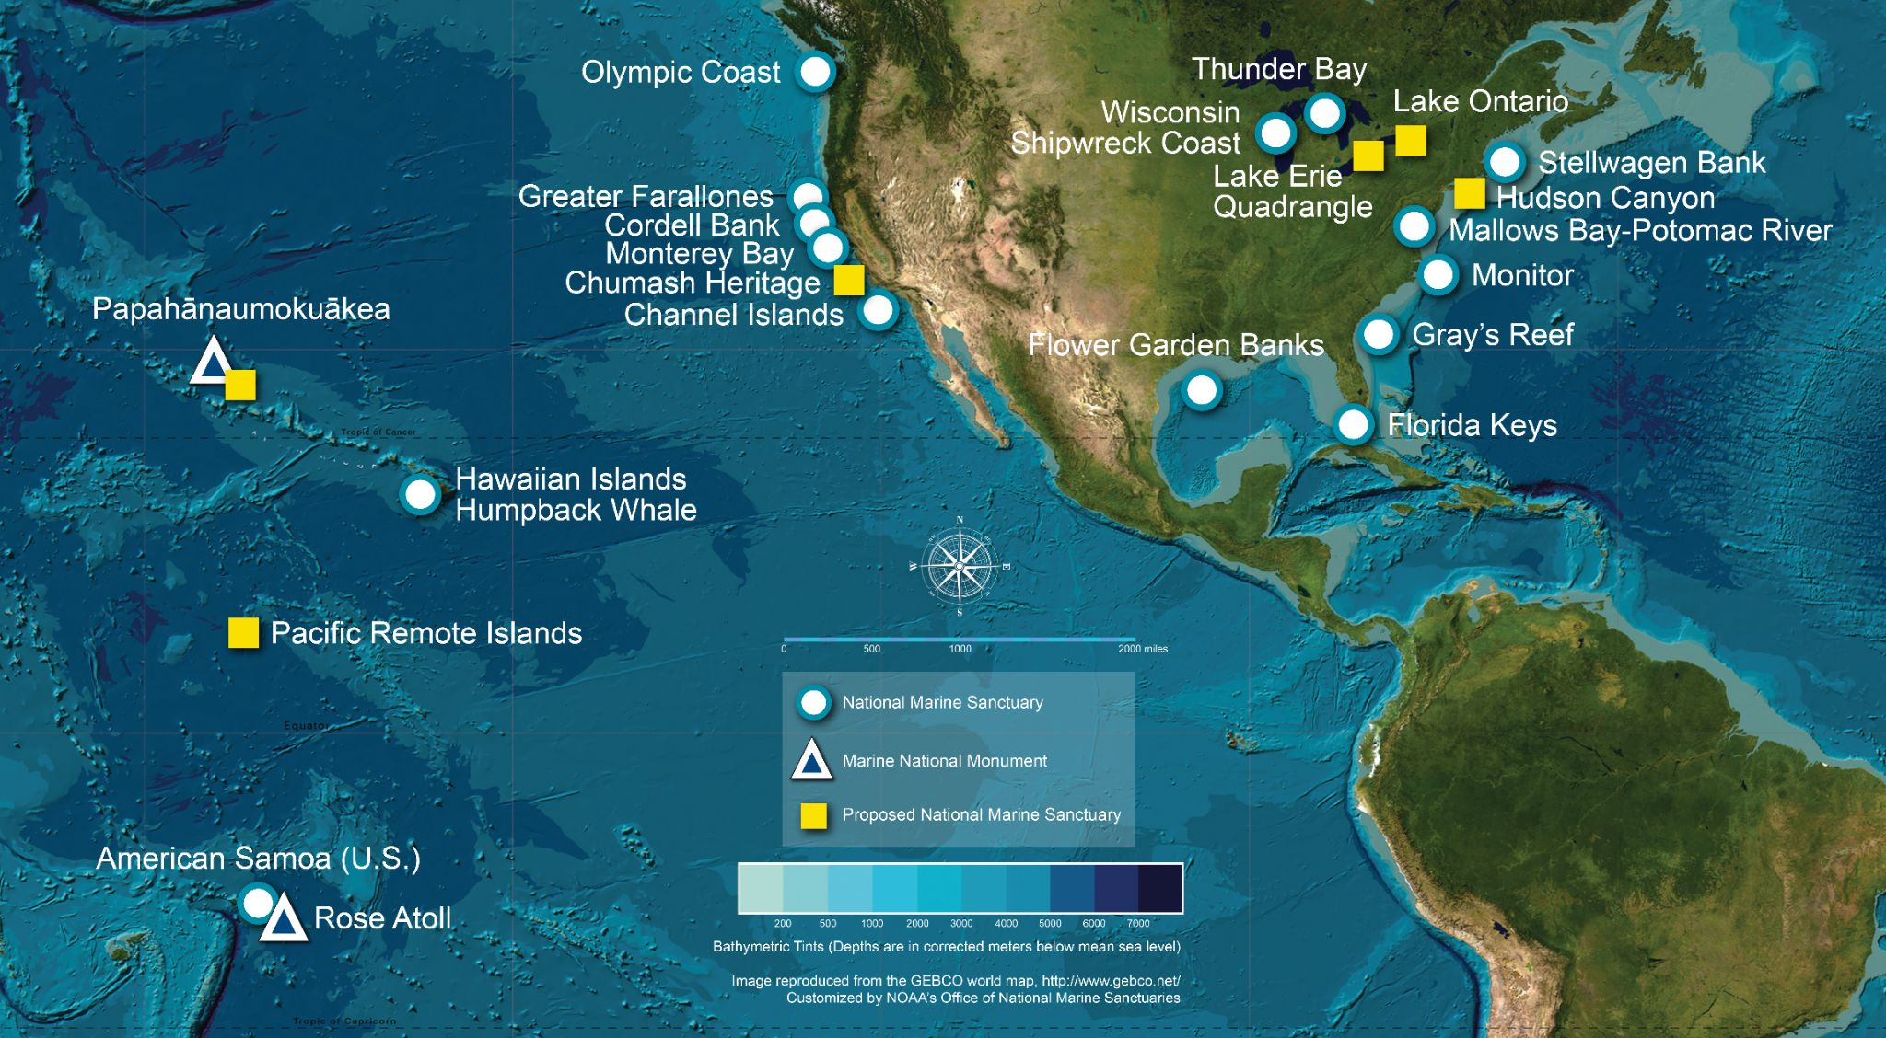
Which National Marine Sanctuaries might the toys have visited?
Which might the toys—or tiny particles of them—visit in the future?

Slide 8
Learn More
sanctuaries.noaa.gov

Slide 9
Funding support provided by: National Geographic Society + Created by: Rick Reynolds, M.S.Ed. + Krista Reynolds, MLIS, M.Ed. Engaging Every Student In collaboration with NOAA’s Office of National Marine Sanctuaries, National Marine Sanctuary Foundation and National Geographic Society
sanctuaries.noaa.gov

Slide 10
Contact Tracy Hajduk National Education Coordinator Office of National Marine Sanctuaries National Oceanic and Atmospheric Administration Phone: 240-533-0663 Email: sanctuary.education@noaa.gov
sanctuaries.noaa.gov

