Slide 1
An Ocean of Oxygen Producers

Slide 2
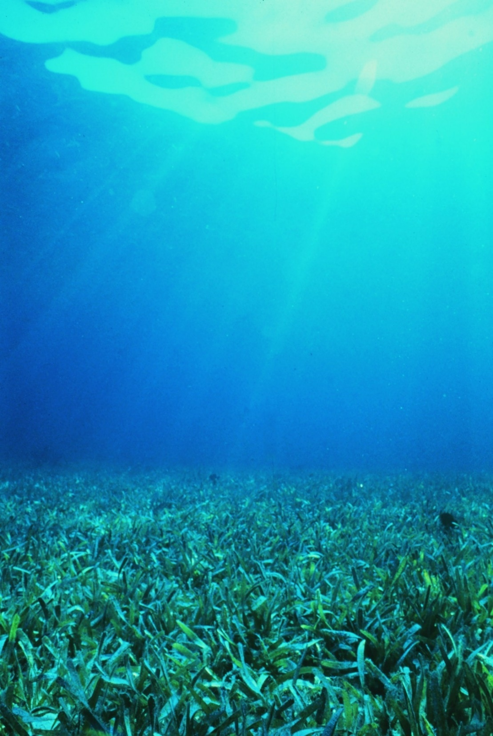
What inputs do photosynthetic organisms need for photosynthesis?
Sunlight
Water
Carbon dioxide
Notes:
Healthy seagrass at Florida Keys National Marine Sanctuary
Image: NOAA: https://www.flickr.com/photos/noaaphotolib/5078470818

Slide 3
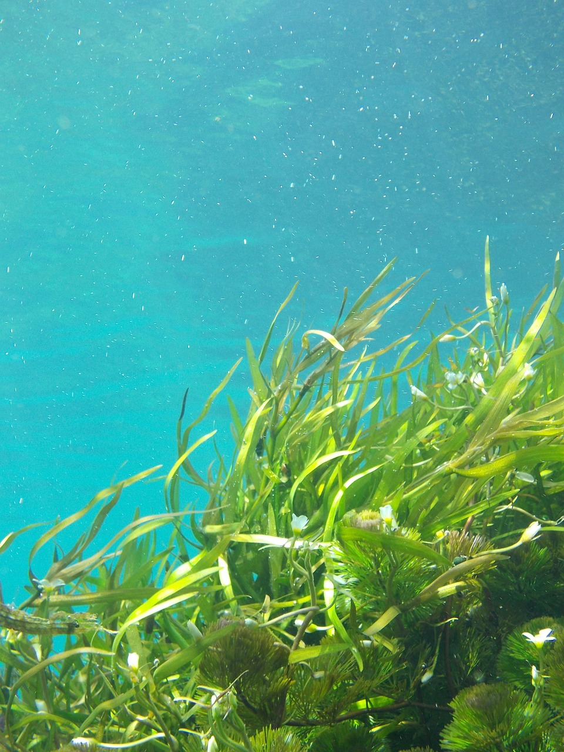
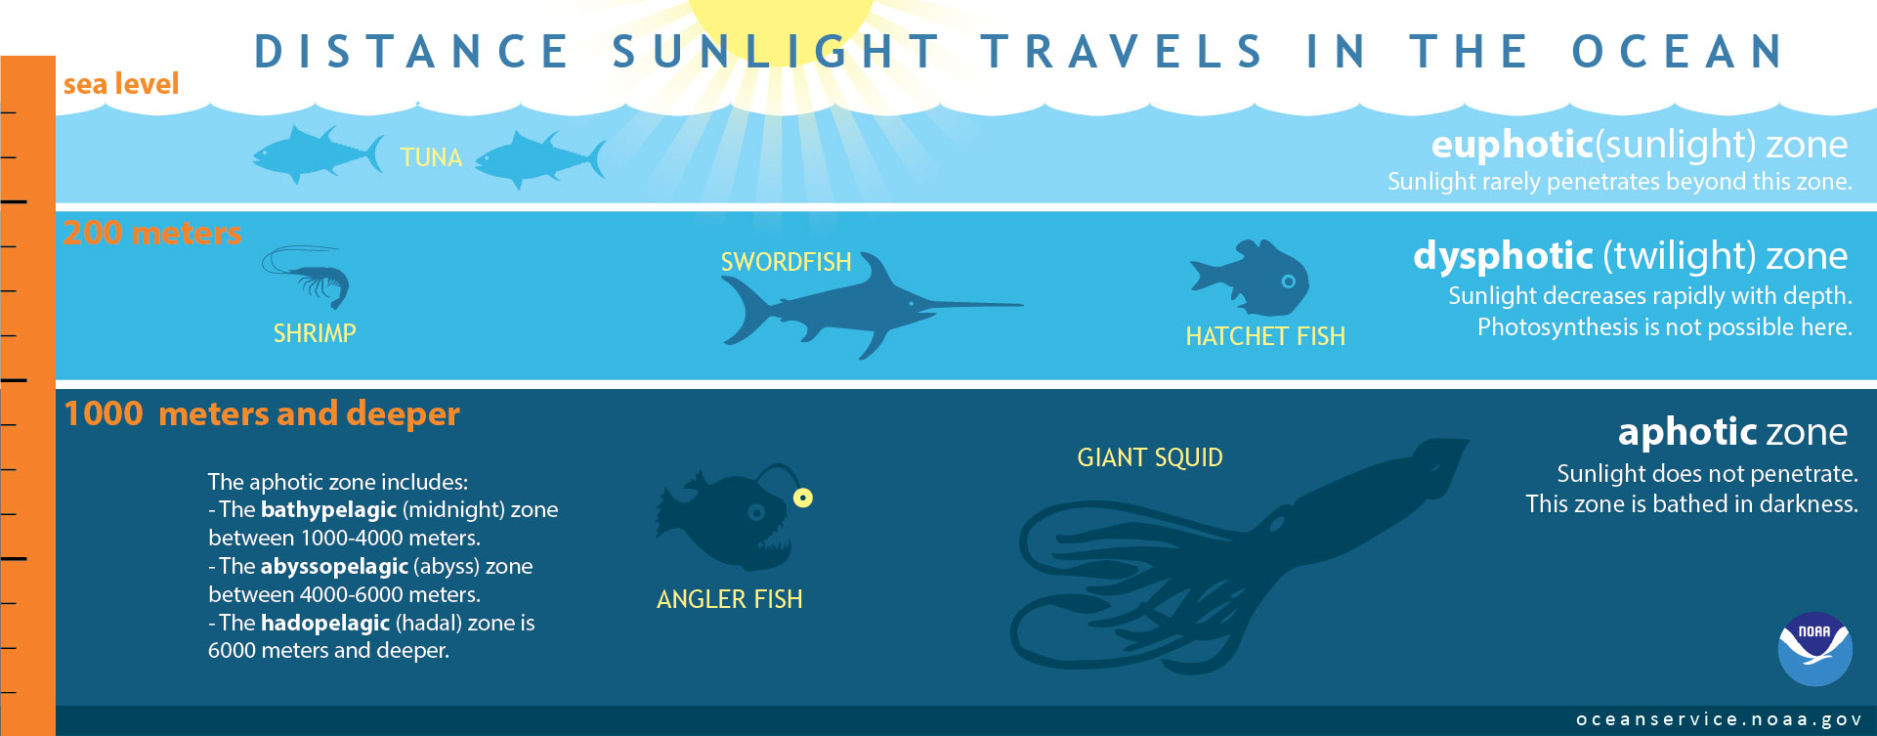
Where do marine photosynthetic organisms live in the ocean? Why?
Photic (sunlight) Zone (also called euphotic or epipelagic zone)
Notes:
Marine plants image: Nichole Bohner from Pixabay: https://pixabay.com/photos/seaweed-underwater-kelp-green-1129226 (Image free to use and adapt for non-commercial purposes)

Slide 4
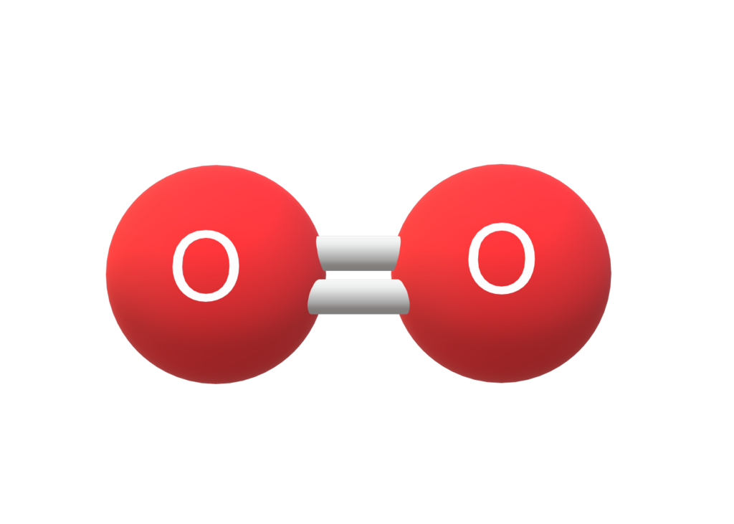
What is the gas molecule producers release that supports life on Earth?
OXYGEN!
Take a big breath and thank PRODUCERS!
Notes:
Oxygen molecule model: Christine L Miller CC BY-SA 4.0: https://commons.wikimedia.org/wiki/File:Oxygen_O2.png

Slide 5
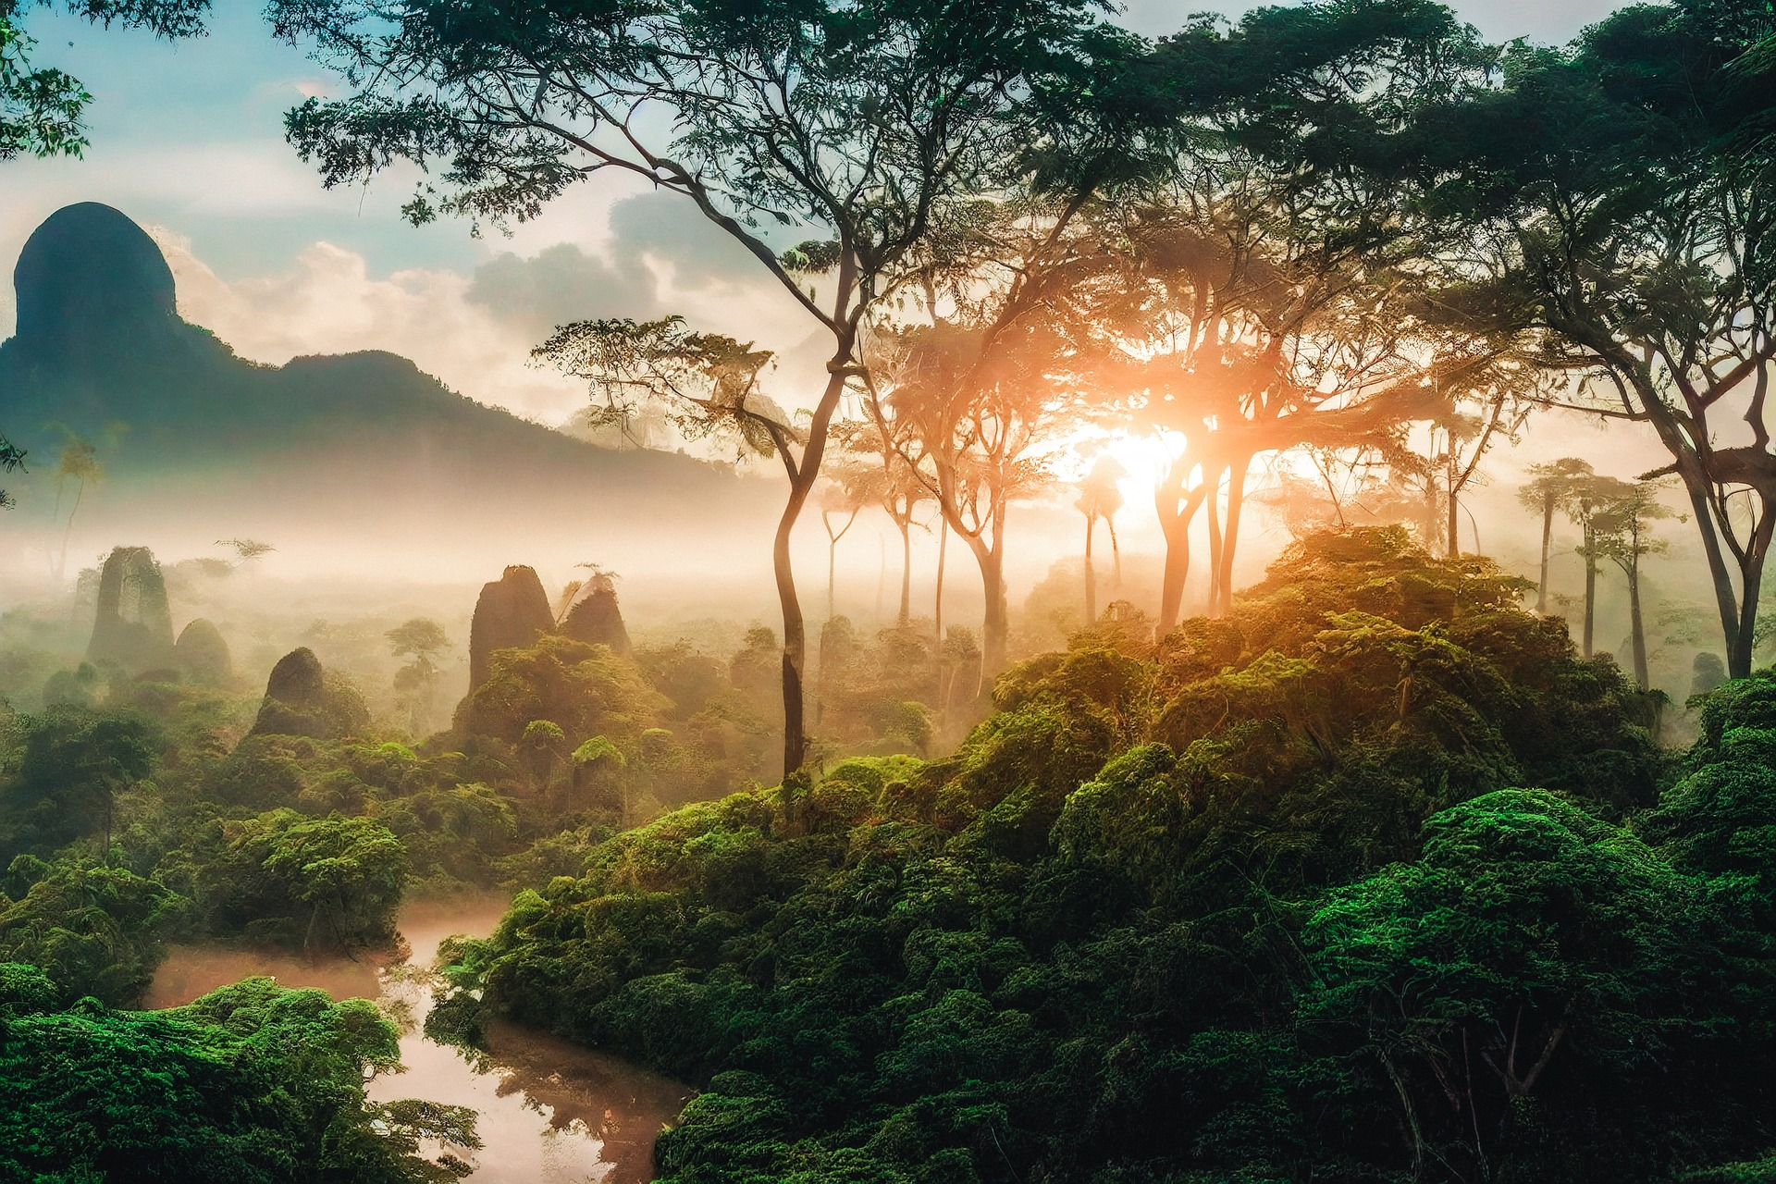
Which ecosystem(s) do you think of when you hear about oxygen production?
Notes:
People often think of rainforests or grasslands when they hear about oxygen production.
Image: Alan Frijns from Pixabay: https://pixabay.com/photos/jungle-rainforest-trees-tropical-7459821 (Image free to use and adapt for non-commercial purposes)

Slide 6
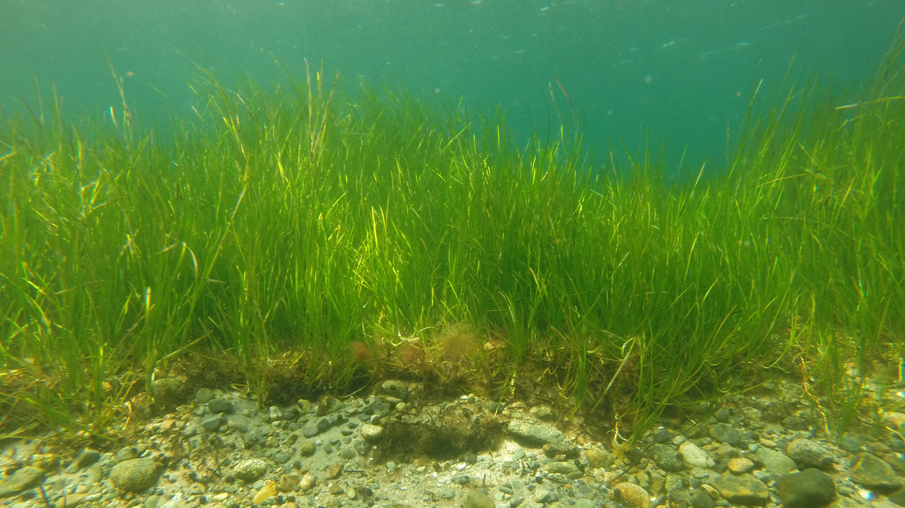
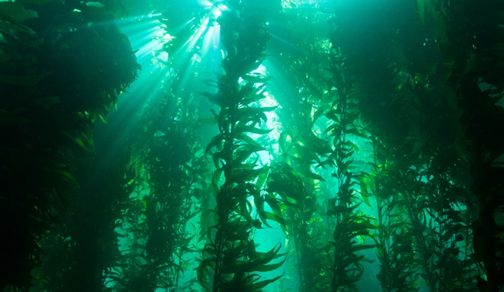
How about these critical OCEAN ecosystems?
Seagrass
Kelp Forest
Notes:
Eelgrass image: NOAA/MIT Sea Grant: https://seagrant.noaa.gov/News/Article/ArtMID/1660/ArticleID/521/Green-Eelgrass-Blue-Carbon
Kelp forest image: NOAA: https://oceanservice.noaa.gov/facts/kelp.html

Slide 7
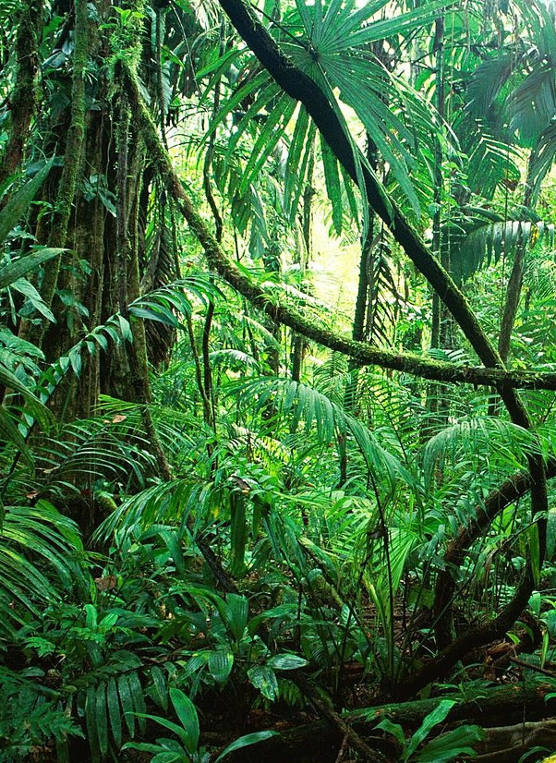
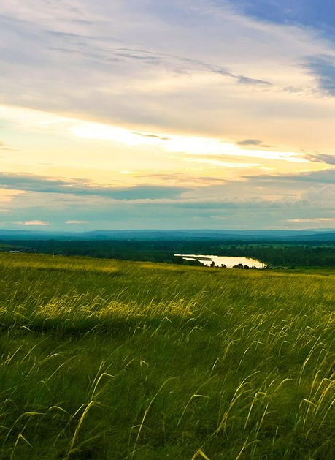
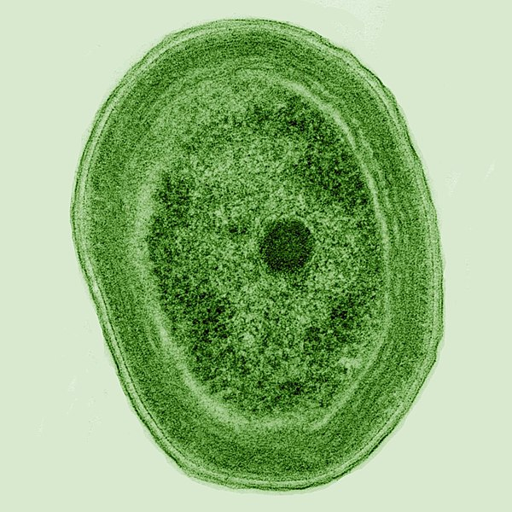
Which of these organisms produce the most oxygen on Earth?
20% of all oxygen on Earth!
All Rainforest Plants
All Grasses
Prochlorococcus
Notes:
Prochlorococcus in the ocean!
Image of rainforest: Bere69 from Pixabay: https://commons.wikimedia.org/wiki/File:Chiapas_Rainforest.jpg (CC0 1.0 Universal Public Domain Dedication)
Image grassland by Larisa Koshkina from Pixabay: https://pixabay.com/de/photos/gr%C3%A4ser-grasland-gr%C3%BCn-wiesen-blau-71241 (Image free to use and adapt for non-commercial purposes)
Image of Prochlorococcus by Luke Thompson and Nikki Watson from MIT CC0 1.0: https://en.wikipedia.org/wiki/File:Prochlorococcus_marinus_%28cropped%29.jpg
Image of ocean: Wallpaperflare: https://www.wallpaperflare.com/close-up-photo-of-water-blue-clean-color-motion-ocean-sea-wallpaper-aoovl

Slide 8
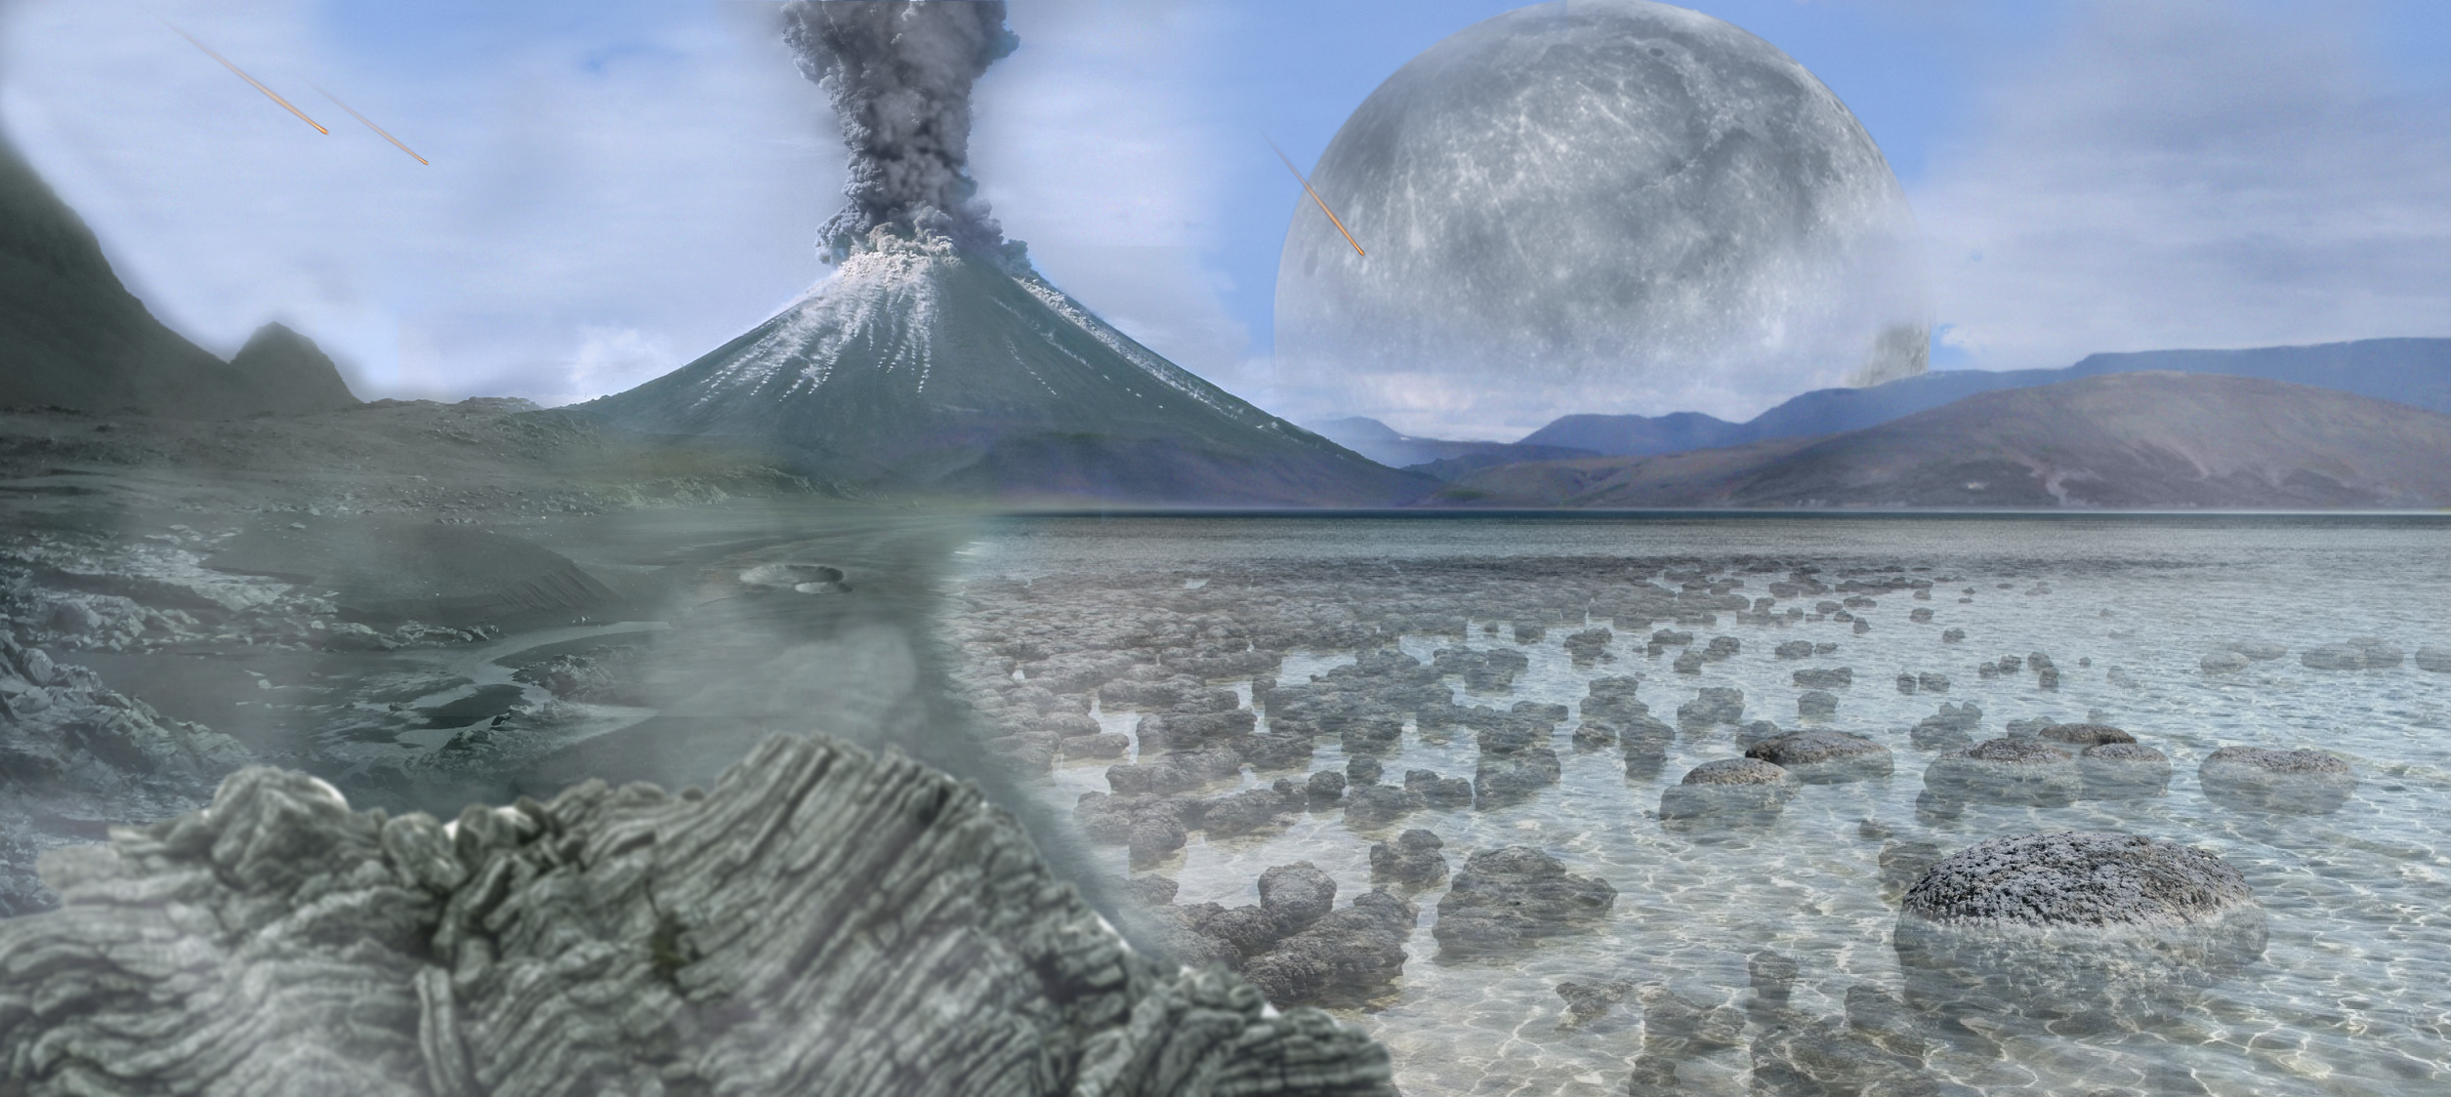
Was Earth’s atmosphere always the same?
Notes:
Until about 600 million years ago, Earth’s atmosphere had less than five percent oxygen. It was mainly a mix of nitrogen and carbon dioxide. Very slowly, over millions of years, cyanobacteria and single-celled algae changed the composition of the atmosphere into what we have today: 78 percent nitrogen and 21 percent oxygen, among other gases. More abundant oxygen set the stage for aquatic animals and plants to make the transition onto land.
Illustration: Artist's impression of the Archean Eon (about 4 billion years ago to about 2.5 billion years ago). Tim Bertelink CC BY-SA 4.0: https://commons.wikimedia.org/wiki/File:Archean.png

Slide 9
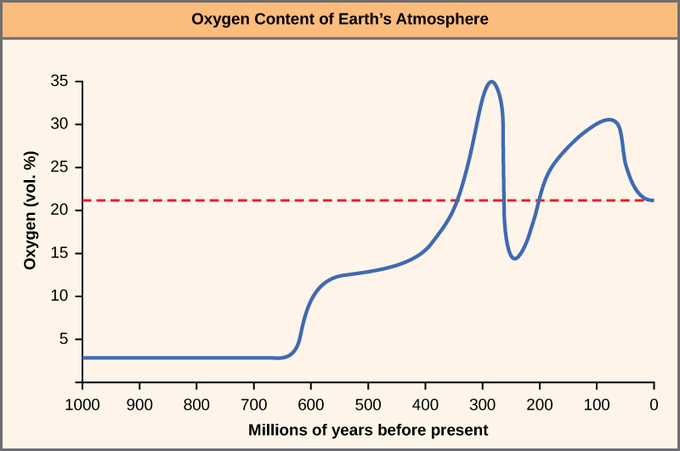
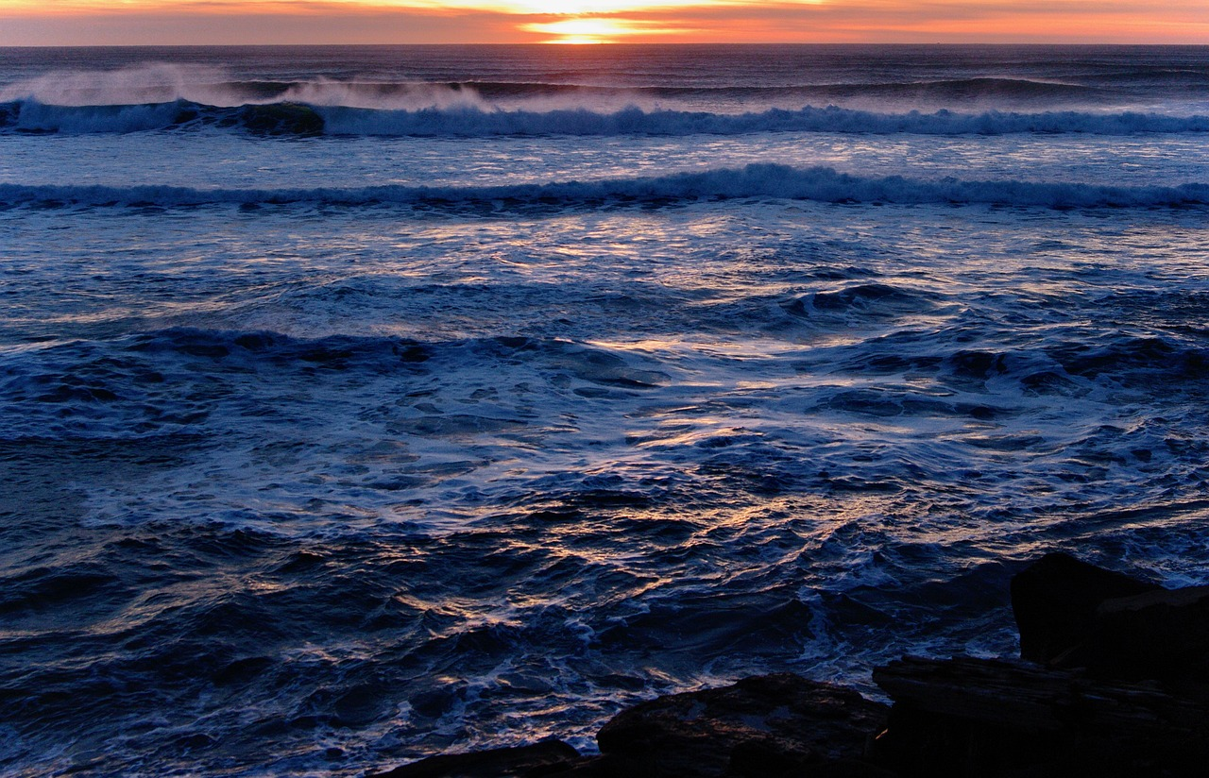
Where did photosynthesis evolve?
Land plants evolved about 500 million years ago…
…but photosynthesis appeared over 2 BILLION years ago. (Earth formed about 4.5 BILLION years ago.)
Where did the first photosynthesizing organisms live?
How did they change our atmosphere?
Notes:
We tend to associate photosynthesis with plants found on land.
Ocean image by Sabrina Eickhoff from Pixabay: https://pixabay.com/photos/waves-sea-sunset-sunrise-sunlight-6002682
Graph: CNX OpenStax CC BY 4.0

Slide 10
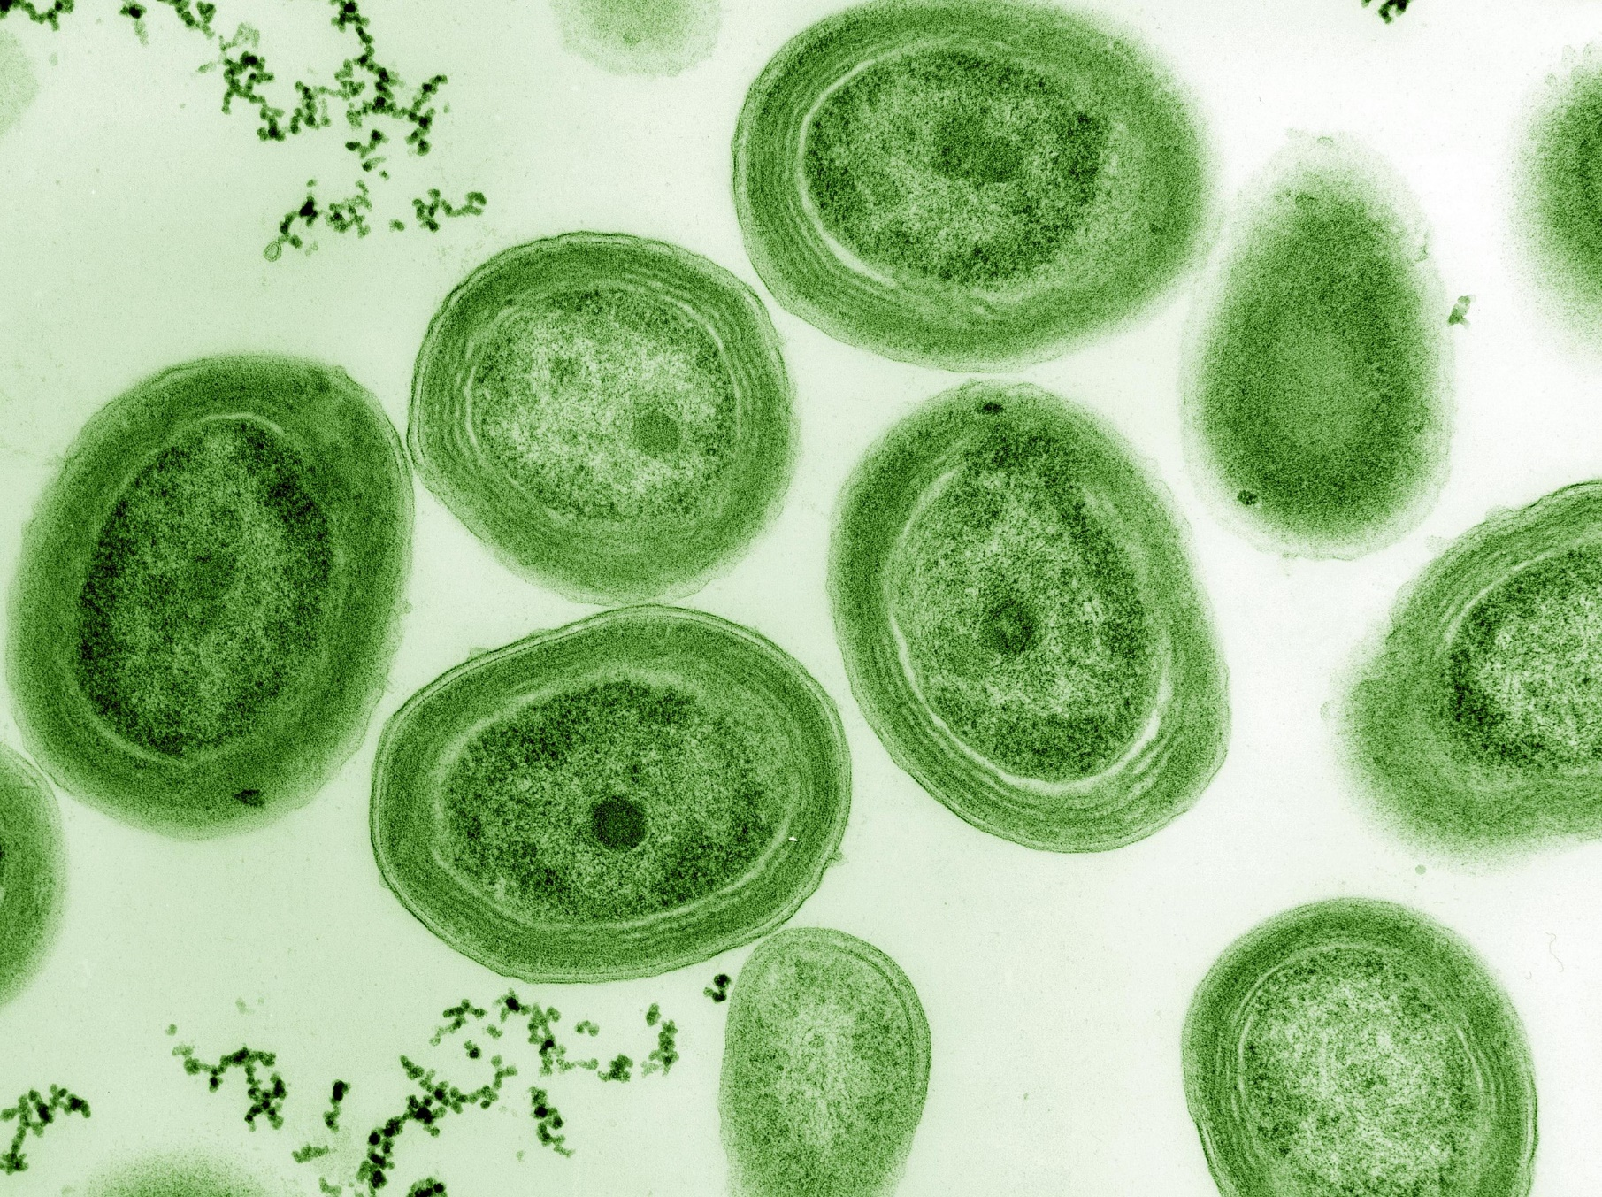
What were the first photosynthetic organisms?
Cyanobacteria!
Notes:
Magnified Prochlorococcus cyanobacteria: Their ancient ancestors were likely the first organisms to photosynthesize.
Photo: Luke Thompson and Nikki Watson from MIT CC0 1.0

Slide 11
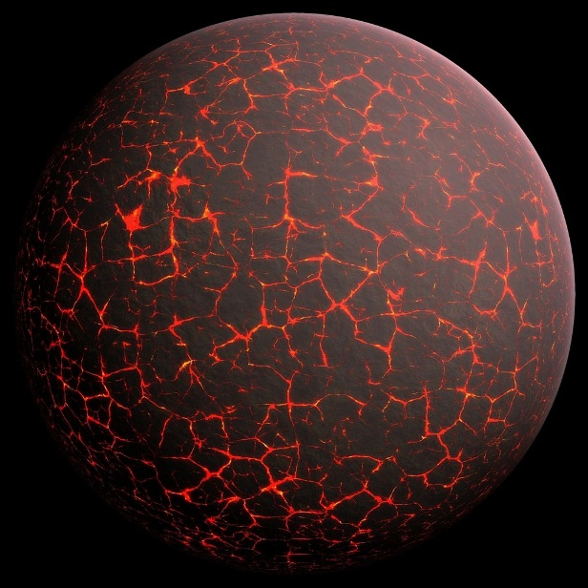
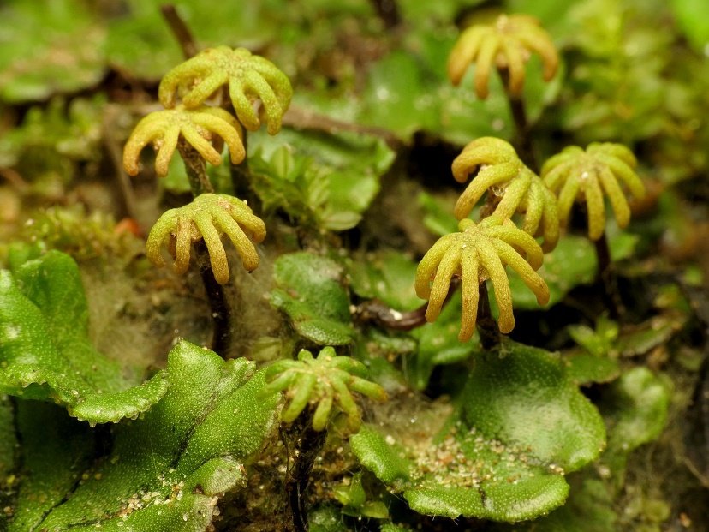
Timeline of Oxygen Production
Earth formed about 4.5 BILLION years ago
Photosynthetic organisms appear in OCEAN over 2 BILLION years ago
Land plants evolved about 500 million years ago
Cyanobacteria
Tiny liverworts: One of the earliest land plants
Notes:
Illustration of Earth formation from Pixabay: https://commons.wikimedia.org/wiki/File:Earth_formation.jpg (Image free to use and adapt for non-commercial purposes)
Photo of magnified cyanobacteria: Luke Thompson and Nikki Watson from MIT CC0 1.0
Photo of liverwort by Katja Schultz CC BY 2.0: https://commons.wikimedia.org/wiki/File:Umbrella_Liverwort_%2828270176220%29.jpg

Slide 12
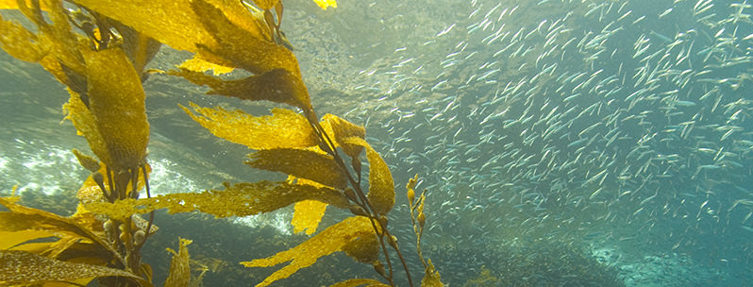
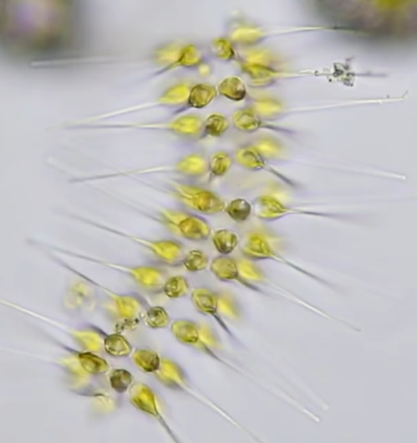
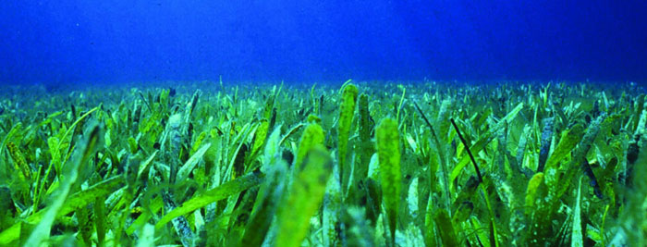
Modern OCEAN photosynthetic organisms
Algae
Seagrasses
Some bacteria (cyanobacteria, often called blue-green algae)
Phytoplankton (diatoms, dinoflagellates and Euglena)
Kelp forest at Channel Islands National Marine Sanctuary
Magnified Dinoflagellates
Turtle grass (Thalassia testudinum) at Florida Keys National Marine Sanctuary
Notes:
Image of kelp forest: NOAA
Image of seagrass: NOAA
Image of dinoflagelletes: Copyright Janai Southworth, Pacific Plankton; used by permission: https://www.instagram.com/p/CGwQ8gvDCvl

Slide 13
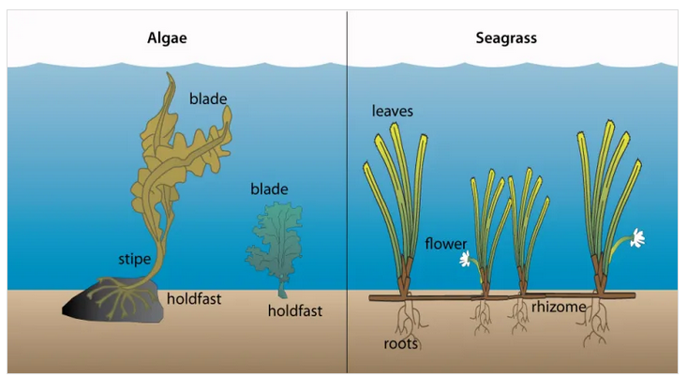
How are kelp/algae and seagrasses similar? Different?
Notes:
Both are photosynthetic oxygen-producers and need to grow where light is available. Algae (such as kelp) on the seafloor have a holdfast and transport nutrients through the body by diffusion, while seagrasses are flowering vascular plants with roots and an internal transport system.
Image courtesy Integration and Application Network (ian.umces.edu), University of Maryland Center for Environmental Science: https://ocean.si.edu/ocean-life/plants-algae/seagrass-and-seagrass-beds#

Slide 14
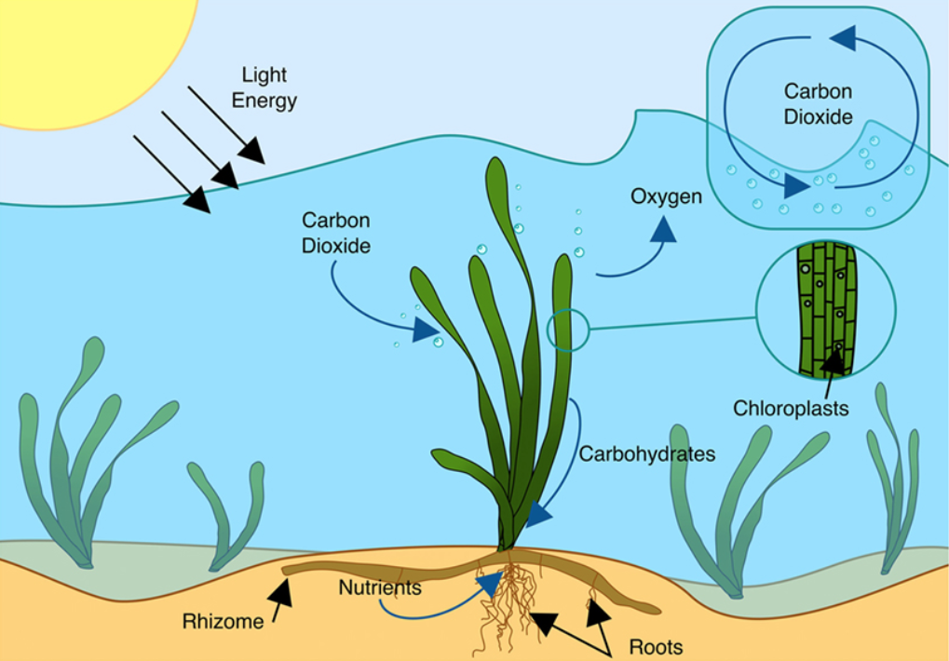
Photosynthesis and carbon uptake in a seagrass meadow
Notes:
Graphic by Cullen-Unsworth L, Jones B, Lilley R and Unsworth R CC BY 4.0: https://commons.wikimedia.org/wiki/File:Carbon_uptake_and_photosynthesis_in_a_seagrass_meadow.png

Slide 15
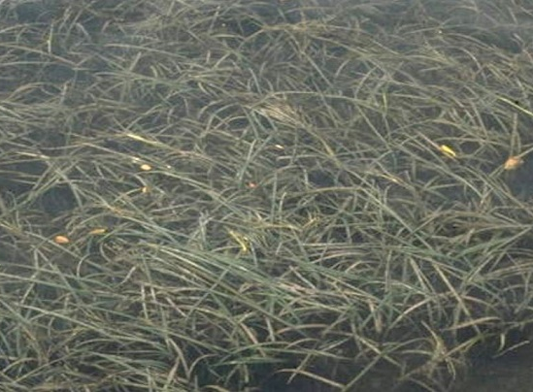
How much oxygen does eelgrass in Tomales Bay produce?
Tomales Bay has about 3,500,655 square meters of eelgrass (primarily Zostera marina)
Each square meter produces 10 liters of oxygen per day
3,500,655 square meters x 10 liters = 35,006,550 liters of oxygen (in one day)!
(Average adult human at rest uses 550 liters of pure oxygen per day)
Eelgrass in Tomales Bay
Notes:
Learn more about seagrass in Tomales Bay at Greater Farallones National Marine Sanctuary: “Seagrass Beds in Tomales Bay.” NOAA: https://nmsfarallones.blob.core.windows.net/farallones-prod/media/archive/eco/tomales/pdf/tomalesbay_seagrass_lecture.pdf
Image of bay: Oleg Alexandrov CC BY-SA 3.0: https://commons.wikimedia.org/wiki/File:Tomales_Bay_as_viewed_from_Tomales_Point_Trail_4.JPG
More about how much oxygen consumed by a human in a day: https://youtu.be/t-QYVKYKyfg

Slide 16
What percent of our oxygen comes from the ocean?
At least 50%!

Slide 17
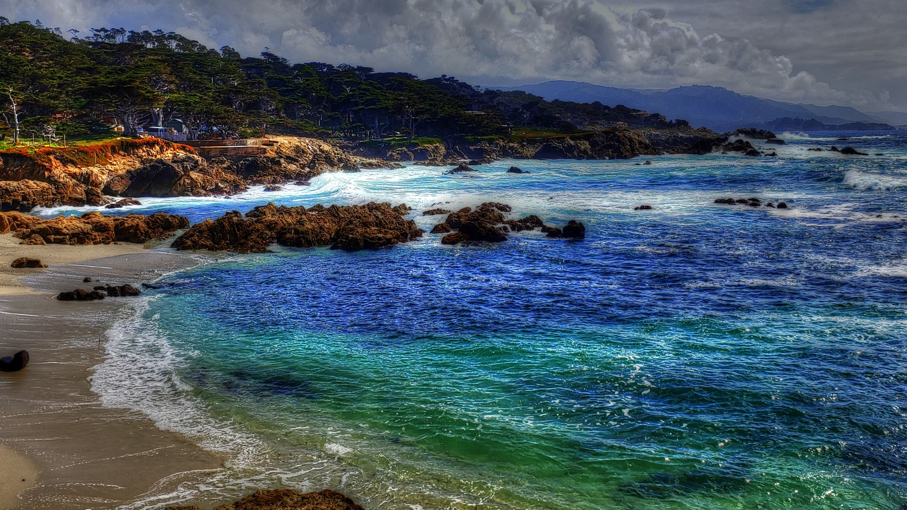
What factors could influence the amount of photosynthesis that occurs in the ocean?
Monterey Bay National Marine Sanctuary
Notes:
Sunlight (depth), nutrients - nitrogen, phosphorus, iron; water temperature, density and salinity
Photo by Circe Denyer CC0 public domain: https://www.publicdomainpictures.net/en/view-image.php?image=290058&picture=monterey-bay-coastline

Slide 18
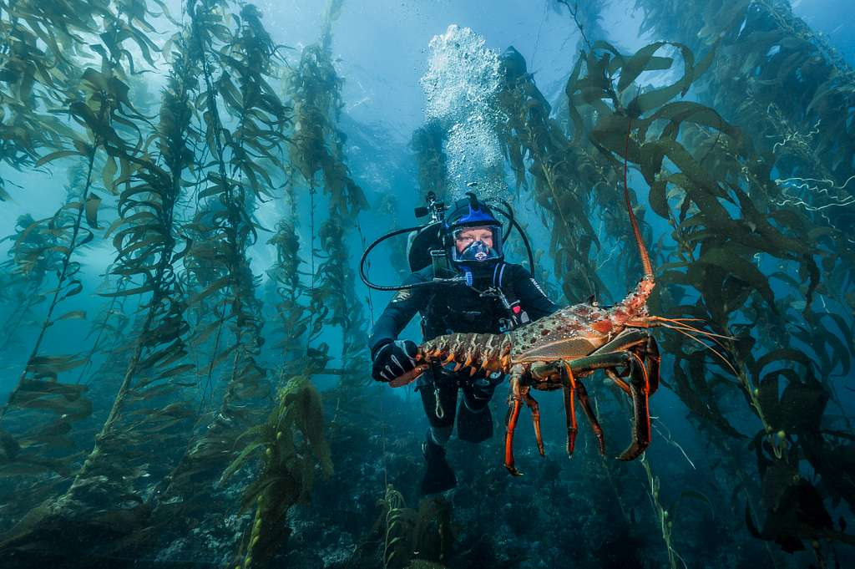
Why is it important to have national marine sanctuaries?
Channel Islands National Marine Sanctuary
Notes:
Sanctuaries are important marine protected areas that are sites of large kelp forests and seagrass ecosystems. Protecting these areas from many human activities can help reduce stressors and increase resiliency of the ecosystems. There is a network of no-take marine reserves within the sanctuary that protects lobsters and other targeted species from being fished. It has been shown that kelp forests with intact, thriving marine communities tend to be more resilient to stressors like marine heat waves and El Niño episodic events.
Photo: National Park Service; Channel Islands Dive Officer Kelly Moore with a spiny lobster that thrives under the protection of the marine sanctuary. Outside of the sanctuary, lobsters are usually taken before growing to this size.

Slide 19
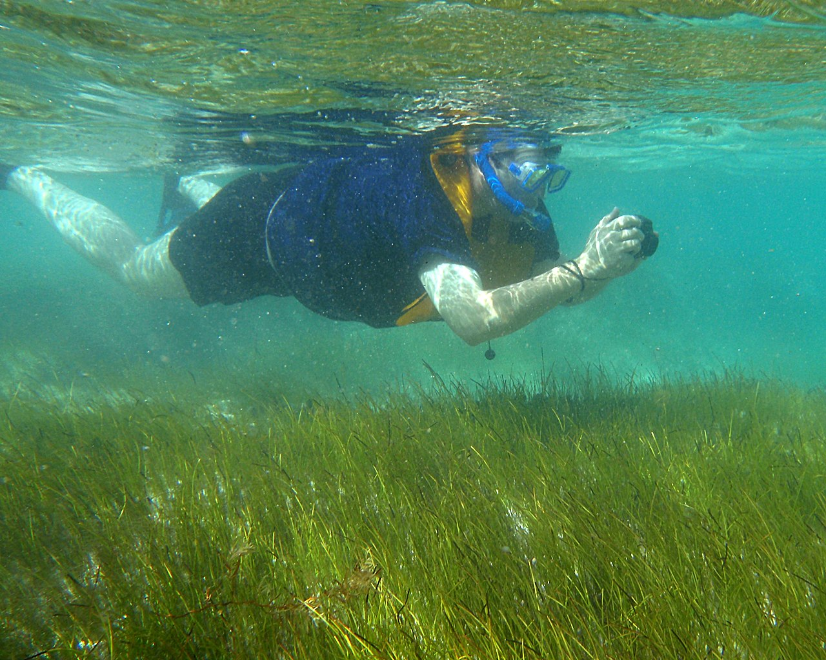
Explore Marine Photosynthetic Organisms
Research a photosynthetic organism found in one or more national marine sanctuaries.
Investigate:
Is it a plant, algae, bacteria or something else?
Is it a single cell or multicellular?
What is the name of its photosynthetic pigment(s)?
In which national marine sanctuaries would you find this organism?
How is the organism (or group of organisms) important in the sanctuaries where it’s found?
What else is interesting and/or important about it?
Bonus: How much oxygen does this organism or group of organisms contribute to the atmosphere? How much carbon does it capture?
A snorkeler observes turtle grass and organisms that benefit from it
Notes:
Photo by James St. John CC BY 2.0: https://www.flickr.com/photos/jsjgeology/15667912398

Slide 20
Learn More
sanctuaries.noaa.gov

Slide 21
Funding support provided by: National Geographic Society + Created by: Rick Reynolds, M.S.Ed. + Krista Reynolds, MLIS, M.Ed. Engaging Every Student In collaboration with NOAA’s Office of National Marine Sanctuaries, National Marine Sanctuary Foundation and National Geographic Society
sanctuaries.noaa.gov

Slide 22
Contact Tracy Hajduk National Education Coordinator Office of National Marine Sanctuaries National Oceanic and Atmospheric Administration Phone: 240-533-0663 Email: sanctuary.education@noaa.gov
sanctuaries.noaa.gov

