Slide 1
Notes:
1
Welcome slide, can introduce self here.

Slide 2
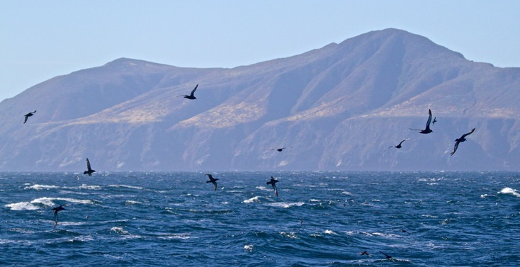
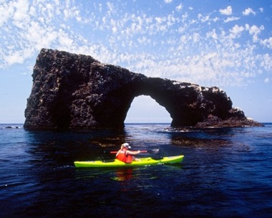
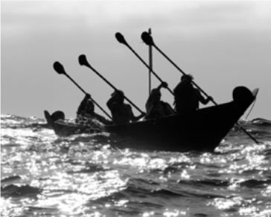
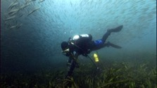
Channel Islands
National Marine Sanctuary
Notes:
2
History
Located off the coast of Santa Barbara and Ventura counties in California, Channel Islands National Marine Sanctuary is one of 14 federally designated marine protected areas administered by the National Oceanic and Atmospheric Administration (NOAA), within the Department of Commerce. The sanctuary encompasses 1,110 square nautical miles (1,470 square miles) of water from Santa Barbara, Anacapa, Santa Cruz, Santa Rosa, and San Miguel islands. The sanctuary is adjacent to metropolitan Los Angeles — one of the largest U.S. population centers — and is therefore impacted by a large range of human activities and pressures.
Web Story: Channel Islands National Marine Sanctuary faring well despite challenging seascape (July 2019)
Pictures Courtesy of:
Chumash: Photo Credit: Robert Schwemmer/NOAA
Trip to Anacapa Island (birds with island in background) Credit: http://www.calliebowdish.com/ChannelIslands.html
Kayaker photo credit: Tim Hauf

Slide 3
Notes:
3
Why are the Channel Islands unique?
First, let’s find Los Angeles. Here it is. And here is the CINMS region, here and here.
The physical and biological oceanographic characteristics of the CINMS region are unique because of the sanctuary’s remote and isolated position. (The next slide will explain more about the uniqueness.)
Image Courtesy of: NOAA

Slide 4
Notes:
4
… two major currents meet at the east-west oriented northern Channel Islands, making it a transition zone where surface temperatures shift from warm in the east, to cool in the west. There is notable seasonal variation of surface temperatures, currents, nutrients, pH, and dissolved oxygen levels. These factors combine to support one of the most productive and biologically diverse marine ecosystems in the world that includes a myriad of sea life from microscopic plankton to blue whales. This is why the Channel Islands National Marine Sanctuary is so unique!
Image Courtesy of: NOAA

Slide 5
Student Outcomes
What will you learn today?
Upon completion of the lesson, students will be able to:
• Identify the characteristics of an eelgrass meadow habitat and its inhabitants, the creatures that live in the habitat.
• Explain ocean acidification and how it affects marine life in this habitat. Identify a healthy pH level for marine life.
• Explain how an eelgrass meadow provides a refuge from ocean acidification and can restore the ocean waters to a healthy pH which best supports marine life in this habitat.
Notes:
5
Student Outcomes.
Instructor reads the outcomes to the students.

Slide 6
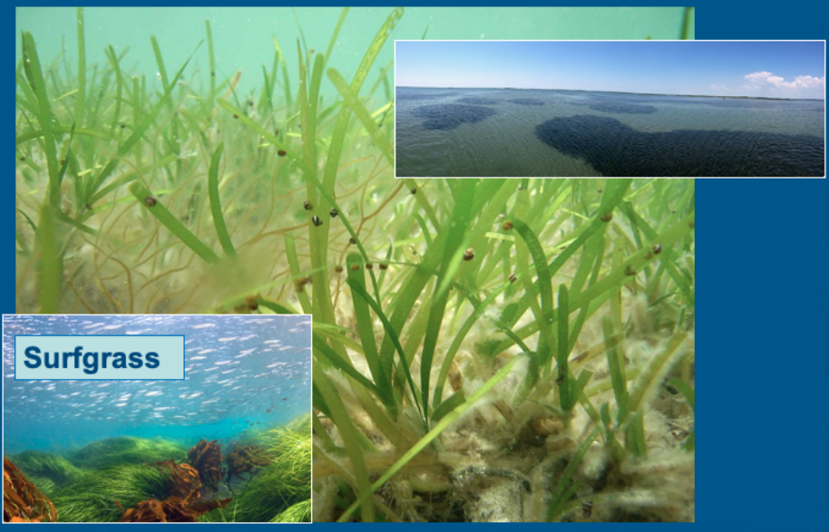
What is an eelgrass meadow?
Notes:
6
What is an Eelgrass Meadow? Where is an Eelgrass Meadow found?
First, there are 2 types of seagrass; eelgrass which is pictured in the large background photo as well as the top aerial photo and surfgrass which is shown on the bottom left image. In this lesson, we will focus on eelgrass.
An eelgrass meadow is a bed, or an area, on the soft seafloor that is covered in a type of marine, flowering seagrass. It is found in temperate zones around the world, typically in shallow bays and estuaries. (National Park Service, 2015)
So, in other words, eelgrass meadows are found in the soft sediment of calm, protected bays.
Ask students: What do you notice? (Listen to their responses)
Pictures Courtesy of:
Background photo credit NOAA
Top inset photo, aerial view: NOAA
Inset Surfgrass Photo Credit: Scott Gietler, Channel Islands Diving & Underwater Photography

Slide 7
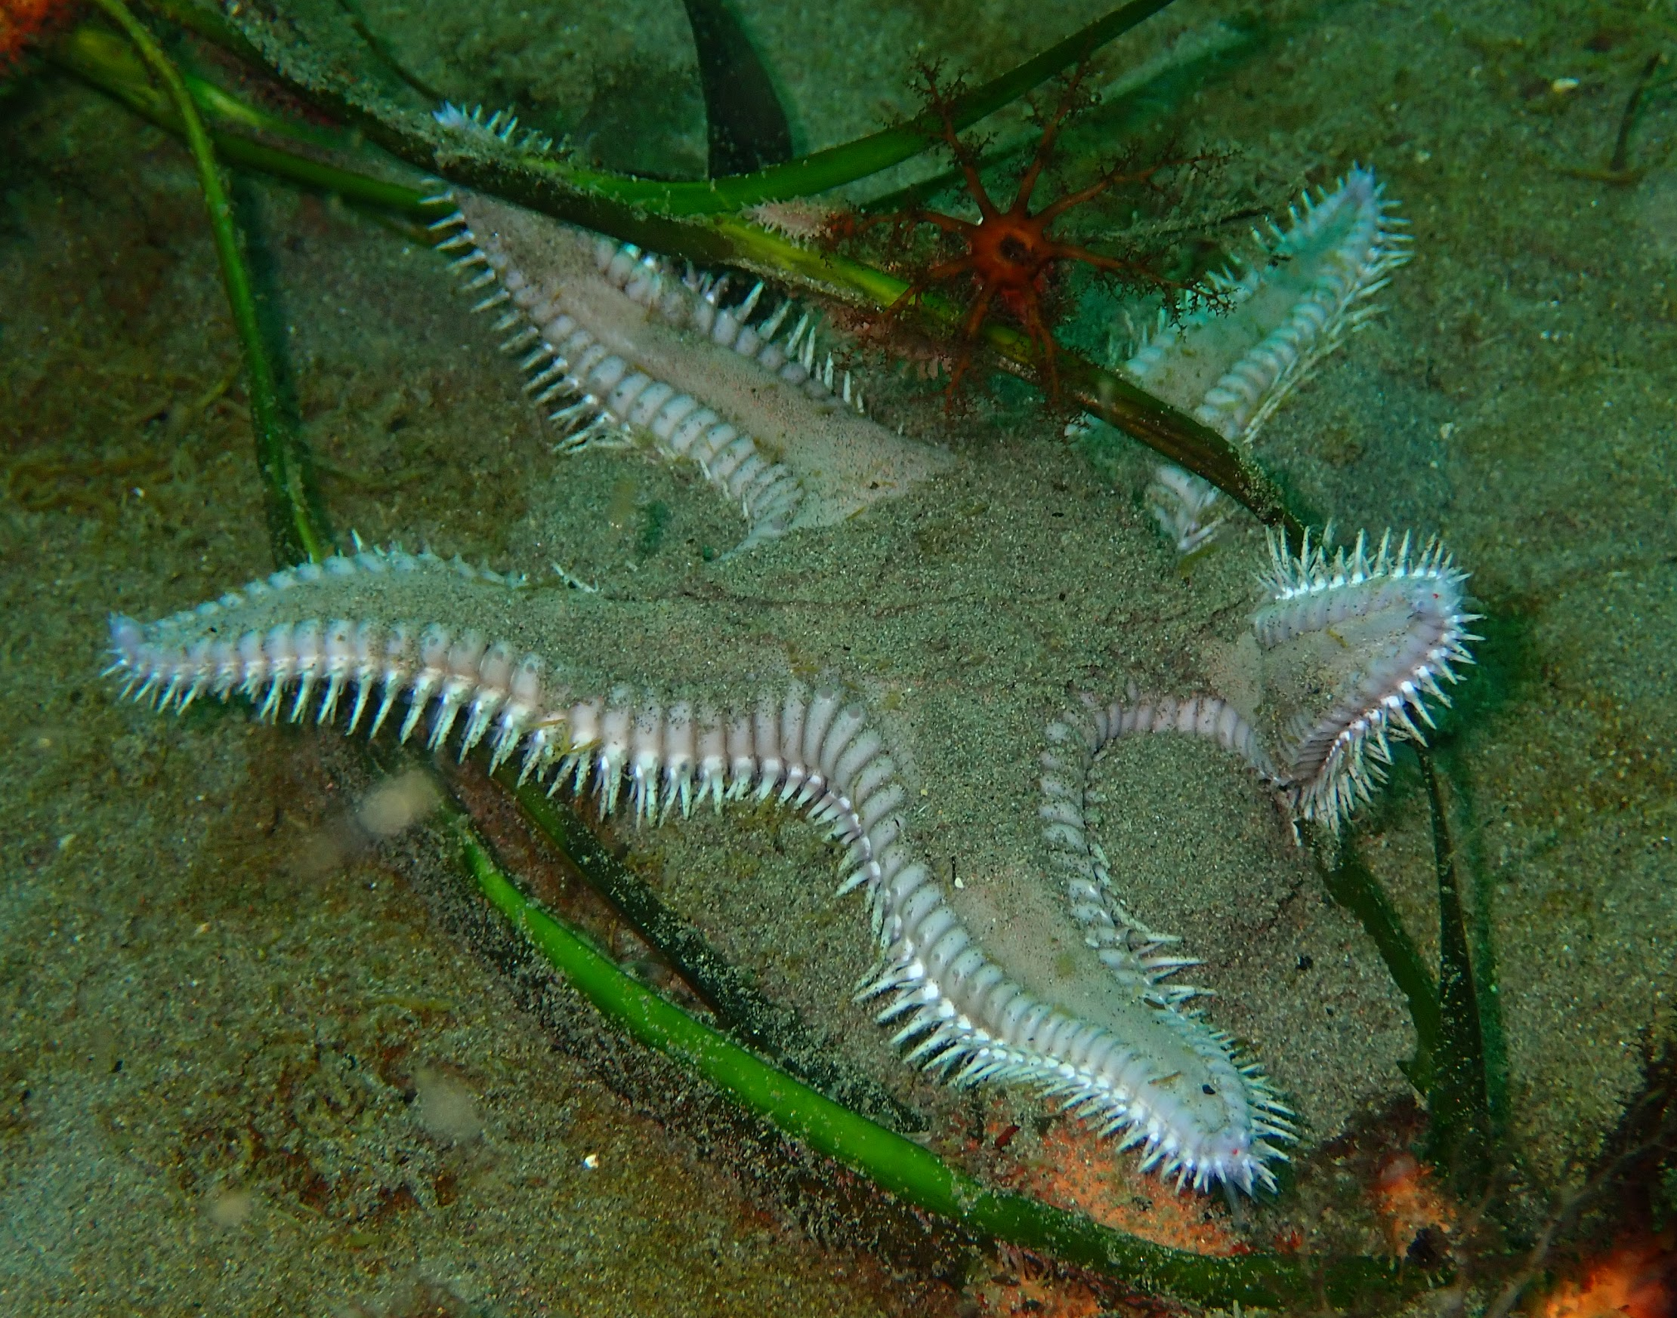
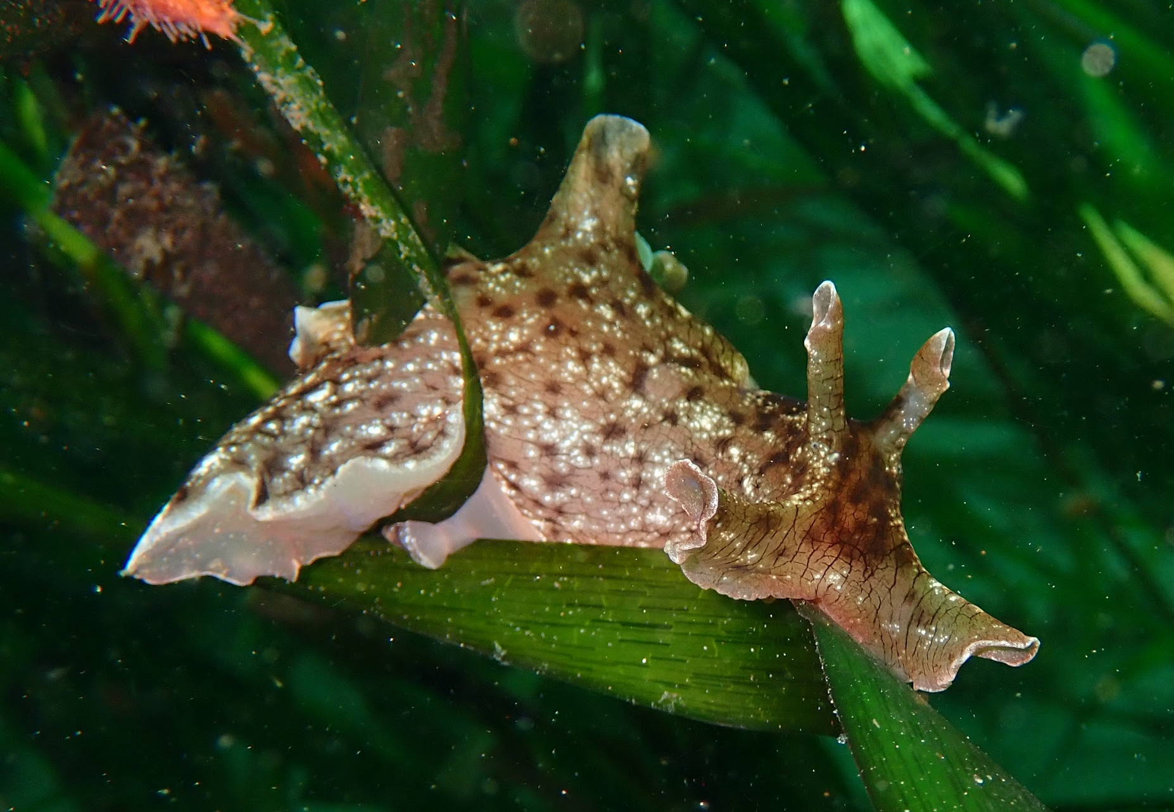
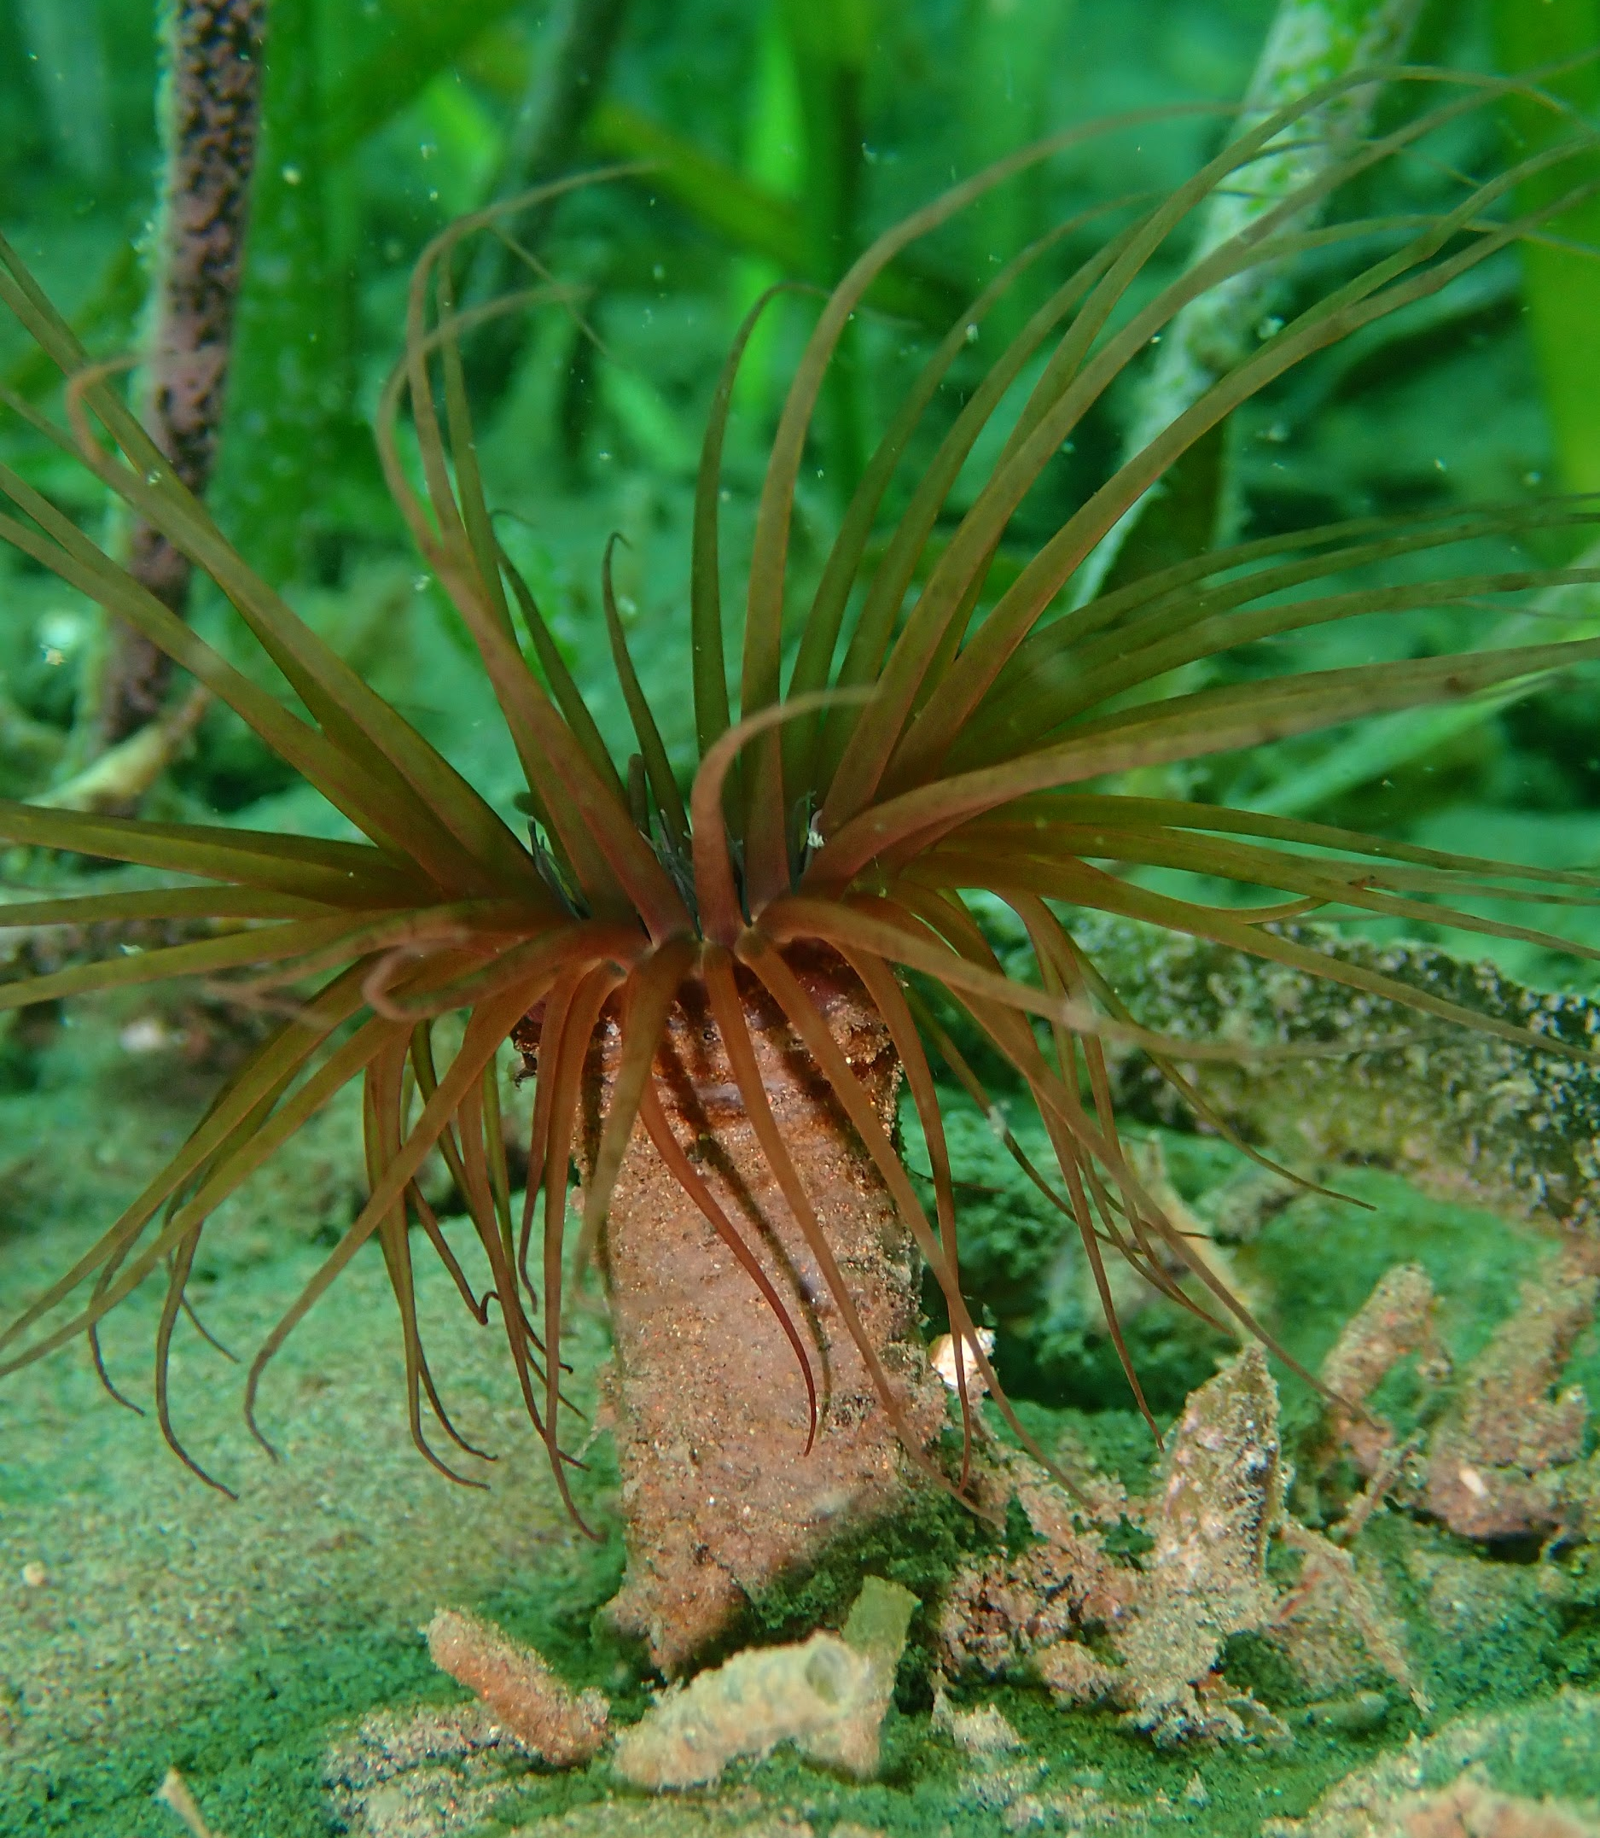
Who are the inhabitants of an eelgrass meadow?
Notes:
7
Who are the inhabitants?
First, an inhabitant is a living creature that occupies, or lives, in a particular place regularly, routinely, or for a period of time.
The inhabitants of an Eelgrass Meadow are snails, sea stars, anemones, crabs, clams, sand stars, bat stars, wavy top snails, kelp bass, senoritas, and many kinds of perch.
All Images Courtesy of: Jessie Alstatt, CINMS

Slide 8
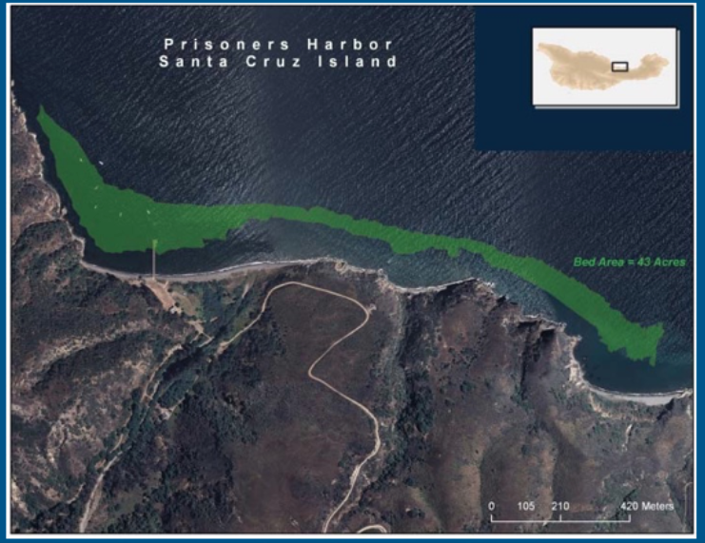
Eelgrass Meadow Mapping
Notes:
8
To map an eelgrass meadow, a team takes a boat to the area to be documented. First, the team uses a sonar system to map the eelgrass meadow but then this data needs to be “ground-truthed” by a scuba team who dives into the water to make sure the sonar mapping is accurate. The dive team has 1 diver who goes into the water towing a surface float with a water-resistant Global Positioning System (GPS) attached to it. Another team member is in a kayak following the diver and this person also has a GPS. There are also 1 or 2 other divers in the water who help the diver with the GPS to follow the boundary of the meadow in order to get the most accurate data from the GPS.
If you have time…
Here is a report about the eelgrass meadows around the Channel Islands that includes maps, the steps of the study and the data tables which will give the students an idea of how much goes into this work. Maps: pgs 5 to 12. Data tables: pgs 25-37 (not numbered)
The Role of Eelgrass Beds As Fish and Invertebrate Habitat 2009 ~ 2010 Final Report
https://www.sbck.org/wp-content/uploads/2013/06/Eelgrass-Report.pdf
All Images Courtesy of: Santa Barbara ChannelKeeper

Slide 9
Notes:
9
Why map an Eelgrass Meadow?
Seagrass meadows (eelgrass meadows and surfgrass meadows) play an important role in the fight against rapid climate change, because seagrasses take up carbon dioxide that is dissolved in seawater, like other plants take it up from the air. The carbon dioxide is used to build the plant’s tissues or is stored in the sediment. Estimates suggest that seagrass meadows can bury carbon in underwater sediments 40 times faster than tropical forests bury it in soil, and seagrasses provide one of the greatest contributions to the total carbon buried in ocean sediments. The removal of carbon dioxide from the water helps to keep the pH of the water stable. A stable pH might protect animals that have shells or external skeletons, such as corals and mollusks (clams, oysters, and their relatives) from the effects of low pH in seawater, which is known as ocean acidification. (Cullen-Unsworth, 2018)
An Eelgrass Meadow can help provide a refuge from ocean acidification and restore ocean waters to healthy pH for marine life so let’s learn more about Ocean Acidification and pH level.
Image credited: Claire Fackler, CINMS, NOAA

Slide 10
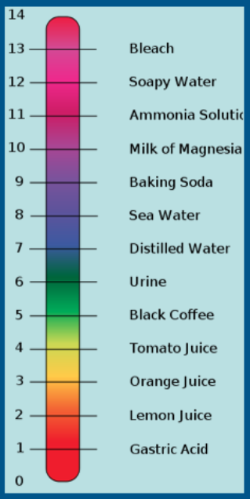
What is ocean acidification? Well, first we need to know: What is the pH scale?
Notes:
10
So, one threat to the Channel Islands National Marine Sanctuary is ocean acidification. What is Ocean Acidification? To understand ocean acidification we first need to understand what the pH scale is.
And before we learn about the pH scale, we need to know about “two special kinds of chemicals, acids and bases. Almost all liquids are either acids or bases to some degree. Whether a liquid is an acid or base depends on the type of ions in it. If it has a lot of hydrogen ions, then it is an acid. If it has a lot of hydroxide ions, then it is a base.”
Now, the pH Scale
Scientists use something called a pH scale to measure how acidic or basic a liquid is. pH is a number from 0 to 14. From 0 to 7 are acids, with 0 being the strongest. From 7 to 14 are bases with 14 being the strongest base. If a liquid has a pH of 7, it's neutral. This would be something like distilled water.”
Note that sea water has a pH level of 8 which is just above distilled water at a pH level 7, so sea water is very close to being neutral.
Definition and image courtesy of: https://www.ducksters.com/science/acids_and_bases.php

Slide 11
What is ocean acidification?
NOAA Ocean Acidification Video
is a reduction in the pH of the ocean over an extended period of time, caused primarily by uptake of carbon dioxide (CO2) from the atmosphere
Notes:
11
What is ocean acidification?
When we burn fossil fuels like coal, oil and natural gas, we add more and more carbon dioxide into the atmosphere. This buildup acts like a blanket that traps heat around the world, which disrupts the climate.
The chemistry of ocean water is changed by absorption of carbon dioxide from the atmosphere (ocean acidification). Increasing carbon dioxide levels in the atmosphere are causing ocean water to become more acidic, threatening the survival of shell-building marine species and the entire food web of which they are a part.
Ocean acidification is a reduction in the pH of the ocean over an extended period of time, caused primarily by uptake of carbon dioxide (CO2) from the atmosphere.
Video about Ocean Acidification: https://oceanservice.noaa.gov/facts/acidification.html

Slide 12
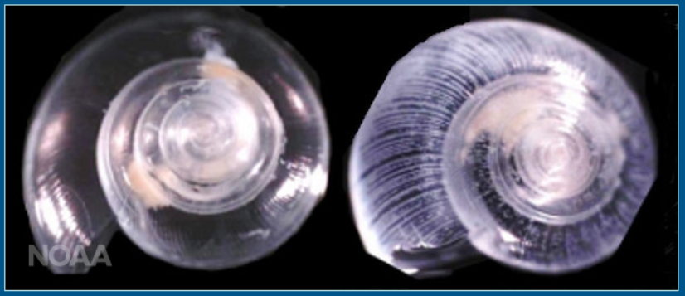
How does ocean acidification and pH level affect the inhabitants of the Eelgrass Meadow?
Notes:
12
How does ocean acidification and pH level affect the inhabitants of the Eelgrass Meadow?
Ocean acidification changes the chemistry of the ocean and causes ‘osteoporosis of the sea,’ which prevents animals at the base of the food chain from building and maintaining the protective shells they need to survive. This has the potential to fundamentally change marine life, food webs and habitats globally, including in national marine sanctuaries. (Concept 7d)
Image: “Shown here in laboratory conditions are (left) a pteropod that has lived for six days in normal waters and (right) a pteropod showing the effects of living in acidified water for the same time period. The white lines indicate shell dissolution and explain why ocean acidification is often called "osteoporosis of the sea." (NOAA)
In case students don’t know what osteoporosis is, it’s the condition when bones become weak and easily break.
Image courtesy of NOAA, https://www.noaa.gov/ocean-acidification-high-co2-world-dangerous-waters-ahead

Slide 13
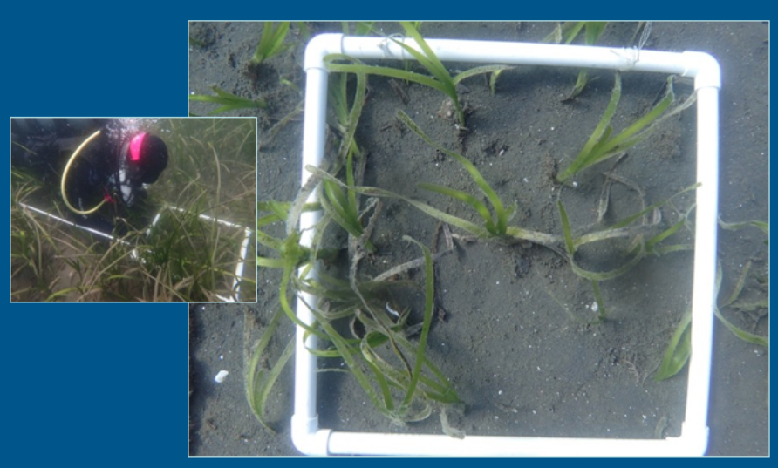
How to use a quadrat
Notes:
13
During the lesson today, you will be a scientist and map an eelgrass meadow. Part of mapping an eelgrass meadow involves counting the number of eelgrass shoots, or plants, in a given area. These images show you how to do that.
How to use a quadrat and why is counting of the shoots important:
To use a quadrat, swim along the transect line to get to the predesignated location and place the quadrat along side the transect tape (see image on left). Then count the number of shoots that are inside the quadrat even if the leaves of the shoot are outside the quadrat. Normally, the scientist would also measure the length of each shoot inside the quadrat and record its length. We are only going to count and record the number of shoots in the quadrat.
The reason why it’s important to count and measure the shoots of the eelgrass is because these plants, through their process of photosynthesis, capture CO2 from the ocean. By documenting where this data was collected, when researchers return to this same eelgrass meadow in the future, they can collect new data to compare to the old data and be able to tell if the eelgrass meadow is growing and remaining healthy or not. The researcher will note more shoots as well as longer shoots to indicate a healthier eelgrass meadow. This data can then be used with data about the water and pH levels to figure out if the eelgrass meadow is in fact helping to maintain a healthy pH level in the water for marine life over time. The more eelgrass, then the more CO2 these plants capture and bury in the seafloor thus the eelgrass meadow can help reverse the effects of ocean acidification.
Photos courtesy of: Jessie Alstatt, CINMS

Slide 14
Let’s learn how to scuba and
save our national marine sanctuaries!
Notes:
14
This is exactly why we need guardians like you!
Our sanctuary deserves to be protected and preserved so that everyone can enjoy it now and in the future.
Let’s learn how to scuba and save our sanctuary!

Slide 15
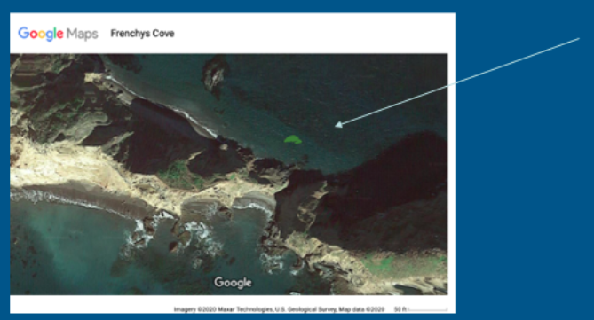
Here is a new sonar map of an eelgrass meadow that you need to “ground-truth” with your team!
Notes:
15
We are going to “ground-truth” a sonar map of an eelgrass meadow at Frenchy’s Cove!
Frenchy’s Cove is located on the west side of Anacapa Island, which is part of the Channel Islands National Marine Sanctuary. See map on slide 3.

Slide 16
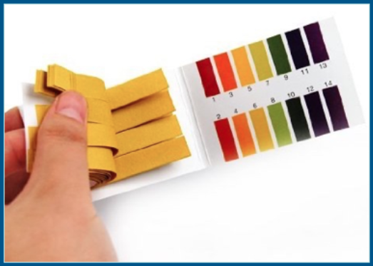
How do I test the water samples? How to use a water testing kit
Notes:
16
Using the real water samples, use the Litmus paper to test each vial of water and record the pH level on the table. Record your data on the “Eelgrass Meadow pH Levels Chart” by making a finding the pH level, marking it and creating a column on the left side of the data already on the chart for each of the 3 locations of the eelgrass meadow. Then discuss with your classmate to compare this data to the data on the chart from 6 months earlier. Did the pH level increase or decrease? What does that mean for the marine life in this eelgrass meadow? What does this mean for ocean acidification?
Photo courtesy of: Amazon.com, Lucky Stone product image

Slide 17
Resources
All resources included at the end of the
Channel Islands National Marine Sanctuary Dive Lesson
Notes:
17
Check the end of the Dive Lesson document for all resources.
All images used are cited in the notes section of each slide in this presentation.

