Slide 1
Notes:
1
Welcome slide, can introduce self here.

Slide 2
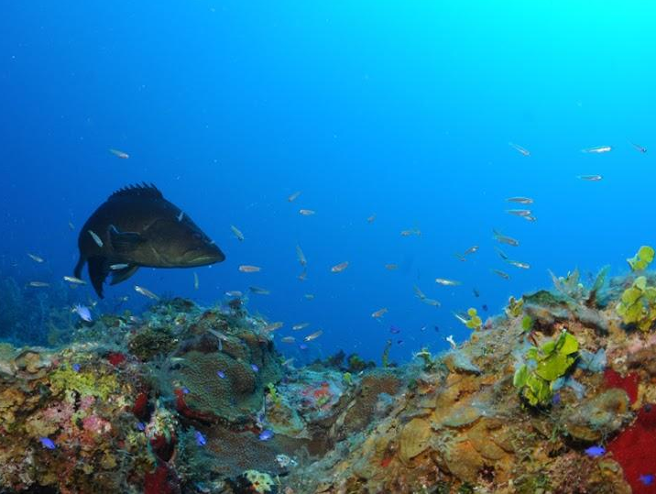
Florida Keys National Marine Sanctuary
Notes:
2
History
25 years ago the United States, with the help of Florida, decided it was very important to help protect the area surrounding the islands of the Florida Keys and all the animals and plants that live in its waters.
Pictures Courtesy of: NOAA

Slide 3
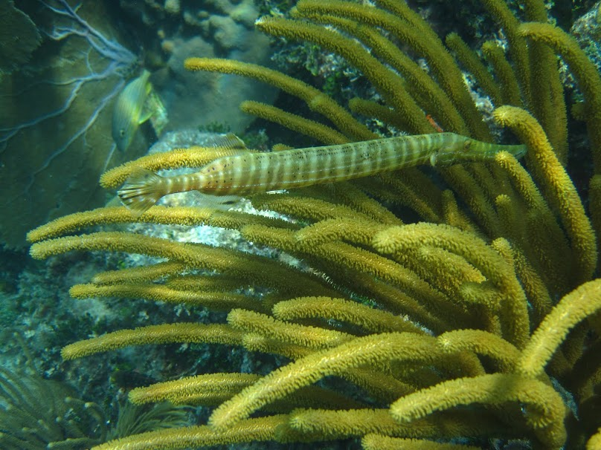
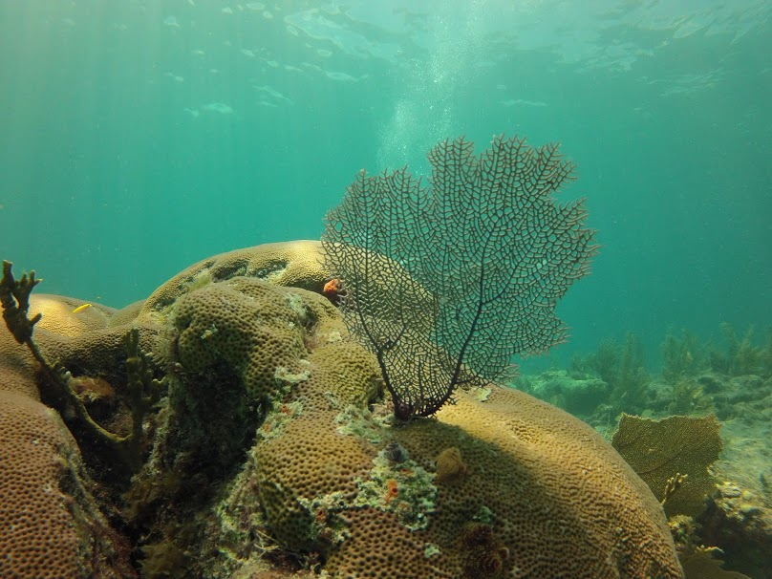
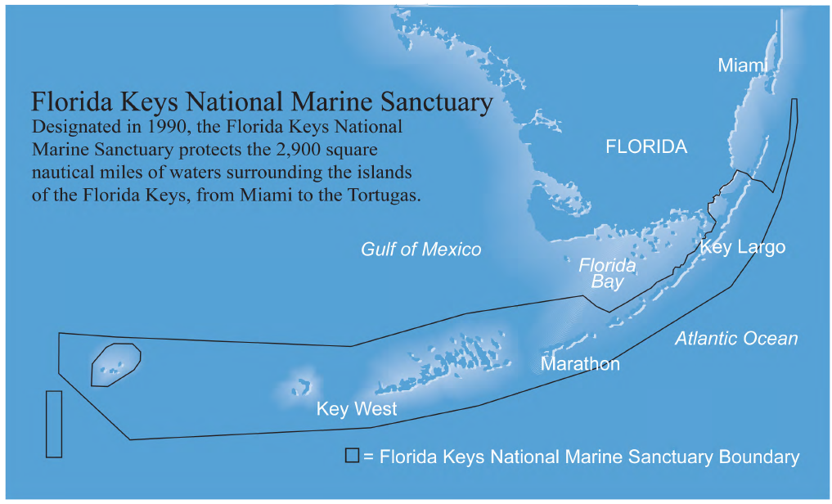
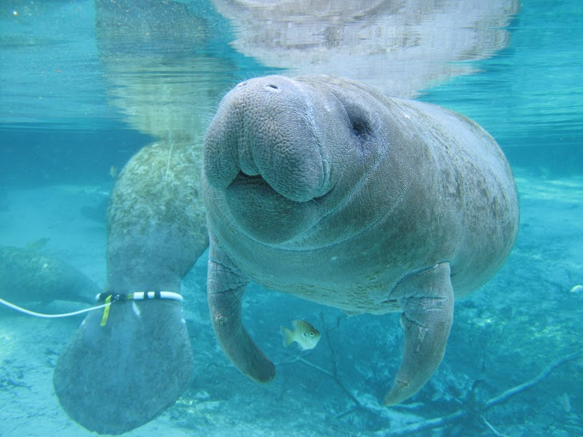
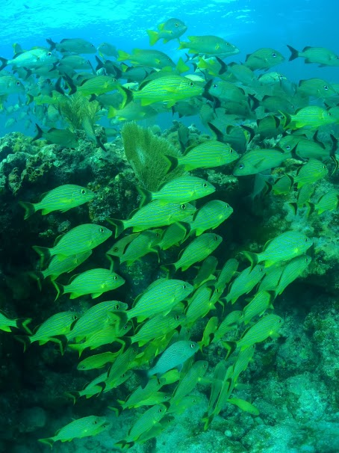
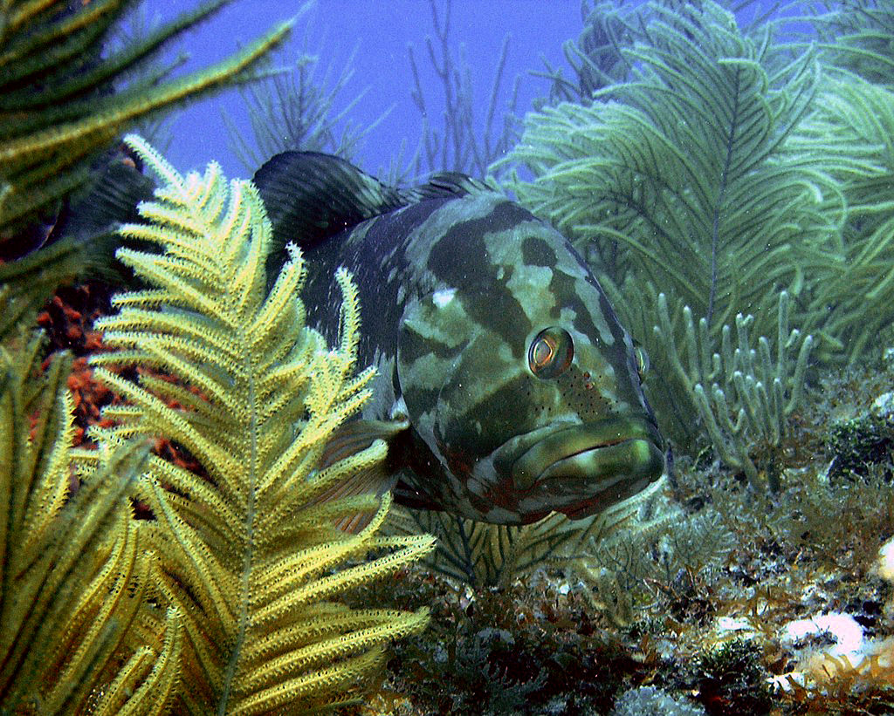
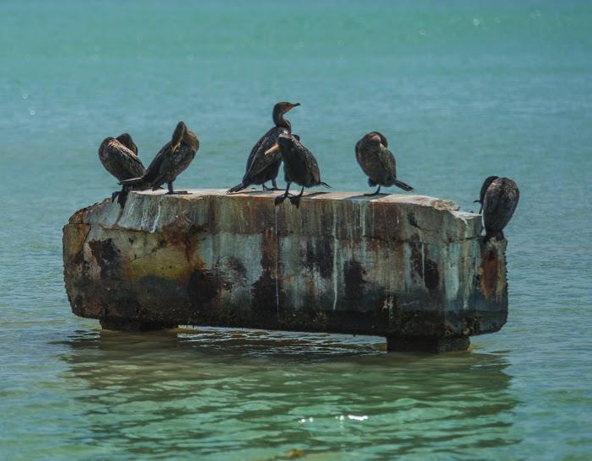
Notes:
Why is Florida Keys unique?
Florida Keys National Marine Sanctuary is home to thousands of different species of animals. Three important habitats can be found within the sanctuary: coral reefs, seagrass meadows, and mangrove forests.
Photos exemplify diversity found in Florida Keys.
Pictures numbered by animation:
Invertebrates:
Picture 1: Fan coral/sea fan
Fish
Picture 2: Nassau grouper
Picture 3: Trumpet fish and soft coral
Picture 4: School of bluestriped grunt
Mammals:
Picture 5: Manatee
Birds:
Picture 6: Cormorants
Pictures Courtesy of: NOAA; (Cormorants) David Ruck/NOAA
3

Slide 4
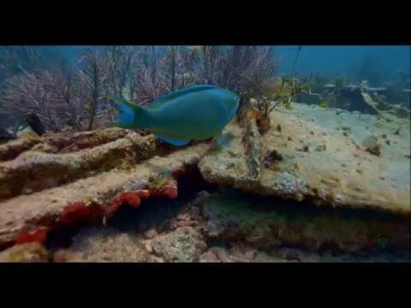
Dive into Florida Keys National Marine Sanctuary!
Notes:
Take a look at this video to see some of the amazing creatures found in Florida Keys National Marine Sanctuary.
4

Slide 5
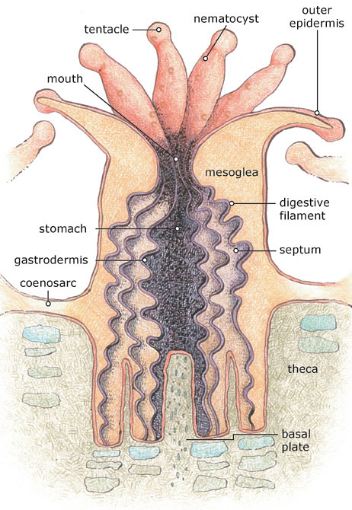
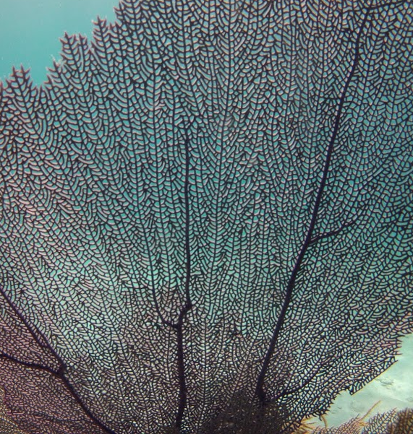
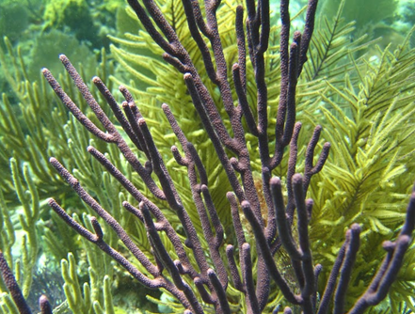
Coral Reefs
Corals are alive! They are made up of thousands of tiny animals called polyps.
Notes:
5
What is a coral reef?
When many individual corals grow close together, in groups called colonies, they form a reef. If a particularly large amount of corals form in an area, like the one in our sanctuary, it is considered a barrier reef. Coral reefs are often compared to a bustling city because they support 25% (or 1 of 4) marine creatures.
Pictures Courtesy of: NOAA

Slide 6
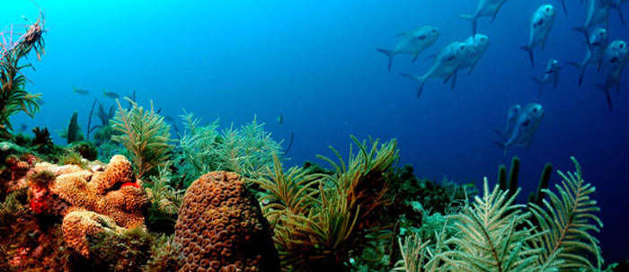
Coral reefs are important for ocean life.
Notes:
6
Why is it important to people and the sanctuary?
Florida Keys National Marine Sanctuary protects one of the largest living coral barrier reef systems in the world. Certain types of fish and coral can only be found in the sanctuary. Many fish and other species can live in or around the reef and also feed off of corals.
Pictures Courtesy of: NOAA

Slide 7
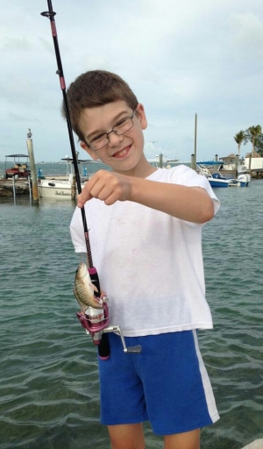
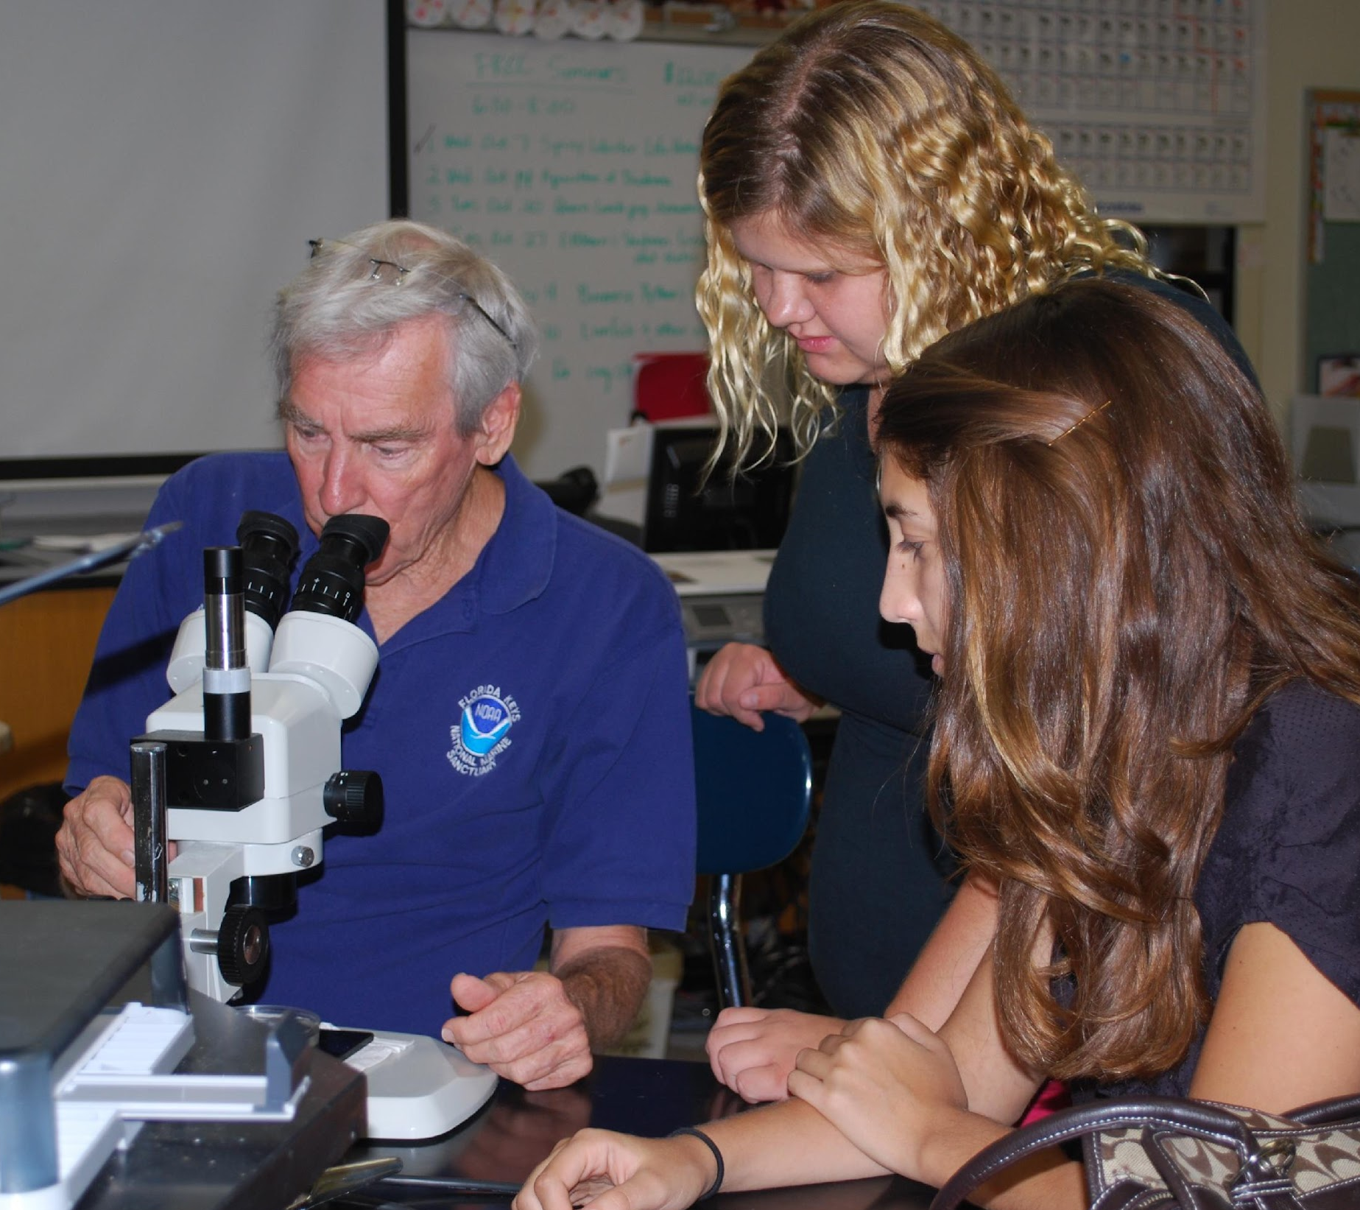
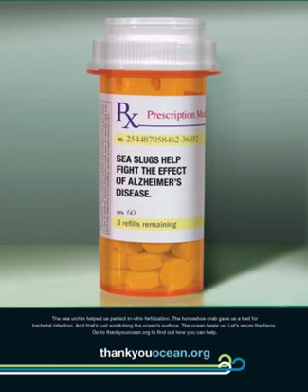
Coral reefs are important for people.
Notes:
7
Reefs are important to people too. Many people travel from all around the world to enjoy and dive among the reefs. Fishermen rely on the reef to provide a safe and healthy place for the fish to grow before they can be caught and sold in our markets. Also, scientists study reefs to find substances that could one day help create important medicines.
Pictures Courtesy of: NOAA and Sanctuary Classic

Slide 8
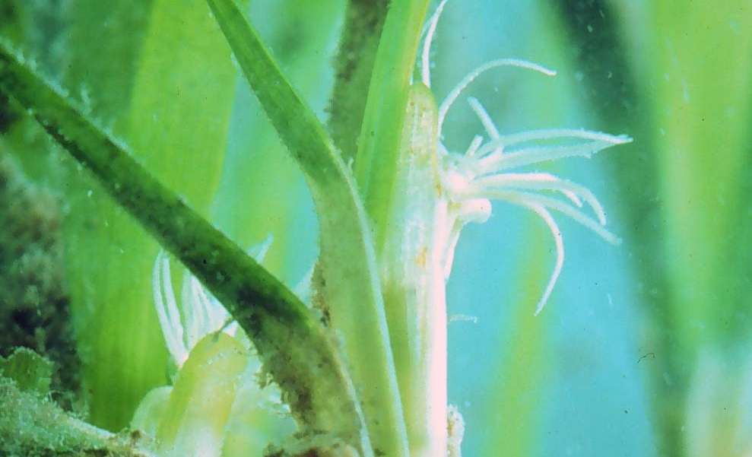
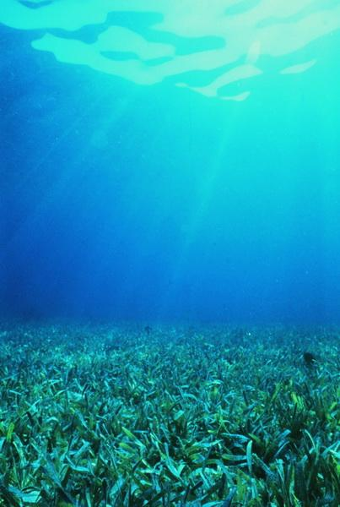
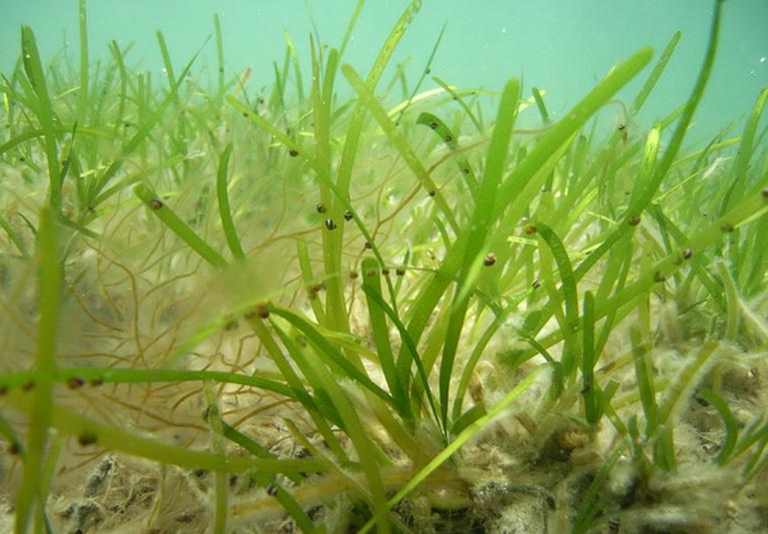
Seagrass Meadows
Seagrasses are one of the only land plants that can live in the ocean.
Notes:
8
What is seagrass?
Seagrasses are not actually a type of grass, but very similar to many plants we see on land. There are over 50 different species (or types) of seagrass. Seagrasses cannot grow in water that is too deep or too murky (dark) since they would not have enough light to grow. They spend their entire lives underneath salt water. Seagrass beds cover a very large part of Florida’s coast, bays and lagoons.
Pictures Courtesy of: NOAA, Florida DEP Staff (Turtle Grass, upper right)

Slide 9
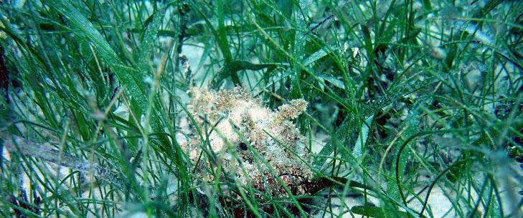
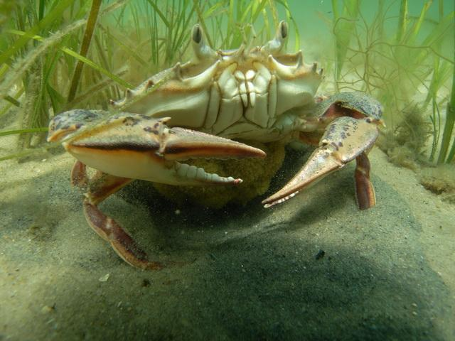
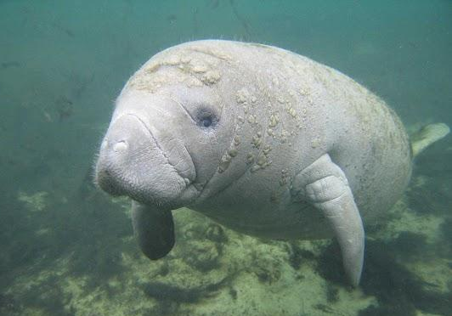
Seagrass meadows are important for ocean life.
Notes:
9
Why is it important to people and the sanctuary?
Seagrass provides shelter and food for many animals. Seagrass communities are home to many different animals at some part of their life, including shrimp, lobster, fish, and crabs. When these creatures become adults they often live in the coral reef habitat. Areas like seagrass meadows and reefs are vey important to fishers because they are a place where fish can hide and eat a lot before they grow large enough to catch.
Pictures Courtesy of: NOAA

Slide 10
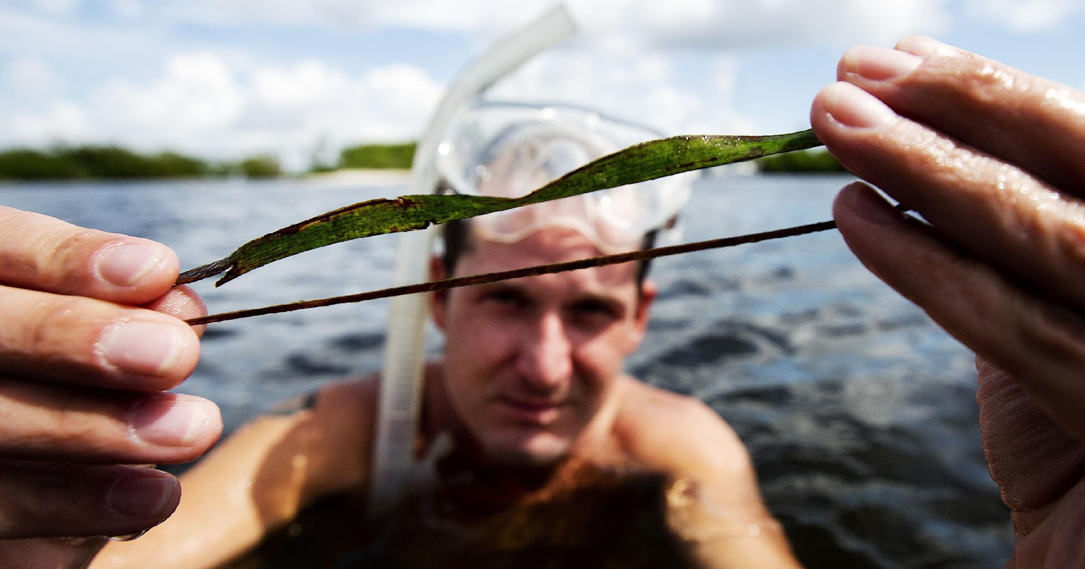
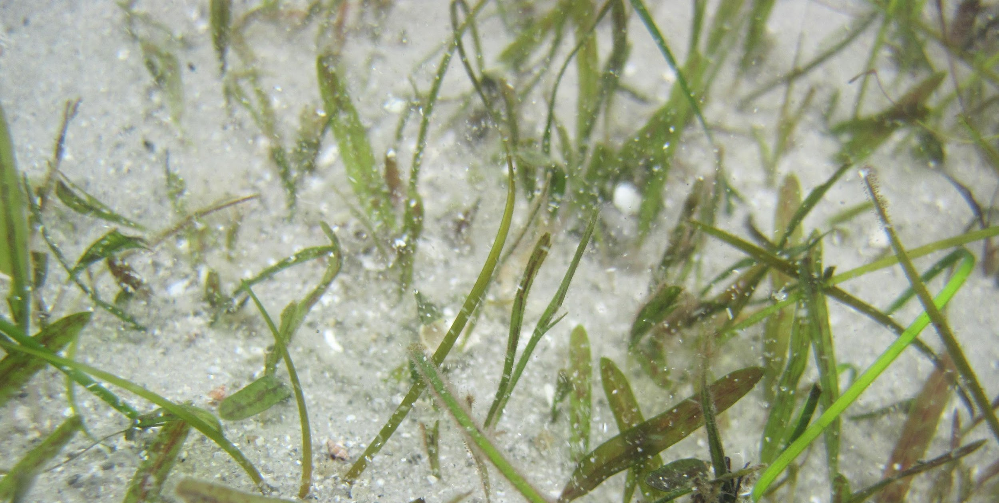
Seagrass meadows are important for people.
Notes:
10
They keep the seafloor stable and stops the land from washing away.
Without seagrass holding the seafloor together, most areas where we currently live would look like a sandy beach and be too soft to even build houses on. Seagrass meadows also help make our ocean waters cleaner and clearer, by filtering out and trapping dirt and other sediments. Do you eat fish or seafood? Seagrass meadows are important for the health of many sea creatures that humans eat!
Pictures Courtesy of: NOAA, Photo: ANDREW WEST/THE NEWS-PRESS

Slide 11
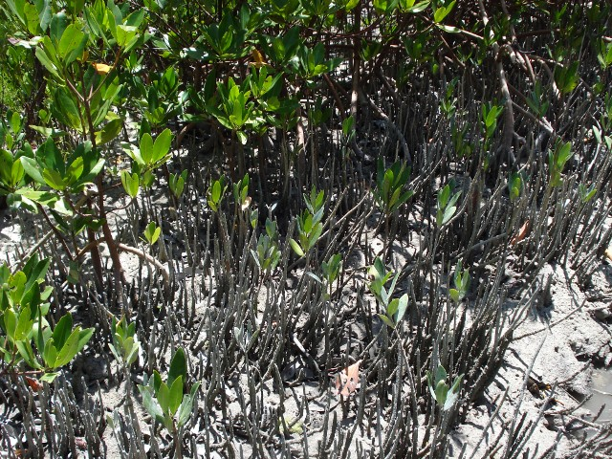
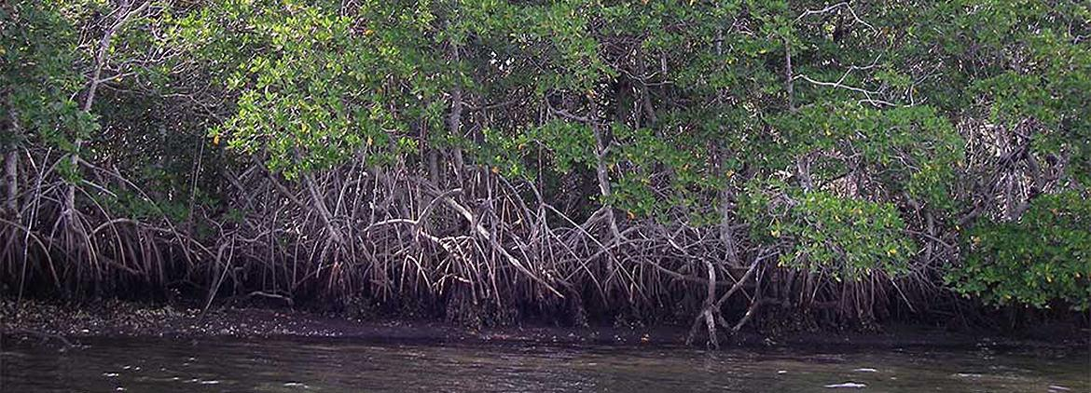
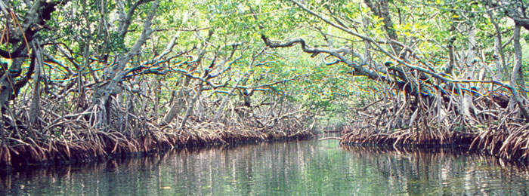
Mangrove Forests
Mangroves are trees or bushes that grow along seashores.
Notes:
11
What is a mangrove forest?
Mangrove trees grow only in warm, slow moving waters. Many of these trees appear to be standing on stilts because of their thick tangle of roots. One type of mangrove, called the black mangrove (photo on the left), has tall roots that act like snorkels and help the tree breathe during high tide.
Mangroves cover a large part of the shores within the Florida Keys National Marine Sanctuary. The tangled roots of the trees also provide food, shelter, and protection for many types of fish, birds, and mammals, especially juvaniles. Fishermen also rely on mangroves since these areas allow fish to become large and healthy just like seagrass beds.
Pictures Courtesy of: NOAA, David Ruck (roots with birds)

Slide 12
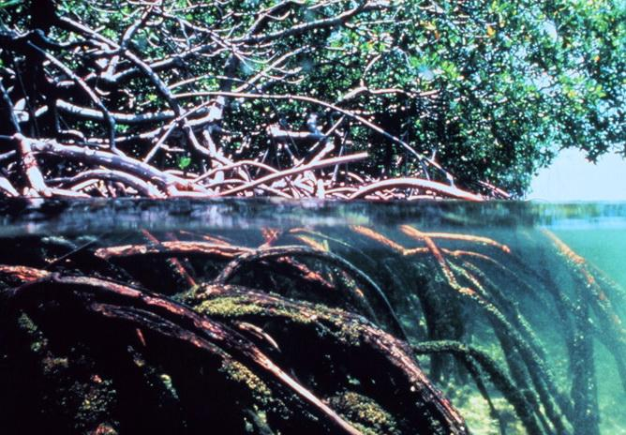
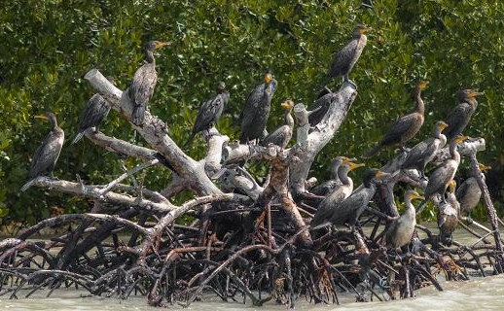
Mangroves are important to people and ocean life.
Notes:
12
Why is it important (to people and the sanctuary)
Mangroves are very similar to seagrasses in the way they affect the ocean. The roots of mangroves help slow down powerful waves and prevent beaches from eroding, or being washed away. They are also filters that remove pollution, trap dirt and sand (sediments), and absorb extra nutrients in the water, which makes the surrounding ocean waters much cleaner and clearer. The tree canopy is also important to nesting and roosting birds.
Pictures Courtesy of: NOAA, David Ruck (roots with birds)

Slide 13
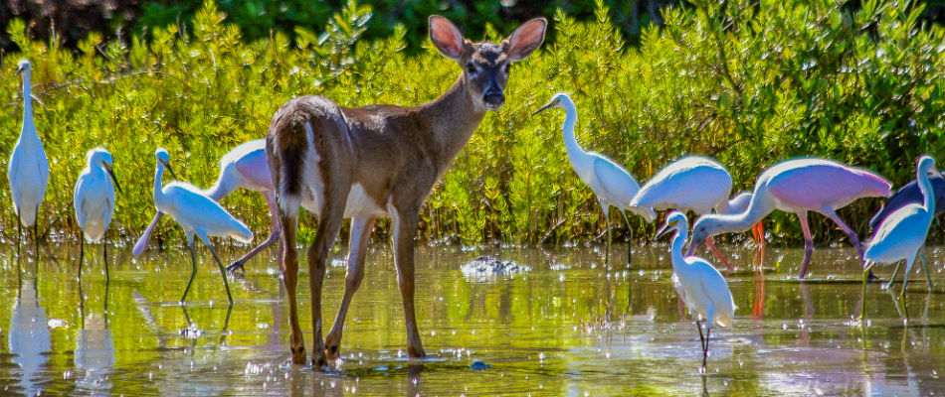
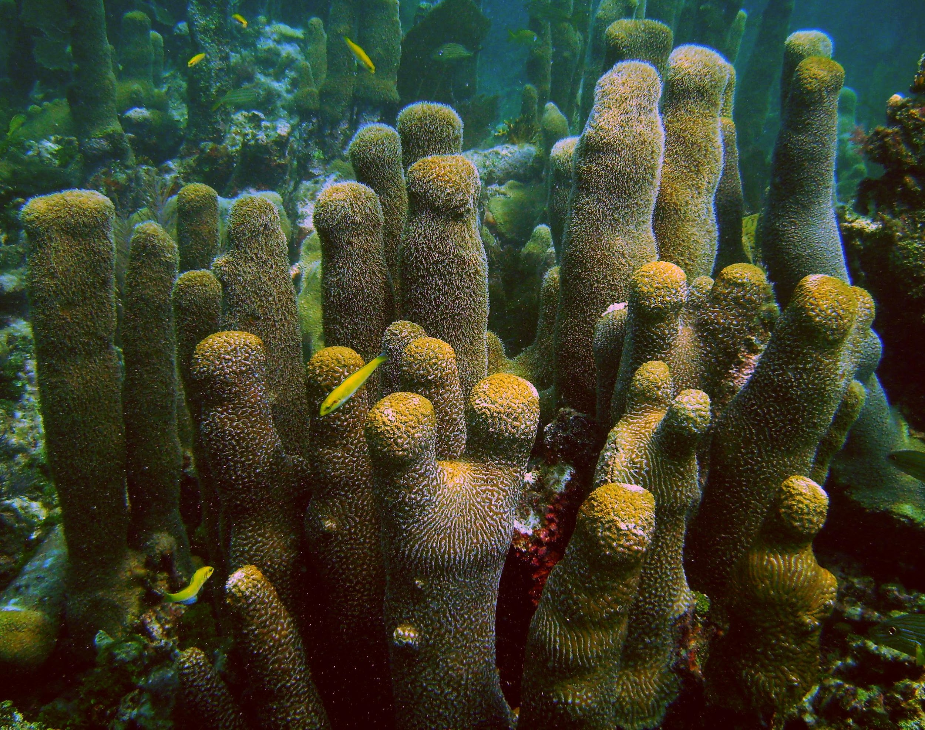
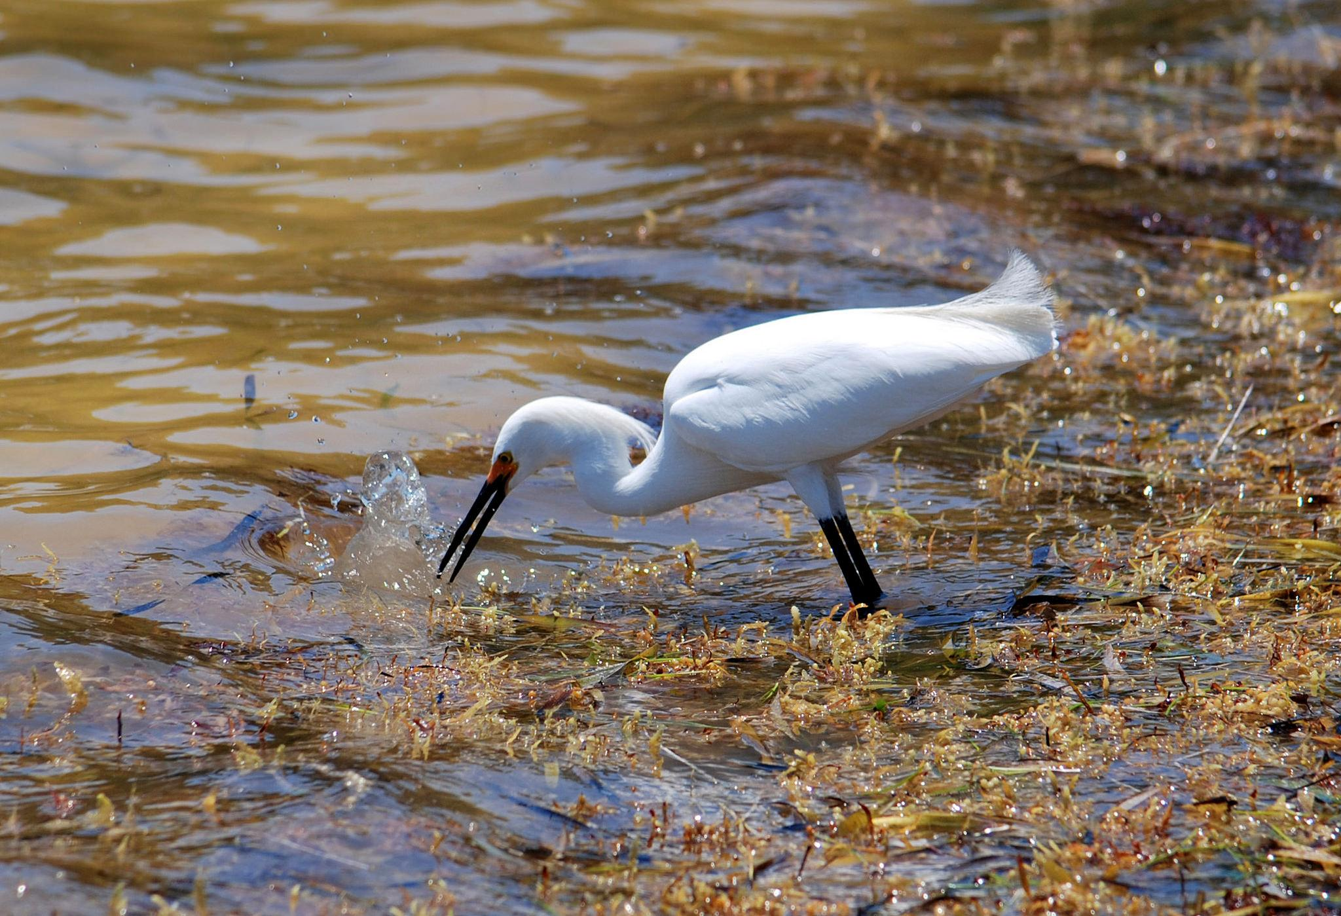
Habitats are interconnected.
Notes:
13
When habitats are interconnected it means that they work together. Imagine streets near your home-- they connect you to your neighbors, friends, school, and to the things you like doing, such as diving. Habitats in Florida Keys National Marine Sanctuary are connected. Seagrass beds and mangrove forests help to filter the ocean and keep coral reefs clean and clear. Both mangrove forests and coral reefs are like nurseries to little baby fish that grow up to impact the larger ocean. All these habitats have a roll to play in keeping the ocean and the creatures that live there healthy.
Photo Credits:
Grouper- Alicia Farrer/NOAA
Pilar Coral- Bill Precht/NOAA
Snowy Egret- Nancy Diersing/NOAA
Keys Deer- US Fish and Wildlife

Slide 14
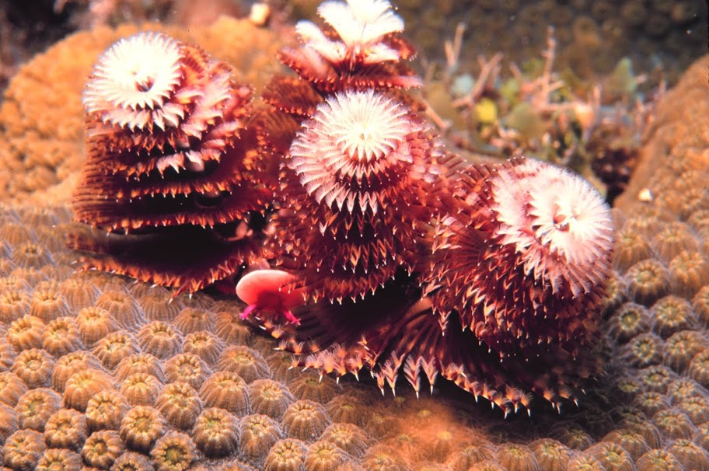
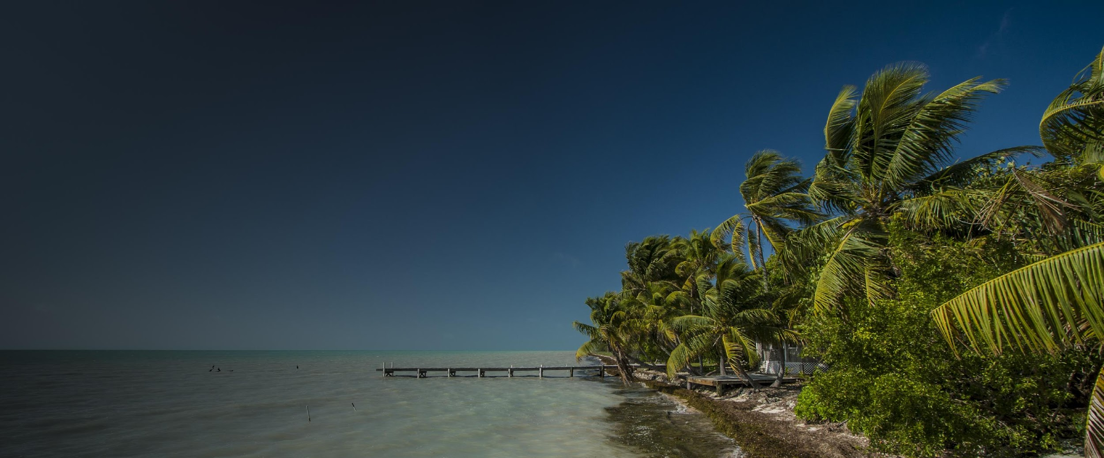
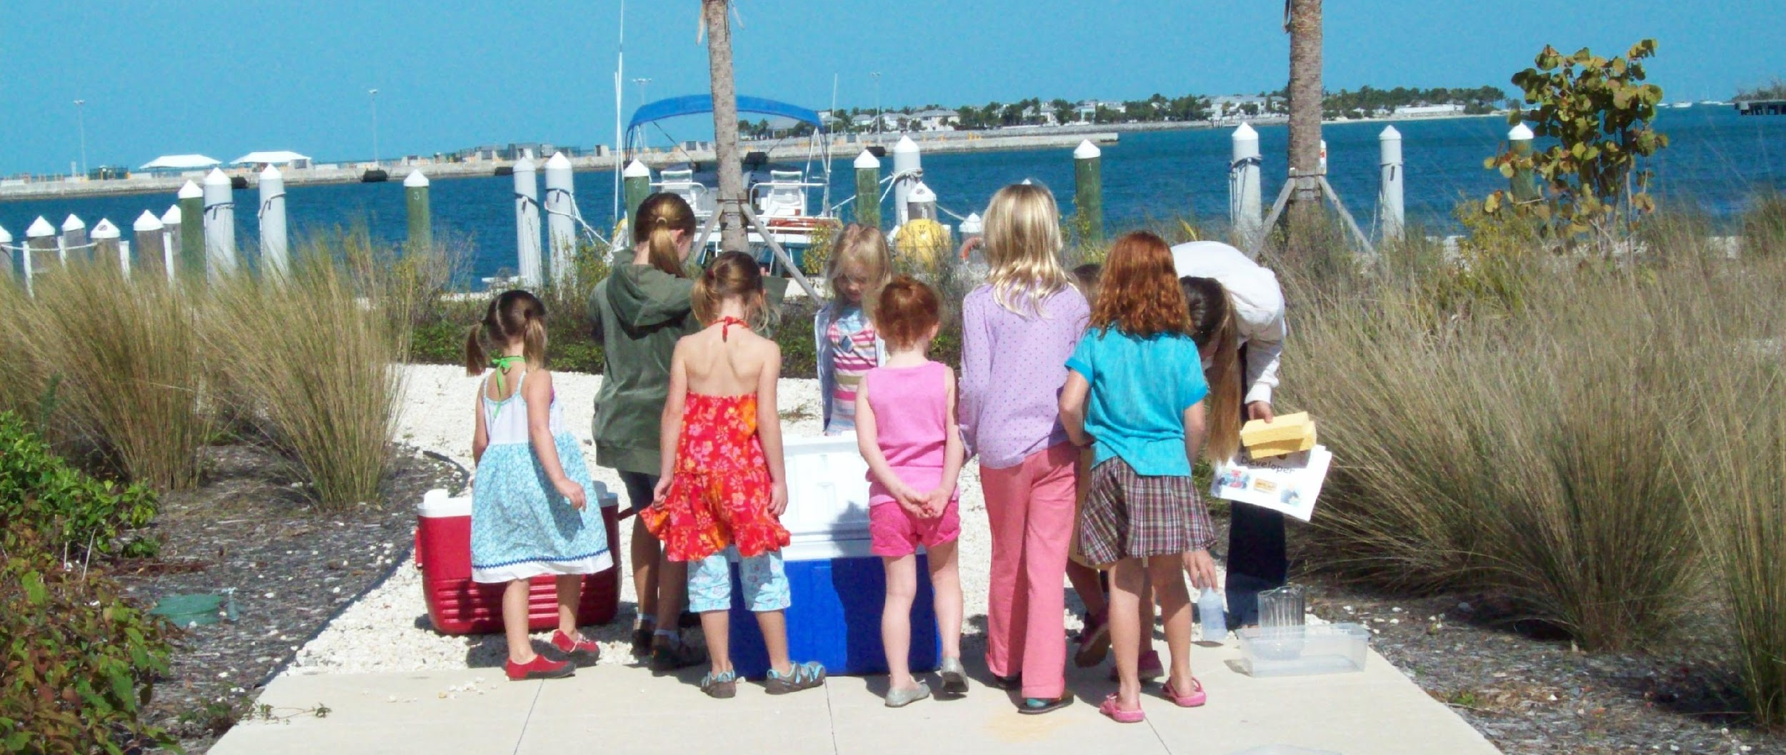
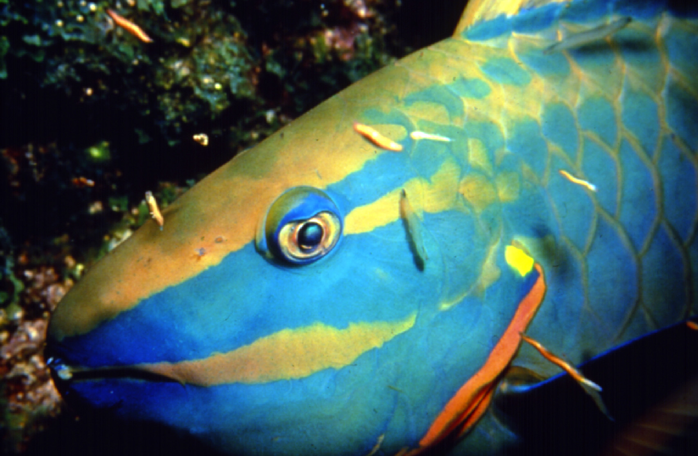
Notes:
14
We Need Guardians!
These habitats are beautiful and special to all the inhabitants of the Florida Keys, both people and animals alike. Our sanctuary deserves to be protected and preserved so that everyone can enjoy it now and in the future.
Pictures Courtesy of: NOAA

Slide 15
Trash Talk: What is Marine Debris?
Notes:
15
One threat to Florida Keys National Marine Sanctuary is marine debris.
Have student watch NOAA’s Ocean Today Trash Talk video: What is Marine Debris?
https://www.youtube.com/watch?v=FfSFKEM5Psc
Pictures Courtesy of: NOAA

Slide 16
What is marine debris?
A. An animal that lives in the deepest part of the ocean
B. Any kind of trash that ends up in the ocean
C. A small plant that floats on the surface of the ocean
D. The seaweed that washes on the beach
Notes:
16
Ask students: What is marine debris?
(read responses and have students raise their had for the answer that they think is correct)

Slide 17
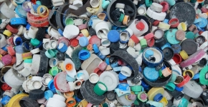
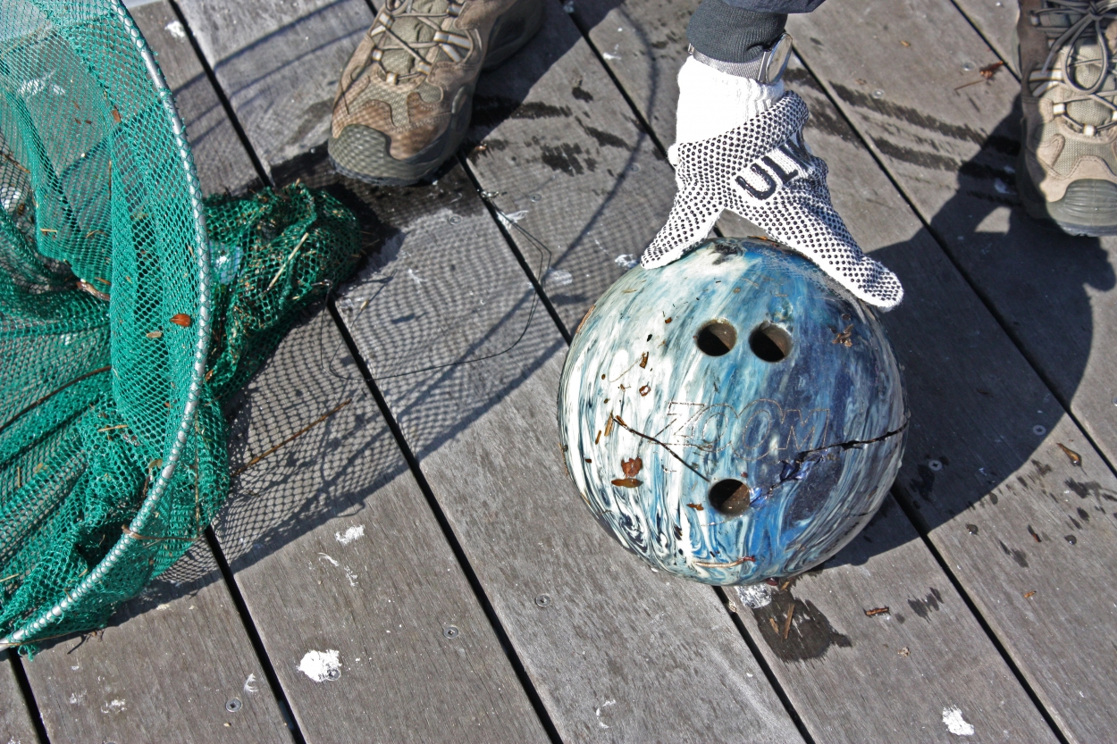
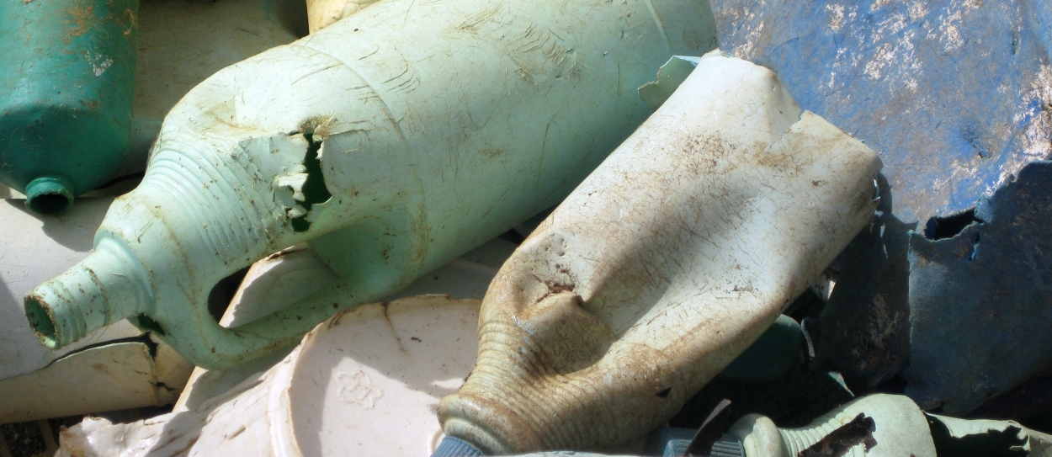
What is marine debris?
B. Any kind of trash that ends up in the ocean
Notes:
17
Trash like plastics, metals, rubber, paper, textiles, derelict (unusable) fishing gear, vessels, and other lost or discarded items enter the ocean every day, making marine debris one of the largest sources of marine pollution.
Pictures Courtesy of: NOAA

Slide 18
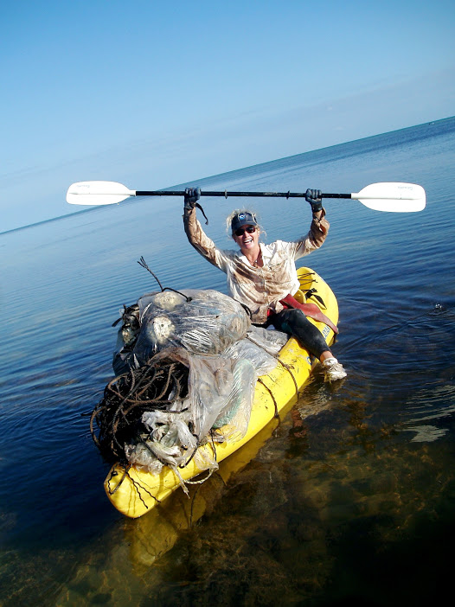
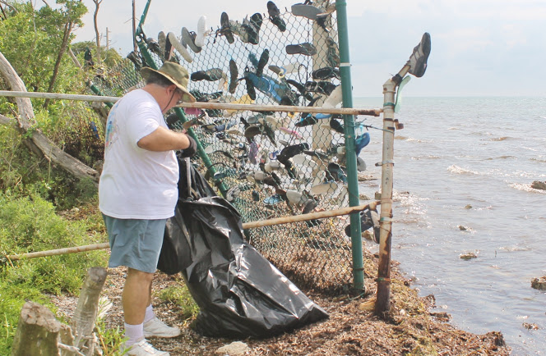
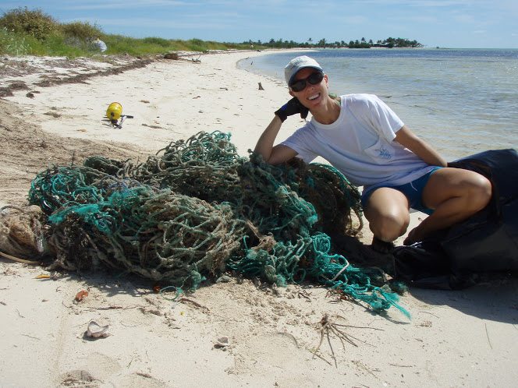
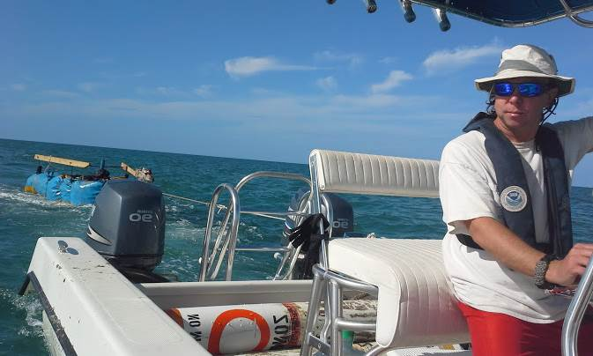
Where does marine debris come from?
Notes:
18
Marine debris can come from both the land and the ocean, but both sources come from humans who do not properly dispose of their gear or other waste.
Trash like plastics, metals, rubber, paper, textiles, derelict (unusable) fishing gear, vessels, and other lost or discarded items enter the ocean every day, making marine debris one of the largest sources of marine pollution.
In the Florida Keys, large and heavy debris like nets, tires and old fishing traps, can crush and damage coral, seagrass beds, and mangrove trees.

Slide 19
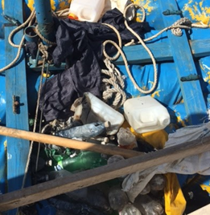
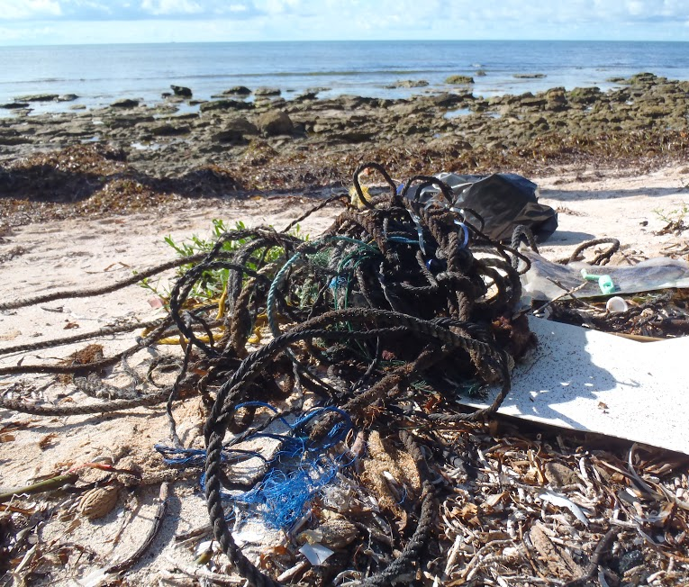
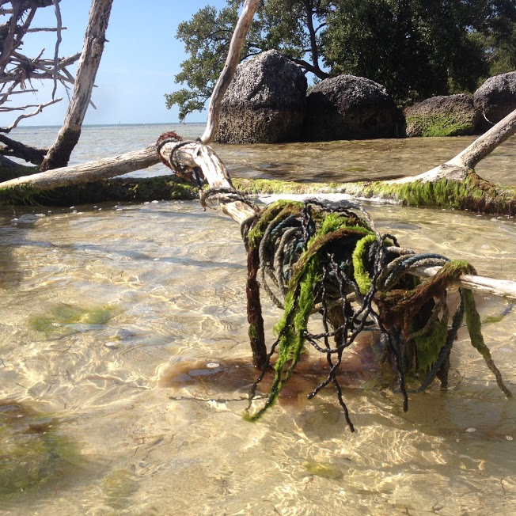
Marine Debris: A Threat to Our Sanctuary
Notes:
19
How does it affect reefs, seagrass beds, and mangroves?
Lost or thrown out nets can break off coral pieces, trap fish and other marine life, and can disturb the reef when it settles on the seafloor or on seagrass beds. Large tangled up nets or rope can also become caught in mangrove roots, trap animals and keep the tree from being able to breathe during high tide.
Marine debris is also bad for humans. It makes beaches less enjoyable and more dangerous. And boaters can also become tangled in marine debris or run into large debris that a floating just below the surface of the water.
But it is very important to remember, that marine debris is preventable.
Pictures Courtesy of: NOAA, Brenda Altmeier (derelict raft)

Slide 20
Trash Talk: What can we do?
Notes:
20
Have student watch NOAA’s Ocean Today Trash Talk video: What can we do?
https://www.youtube.com/watch?v=XuhdmDc4L1Y

Slide 21
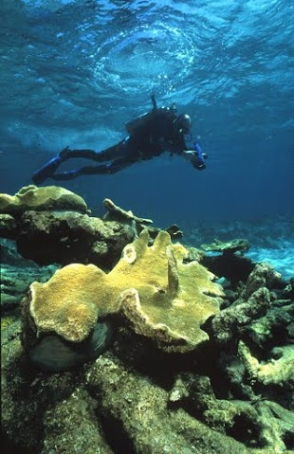
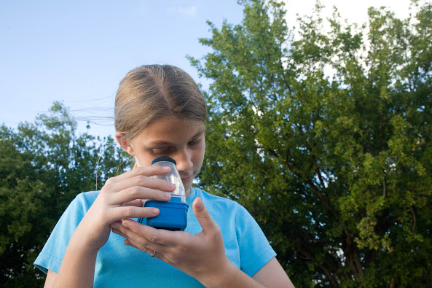
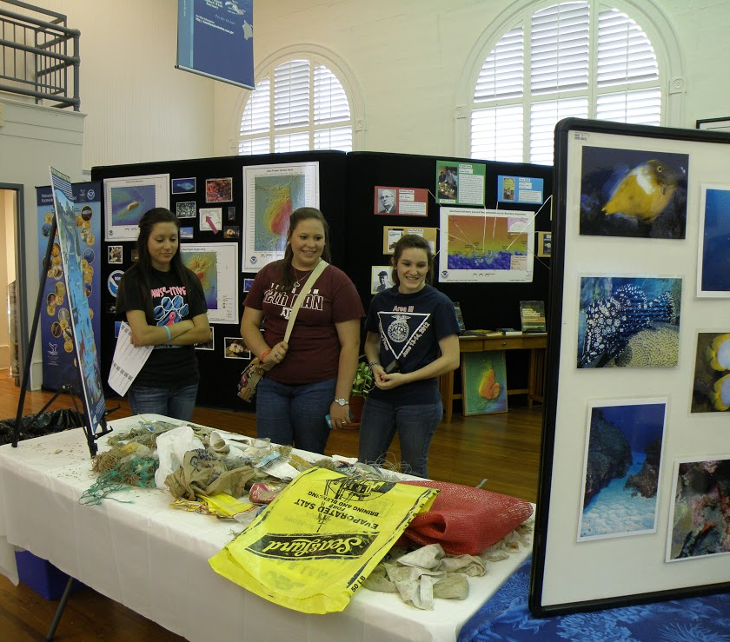
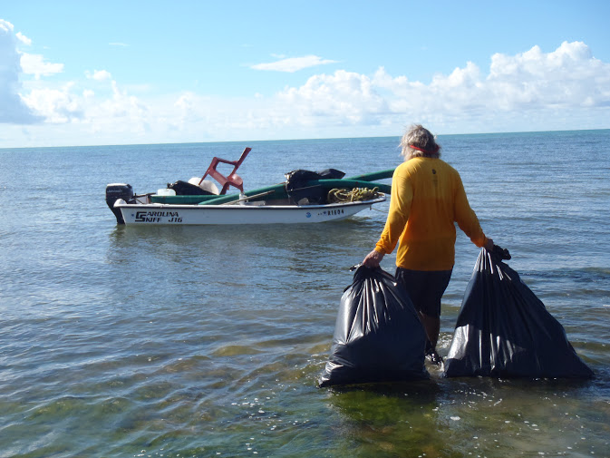
How can you prevent marine debris?
Notes:
21
Assess for student understanding by asking the question: (answers in italics)
What can you do in your community to prevent marine debris?
Volunteer:
-Help in local coast and beach cleanups. Removing trash from on and around the beach will keep it from entangling animals and reefs, falling on seagrass beds, and piling up in mangrove forests
-Prevent trash from being thrown away incorrectly, help sort recyclables, trash, and food waste at home, school, and the beach
Educate
-Talk to your friends and parents about what you’ve learned today, share with them how we can help our oceans!
-Encourage your school to have a day to educate students about marine debris effects and how to prevent it
Explore
-Continue to dive! Appreciate all that the ocean has to offer and help others understand why it is so important to protect our ocean
-Bring friends and family to enjoy the ocean too, dive, snorkel, or just go to the beach!
Pictures Courtesy of: NOAA

Slide 22
https://floridakeys.noaa.gov
Notes:
22
After completing the PowerPoint you may choose to take students on a virtual dive of Florida Keys National Marine Sanctuary by visiting http://sanctuaries.noaa.gov/vr/
You can view these images over your large screen with students or have them view them individually on cell phones. The images are also compatible with VR goggles.
- Ask students: What do you notice? What types of habitats do you see? Do you notice any marine debris?

