Slide 1
Monitor National Marine Sanctuary
Notes:
Instructional suggestion:
Share with students the purpose of the Ocean Guardians Dive Club: to learn about the importance national marine sanctuaries and how scuba skills can be used to study and protect them.

Slide 2
National Marine Sanctuaries
“America’s Ocean and Great Lakes Treasures”
Notes:
Instructional suggestion:
Use the images to lay the groundwork for the types of habitats and organisms provided protection by national marine sanctuaries.
Some organisms shown include: sea turtles, whales and dolphins, sharks, and invertebrates, like corals and sea stars.
Instructor Notes:
Few places on the planet can compete with the diversity of the National Marine Sanctuary System, which protects America's most incredible natural and cultural marine resources. Sanctuaries are America’s ocean and Great Lake treasures.

Slide 3
sanctuaries.noaa.gov
Notes:
Monitor National Marine Sanctuary is located off the North Carolina coast, 16 miles south-southeast of the Cape Hatteras Lighthouse. Resting at 230 feet below the ocean’s surface, the USS Monitor wreck site is not easily accessed by the average diver. However, for those qualified technical divers, the experience of coming face-to-face with history is one that will never be forgotten.
Optional: Fortunately, for those who don't want to get their feet wet, there are many places on shore that offer the opportunity to discover the wonders of this great ship. One of these places is The Mariners’ Museum and Park in Newport News, Virginia, where visitors can learn about the history and legacy of Monitor and its crew.
Photo Credit: NOAA

Slide 4
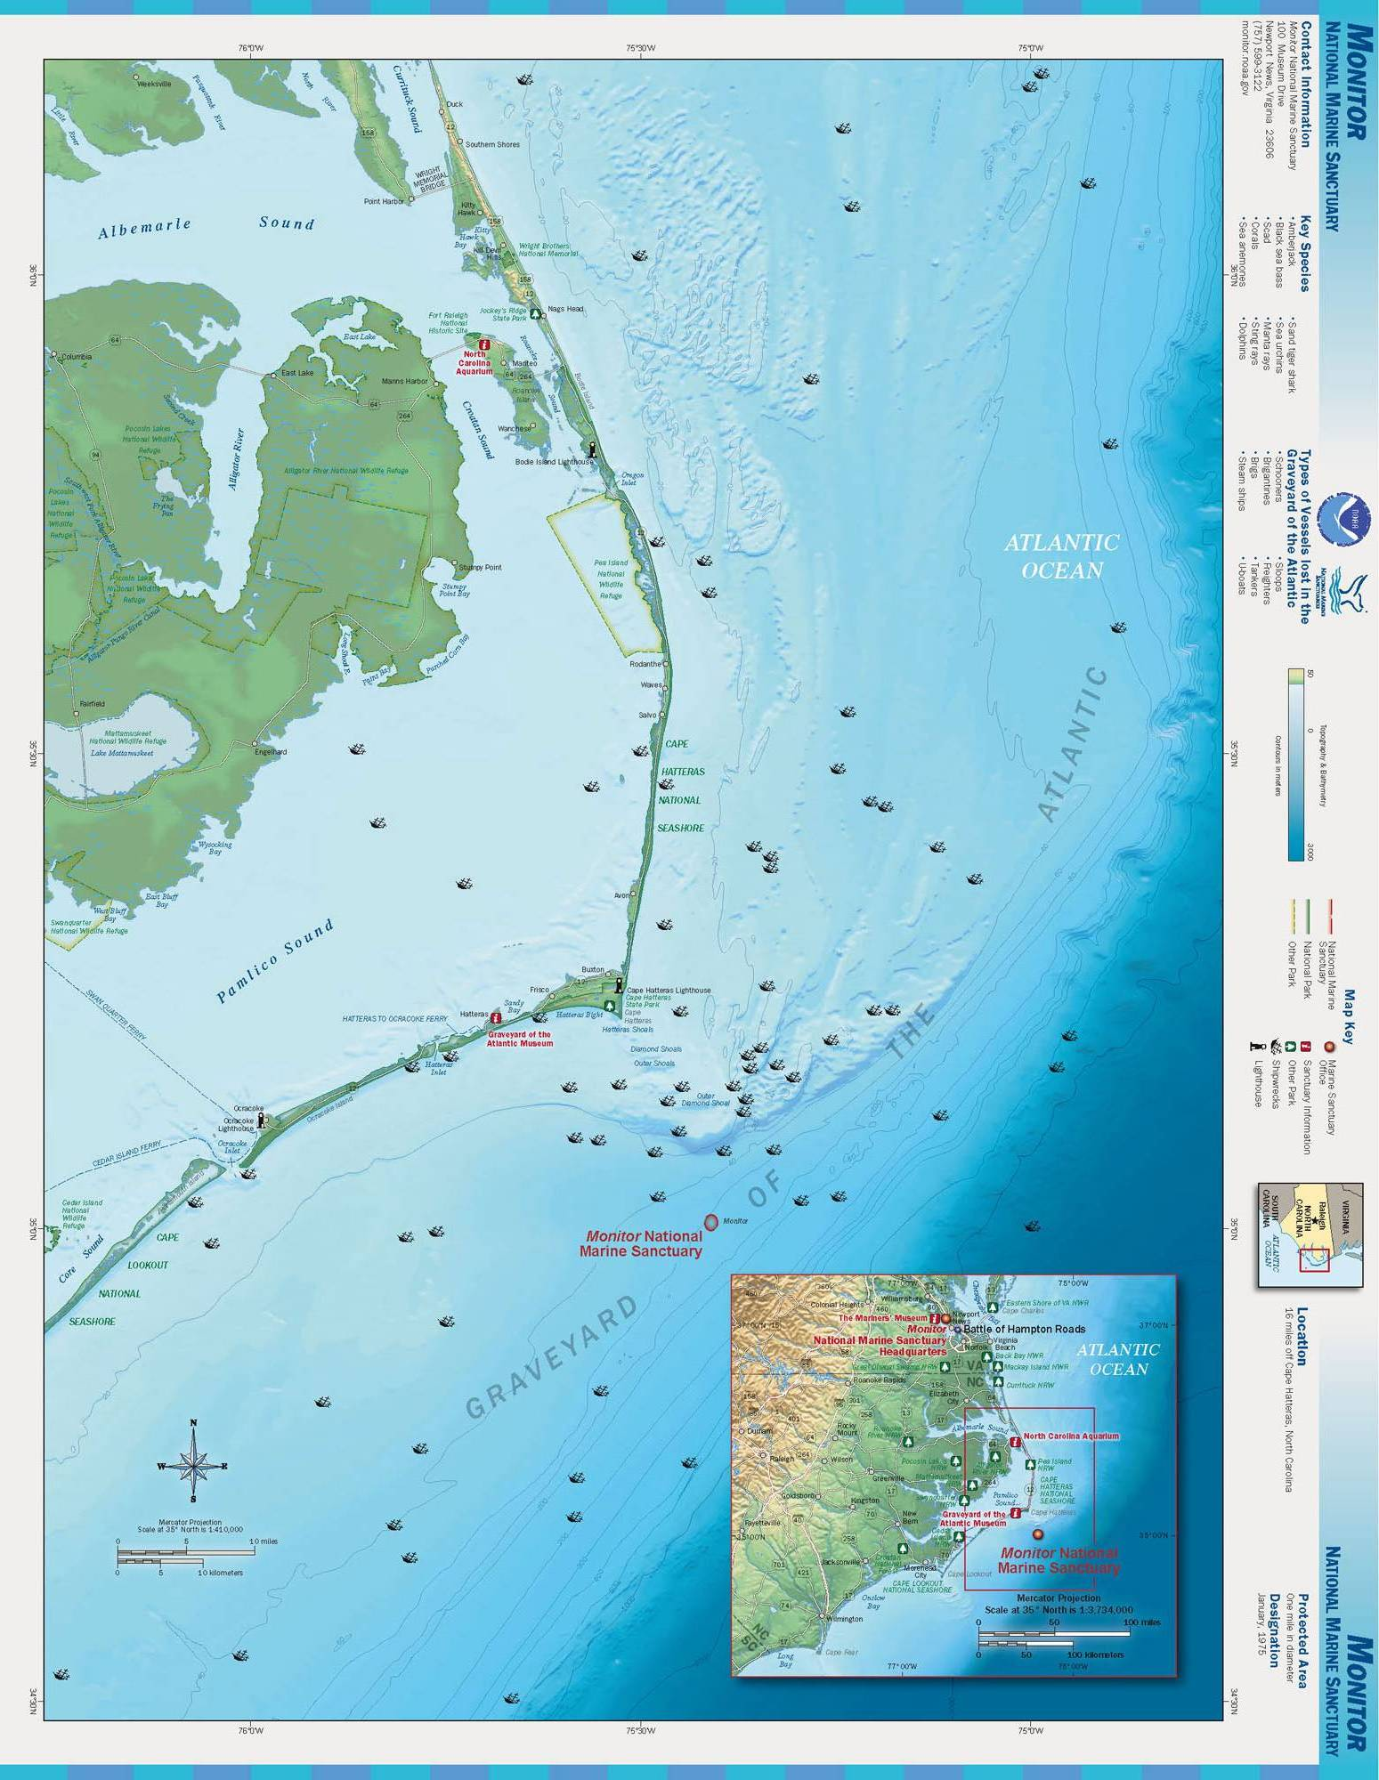
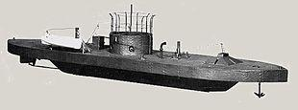
xx
Why is Monitor National Marine Sanctuary unique?
Notes:
Why is Monitor National Marine Sanctuary unique? (Instructor points out Cape Hatteras and Monitor National Marine Sanctuary)
Monitor National Marine Sanctuary was designated as the nation's first national marine sanctuary on January 30, 1975. The site is named after the wreck of USS Monitor, a Civil War ironclad, designed by Swedish-American engineer John Ericsson. The USS Monitor lies beneath 230 feet of water off Cape Hatteras, North Carolina. The sanctuary is approximately 1-mile in diameter. This vessel contained all of the emerging innovations that revolutionized warfare at sea in the 19th century during the U.S. Civil War.
In response to the Confederate Navy building an ironclad ship, the Union army began designing an ironclad ship under the direction of President Abraham Lincoln. The design by Ericsson included a rotating gun turret, had low draft and a sleek profile. Ericsson claimed it as an "Impregnable Battery.” The USS Monitor was constructed in under 100 days at the Continental Ironworks in Greenpoint, Brooklyn, NY, and it was launched into the East River on January 30, 1862.
The design and innovations of the USS Monitor changed naval warfare for all time.
Photo credits: Map, NOAA
Inset image: Drawing of USS Monitor, NOAA

Slide 5
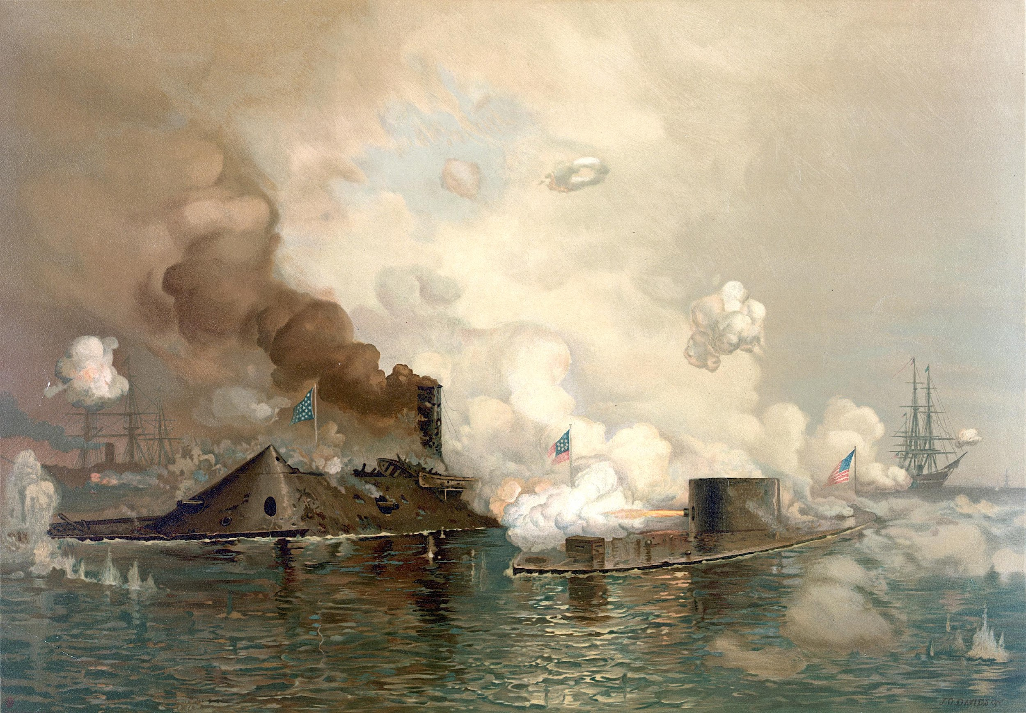
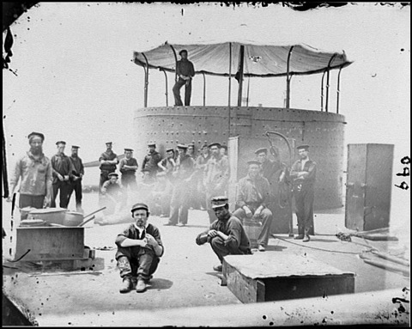
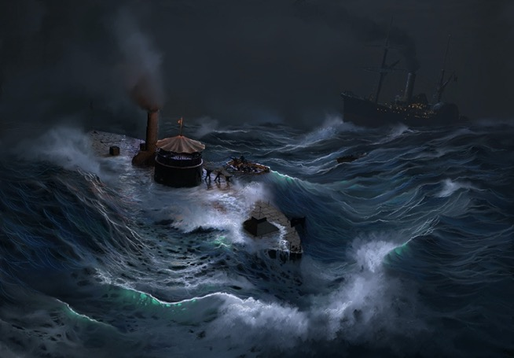
History of the USS Monitor
Monitor and its crew on July 9, 1862
J.O. Davidson painting of the Battle of Hampton Roads between USS Monitor and CSS Virginia on March 9, 1862.
On December 30, 1862, USS Monitor was under tow of USS Rhode Island when one of the ropes snapped. USS Monitor sank hours later off the coast of Cape Hatteras.
Notes:
Read the highlights on the slide to the students.
On March 9, 1862, USS Monitor and CSS Virginia battled for four hours in the Battle of Hampton Roads. Cannon balls bounced off of both vessels with neither side able to claim victory. Although the battle was fought to a draw, what did change that day was naval technology. The era of the wooden battleship had come to an end. Also, ever since, the rotating turret has been on every US naval vessel in some form or another.
Photo Credits: top left- Library of Congress
Top right- One of eight known stereoscopic images taken by James F. Gibson of USS Monitor. Photos were taken on July 9, 1862, while Monitor was docked on the James River in Hampton Roads, Virginia. The glass plate is missing a portion of the lower left corner. (Courtesy of Library of Congress)
Bottom right- Painting of Monitor sinking on December 31, 1862, off Cape Hatteras, North Carolina. (Courtesy of the Monitor Collection, NOAA).

Slide 6
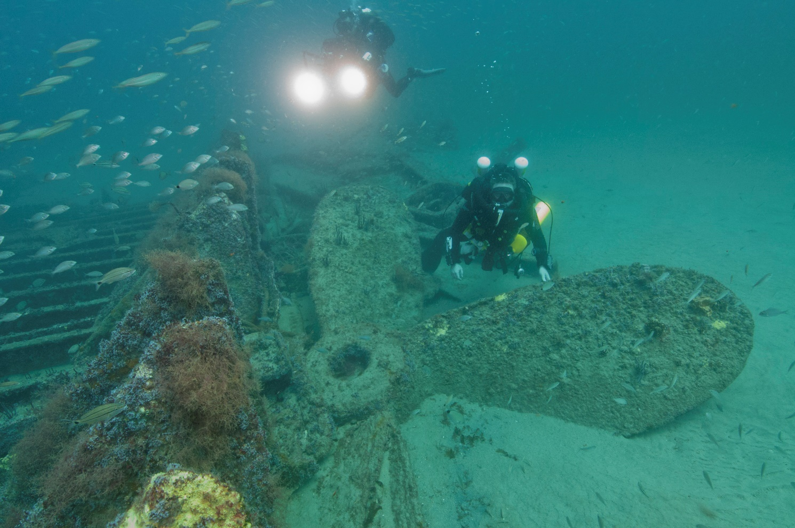
Why are shipwrecks important?
Notes:
Humans, ships, and the ocean have long been intricately bound together. Even in ancient times, ships provided the fastest and most economical method to move goods, people, and ideas from one place to another. However, the ocean can be an unforgiving place and some ships will inevitably wreck.
The preservation and research of sunken vessels provide a variety of information, such as the history of shipbuilding, a better sense of the physical development of the area, an understanding of innovations of the day, a look at the culture of the people on the ship, the identification of products that were coming into and through a region, the social structure in ship construction, and so much more.
Photo credit: NOAA

Slide 7
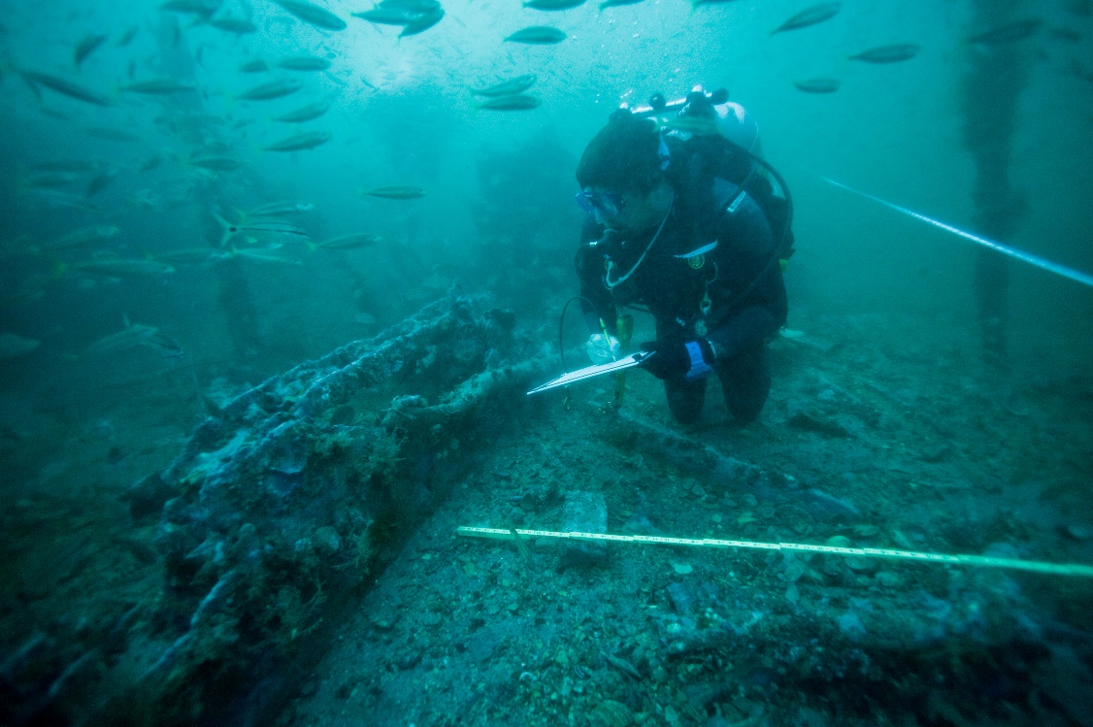
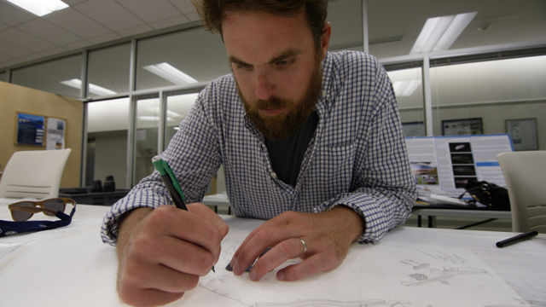
What is maritime archaeology?
Who studies shipwrecks?
Notes:
Maritime archaeology is the study of human interaction with the ocean, seas, lakes, and rivers through the study of associated physical remains. It is the job of maritime archaeologists to find and study these links to our past in order to better understand our history, conserve our heritage, and honor the memory of those who died defending our nation’s future. To better understand these cultural resources, maritime archaeologists often document them by physically mapping the shipwrecks.
Photo credits: NOAA

Slide 8
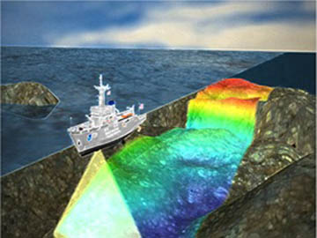
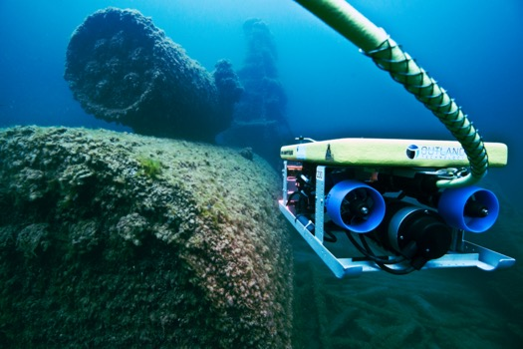
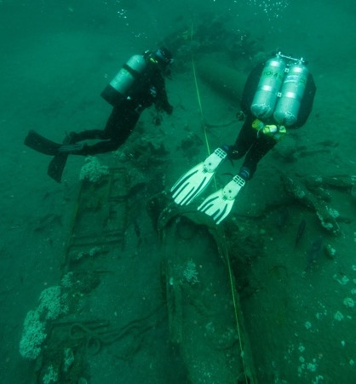
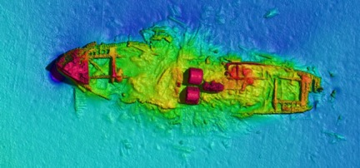
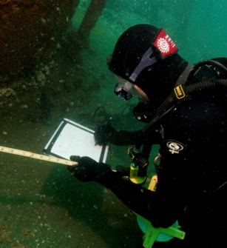
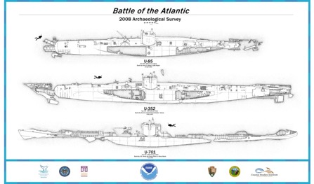
Tools Used to Study a Shipwreck
Notes:
Maritime archaeologists can map a shipwreck using a variety of technology and tools. Top left are two sonar mages. One shows a NOAA ship using multibeam sonar to map a large area of the ocean floor. These type of images can also show anomalies, which sometimes require additional investigation to determine if it is a shipwreck. The other sonar image shows the details of a shipwreck as it lies on the ocean floor. The rainbow of colors help scientists to determine the depth of objects.
In the top center, a side scan sonar is connected to a ROV (remotely operated vehicle) that is tethered to a boat/ship and operated by a ROV driver. ROVs can go deeper than divers and stay down for a longer period of time to collect more data.
When shipwrecks are within diving limits, divers may dive on the wrecks site to accurately measure the wreck, its key structural features, and note any artifacts. In the top right image, two divers have run a baseline down the center of the wreck from bow to stern to aid in measuring. Maritime archaeologists use the baseline to measure offsets from the baseline to various points on the wreck and prominent features.
In the bottom left image, a maritime archaeologist is recording his measurements and sketching in details on his dive slate. Video and still images also aide in the documentation to fill in any missed information. Once the shipwreck is documented and mapped, a scaled drawing called a site plan (inset white image) is created to show the shipwreck and its artifacts as they lie on the bottom’s surface at that moment in time.
With the collection of hundreds of images, maritime archaeologists use computer programs to “stitch” them together to create a photomosaic (bottom blue colored image) of the shipwreck site, which can be used for further study of the ship and its features.
All Photo credits: NOAA

Slide 9
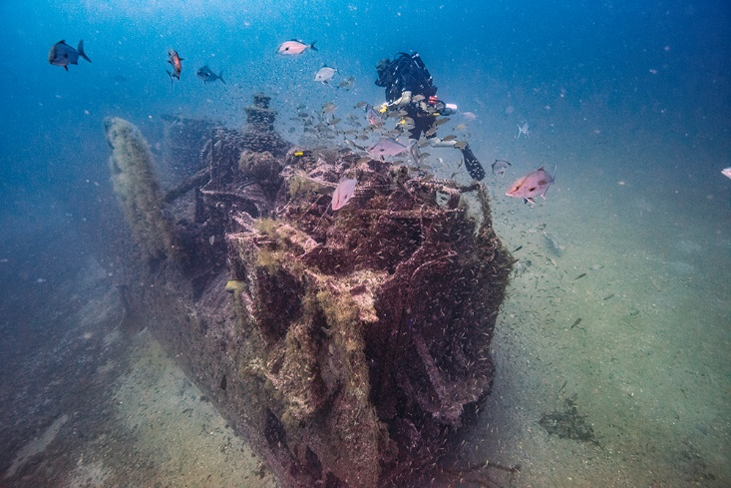
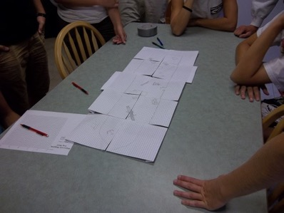
Mud Mapping
A shipwreck map (site plan) is a general sketch of a shipwreck site. It provides needed information to maritime archaeologists for planning future dives and study.
Notes:
To create a shipwreck map (site plan), maritime archaeologists will work in teams to sketch the outline of a shipwreck. Usually, each team is assigned a section of the shipwreck. After a general outline is sketched, they sketch the key features and any significant artifacts located in their sections. Once all sections of the wreck have been sketched, the sections are put together to form a complete sketch of the wreck site.
Photo credits: NOAA

Slide 10
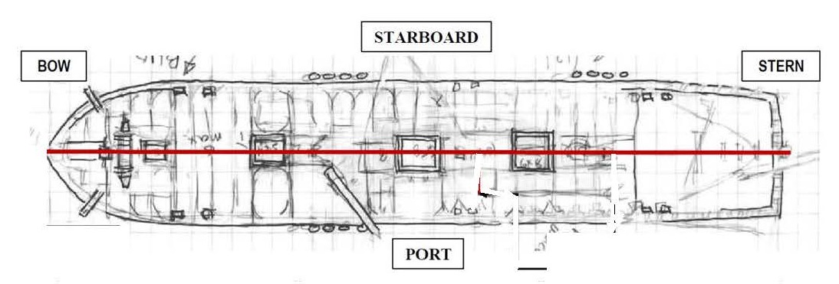
How to Make a Site Plan
The next slides will introduce vocabulary and how the work is divided into sections to create our site plan, also known as a shipwreck map.

Slide 11
Parts of a Ship - Vocabulary
A baseline is created by running a tape measure down the center of a ship from bow to stern dividing the ship in two.
Port – left side when facing the bow
Starboard – right side when facing the bow
Bow – front of the ship
Stern – back of the ship
Notes:
Before beginning mapping or sketching a wreck site, students should be familiar with several terms: Bow, stern, port, starboard, baseline (transect), baseline offset, and artifact. Instructor should point to each part and have students repeat the vocabulary word.

Slide 12
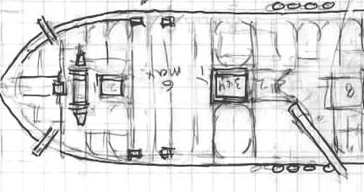
After the baseline is set, the shipwreck is divided into
5-foot sections across the baseline. Each section has a starboard and port side.
0-5 ft. Starboard
5-10 ft. Starboard
10-15 ft. Starboard
0-5 ft. Port
5-10 ft. Port
10-15 ft. Port
Notes:
Instructor should point out and read each sections’ heading. Tell students that this information is important because they will be assigned to a specific section. After assigning student groups to a section, use this slide to ask “Who has 0-5ft Starboard?,” etc… to make sure students know their section.

Slide 13
To get the general dimensions and a sketch of the shipwreck in your section, measure from the baseline to the edge in a couple of key places. See yellow arrows. These are called baseline offsets.
0-5 ft. Port
5-10 ft. Port
10-15 ft. Port
Notes:
Instructor explains that several key measurements are needed to give the general shape and width of the shipwreck. These are called baseline offsets. Demonstrate how each baseline offset is measured from the baseline to the edge of the shipwreck.

Slide 14
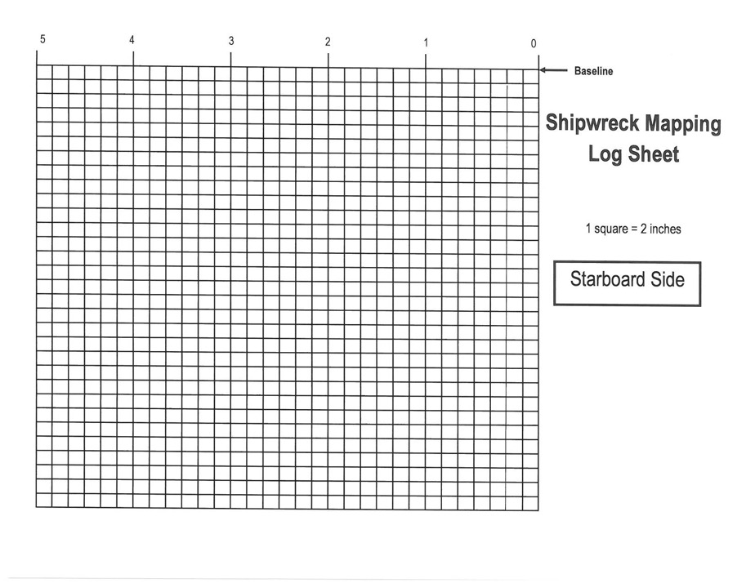
Each team has a log sheet that corresponds to the section they will map. Below is starboard, 0-5 ft.
Note that ‘0’ is on the right side of the graph because
this is starboard.
Note the scale: 1 square = 2 inches
Notes:
Instructor point out the important parts of the log sheet and make sure students understand how to measure and scale the measurement. If needed, handout the Division by 2 chart to the students. For example, if they measure 22 inches, then divide by 2 for an answer of 11. Count down 11 squares from the point they took the measurement.

Slide 15
Take your measurement and use the scale 1sq. = 2in to calculate how many squares to count down from the baseline and plot point
Example: First measurement from the 2 ft. mark is 8 inches. Divide 8 by 2, which equals 4. Count down four squares from the 2 ft. point you measured from and plot point.
Notes:
Instructor explains and demonstrates how to scale measurements (use the Division by 2 sheet if necessary). Then show the students how to plot their scaled points onto the log sheet. If needed, define the term “plot,” which simply means here to use the coordinate grid system to draw a dot at the correct position on the graph/log sheet.
How to plot: Count over on the baseline the correct number of spaces. For example, if you measured from the 2 feet mark from zero, then come over to the 2nd line from zero. If the measurement is 8 inches, then divide by 2 = 4, then count down along that line four spaces/lines and plot point where they intersect.

Slide 16
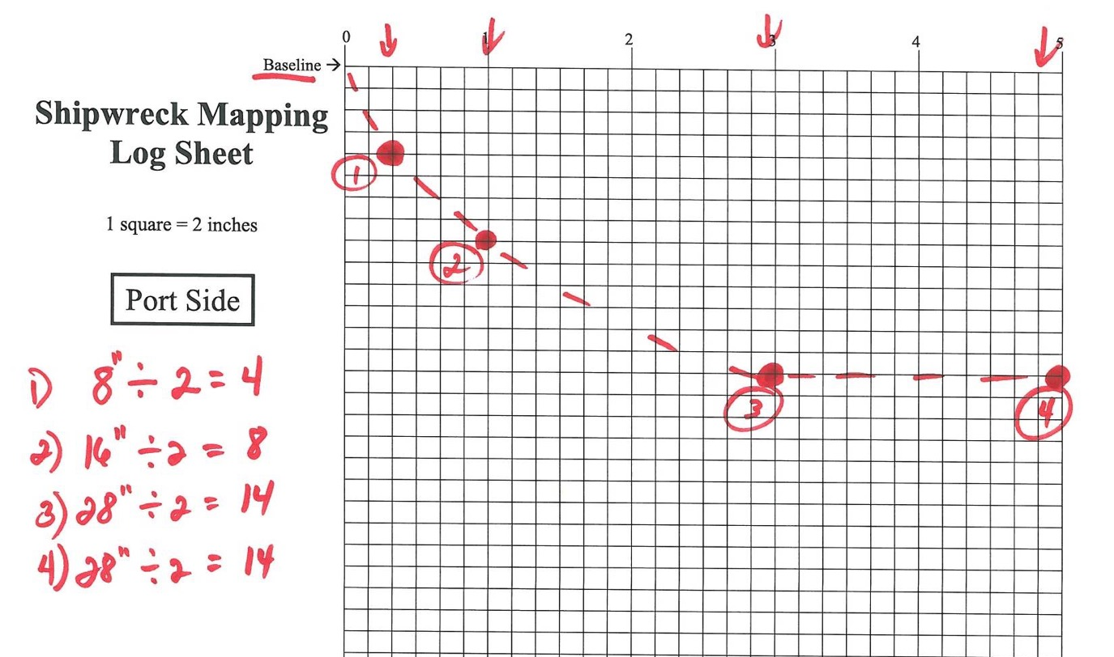
Continue to measure, scale, and plot points for the ship’s outer edge. Once you have several points, sketch in the outline of the shipwreck.
Notes:
Continue to demonstrate and explain how each point is calculated using the Division by 2 chart. Show students how to “connect the dots” to get the general outline of the shipwreck.

Slide 17
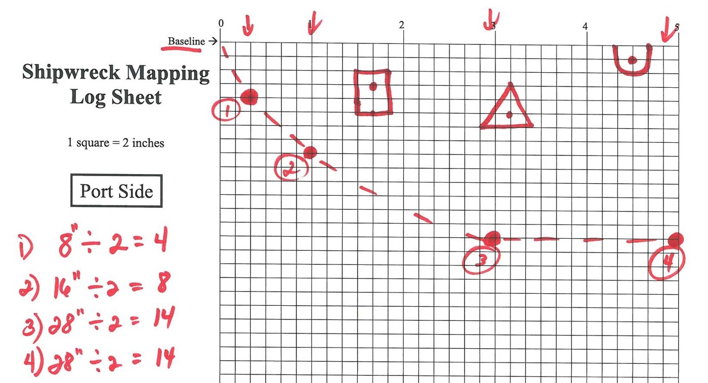
After completing the outer edge, determine the key features or artifacts in your section. Measure from the baseline to the center or edge of the feature and plot point. Sketch the feature or artifact.
Notes:
For any artifacts in their section, explain that the students should measure to the center of each artifact and plot that point. Then they will measure the length and width of the artifact and sketch it in to scale as accurately as possible. If needed, keep demonstrating using the Division by 2 chart. Being able to accurately measure and plot points is crucial to a site plan (shipwreck map).
Check out these 2 links for artifacts found at the USS Monitor shipwreck.
https://monitor.noaa.gov/150th/artifacts.html
https://monitor.noaa.gov/150th/sailors2.html

Slide 18
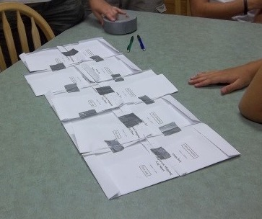
When all sections have been sketched, put the log sheets in order and on the correct side (bow or starboard) to create the site plan.
Notes:
Explain that at the end of both the deck and pool activities, the log sheets will be brought together and taped to make the complete sketch of the shipwreck that they completed as a team.

Slide 19
Notes:
Our sanctuary deserves to be protected and preserved so that everyone can enjoy it now and in the future. This is exactly why We Need Guardians like you!
Let’s learn how to scuba and save our sanctuary!

Slide 20
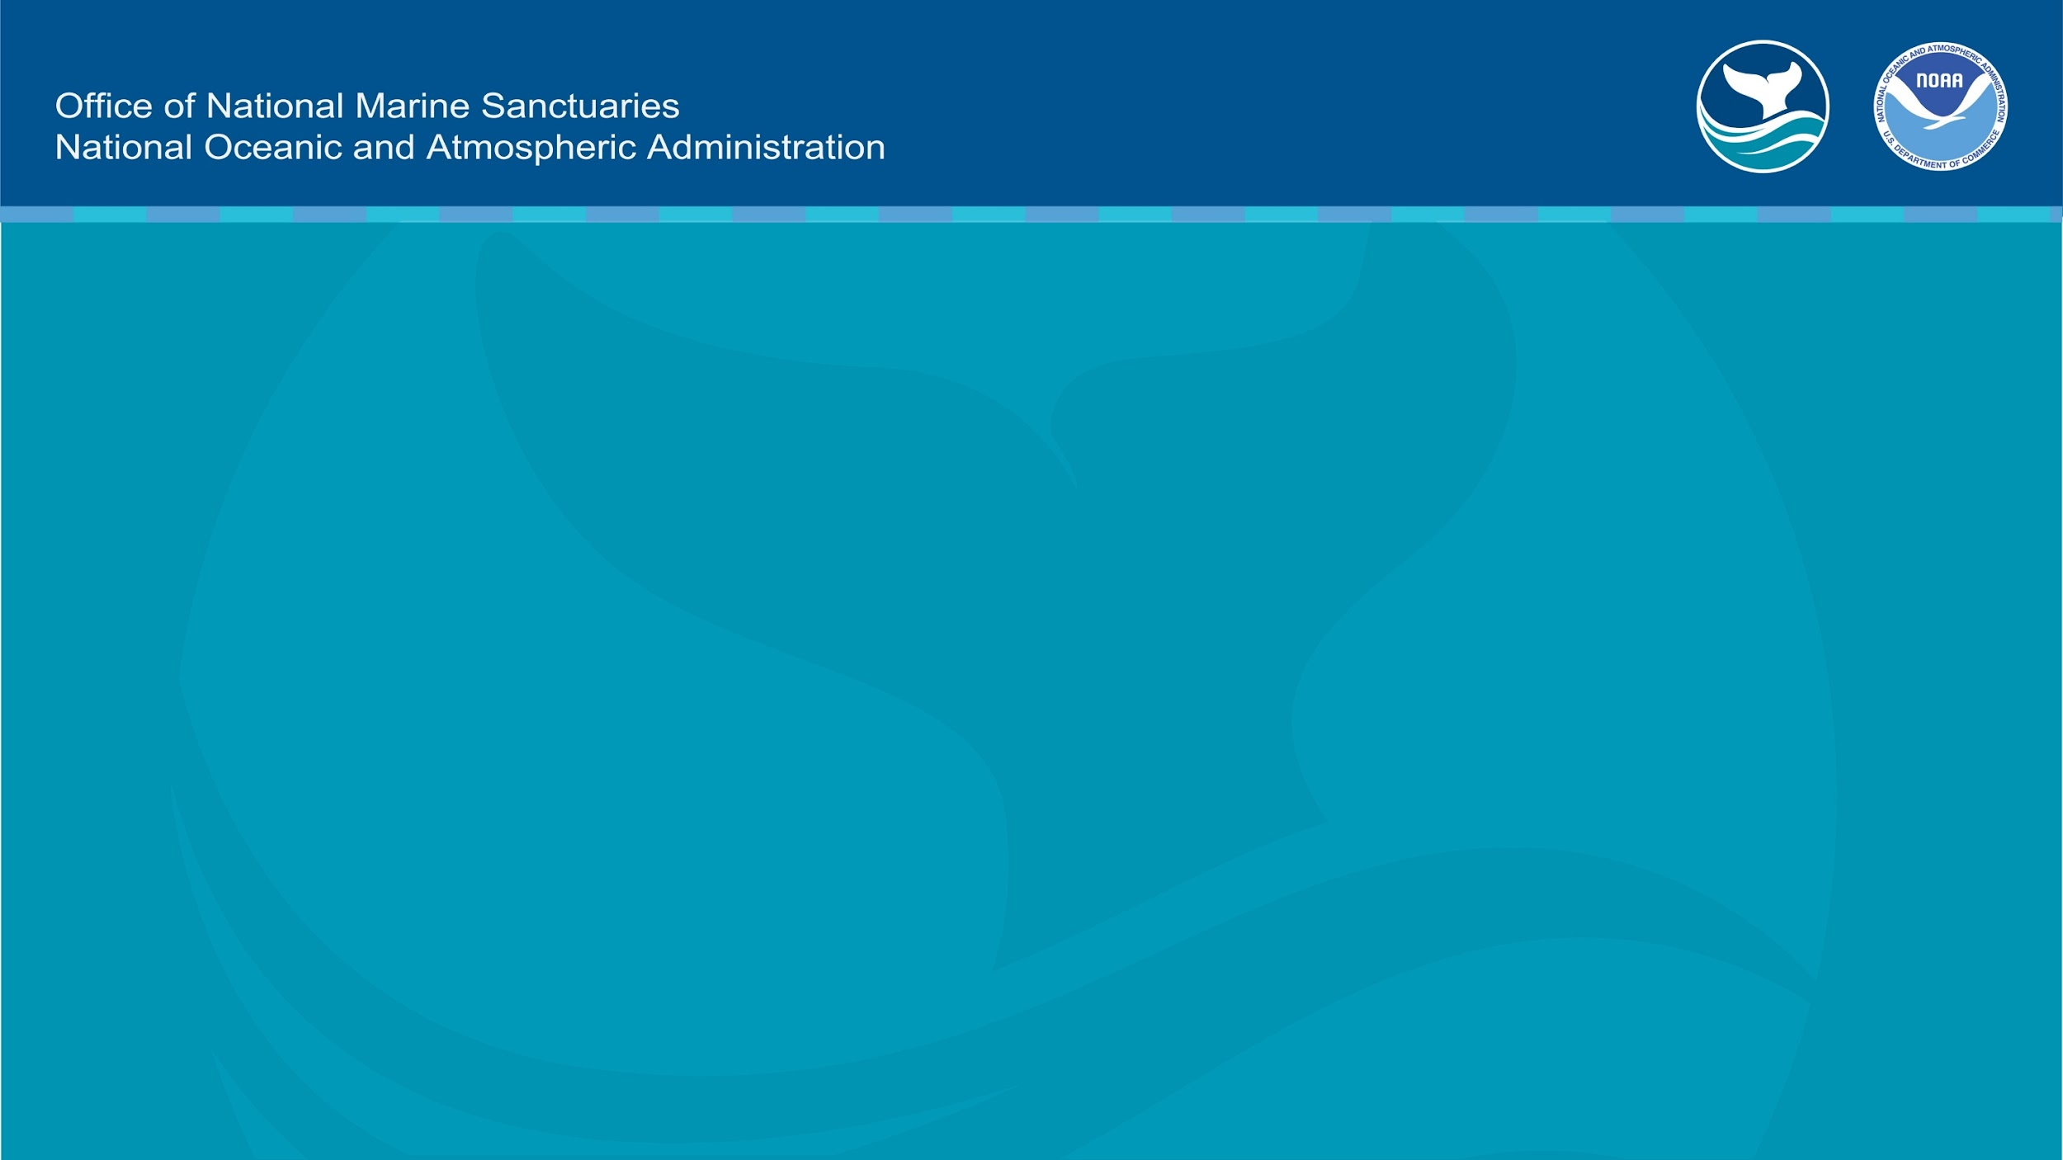
Learn more at
monitor.noaa.gov

