Slide 1
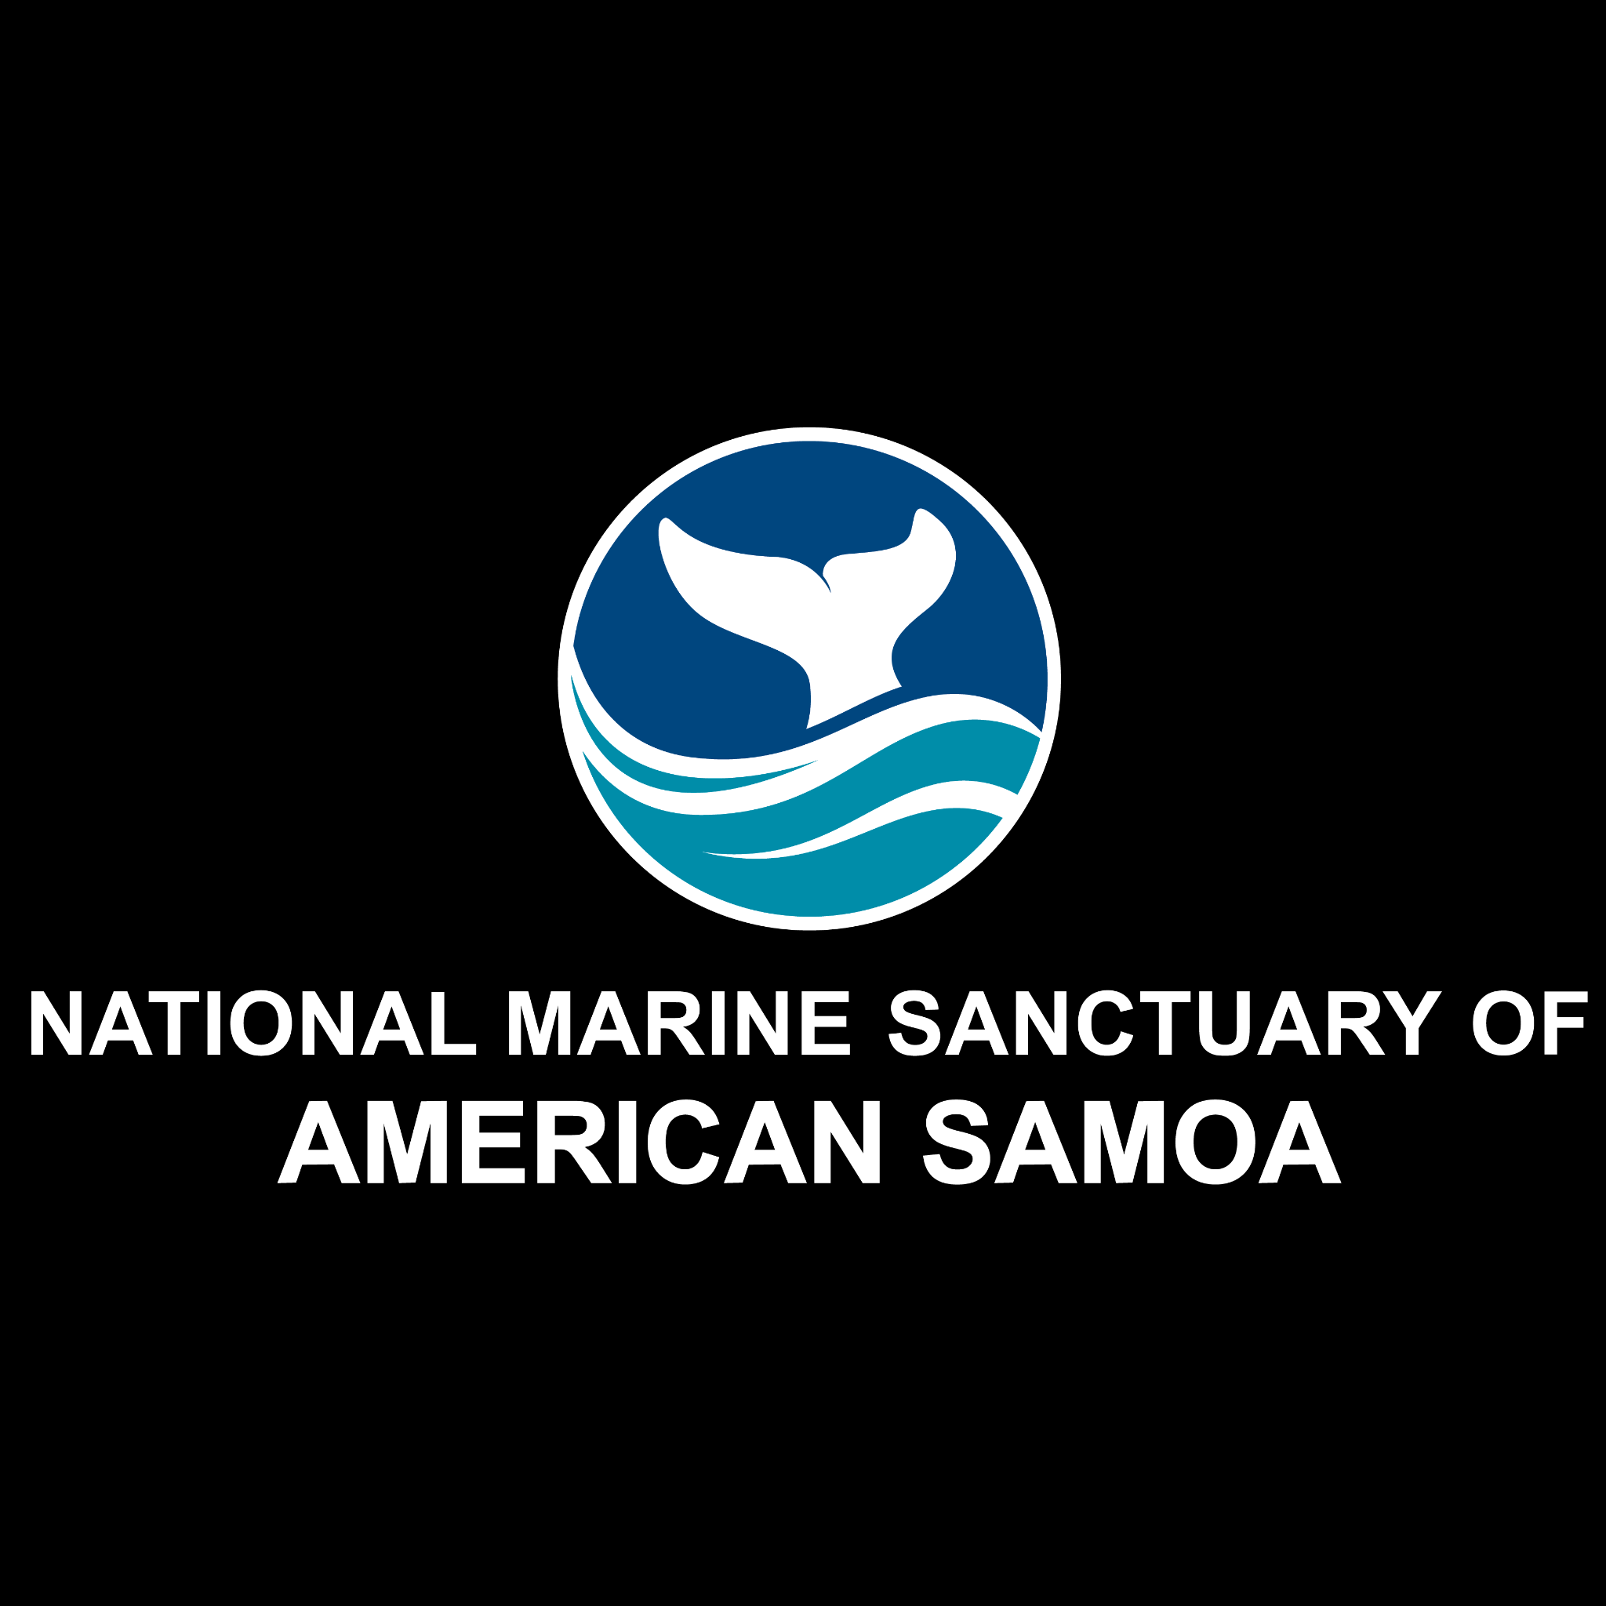
Exploring Ocean Acidification

Slide 2
National Marine Sanctuary of American Samoa
Notes:
Instructional suggestion:
Share with students the purpose of the NOAA Ocean Guardians Dive Club: to learn about the importance national marine sanctuaries and how SCUBA skills can be used to study and protect them.

Slide 3
National Marine Sanctuaries
“America’s Ocean and Great Lakes Treasures”
Notes:
Instructional suggestion:
Use the images to lay the groundwork for the types of habitats and organisms provided protection by national marine sanctuaries.
Some organisms shown include: sea turtles, whales and dolphins, sharks, and invertebrates, like corals and sea stars.
Instructor Notes:
Few places on the planet can compete with the diversity of the National Marine Sanctuary System, which protects America's most incredible natural and cultural marine resources. National marine sanctuaries are America’s ocean and Great Lake treasures.

Slide 4
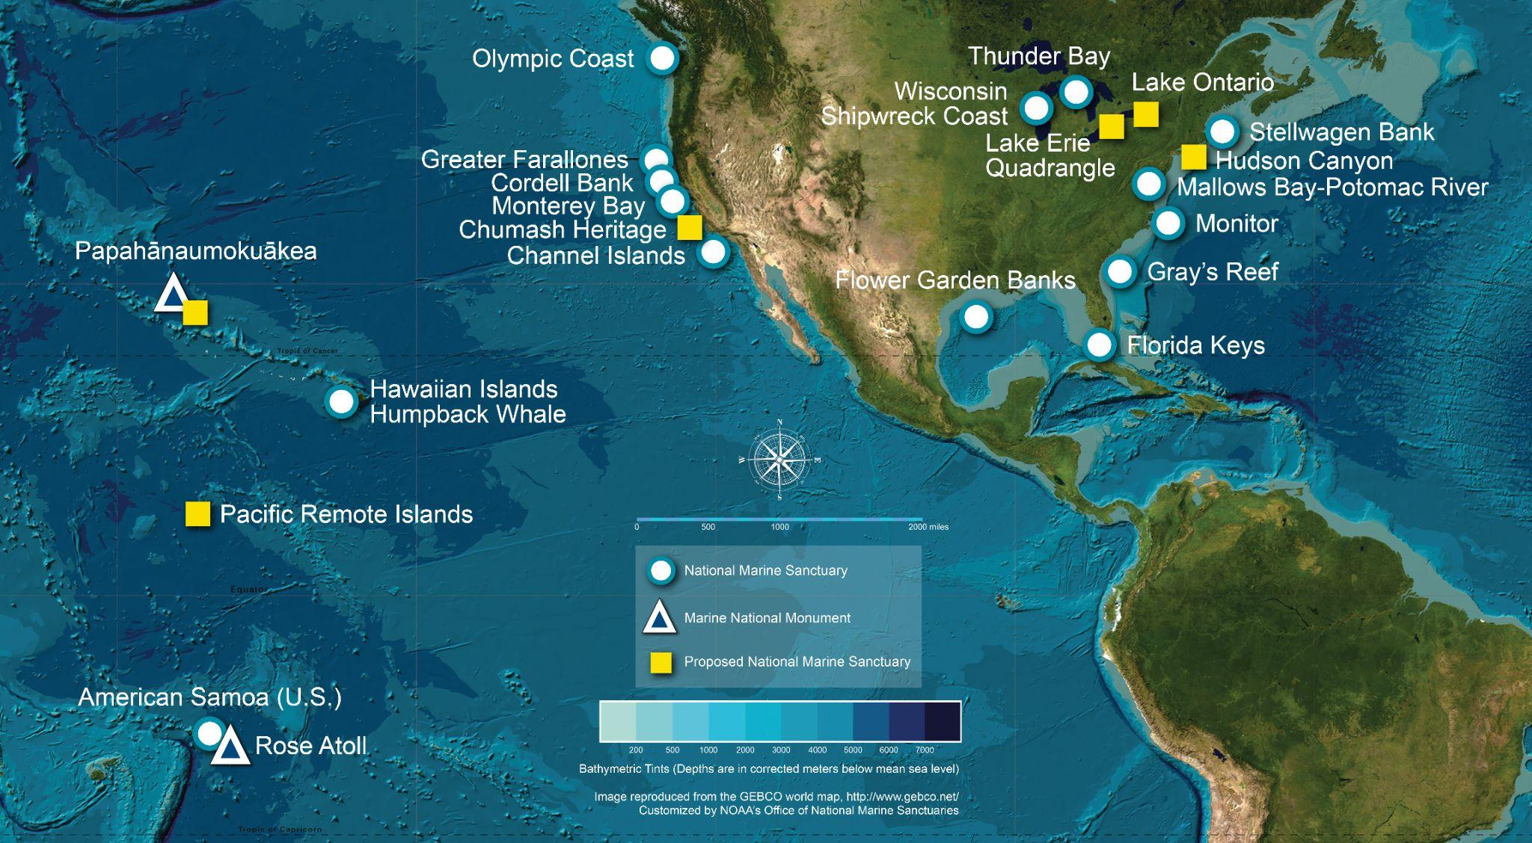
What is a national marine sanctuary?
Why are they important?
A national marine sanctuary is an area that allows important ocean resources to be protected for now and future generations.
sanctuaries.noaa.gov
Notes:
Instructional suggestion:
Think-Pair-Share. Ask students to explain what they think a marine sanctuary is and why they are important. Allow them to share their ideas with a partner and then solicit contributions from the whole group.
Instructor Notes:
The National Marine Sanctuary System encompass more than 620,000 square miles of marine and Great Lakes waters. This network of underwater areas includes a system of national marine sanctuaries and Papahānaumokuākea and Rose Atoll marine national monuments. These protected areas are on both the west and east coasts of the United States, and off Hawai’i and American Samoa. Additionally, there are protected areas within the Great Lakes.
Image: a map of marine sanctuaries and monuments in the US

Slide 5
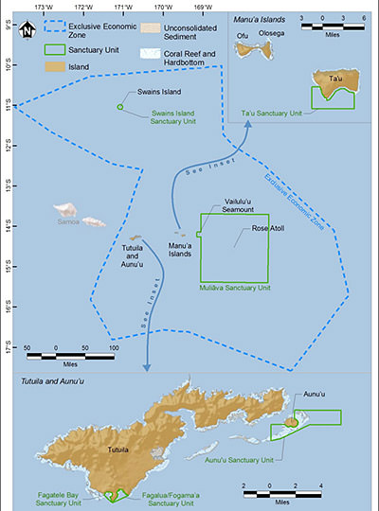
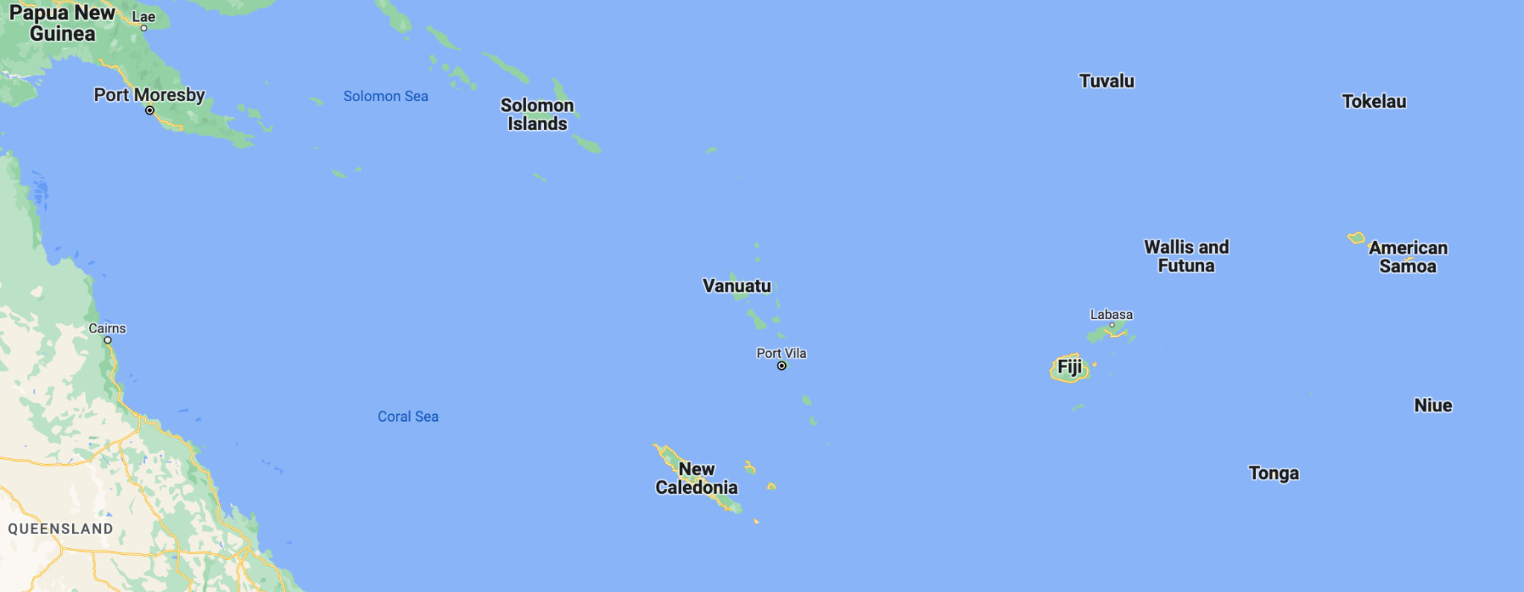
National Marine Sanctuary of American Samoa
Notes:
Instructional suggestion:
Advance the slide to see a short video highlighting National Marine Sanctuary of American Samoa.
Instructor Notes:
National Marine Sanctuary of American Samoa comprises six protected areas including areas at Tutuila, Aunu'u, Ta'u, Rose Atoll, and Swains Island. The sanctuary is the largest and most remote of any protected area within NOAA’s sanctuary system and supports the greatest biodiversity. National Marine Sanctuary of American Samoa was established in 1986 to protect the coral reef ecosystem within Fagatele Bay on Tutuila. In 2012, NOAA expanded the sanctuary to include Fagalua and Fogama`a Bays, also located on Tutuila, as well as areas at Aunu'u, Ta'u, and Swains Island, and a marine protected area at Rose Atoll (Muliāva as it is known by residents) including nearby Vailulu'u Seamount. The sanctuary now protects 13,581mi2 of nearshore coral reef and offshore open-ocean waters.
Images:
Left: American Samoa is located in the south Pacific, about 2500 mi from the east coast of Australia. Image credit: Google maps.
Right: A map of National Marine Sanctuary of American Samoa.

Slide 6
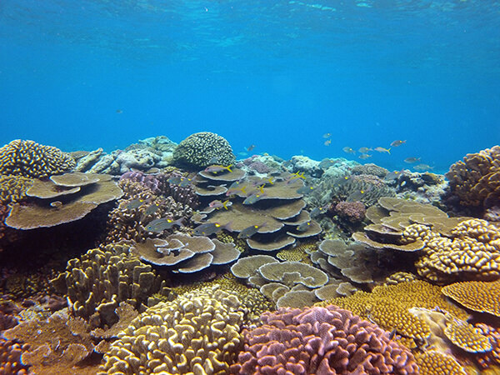
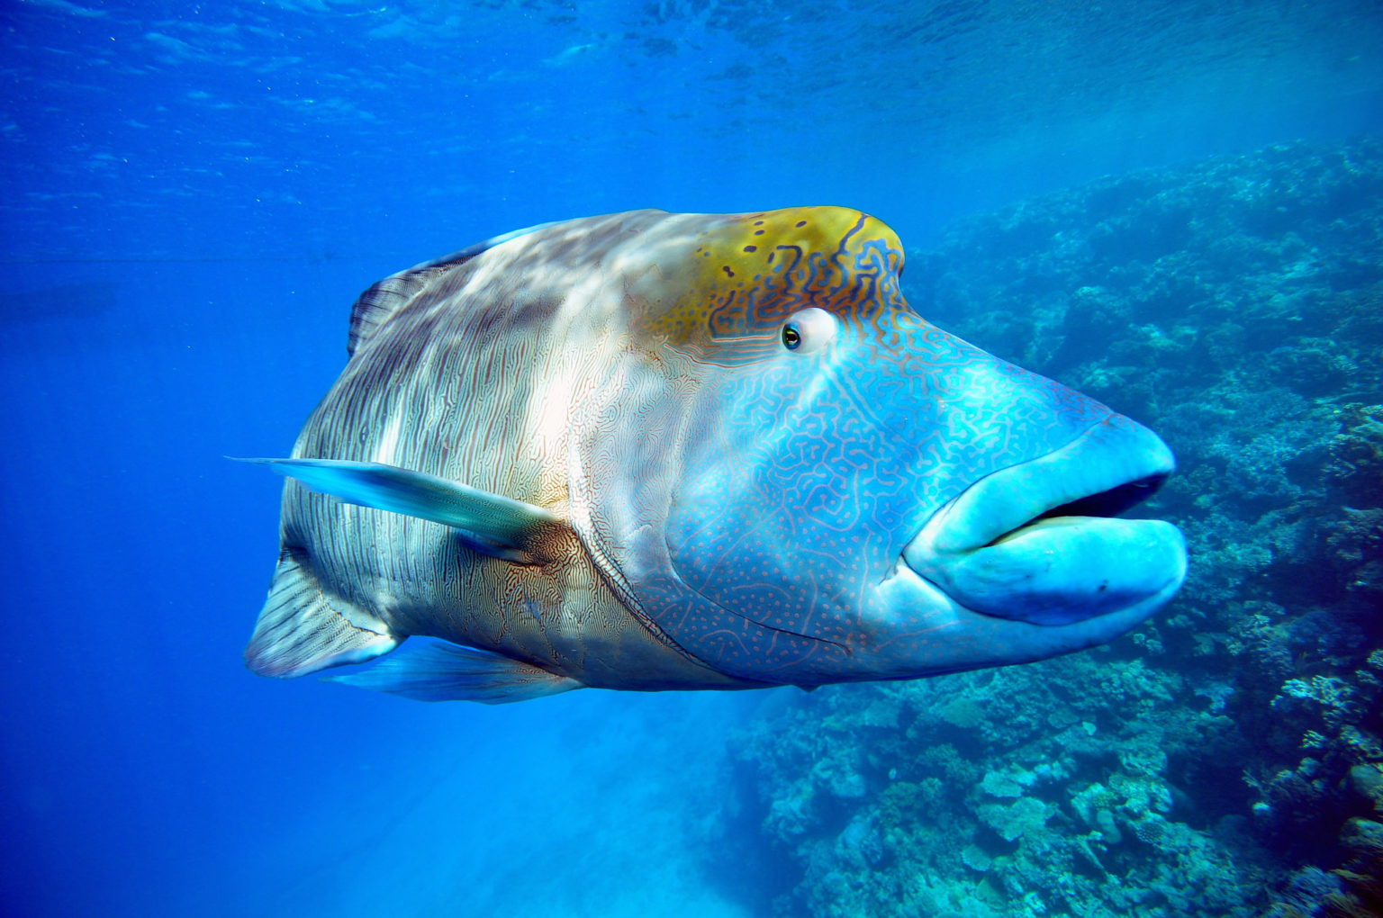
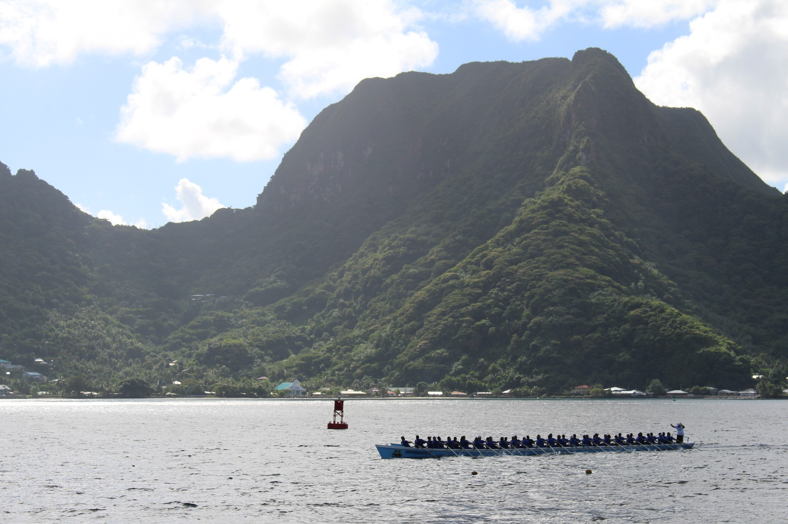
National Marine Sanctuary of American Samoa
What resources does
National Marine Sanctuary of American Samoa protect?
- ecosystems: coral reefs
- organisms: humphead wrasse
- other resources: fautasi
Notes:
Instructional suggestion:
Ask students to propose some types of resources that might be protected by the sanctuary. Possible answers include: sensitive habitats, endangered or threatened species, historical artifacts, and/or important cultural resources.
Images:
Top: A vibrant coral reef in National Marine Sanctuary of American Samoa.
Bottom left: A humphead wrasse, one of the largest reef fish in the world’s ocean, reaching lengths of seven feet and weighing more than 420 pounds are sometimes called “the king of the coral reef.” In many areas of the Indo-Pacific ocean, these fish are of cultural significance. Photo credit: Larry Koester
Bottom right: The ocean is an important part of the Samoan culture that provides food and protection, and also for recreational uses. Like the men on the fautasi longboat working together as a team to reach the finish line, we all must work together to protect it. Photo Credit: National Marine Sanctuary of American Samoa

Slide 7
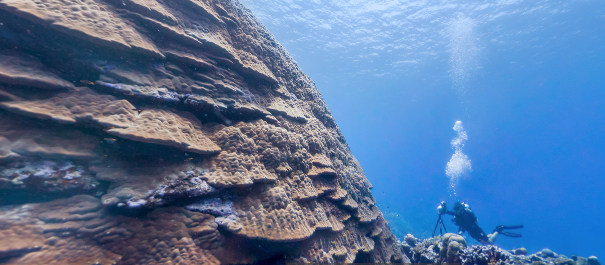
Diving in
National Marine Sanctuary of American Samoa
Notes:
Instructional suggestion:
Click image to view 360 dive of Big Momma, a large Porities colony in National Marine Sanctuary of American Samoa. View other 360 dives as desired: https://sanctuaries.noaa.gov/vr/american-samoa/.
Instructor Notes:
The waters of the Samoa archipelago are a hotspot for both coral and fish diversity. The sanctuary supports 250 known species of coral including some of the oldest and largest Porities colonies in the world. Porities, also known as lobe corals, are small polyp stony corals that hat provide habitat for other animals including fish, lobsters, and crabs. One such Porities colony called “Big Momma,” located in a reef area called the “Valley of the Giants,” measures over 20 feet tall and 135 feet in circumference. This colony is estimated to be at least 500 years old!
Images: A diver next to Big Momma.

Slide 8
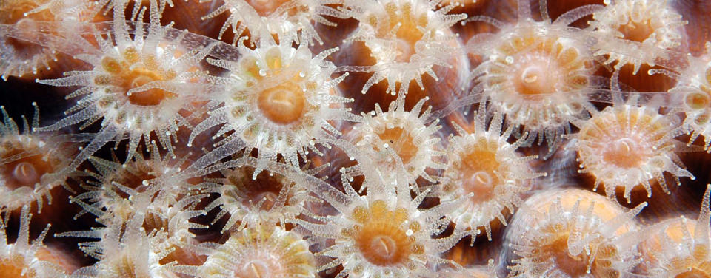
Corals in National Marine Sanctuary of American Samoa
What are corals?
Why are coral reefs important?
Notes:
Instructional suggestion:
Prompt students to share one things they know about corals and the importance of coral reefs.
Instructor Notes:
Corals are animals related to jellies and anemones that use their tentacles to capture planktonic prey as it drifts by. Corals live in clear, nutrient-poor waters in tropical and subtropical regions around the globe. Many corals have evolved a mutualistic relationship with a microalgae called zooxanthellae which live inside the coral tissue and give the coral its color. Via photosynthesis, the zooxanthellae provide food to the coral while in turn receiving a place to live. An individual coral animal is called a polyp. Some corals build hard external skeletons. Many polyps together form a colony. Many different colonies make up a coral reef. Coral reefs provide food and shelter for the numerous organisms which live there.
Coral reefs are arguably the most biodiverse ecosystem on the planet. While they only account for 2% of the ocean, they are home to 25% of known marine species. Coral reefs provide many ecosystem services to humans. They provide food for many people and support the economies of many countries. In addition, reefs protect coastlines from erosion and provide sources of potentially therapeutic compounds.
Images: Multiple coral polyps.

Slide 9
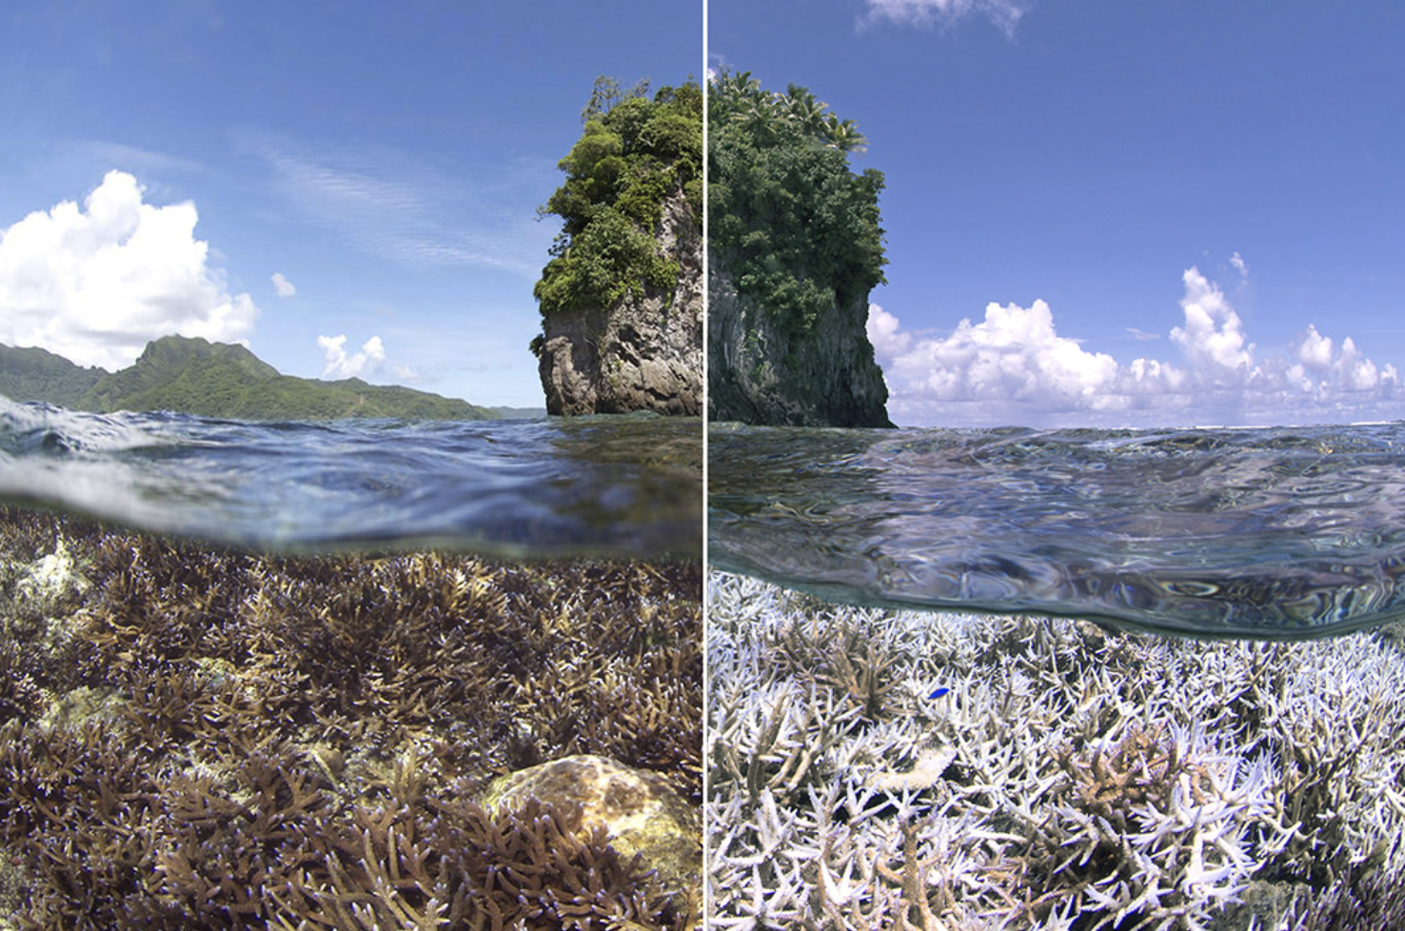
Corals in National Marine Sanctuary of American Samoa
Why are coral reefs threatened?
bleaching
ocean acidification
pollution
Notes:
Instructional suggestion:
Prompt students to share one thing they know about threats to corals. The, click the image to view a short video about ocean acidification.
Instructor Notes:
Unfortunately, corals are at risk due to human activities. These include local actions such as overfishing, habitat destruction, and poor water quality from pollution. One significant global stressor on coral is ocean acidification. The ocean absorbs extra carbon dioxide we emit into the atmosphere when we burn fossil fuels, like coal, oil, and methane gas, changing the chemistry of the ocean. The change in chemistry, called "ocean acidification," is reducing the amount of calcium carbonate in the ocean. Just as humans need calcium to build their bones, sea creatures need calcium carbonate to build strong skeletons and shells. As a result of the changing chemistry, we are seeing “osteoporosis of the sea,” with sea creatures’ skeletons and shells becoming thinner or more brittle. Reef-building corals and shellfish, like clams, oysters, and mussels, are all organisms that use calcium carbonate to build their shells.
Images:
Pteropods, or sea butterflies, are a vital food source for many fish. Shown here in laboratory conditions are (left) a pteropod that has lived for six days in normal waters and (right) a pteropod showing the effects of living inwater experiencing ocean acidification for the same time period. The white lines indicate shell dissolution and explain why ocean acidification is called "osteoporosis of the sea." (NOAA)

Slide 10
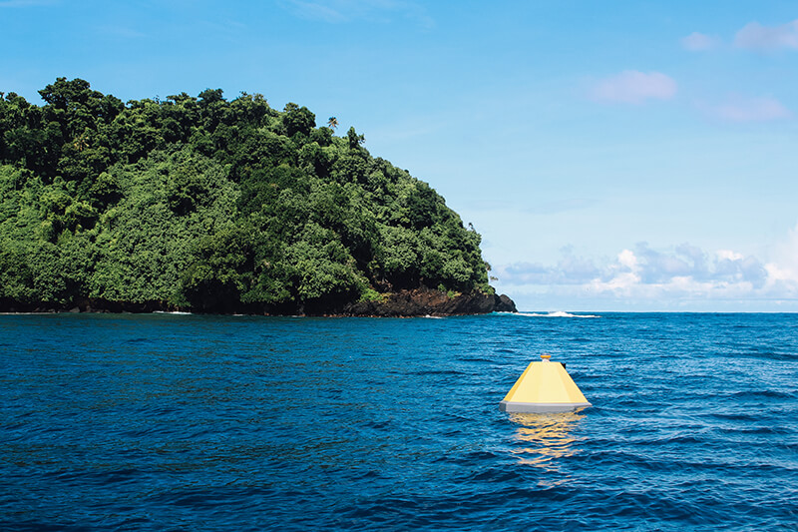
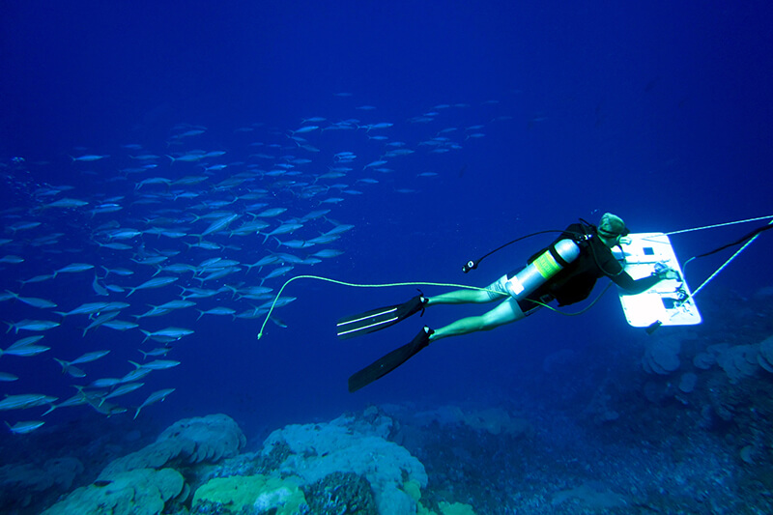
Corals in National Marine Sanctuary of American Samoa
How is coral health monitored?
regular visual surveys
water quality monitoring
Notes:
Instructional suggestion:
Prompt students to think what scientists might be measuring/observing with the buoy and diver surveys. Accept all reasonable answers. Possible answers include evidence of bleaching, disease, and predation.
Images:
Top: The monitoring buoy in Fagatele Bay collects data on carbon dioxide from surface seawater and the atmosphere as well as data on water temperature, salinity, pH, oxygen, and chlorophyll.
Bottom: Divers monitor reefs for bleaching, disease, predation by snails and crown-of-thorn starfish, and marine debris.

Slide 11
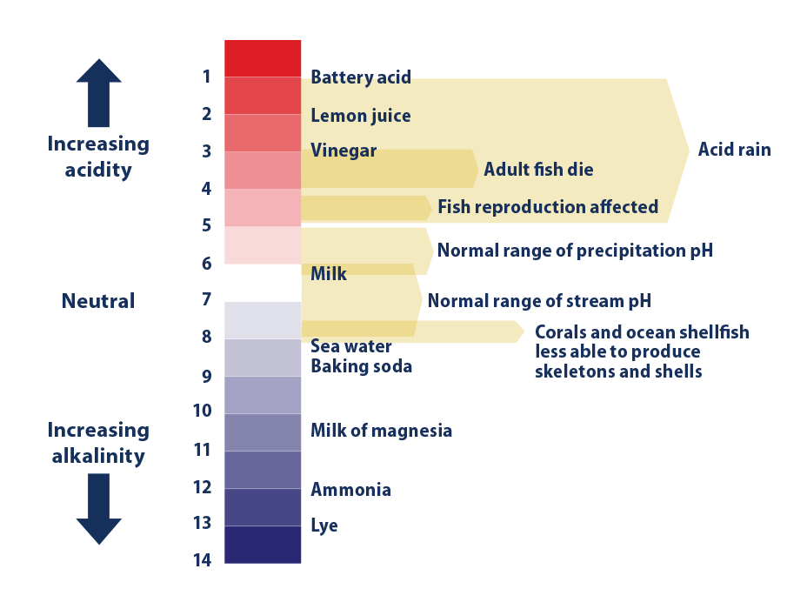
National Marine Sanctuary of American Samoa
Simulating Ocean Acidification Debrief
State the pH changes that you observed and a possible explanation for your results.
Describe one way that this simulation accurately models the cause of ocean acidification and propose one way that you could improve the simulation.
Notes:
Instructor Notes:
pH is a measure of the acidity of a substance. The pH of distilled water is 7 or neutral. Acids have a pH lower than 7; bases have a pH greater than 7. Seawater is a weak base with a pH of around 8.
The pH of the treatment group should decrease. The pH of the distilled water in the control group should remain unchanged. The neutralization reaction between vinegar and baking soda in the simulation treatment produces carbon dioxide. In the sealed container, some of this carbon dioxide will dissolve in the distilled water, thereby reducing its pH, increasing its acidity. This is analogous to how increased carbon dioxide in the atmosphere from the burning of fossil fuels dissolves in seawater, increasing acidity.
Accept all reasoned answers to the student evaluation of the simulation.
Images: A summary of the pH scale and some common acids and bases. Source: Environmental Protection Agency

Slide 12
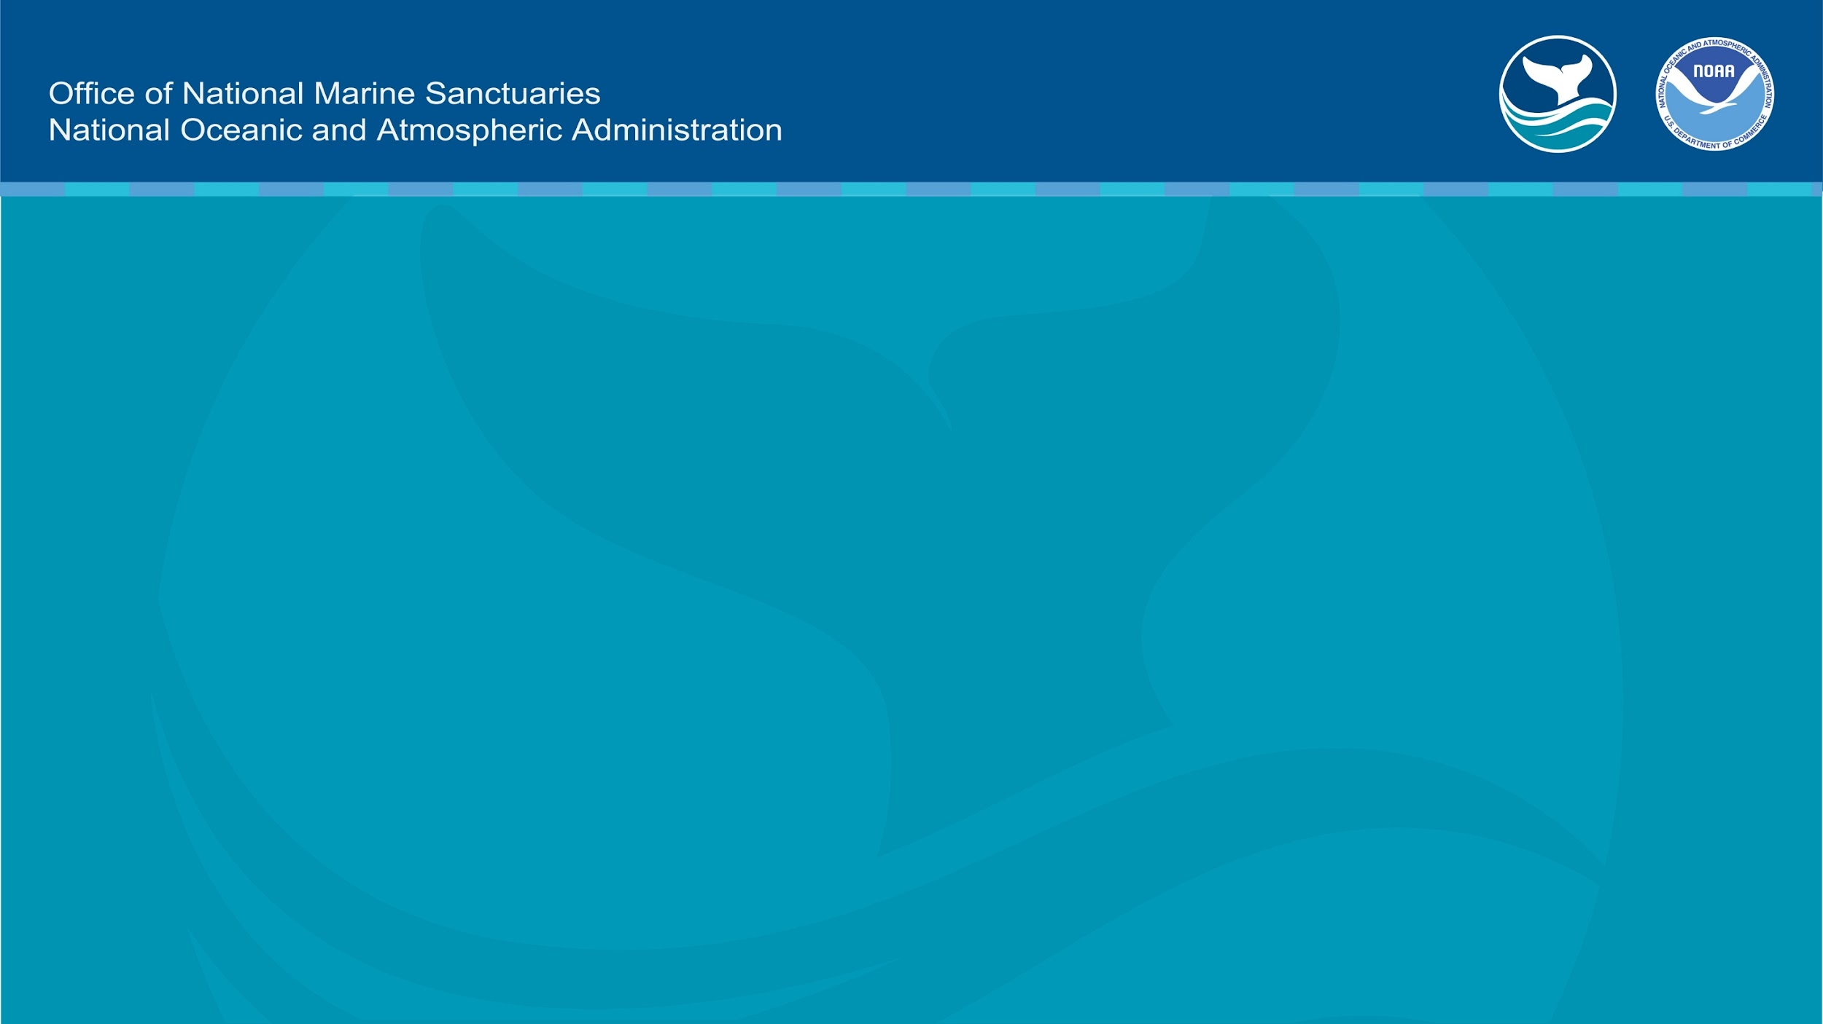
Learn more at
americansamoa.noaa.gov

