Slide 1
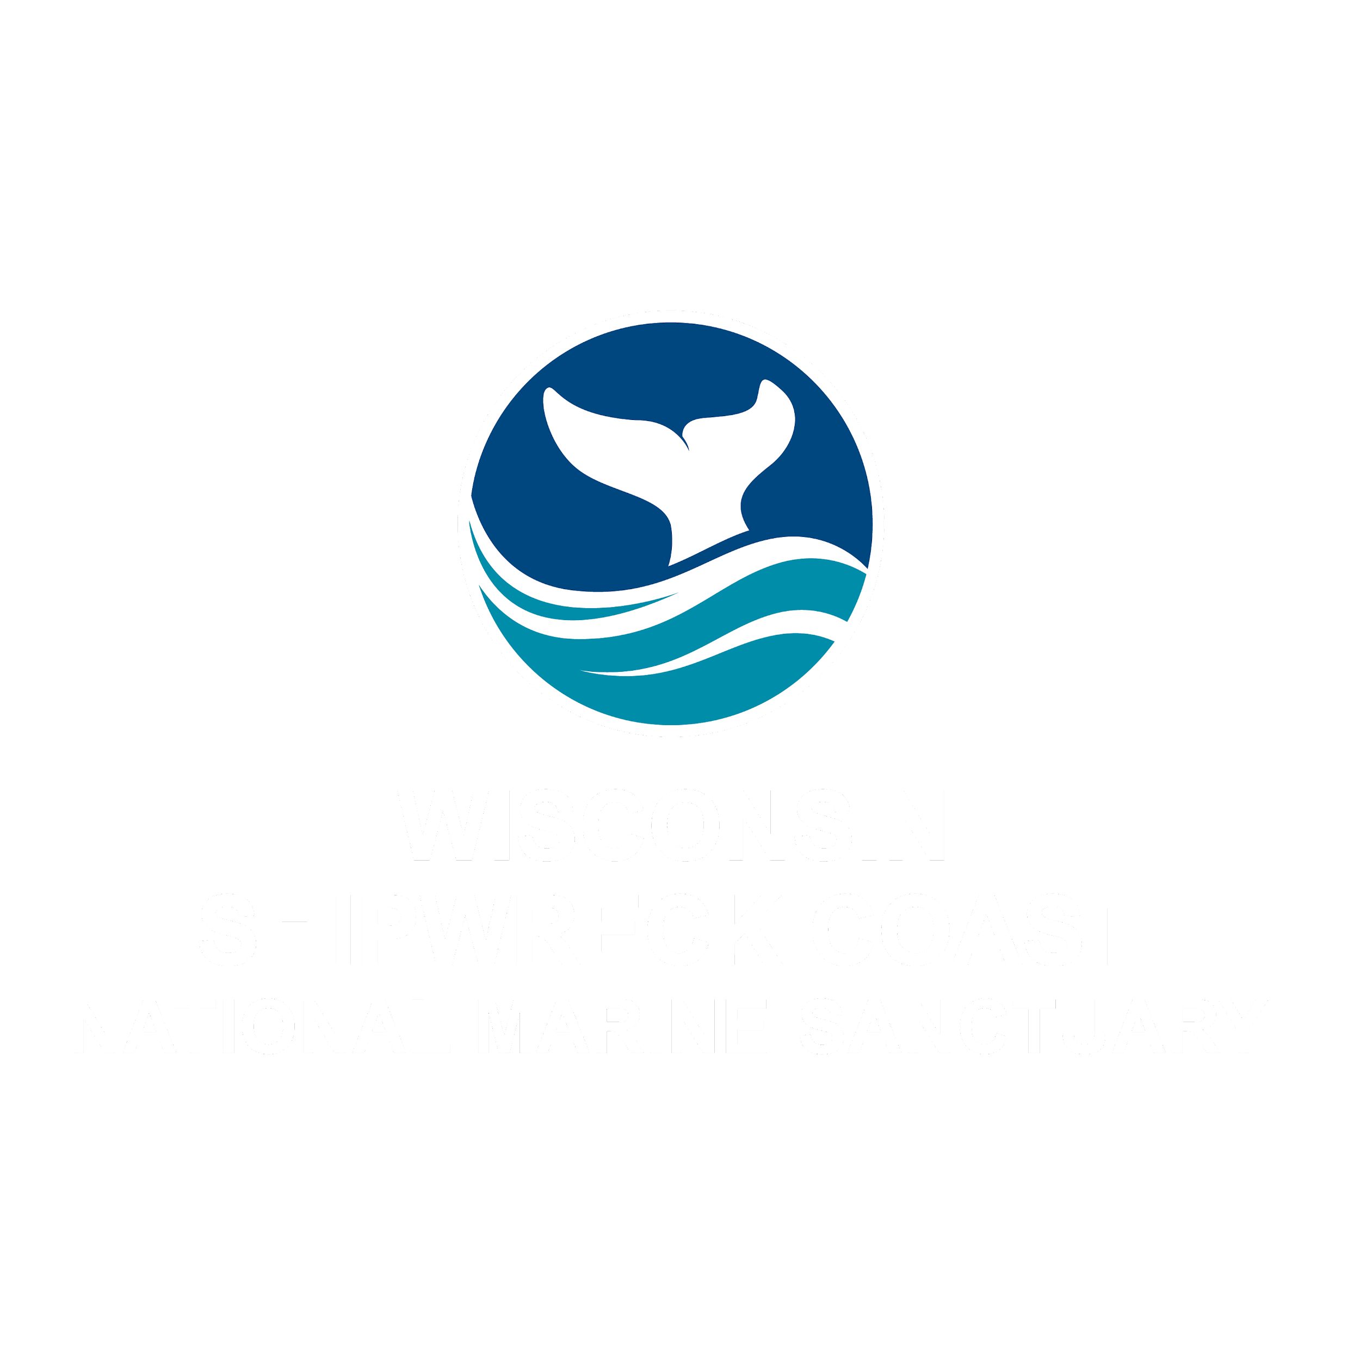
Exploring Shipwrecks

Slide 2
Wisconsin Shipwreck Coast National Marine Sanctuary
Notes:
Instructional suggestion:
Share with students the purpose of the Ocean Guardians Dive Club: to learn about the importance national marine sanctuaries and how SCUBA skills can be used to study and protect them.

Slide 3
National Marine Sanctuaries
“America’s Ocean and Great Lakes Treasures”
Notes:
Instructional suggestion:
Use the images to lay the groundwork for the types of habitats and organisms provided protection by national marine sanctuaries. Some organisms shown include: sea turtles, whales and dolphins, sharks, and invertebrates, like corals and sea stars.
Instructor Notes:
Few places on the planet can compete with the diversity of the National Marine Sanctuary System, which protects America's most incredible natural and cultural marine resources. Sanctuaries are America’s ocean, Great Lakes, and other freshwater treasures.

Slide 4
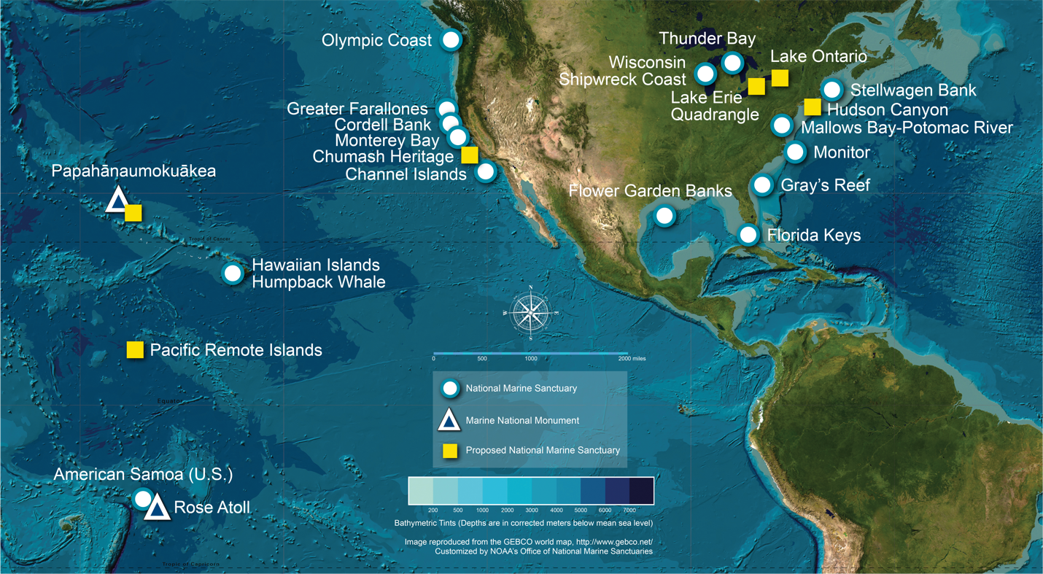
What is a national marine sanctuary?
Why are they important?
A national marine sanctuary is an area that allows important ocean resources to be protected for current and future use.
sanctuaries.noaa.gov
Notes:
Instructional suggestion:
Think-Pair-Share. Ask students to explain what they think a national marine sanctuary is and why they are important. Allow them to share their ideas with a partner and then solicit contributions from the whole group.
Click map to watch a short video that highlights the National Marine Sanctuary System.
Instructor Notes:
National marine sanctuaries encompass more than 620,000 square miles of marine and Great Lakes waters. This network of underwater areas includes a system of national marine sanctuaries and Papahānaumokuākea and Rose Atoll marine national monuments. These protected areas are on both the west and east coasts of the United States, and off Hawai’i and American Samoa. Additionally, there are protected areas within the freshwater environments of the Great Lakes.
Image: a map of national marine sanctuaries and marine national monuments in the U.S.

Slide 5
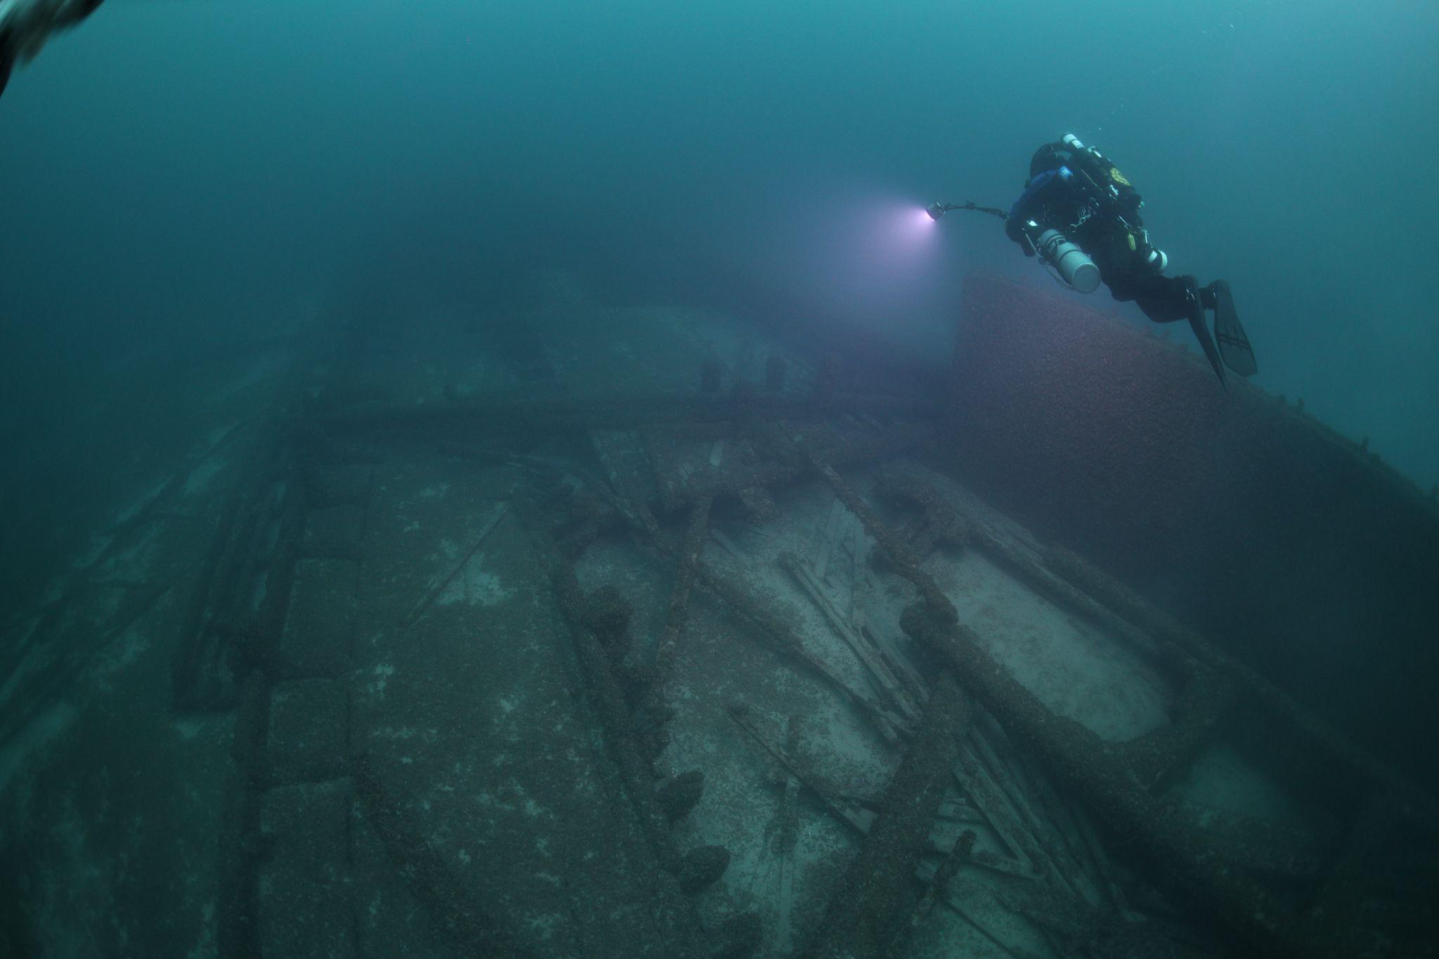
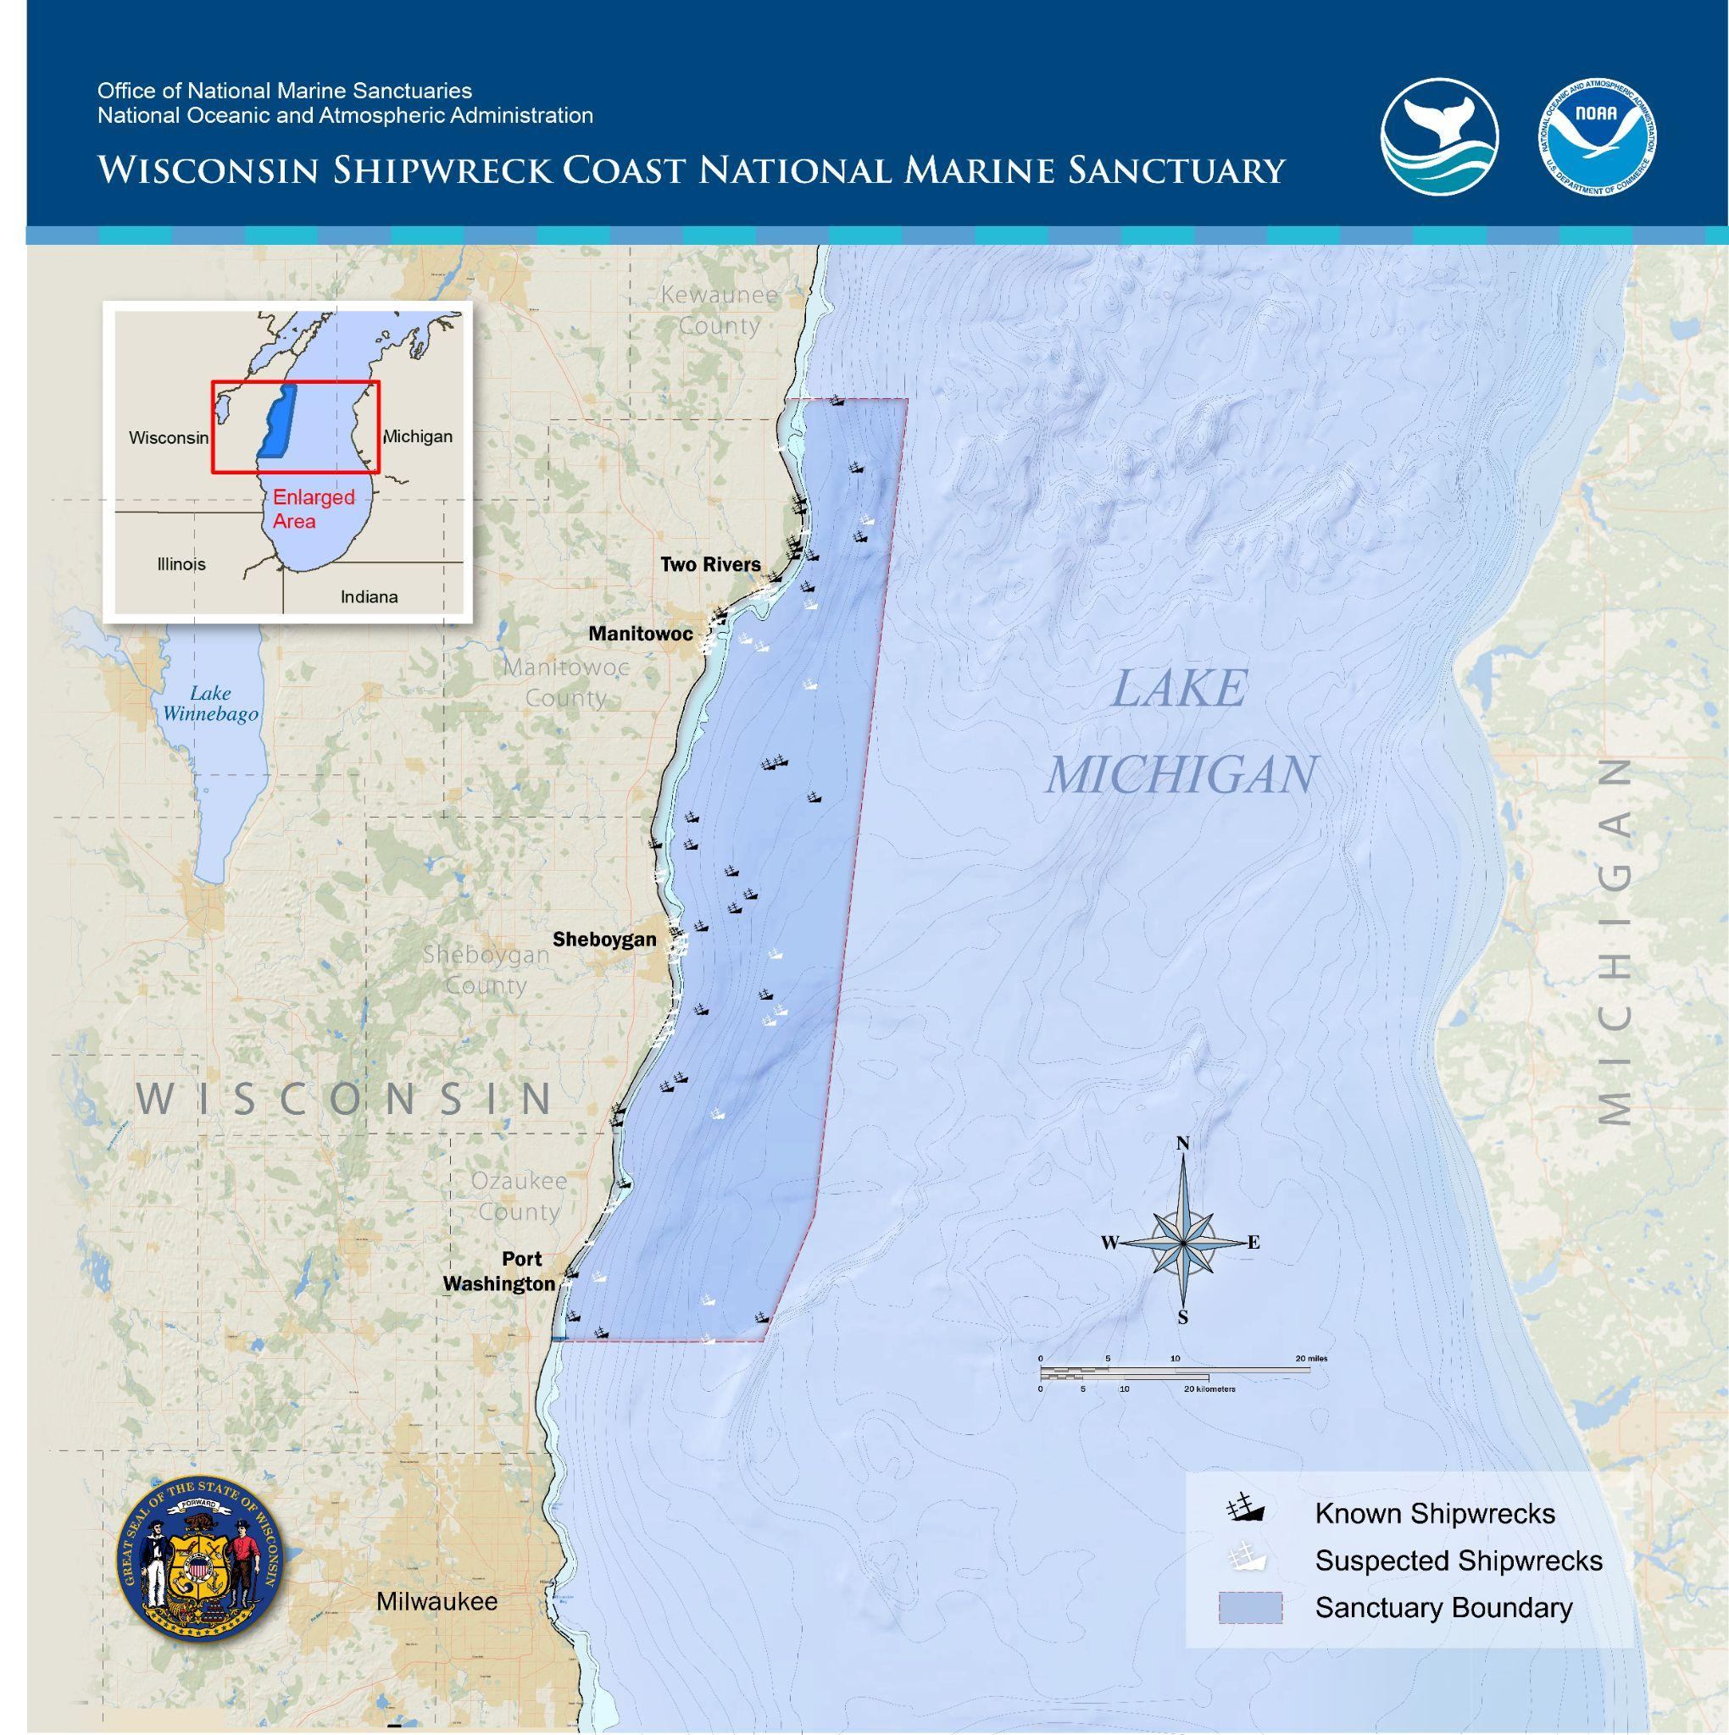
Wisconsin Shipwreck Coast National Marine Sanctuary
What resources does Wisconsin Shipwreck Coast National Marine Sanctuary protect?
- maritime heritage: shipwrecks
- opportunities for important conservation research
Notes:
Instructional suggestion:
Ask students to propose some types of resources that might be protected by the sanctuary. Possible answers include: sensitive habitats, endangered or threatened species, historical artifacts, and/or important cultural resources.
Click the map to watch a short video that highlights the sanctuary.
Instructor Notes:
The National Marine Sanctuary System includes a strong commitment to maritime heritage, the study of human interactions with the ocean and coastal lands and waters. Maritime heritage seeks to preserve valuable historical, cultural, and archaeological resources above and below the waves, including not only physical resources such as shipwrecks and archaeological sites, but also intangible resources such as cultural practices and traditions. The study of maritime heritage enriches our understanding of how exploration, trade, and the transportation of goods and people affected our country’s development and continues to influence the character and economies of coastal communities. The study and preservation of maritime heritage is a large part of the research conducted at Wisconsin Shipwreck Coast National Marine Sanctuary.
The sanctuary protects 36 historic shipwreck sites, representing vessels that played a central role in building the nation between 1830 and 1930. Twenty-seven of these wrecks are listed on the National Register of Historic Places and research suggests that another 60 plus shipwrecks may yet to be discovered. Some wrecks are visible from the surface by paddlers and snorkelers, while others lie much deeper and are only accessible by trained divers and/or other exploration technology.
Wisconsin Shipwreck Coast National Marine Sanctuary was designated in 2021. It is only the second sanctuary in the Great Lakes region. The sanctuary is located in Lake Michigan, the second largest of the five Great Lakes. The Great Lakes system, often referred to as an “inland sea,” includes lakes Superior, Michigan, Huron, Erie, and Ontario as well as a number of rivers and tributaries that connect the lakes to each other and, via the St. Lawrence River, to the Atlantic Ocean. Together, they hold about 90% of the surface freshwater in North America and approximately 20% of the world's surface freshwater supply. Wisconsin Shipwreck Coast National Marine Sanctuary protects 962mi2 of Lake Michigan waters and the shorelines of the historic port towns of Two Rivers, Manitowoc, Sheboygan, and Port Washington, Wisconsin.
Important sanctuary conservation research efforts include lake bed mapping to determine important habitats and the installation of weather buoys for long-term monitoring of water temperature.
Images:
Left: Map of Wisconsin's mid Lake Michigan shoreline showing the sanctuary boundaries, which encompasses 962 square miles and includes 36 known shipwreck sites. Credit: NOAA
Right: A diver on a wreck in Wisconsin Shipwreck Coast National Marine Sanctuary.

Slide 6
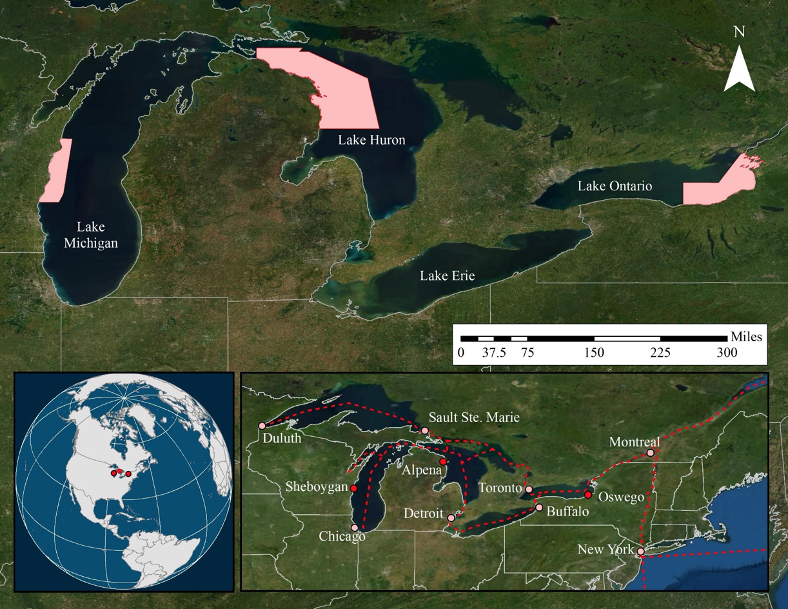
Wisconsin Shipwreck Coast National Marine Sanctuary
The Great Lakes
“inland sea,” includes lakes Superior, Michigan, Huron, Erie, and Ontario
90% of the surface freshwater in North America and 20% of the world's surface freshwater
important for drinking water, agriculture, industry, trade, and employment
Notes:
Instructional suggestion:
Ask students if any of them have ever been to one of the Great Lakes. If so, invite them to share their experience.
Invite students to predict why the Great Lakes are included as a national marine sanctuary. Accept all reasoned responses. Use this as an opportunity to reinforce that all waterways are connected and that actions inland impact the ocean.
Reinforce the importance of the Great Lakes region.
Instructor Notes:
Tens of millions of people depend on the Great Lakes, including Lake Michigan, for drinking water. Additionally, the Great Lakes provide water for much of the agricultural production and industrial processes of both the United States and Canada. Spanning more than 750 miles from west to east, and bordering eight U.S. states and two Canadian provinces, the Great Lakes provide means of transportation and power generation, many recreational opportunities, and habitat for over 3500 species. Commercial and sport fishing, agriculture, recreation, tourism, manufacturing, and shipping are all important to the region. These activities create millions of jobs and provide many goods, like whitefish and timber, and services, like water filtration and flood control. Wisconsin Shipwreck Coast National Marine Sanctuary plays an important role in conserving the many important resources of the Great Lakes region.
Images:
Top and bottom right: Map showing Wisconsin Shipwreck Coast National Marine Sanctuary in Lake Michigan, Thunder Bay National Marine Sanctuary in Lake Huron, and the proposed Lake Ontario National Marine Sanctuary in Lake Ontario.
Bottom right: The five Great Lakes Credit: NOAA

Slide 7
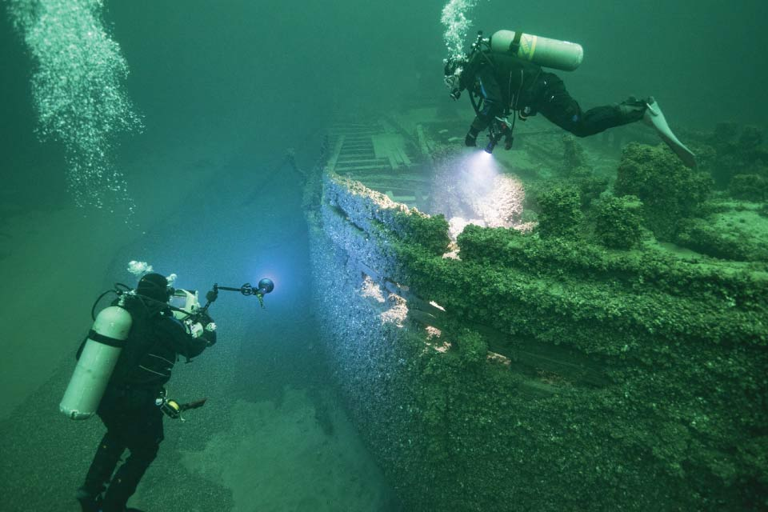
Wisconsin Shipwreck Coast National Marine Sanctuary
Maritime Heritage
What is it?
The study of human interactions with the ocean and coastal lands and waters
Why is it important?
Preservation of resources and traditions
Betters understanding of history
Notes:
Instructional suggestion:
Ask students to propose a definition of maritime heritage.
Prompt them to consider why maritime heritage is important
Reinforce that the study of maritime heritage helps us to better understand our nation’s history.
Instructor Notes:
The National Marine Sanctuary System includes a strong commitment to maritime heritage, the study of human interactions with the ocean and coastal lands and waters. Maritime heritage seeks to preserve valuable historical, cultural, and archaeological resources above and below the waves, including not only physical resources such as shipwrecks and archaeological sites, but also intangible resources such as cultural practices and traditions. The study of maritime heritage enriches our understanding of how exploration, trade, and the transportation of goods and people affected our country’s development and continues to influence the character and economies of coastal communities. The study and preservation of maritime heritage is a large part of the research conducted at Wisconsin Shipwreck Coast National Marine Sanctuary.
Images:
Divers on a wreck. The study of maritime heritage resources may include photo-documentation (shown in the image above) and site plans. These are two activities in which students will participate. Credit: NOAA

Slide 8
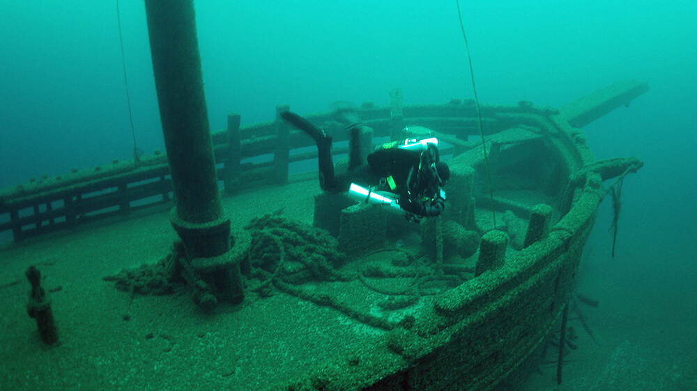
Wisconsin Shipwreck Coast National Marine Sanctuary
Great Lakes Shipwrecks
Many wrecks due to number of vessels and treacherous waters
Cold, freshwater preserve details of wrecks and artifacts
Notes:
Instructional suggestion:
Prompt students to consider why there are so many wrecks in the Great Lakes.
Click the image to watch video footage of the wreck of the Walter B. Allen.
Instructor Notes:
In the mid-19th century, the inland waterways of the Great Lakes became busy highways for trade in goods, such as wheat, corn, lumber, coal, and iron ore, and provided transportation for millions of people moving west. Fleets of ships served industries around the lakes and helped grow port cities, such as Cleveland, Detroit, and Chicago. The shipping industry also shaped the character of smaller industrial centers fueled by Great Lakes trade such as those on the shores of Wisconsin Shipwreck Coast National Marine Sanctuary.
The Great Lakes are among the most treacherous waters in the world. Powerful storms are common, especially in late fall, and often form quickly giving little warning. As the shipping industry expanded in the 19th century, loss of vessels, cargo, and crew became very real factors affecting the industry and the people who relied upon it. In 1871, there were 591 maritime accidents — one for every four boats on the Great Lakes. Maritime historians estimate that there are upwards of 6,000 shipwrecks, most awaiting discovery, in the Great Lakes. The cold, freshwater of the Great Lakes preserves the structural integrity of vessels sunk hundreds of years ago, making it possible to observe details of the vessels structure and cargo, and in some cases, even the personal items brought on board by the crew. Unlike their saltwater counterparts, freshwater shipwrecks have not experienced the same deterioration from shipworms (a saltwater clam) burrowing through their wooden hulls. As saltwater speeds metal deterioration, iron and steel vessels also maintain their structural details much longer in freshwater. The quality of the shipwrecks found throughout the Great Lakes make them a top destination for many wreck divers and shipwreck explorers interested in experiencing each vessel.
Images:
A scuba diver explores Walter B. Allen, a two-masted schooner within Wisconsin Shipwreck Coast National Marine Sanctuary. Canallers like the Allen were unique to the Great Lakes and were constructed to fit perfectly through the Welland Canal Locks which connects Lakes Erie and Ontario. Photo: Tamara Thomsen/Wisconsin Historical Society

Slide 9
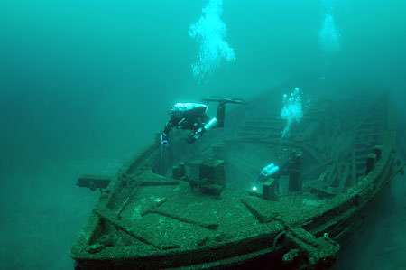
Wisconsin Shipwreck Coast National Marine Sanctuary
Wrecks in Wisconsin Shipwreck Coast National Marine Sanctuary
Diversity of very well-preserved vessels
36 known wreck sites, many more to be discovered
Notes:
Instructional suggestion:
Use the points on this slide to reinforce why the wrecks in Wisconsin Shipwreck Coast National Marine Sanctuary are important. (variety and well-preserved; sanctuary presents many opportunities for discovery)
Click the image to watch video footage of the wreck of Rouse Simmons.
Instructor Notes:
Shipwrecks in Wisconsin Shipwreck Coast National Marine Sanctuary represent a diversity of vessels that played a pivotal role in the growth of the United States. From pre-Civil War sailing ships to modern bulk-freighters, these vessels transported America’s business and industry to population centers on the East Coast and supported western expansion. The collection of shipwrecks within Wisconsin Shipwreck Coast National Marine Sanctuary is considered a national treasure because, in addition to the shipwrecks themselves, many of their cargo remain largely intact. One example is the three-masted schooner Rouse Simmons, also known as the Christmas Tree Ship. It was built in 1868 and sank along with its captain and crew in 1912 as it carried Christmas trees destined for port in Chicago.
Fifteen of the sanctuary’s wrecks are almost completely intact and three have standing masts, a rarity among sunken wrecks. The sanctuary includes Wisconsin’s two oldest known shipwrecks, including the schooner Home. Home was a trade ship that carried grain, lumber, and general merchandise between Lake Erie and the upper Great Lakes. Home’s captain James Nugent was a known abolitionist and collaborator on the Underground Railroad. While difficult to confirm, Home was likely used in some capacity but never caught with fugitive slaves aboard.
Images:
Bound for Chicago with a hold full of Christmas trees, Rouse Simmons was lost with all hands in a November gale in 1912. Some tree remnants can be observed within the wreck. Credit: Wisconsin Historical Society

Slide 10
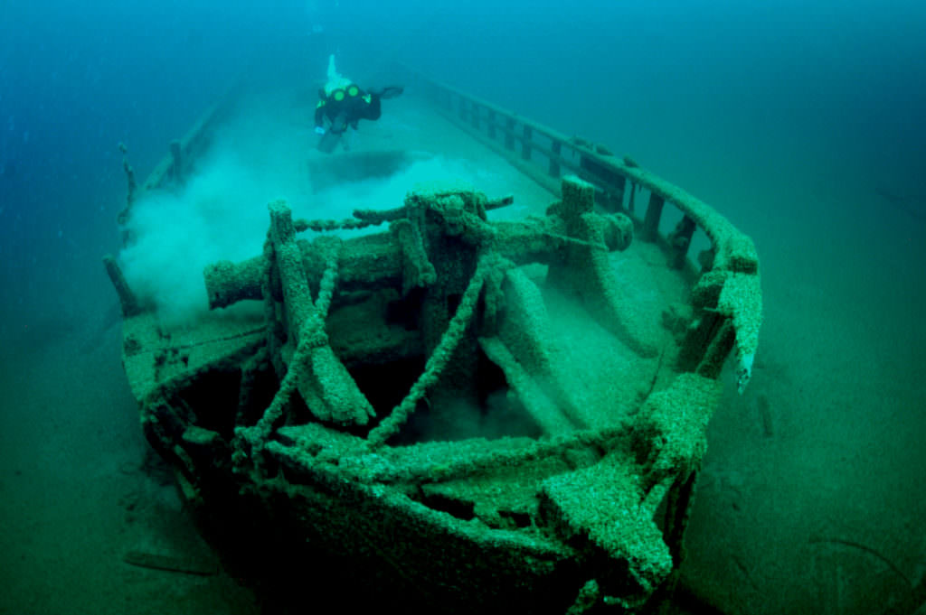
Wisconsin Shipwreck Coast National Marine Sanctuary
Wreck Diving in Wisconsin Shipwreck Coast National Marine Sanctuary
Conditions are cold and visibility can vary
Rapidly changing weather
Some require technical diving due to their depth
Some available to recreational divers; requires training and specific equipment
Some available to paddlers and snorkelers
Notes:
Instructional suggestion:
Prompts students to predict what they think diving conditions are like in the Great Lakes
Introduce technical diving to spark student interest.
Click the image to watch video footage of the wreck of the Home.
Instructor Notes:
Historic sites like the wrecks in Wisconsin Shipwreck Coast National Marine Sanctuary create exceptional scuba diving opportunities. Due to their depth, some of the wrecks in the sanctuary require technical diving. Technical diving includes all diving methods that exceed the limits imposed on depth and/or bottom time for recreational scuba diving. Technical diving involves the use of special gas mixtures for breathing. The type of gas mixture used is determined by the specific dive plan. Technical divers may work in the range of 170 feet to 350 feet, sometimes even deeper. Technical diving almost always requires one or more mandatory decompression stops, during which the diver might change breathing gas mixes. Decompression stops are necessary to allow gasses that have accumulated in the diver's tissues to be released in a slow and controlled manner.
Many of the sanctuary’s wrecks are within the depth limits of recreational scuba diving (less than 130 feet). Some wrecks, like two near Two Rivers, provide opportunities for snorkelers. However, the water in Lake Michigan is often cold. A 7mm wetsuit is generally sufficient protection for most divers during the main diving season (May through October). During the colder months, a dry suit is required. Divers should use a regulator that is designed to be used in temperatures below 50℉. Free flows can occur on any regulator, but this is a common problem with equipment not designed for the cold conditions found in Lake Michigan. Carrying a redundant air source is recommended. Visibility can vary dramatically from day to day. At times visibility can exceed 100 feet, but generally visibility is about 35 to 40 feet. Currents may be present and conditions can change quite quickly. Divers should be sure to check with the National Weather Service before going out. Most dive operators that conduct dives on sanctuary wrecks require divers to hold both their Advanced Open Water and Deep Diver Specialty certifications.
Images:
Built in 1843 the schooner, Home, is one of the oldest shipwrecks discovered in Wisconsin. Photo: Tamara Thomsen/Wisconsin Historical Society

Slide 11
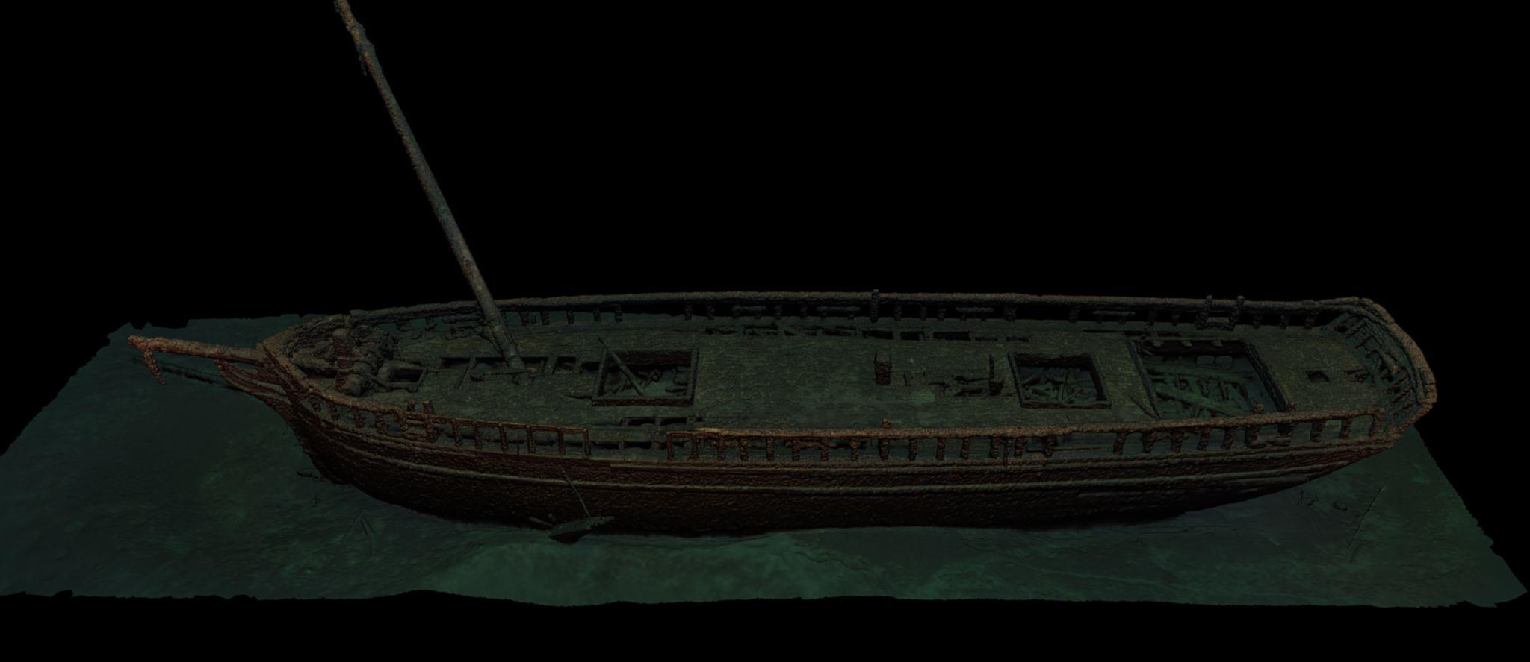
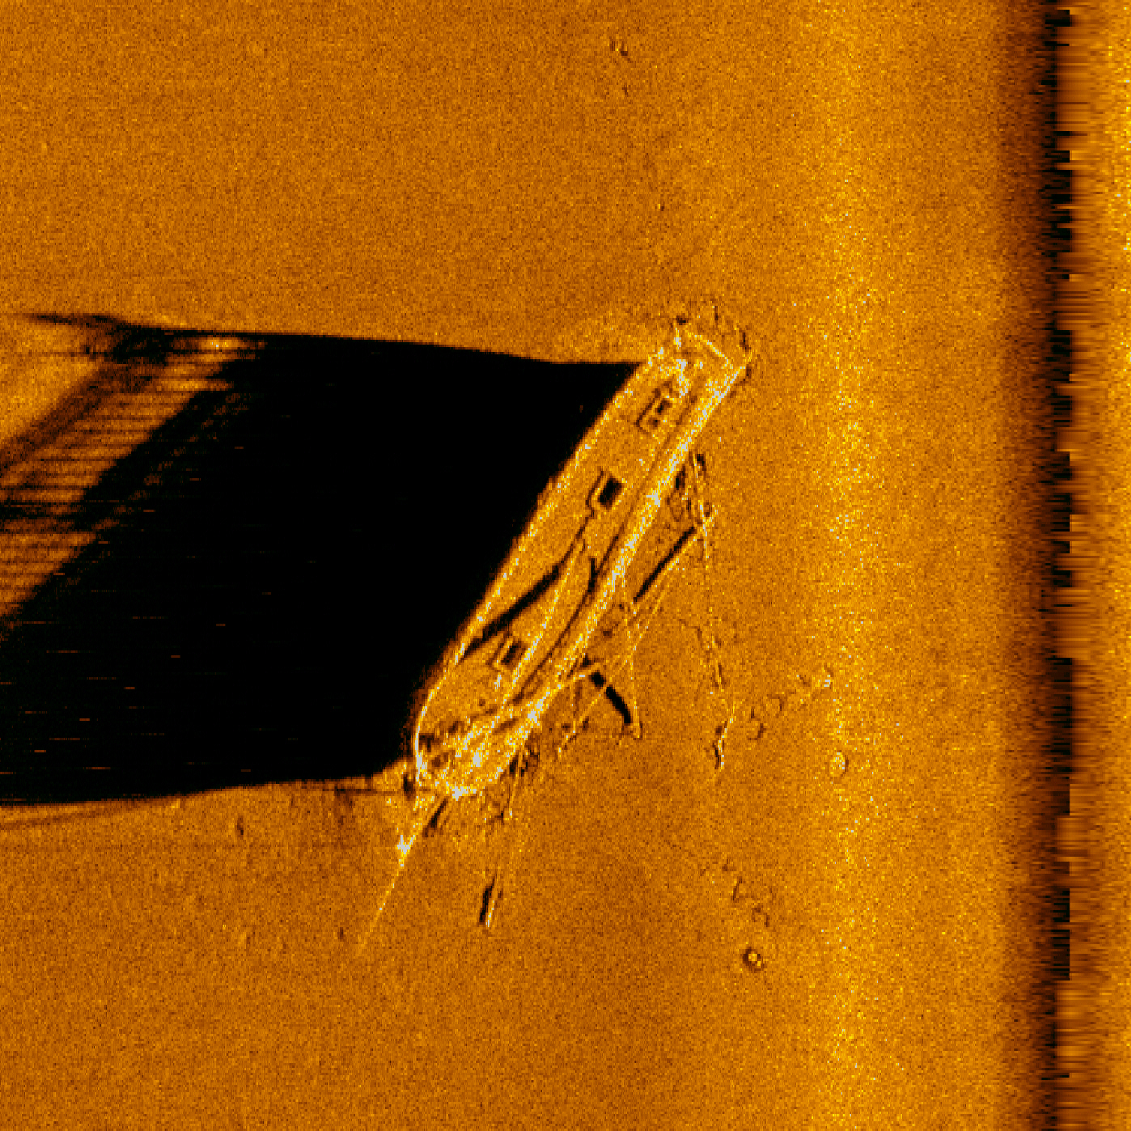
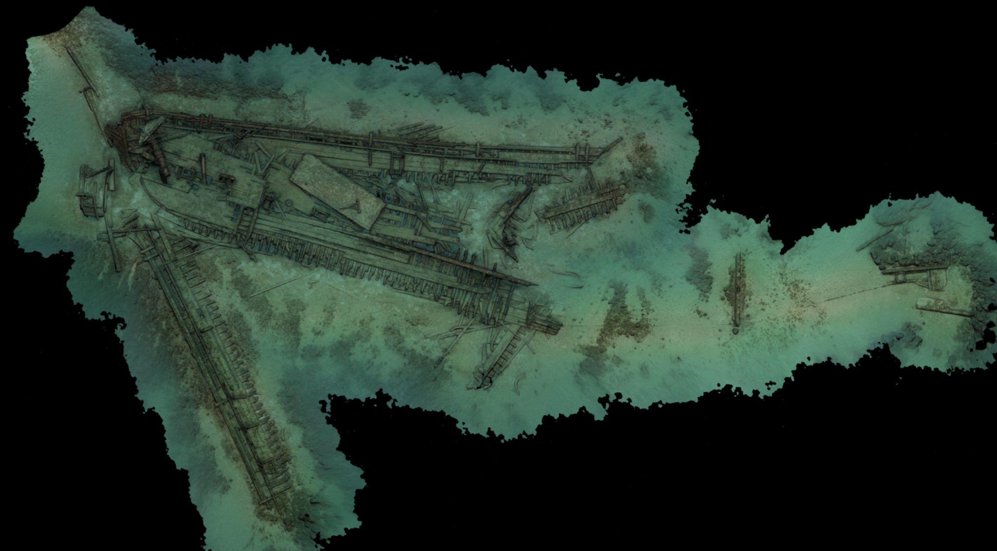
Wisconsin Shipwreck Coast National Marine Sanctuary
Exploring Shipwrecks
Research
Search area established
Wreck located
Wreck surveyed
Wreck identified and studied
Notes:
Instructional suggestion:
Use the points on the slide to convey the general steps of exploring shipwrecks
Instructor Notes:
Shipwrecks offer valuable insight into past communities, their values, and their livelihoods. The process of shipwreck exploration begins with research. For example, in building an understanding of the maritime heritage of Wisconsin Shipwreck Coast National Marine Sanctuary researchers use primary sources such as newspaper articles to compile a list of shipwrecks potentially located within the sanctuary boundary. Researchers record the vessel’s name, cargo, and accounts of the wrecking events. They then research key pieces of information that could help with vessel identification if wreckage was found. For example, they use builder’s plans to identify vessel dimensions such as length and width (referred to as “beam”), and features like the number of masts, deck machinery, and hull shape.
Once the list of potential shipwrecks is created, researchers then establish a search location where the vessel remains may be located. Researchers primarily use eyewitness accounts that document the vessel’s last known position to generate a search area. This area is then refined using historical weather data, current and tidal models, and nautical charts that depict underwater terrain. Once the search area is defined, there are many technologies researchers may use to help locate wreckage. Sonar is a tool that uses acoustic echoes to visualize underwater features. Many shipwrecks have been located by amateur wreck explorers using single-beam sonar. Maritime archaeologists and other professional scientists often have access to more advanced sonar systems. Surveyors are looking for underwater features that appear human-made. Natural features rarely have the straight lines seen in human-made structures. The presence of straight lines and unnatural shapes may indicate a debris trail or the remnants of the shipwreck itself.
Images:
Left: A sonar model of the schooner Gallinipper, Wisconsin's oldest shipwreck discovered to date. Credit: University of Delaware.
Right top: A photo-model of the well-preserved schooner Northerner which lies in 130 feet of water. Credit: NOAA
Right bottom: A photomosaic of the Mahoning. This wreck lies at a depth of 55 feet off the coast of Port Washington in Lake Michigan. Credit: NOAA

Slide 12
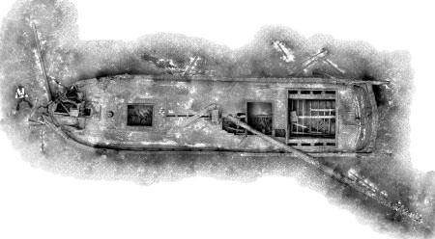
Wisconsin Shipwreck Coast National Marine Sanctuary
Exploring Shipwrecks
Locate wreck using SONAR
Survey wreck:
site plan - detailed and scaled drawing
photogrammetry - technologies that use images to make measurements and generate models
Notes:
Instructional suggestion:
Use this slide to convey exploration technologies like SONAR and photogrammetry, as well, as data collection methods like making site plans.
Instructor Notes:
Once wreckage is located, divers may be sent to survey the shipwreck or the survey may be completed using a submersible like a remotely-operated vehicle (ROV) or an autonomous underwater vehicle (AUV). By taking measurements, pictures, and video, and by making drawings, the survey carefully documents the wreckage and its artifacts. Scientists may make a detailed and scaled drawing called a site plan. Images may be used to make a three-dimensional map of the wreck site using a process called photogrammetry. If you deconstruct the word photogrammetry, you see it contains “photo,” meaning light, “gram,” meaning drawing, and “metry,” meaning measurement. Therefore, photogrammetry is the use of photographs to make measurements and models. Someone wishing to employ photogrammetry to model a shipwreck takes a series of overlapping images of the wreck site. Photogrammetry software then uses all the images to create an accurate model of the shipwreck, with the distance between the points plotted to scale.
Once data has been collected, scientists try to identify the shipwreck by matching their observations to their research on the vessel's dimensions, cargo, and last known location. Sometimes researchers get lucky and the vessel’s name plate or its bell, which both show the vessel name, are located on site. Otherwise, scientists use the process of elimination to identify vessel candidates for the site. Once an identification has been made, artifacts may offer clues as to how the crew lived and worked. For example, the presence of cannon may suggest that the crew needed to defend their cargo while traveling through dangerous waters; recreational artifacts, such as game pieces or musical instruments, offer insight into how crew members relaxed. Similarly, objects like cooking pots, glass bottles, and ceramic dishes shed light on the foods the crew ate and their preparation while on board.
Images:
A photomosaic, a type of image made using photogrammetry, of the schooner Home, made by stitching hundreds of individual images together. Credit: Wisconsin Historical Society

Slide 13
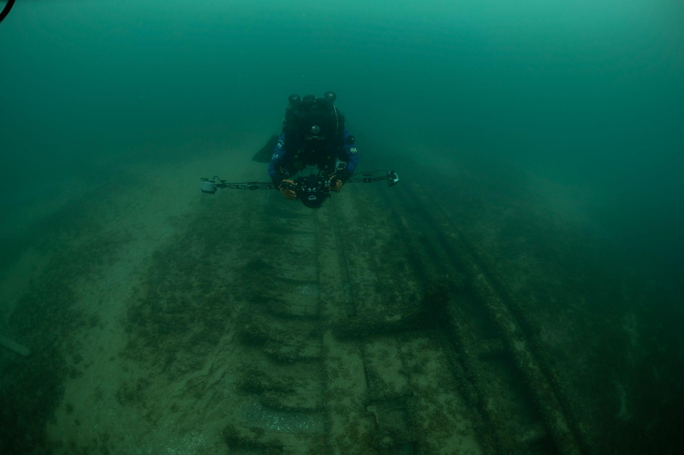
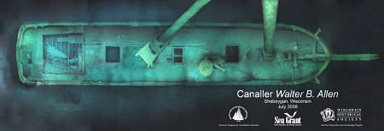
Wisconsin Shipwreck Coast National Marine Sanctuary
Simulating Photogrammetry to Model Shipwrecks
Follow your instructor’s guidance to simulate how scientists use photogrammetry to construct models of shipwrecks!
Notes:
Instructional suggestion:
Prompt students to imagine that they are part of a team of divers on an expedition to use photogrammetry to make a 3D model of the shipwreck they have discovered in Wisconsin Shipwreck Coast National Marine Sanctuary. Explain that in photogrammetry, the diver takes a series of overlapping photographs of the shipwreck. Photogrammetry software then triangulates all those image points to create an accurate model of the shipwreck, with the distance between the points plotted to scale. 3D scanning apps use a similar method to create models.
Instructor Notes:
Specific directions are found in the instructor guide.
Images:
Left: A photomosaic of the schooner Walter B. Allen. Credit: Woods Hole Oceanographic Institute, Sea Grant, Wisconsin Historical Society
Right: A diver performing photogrammetry. Credit: NOAA

Slide 14
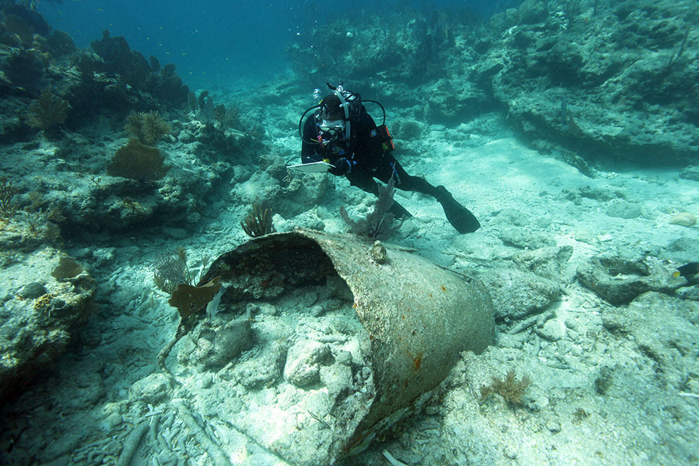
Wisconsin Shipwreck Coast National Marine Sanctuary
Simulating Photogrammetry to Model Shipwrecks Debrief
Imagine you are diving a wreck and gathering images to be used to make a photogrammetric model. Predict how this task might impact your dive.
In addition to a camera, what other tools do you think are used by divers when surveying wrecks?
Notes:
Instructional suggestion:
Think-Pair-Share: Give students time for individual and partner discussion prior to eliciting responses from the whole group.
Instructor Notes:
Use student responses to set the stage of the pool mission where students will make a site plan and collect images of a simulated wreck.
Images:
A diver draws a cylindrical structure believed to be a water tank on a dive slate. Photo: Matthew Lawrence/NOAA

Slide 15
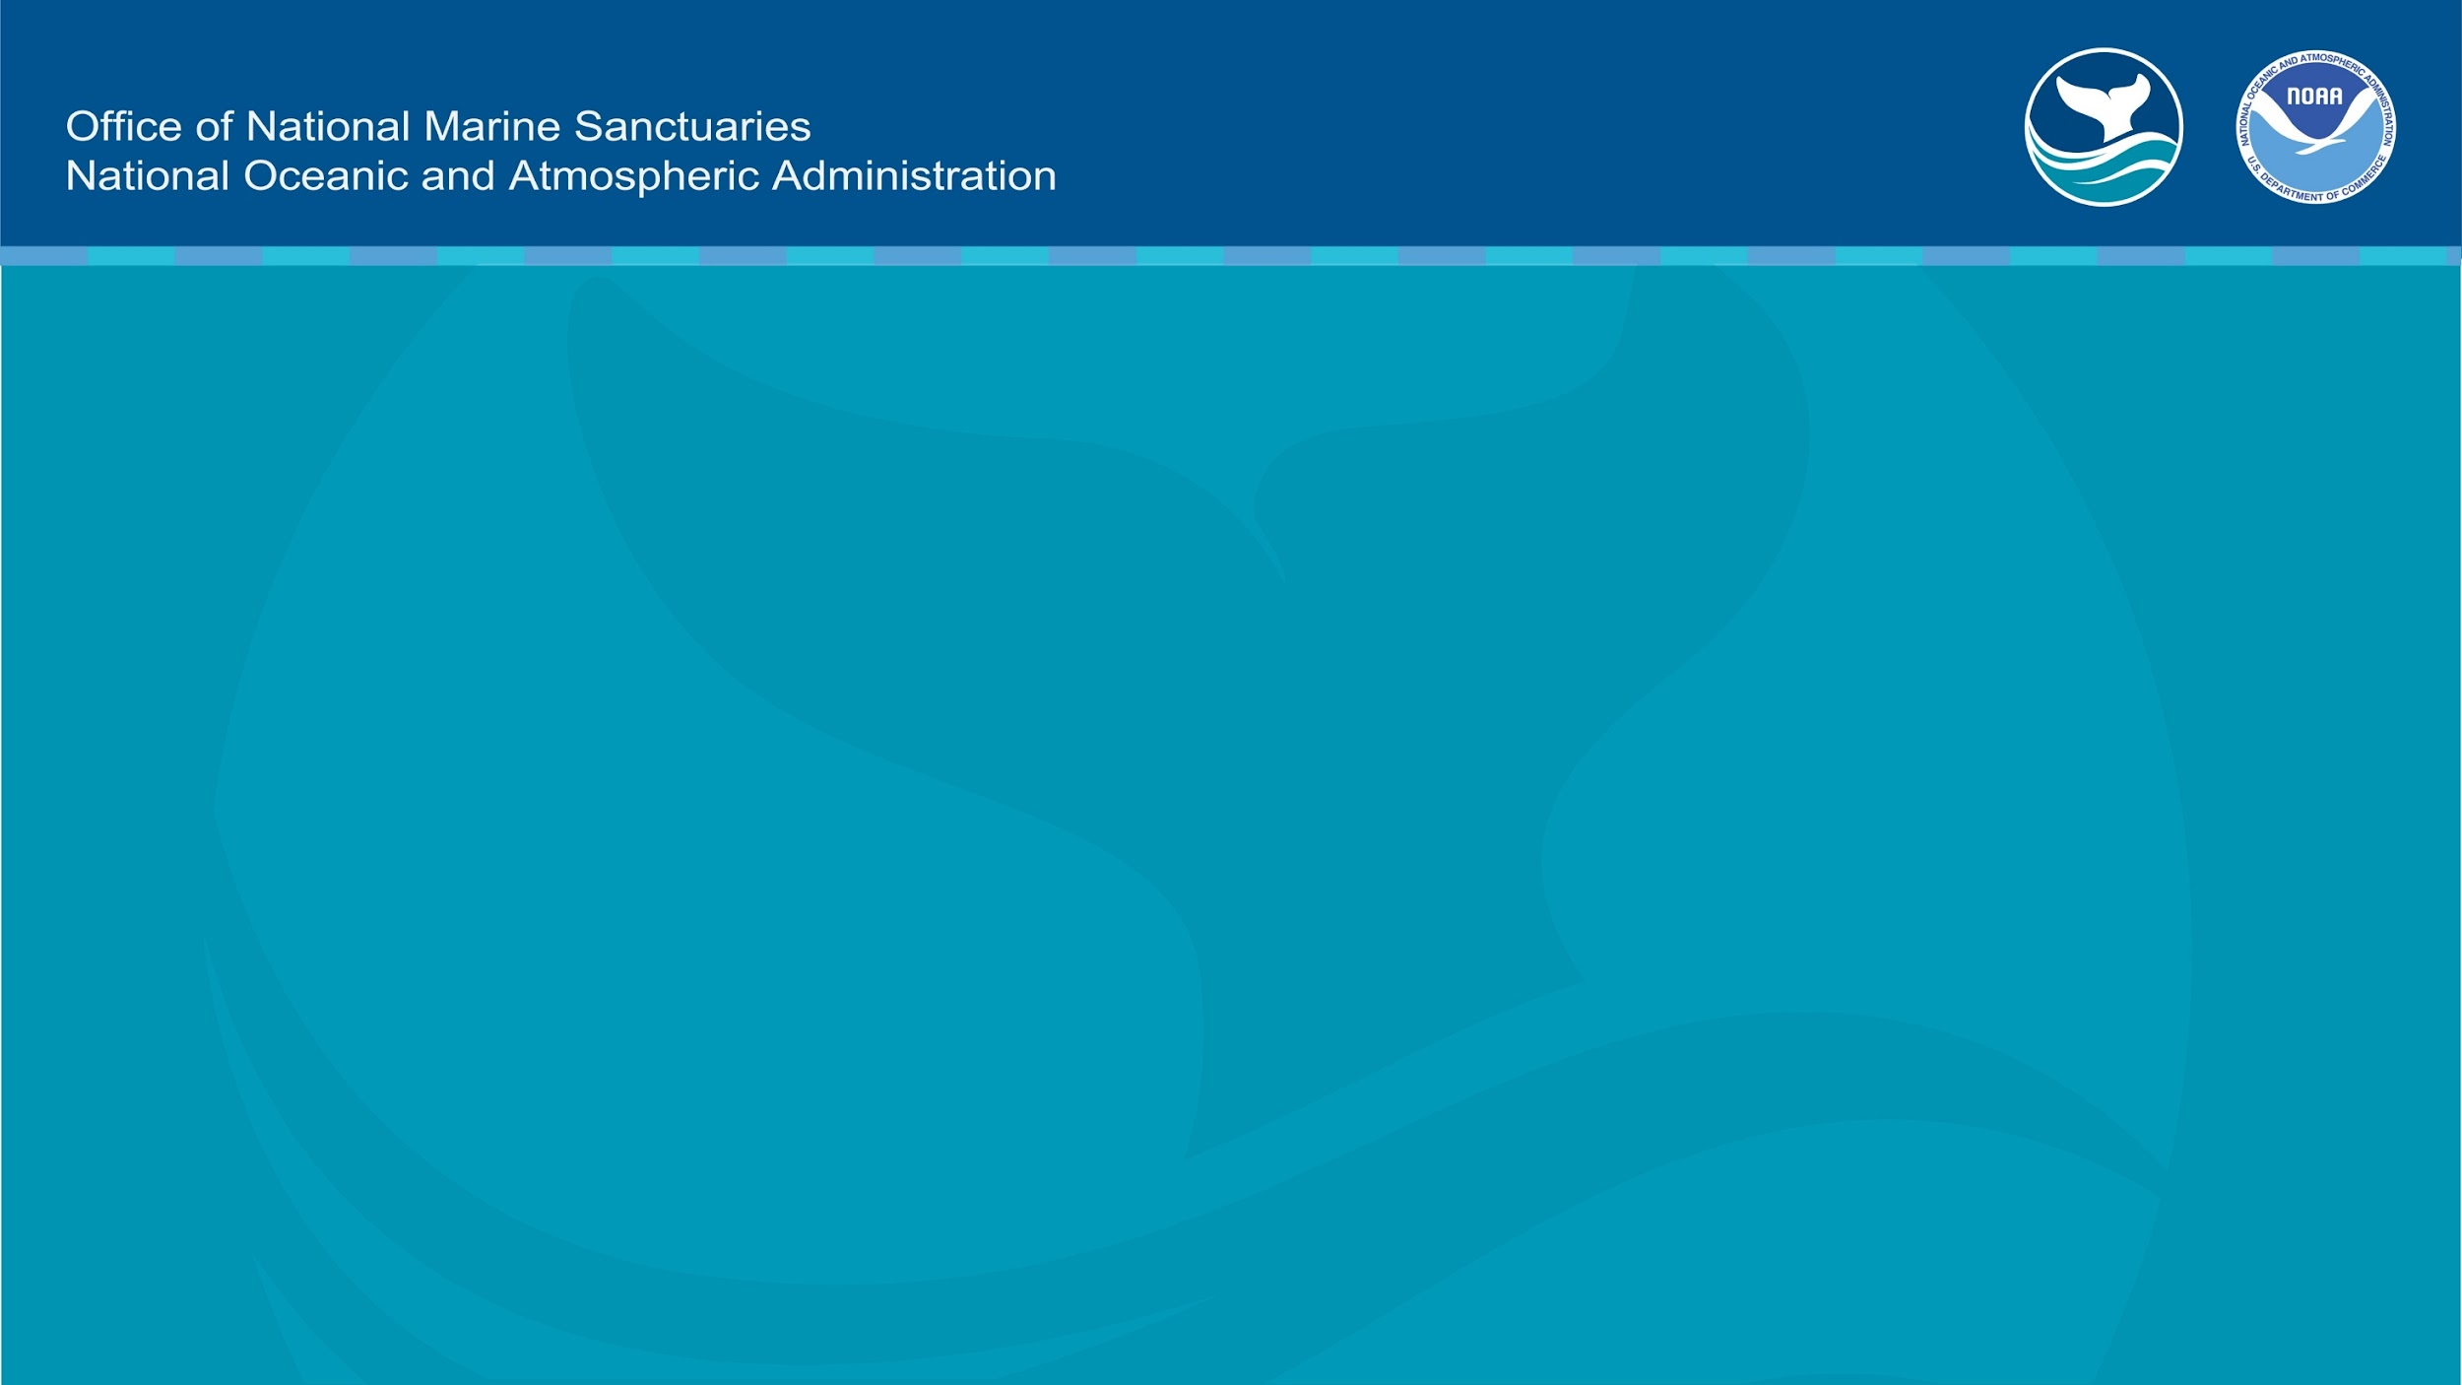
Learn more at
https://sanctuaries.noaa.gov/wisconsin

